Slide 1
PAAD Analysis
MALE Subject

Slide 2
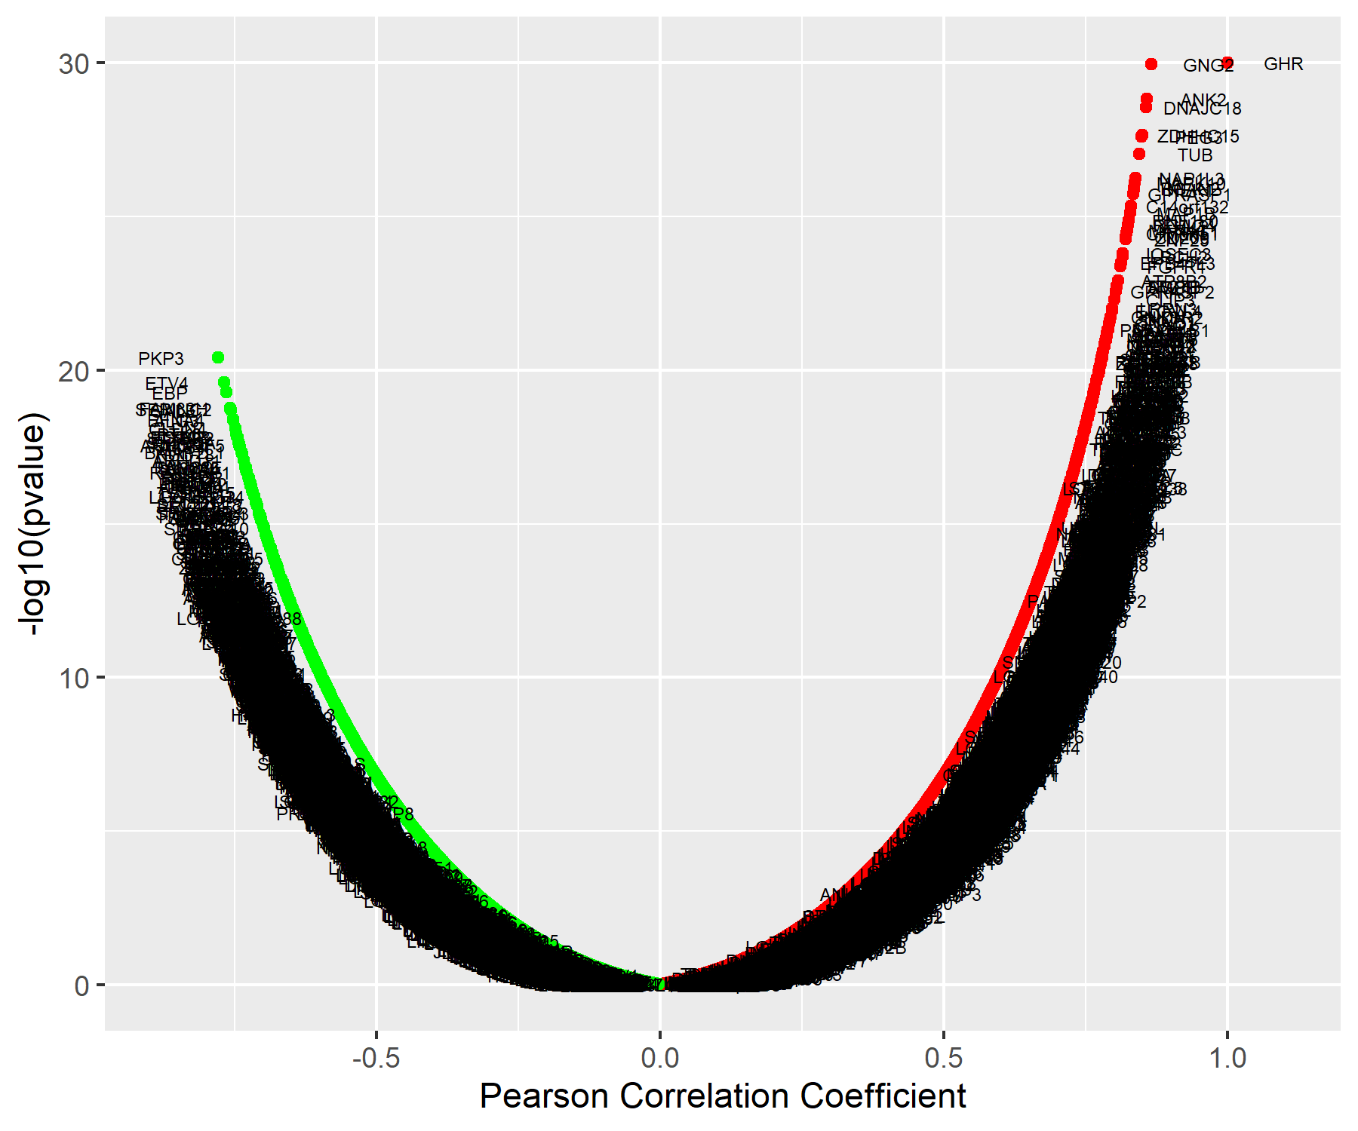
GHR Association Results

Slide 3
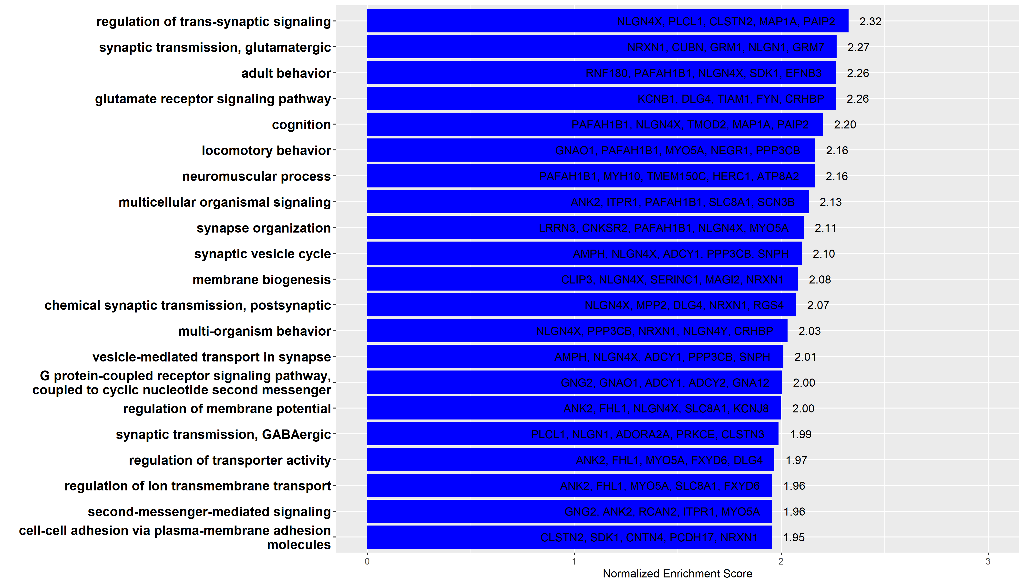
GO Analysis: Biological Process

Slide 4
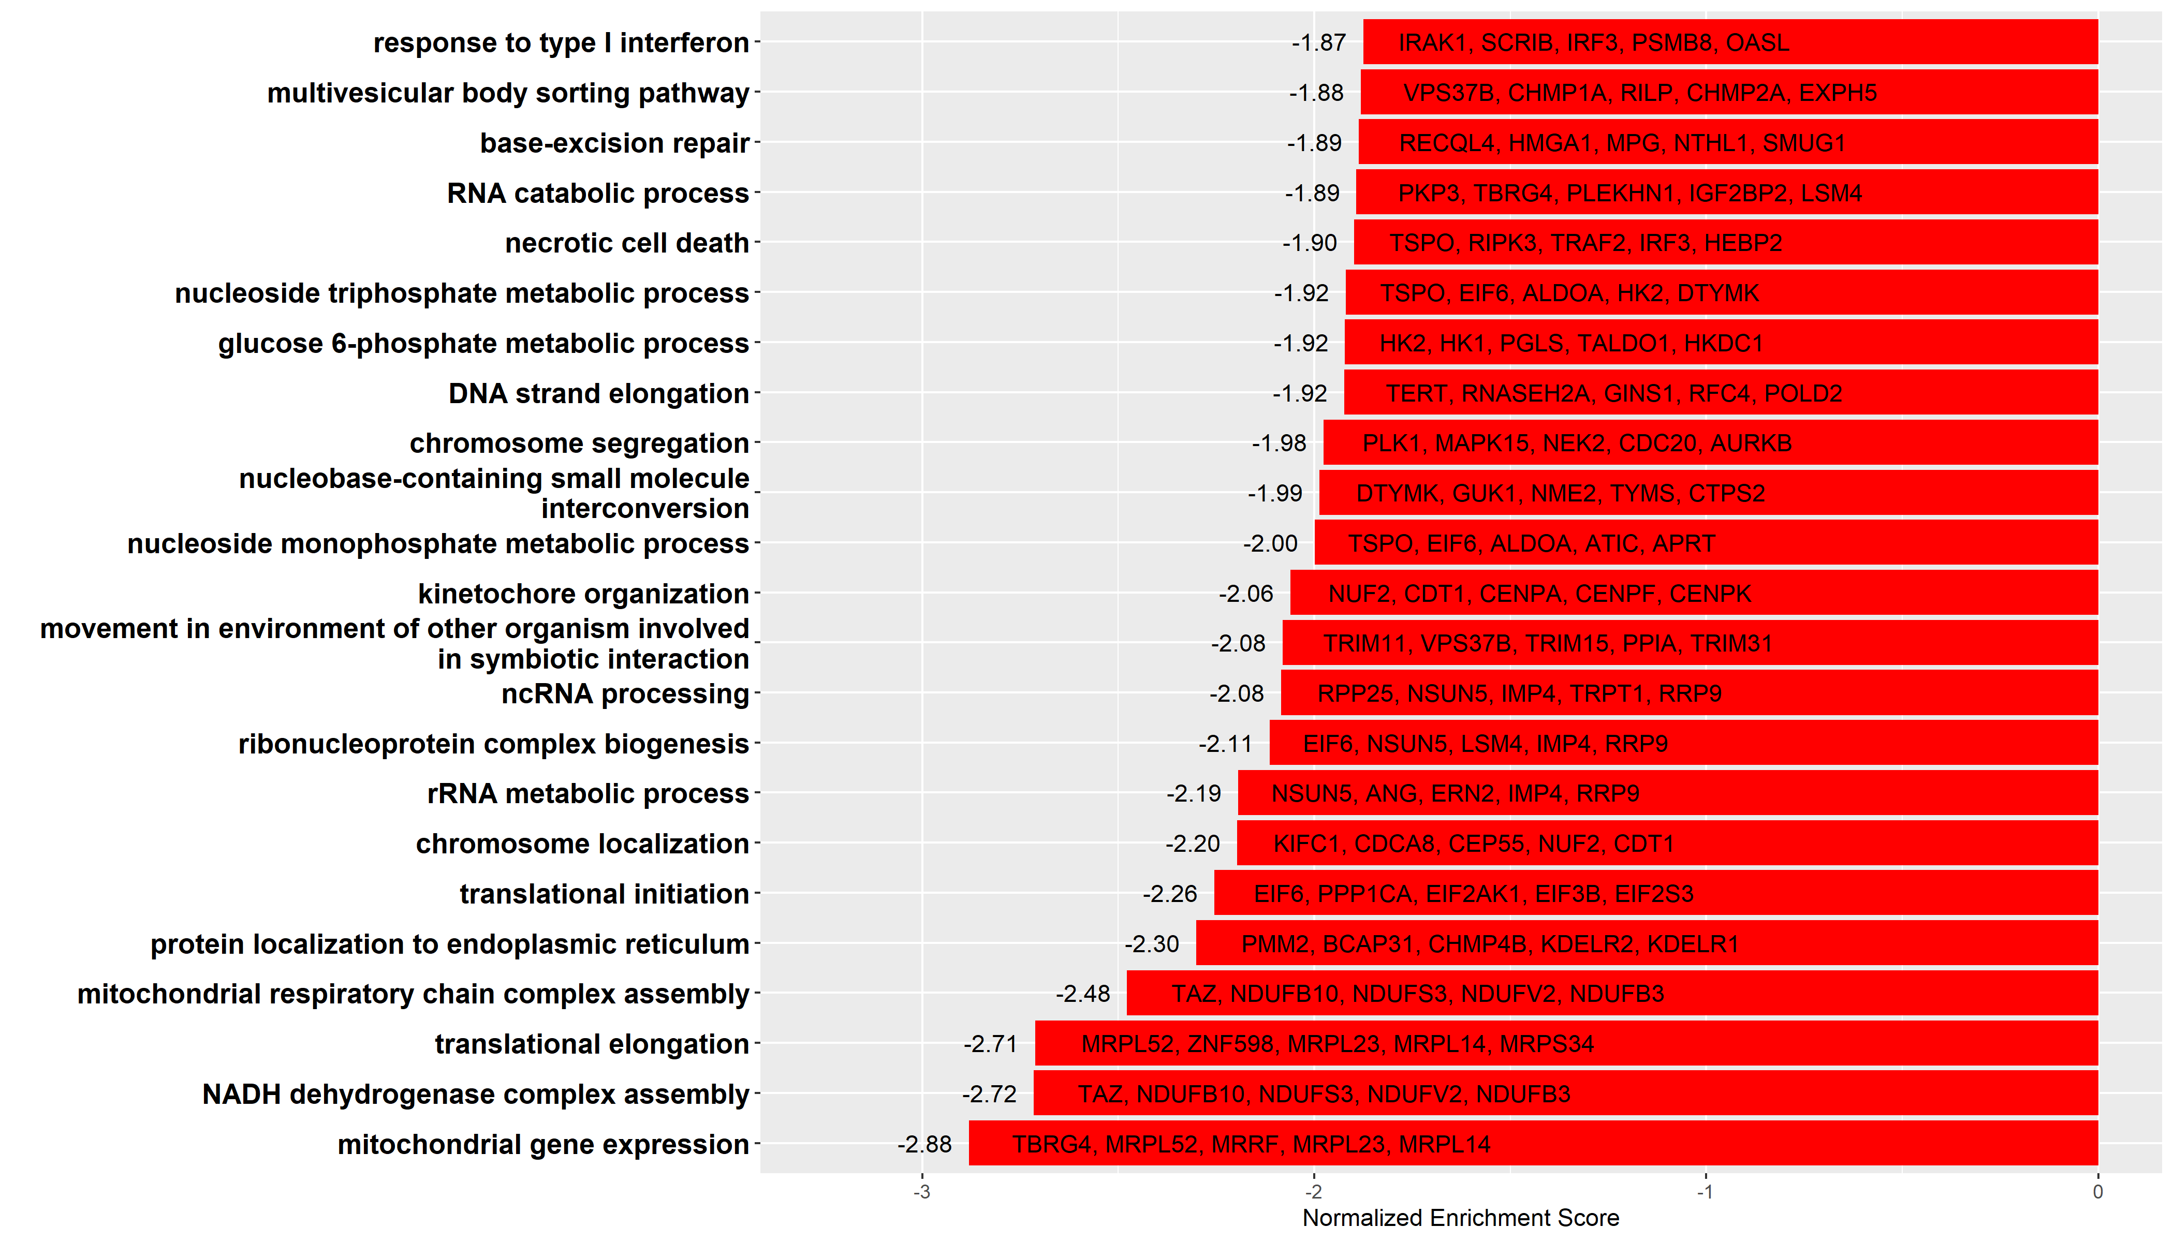
GO Analysis: Biological Process

Slide 5
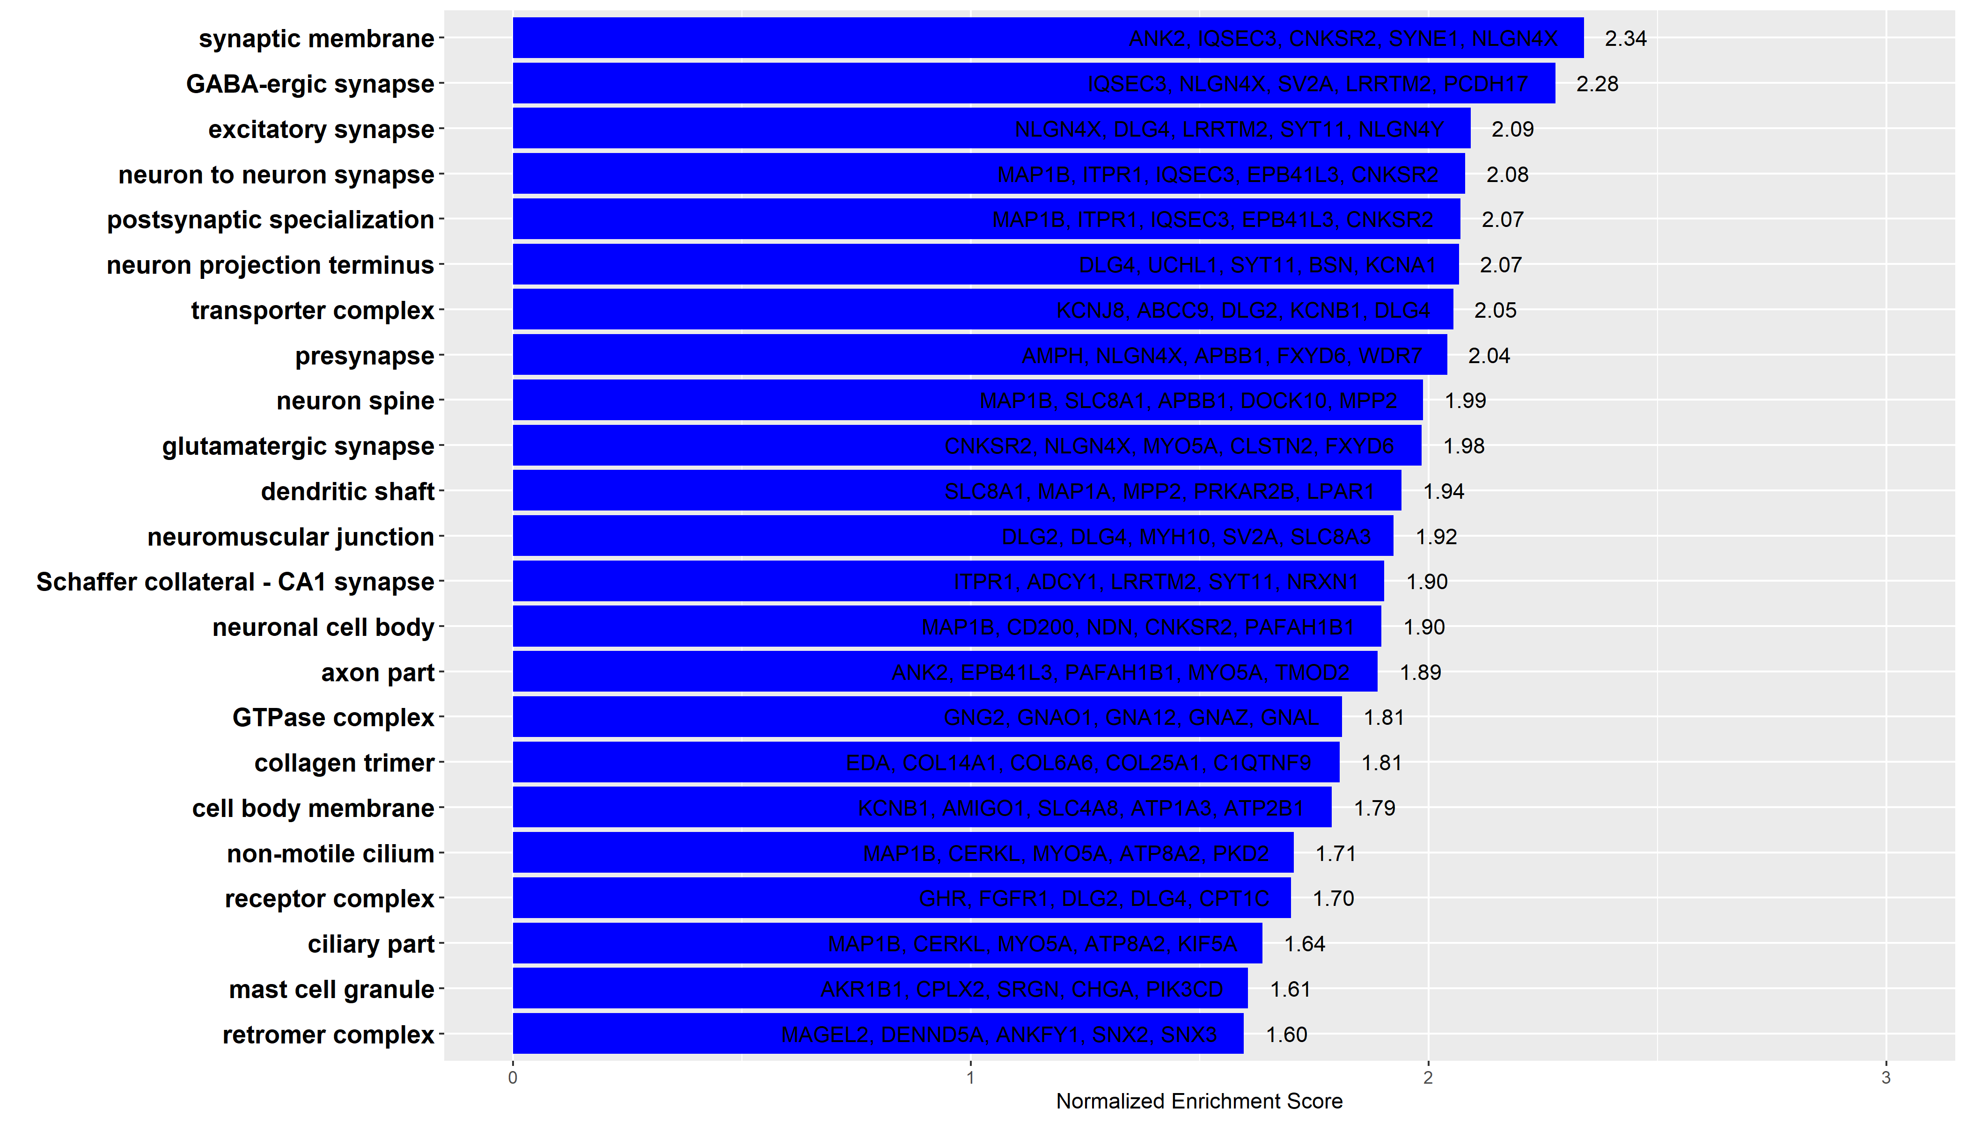
GO Analysis: Cellular Component

Slide 6
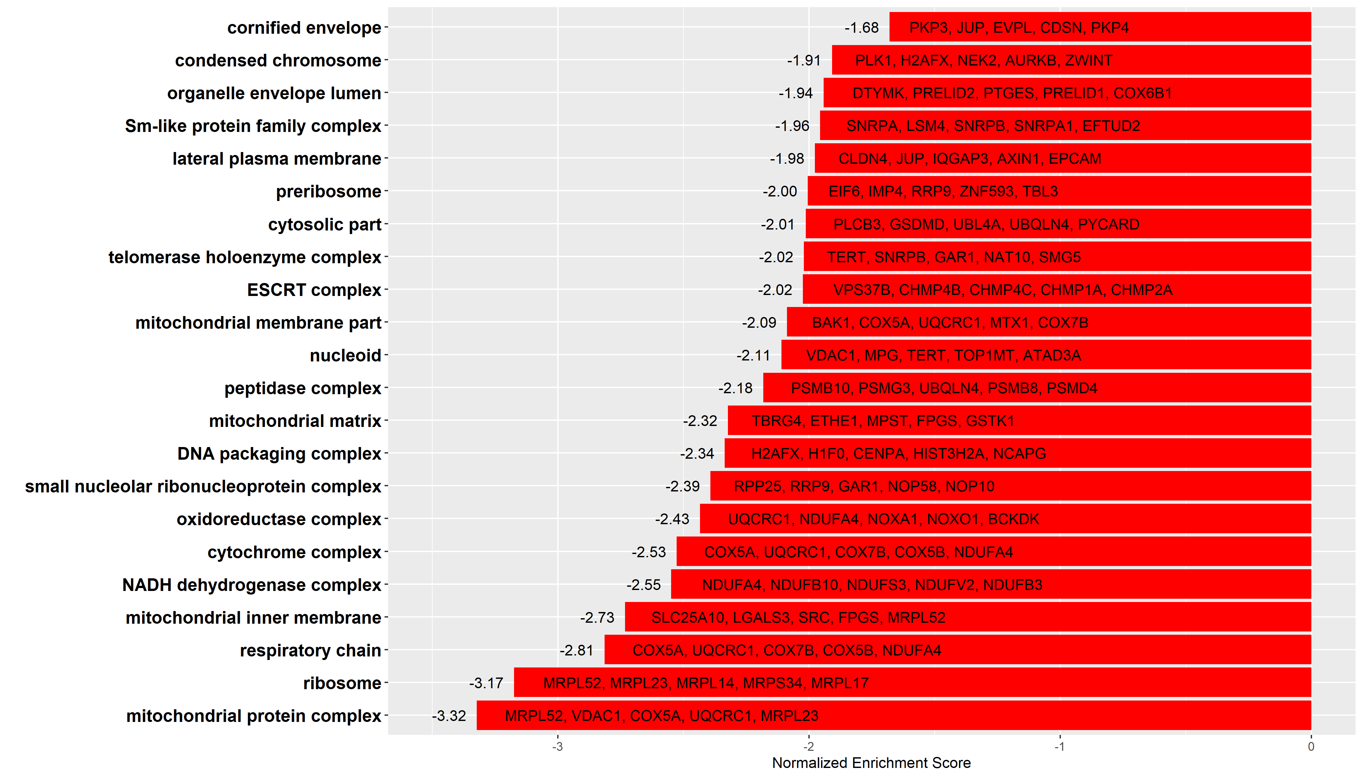
GO Analysis: Cellular Component

Slide 7
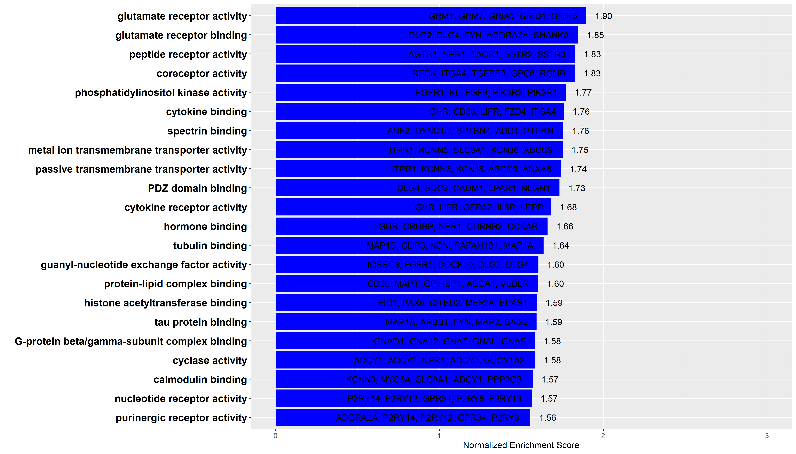
GO Analysis: Molecular Function

Slide 8
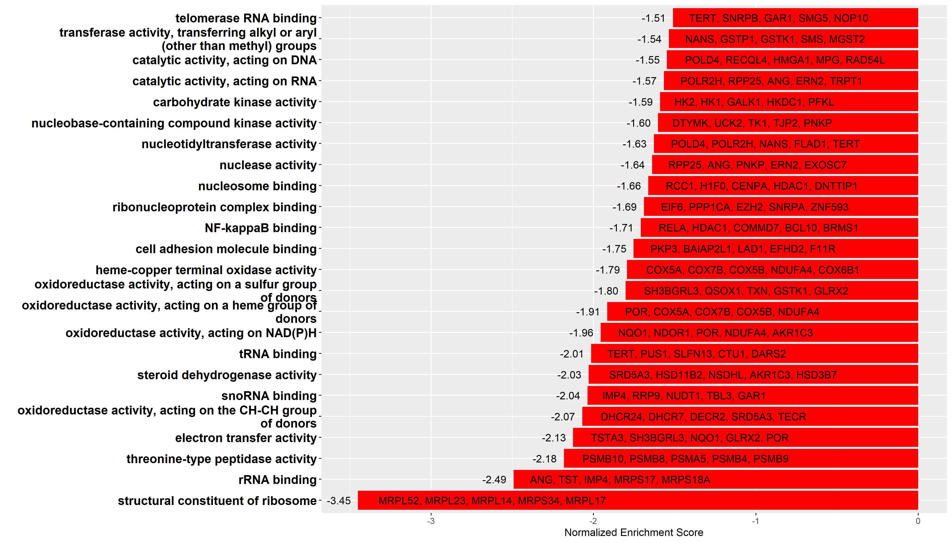
GO Analysis: Molecular Function

Slide 9
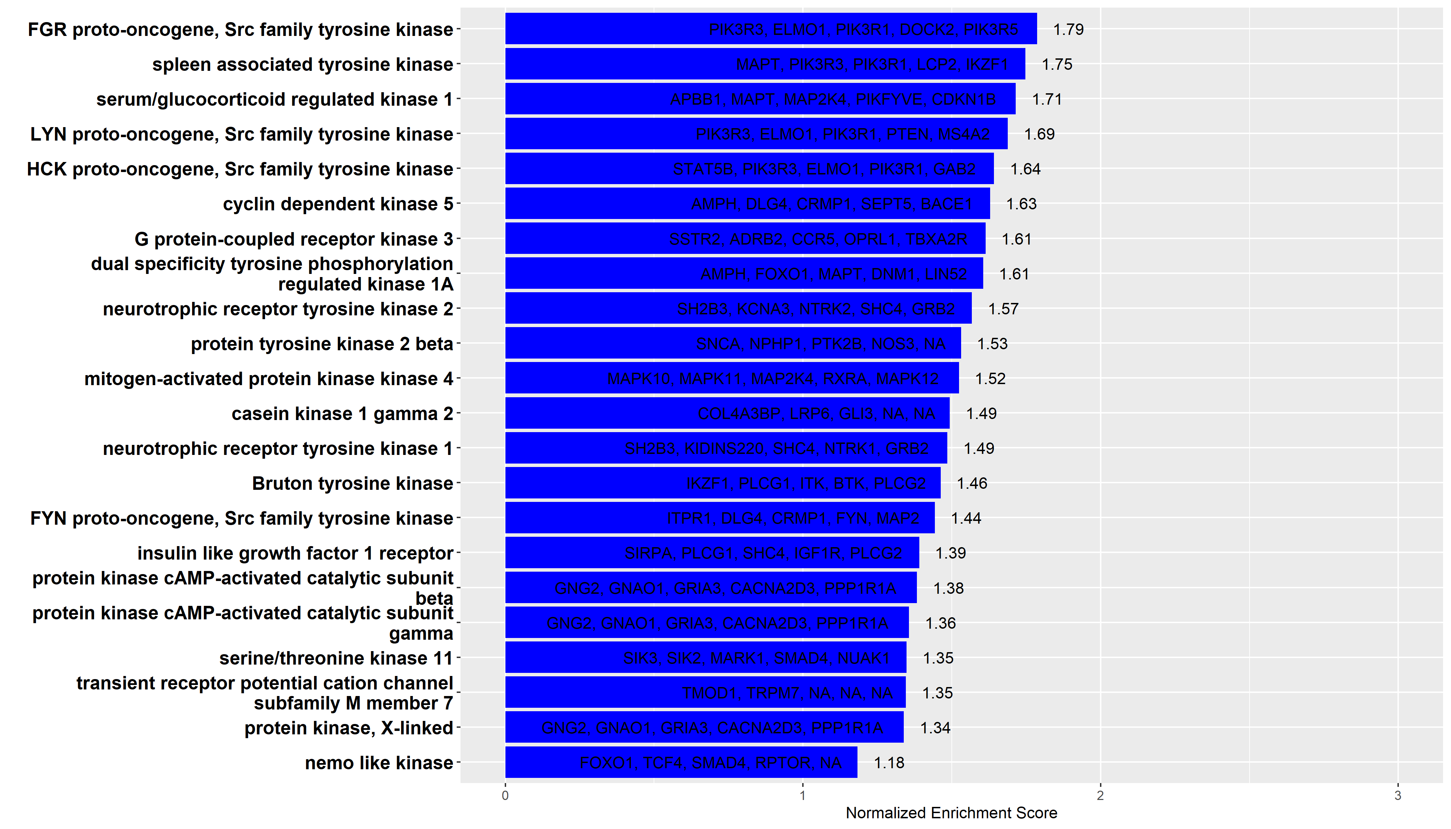
Kinase Target

Slide 10
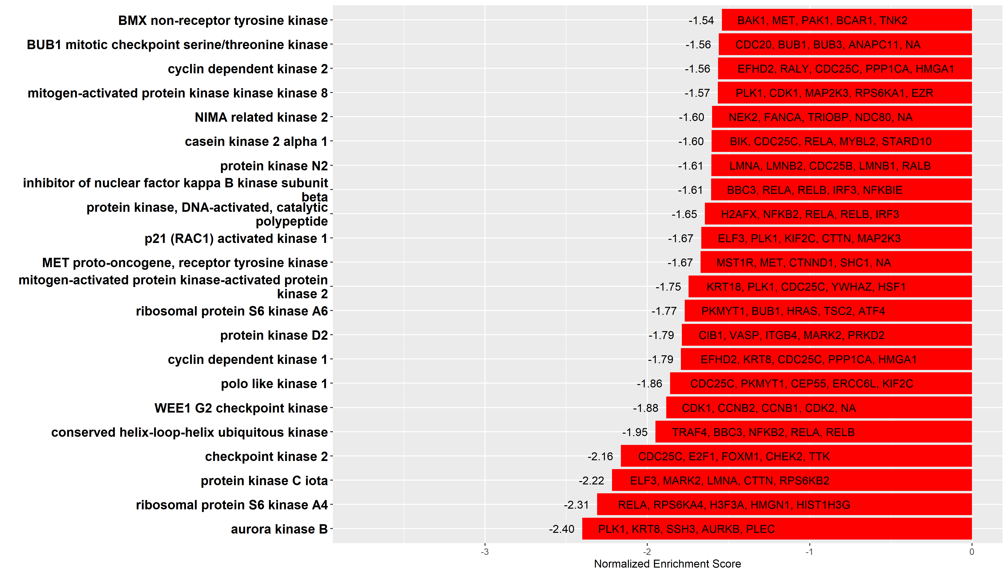
Kinase Target

Slide 11
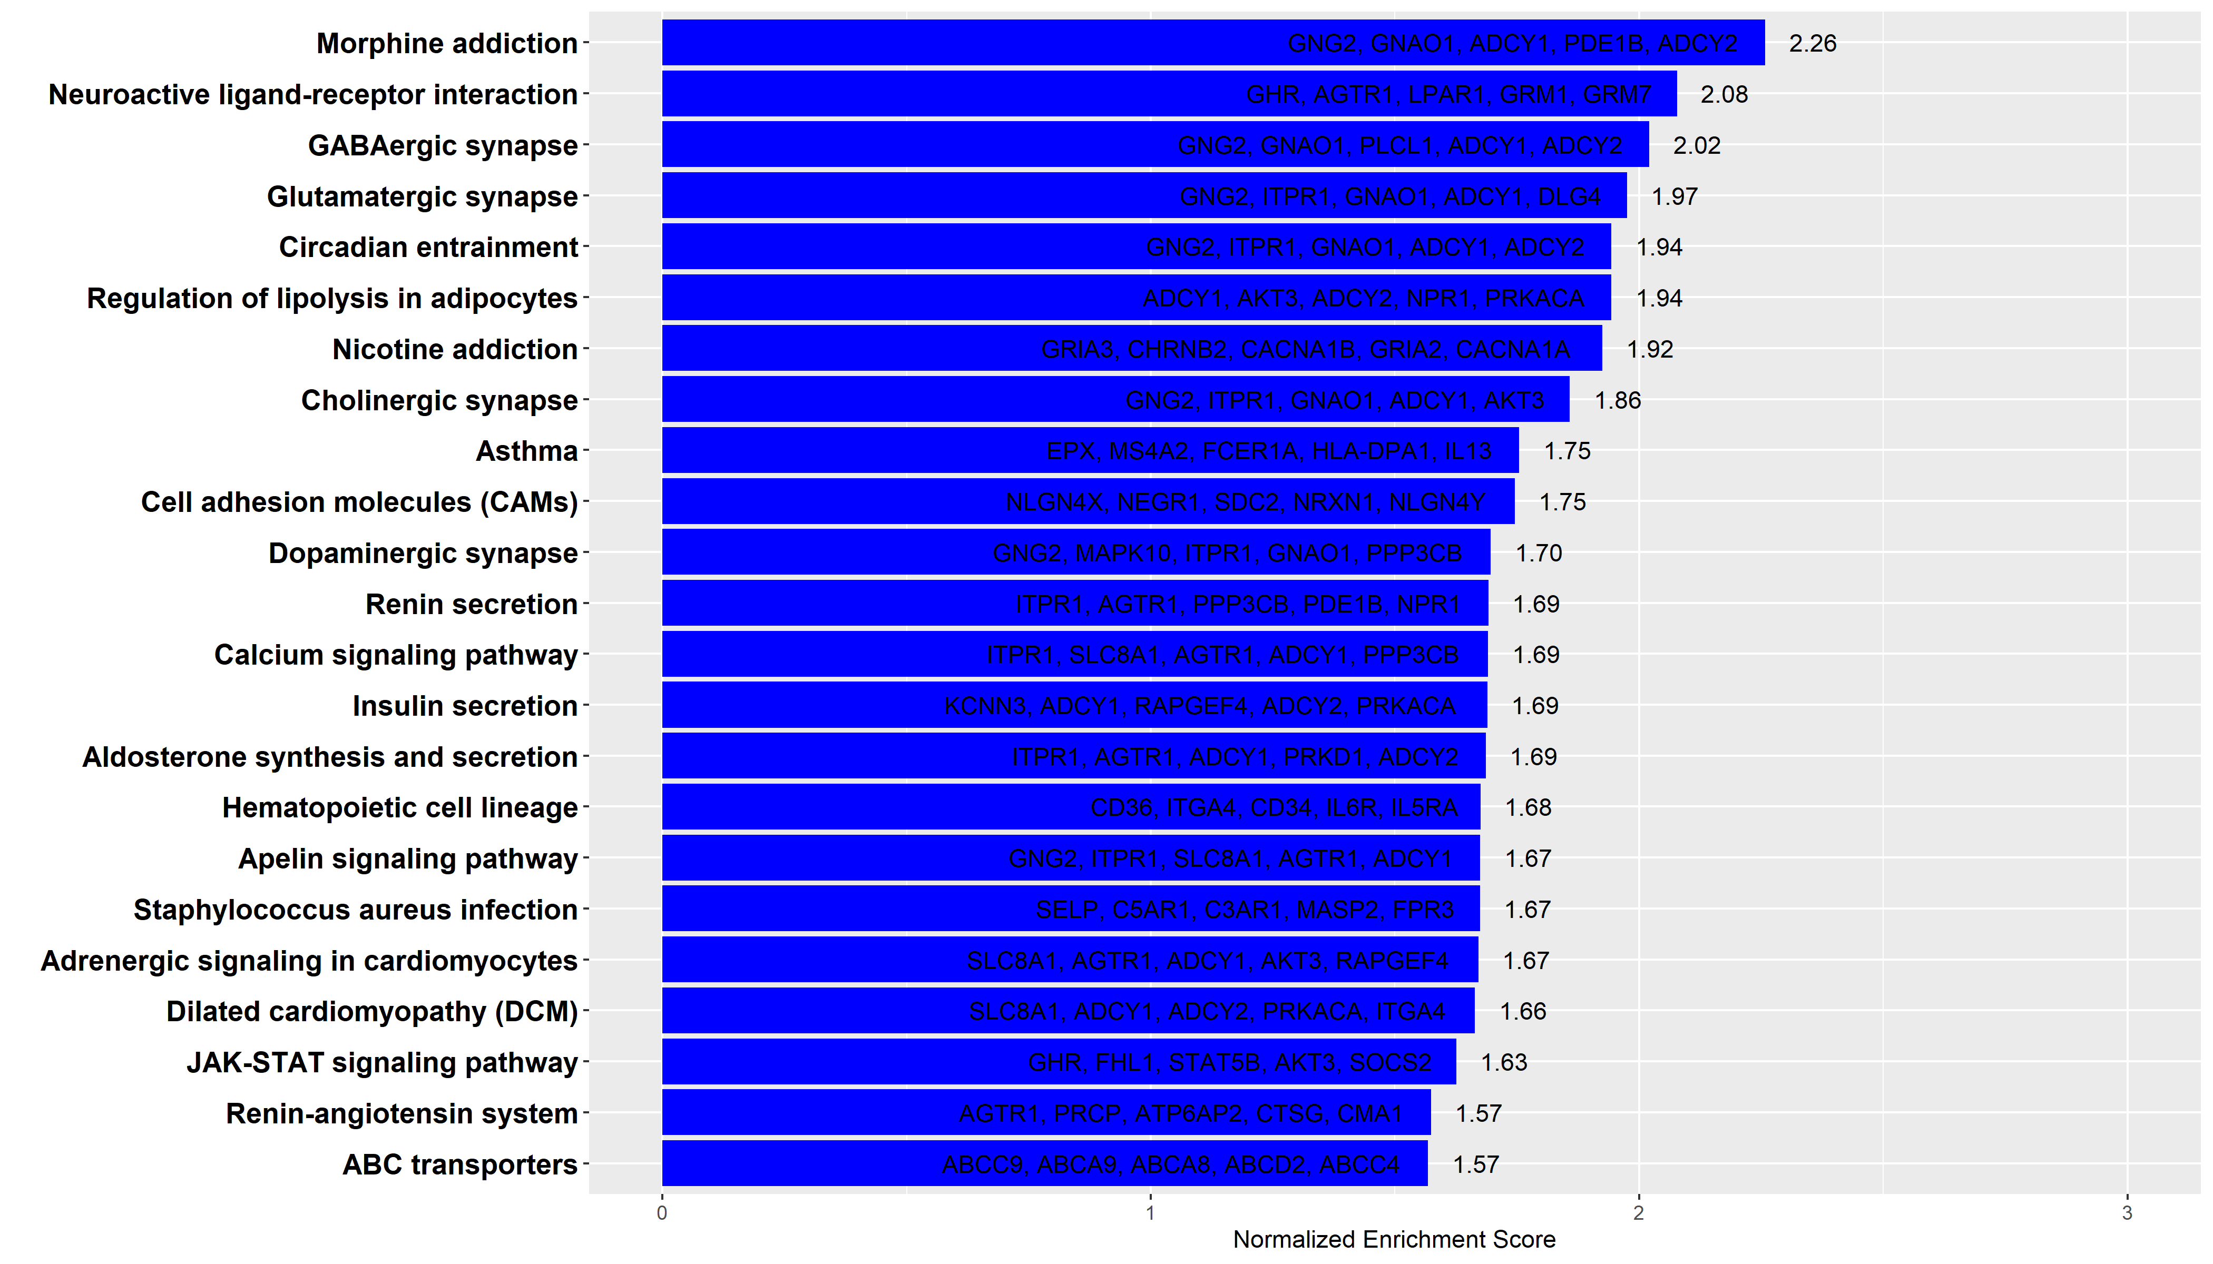
KEGG Pathway

Slide 12
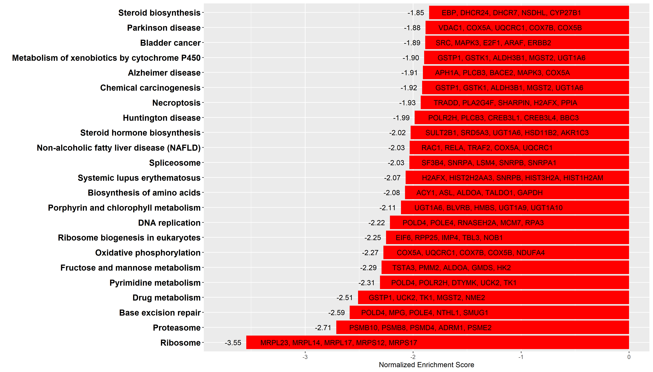
KEGG Pathway

Slide 13
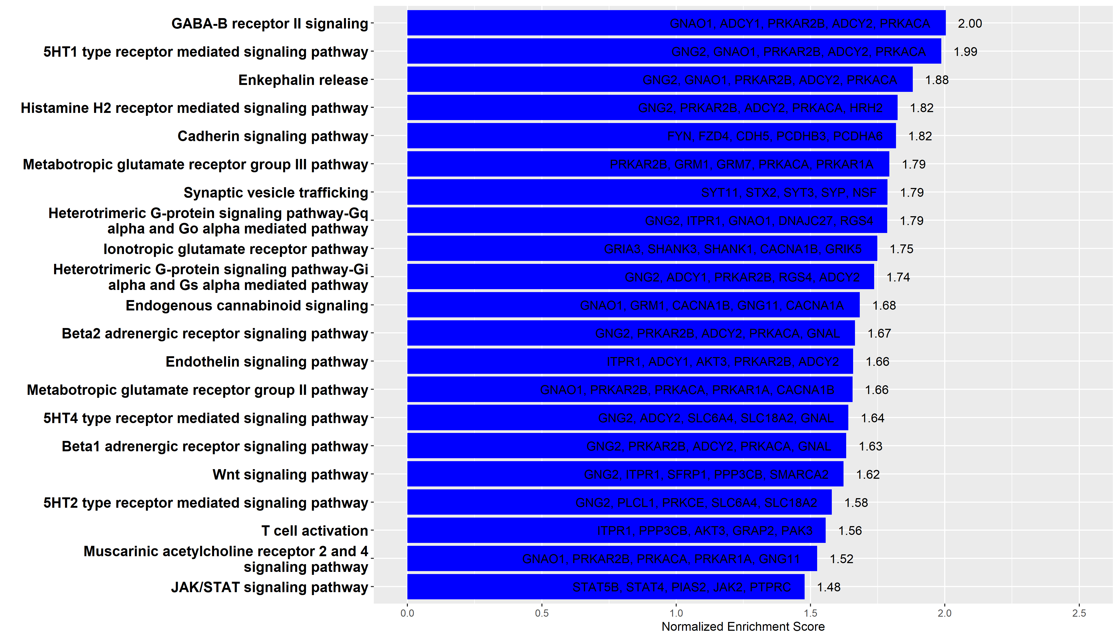
Panther Pathway

Slide 14
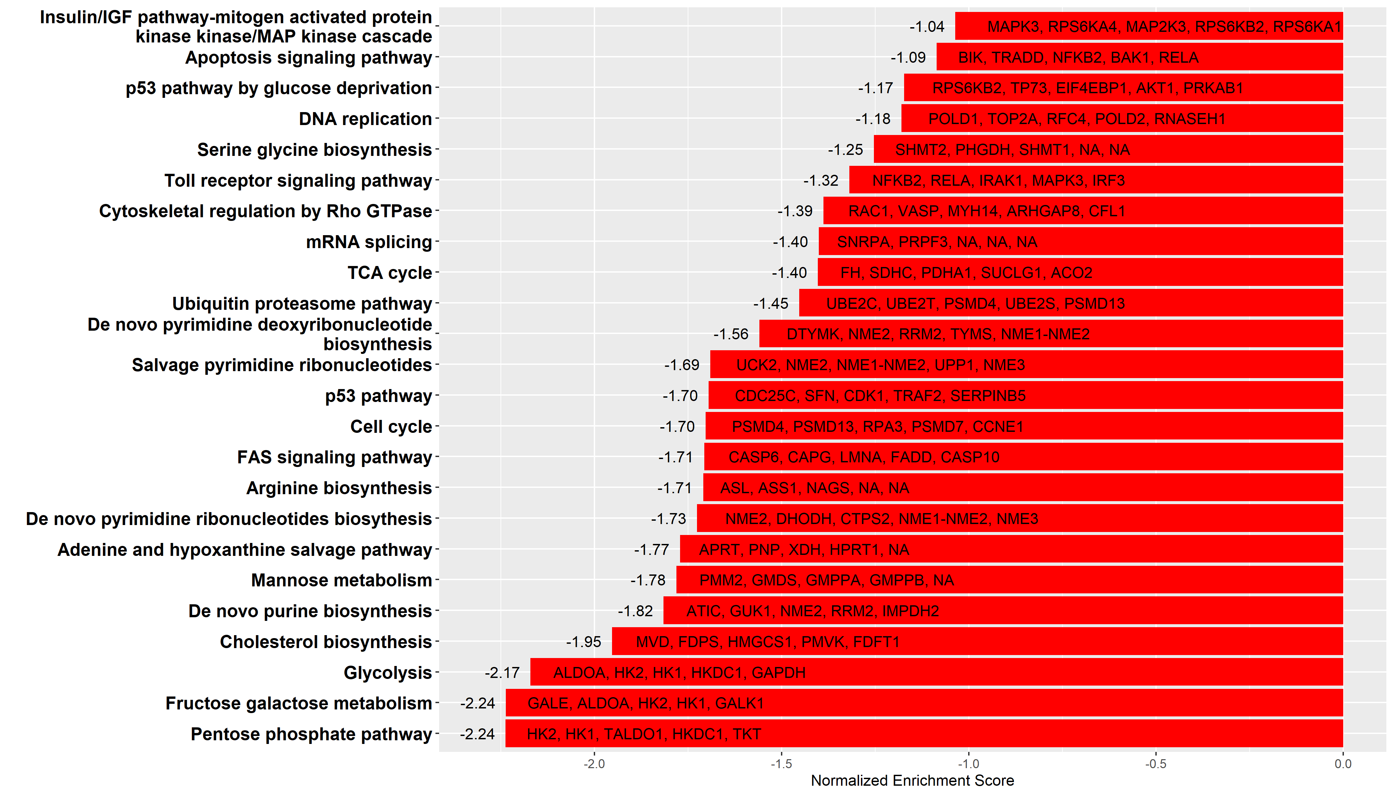
Panther Pathway

Slide 15
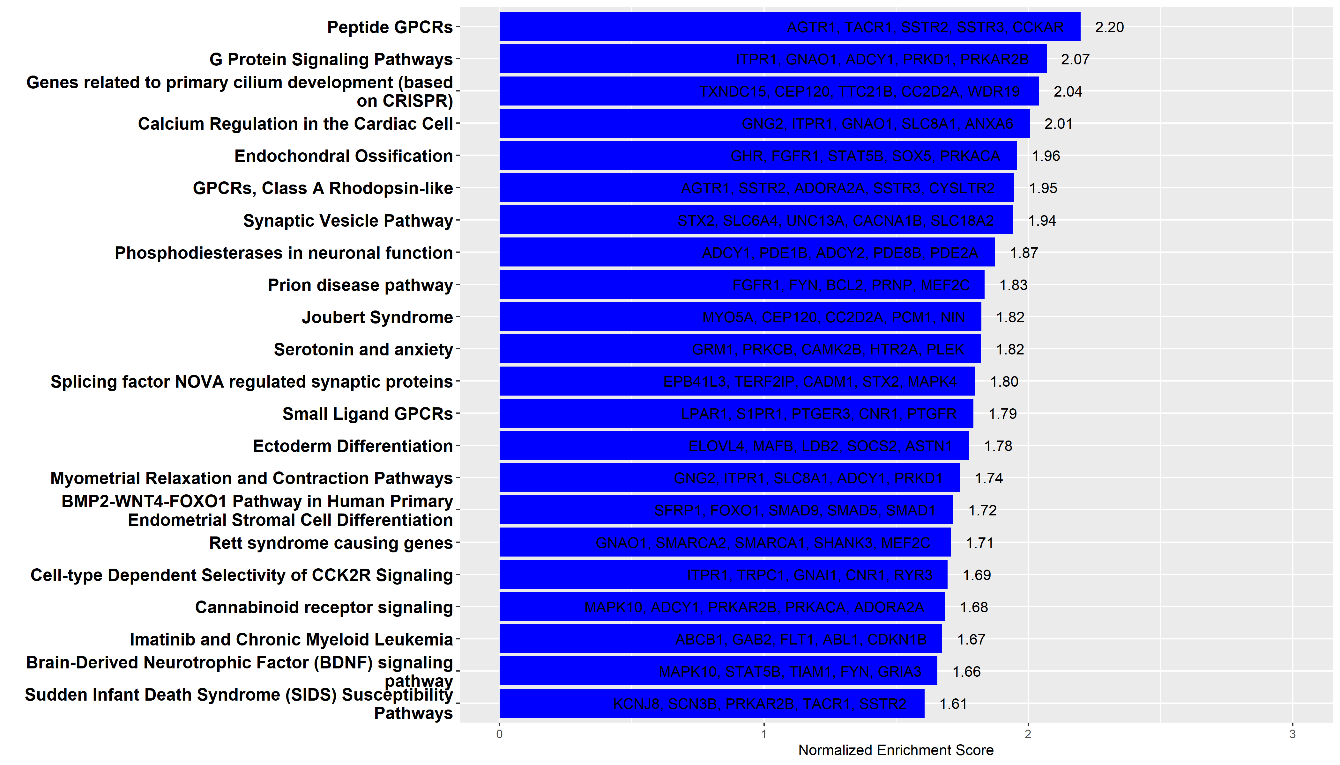
Wiki Pathway

Slide 16
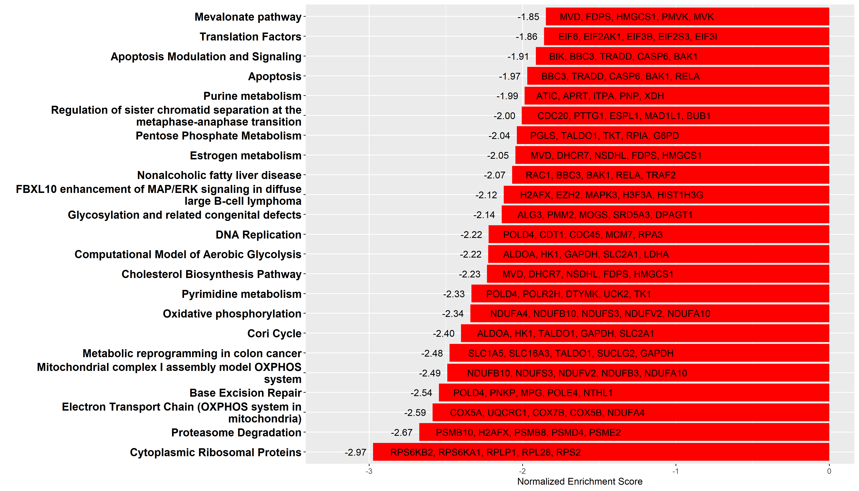
Wiki Pathway

