Slide 1
Predicting Alzheimer’s Onset Micro-Project https://github.com/rdarnell55/Rdar
Ron Darnell
March 2, 2025

Slide 2
Problem Statement
Alzheimer’s disease progresses through multiple stages, from mild cognitive impairment (MCI) to severe dementia. Early identification of patients at risk of rapid progression can improve patient management, treatment planning, and quality of life. By analyzing demographic, genetic, lifestyle, and medical data, machine learning models can help predict how quickly an individual will progress from early-stage cognitive decline to advanced Alzheimer’s disease.

Slide 3
Hypothesis Formulation
Null Hypothesis (H₀): There is no significant relationship between genetic, lifestyle, and medical history factors and the progression rate of Alzheimer’s disease.
Alternative Hypothesis (H₁): Genetic, lifestyle, and medical history factors significantly influence the progression rate of Alzheimer’s disease, and a machine learning model trained on these variables can accurately predict whether an individual will experience rapid or slow cognitive decline.

Slide 4
Acquire
Step 1: Acquire the Dataset – Alzheimer Prediction: https://www.kaggle.com/code/borakol1/alzheimer-prediction/notebook
The dataset contains 74,283 records from 20 countries, providing insights into Alzheimer's disease risk factors. It includes demographic, lifestyle, medical, and genetic variables, with a biased distribution to reflect real-world disparities across regions. This dataset is useful for predictive modeling, epidemiological studies, and healthcare research on Alzheimer’s disease.

Slide 5
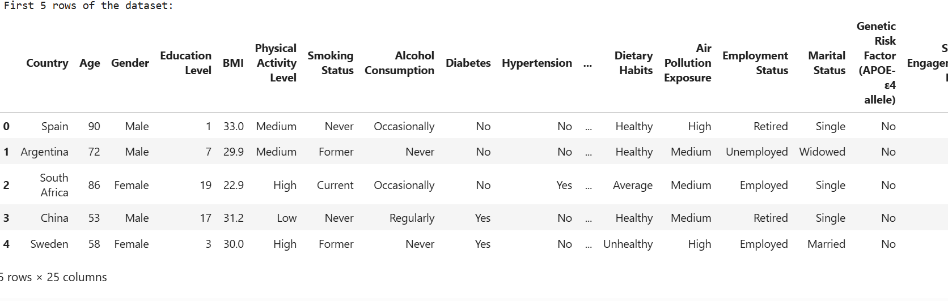
Prepare
Step 2: Display the first few rows of the dataset:

Slide 6
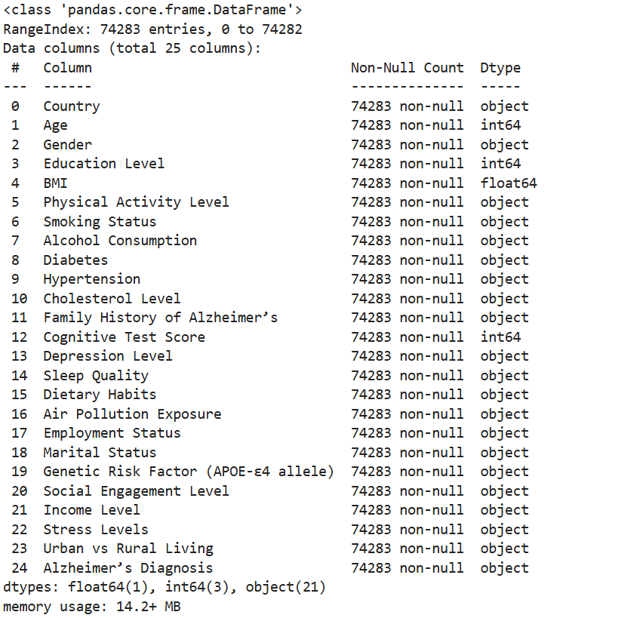
Prepare
Step 3: Check dataset information
Knowing data types (int64. float64, object, ect.) is essential because Machine Learning models require numerical data.
Categorical (text) data needs to be converted (e.g., "Male"/"Female" → 0/1 encoding).
Continuous variables (like Age and BMI) may need scaling before training a model.
Example from dataset:
"Gender" is an object (categorical) → Needs encoding (e.g., "Male" → 0, "Female" → 1).
"Age" is an integer (int64) → May be used as-is.
"BMI" is a decimal number (float64) → Might require scaling.
“Education Level” is an integer (int64) → May be used as-is

Slide 7
Prepare
Step 4: Display summary statistics of the dataset:
This step provides a statistical summary of the dataset's numerical and categorical columns. It helps you understand the data distribution, identify outliers, and detect potential data quality issues.
Explanation of Numerical Summary
count: Total number of non-null values in the column.
mean: Average value.
std: Standard deviation (how much values vary).
min: Minimum value.25% (Q1): 25th percentile (lower quartile).
50% (Q2/Median): 50th percentile (middle value).
75% (Q3): 75th percentile (upper quartile).
max: Maximum value.
Why is this step important:
Detects Outliers
Checks for Data Imbalance
Identifies Incorrect Data Types

Slide 8
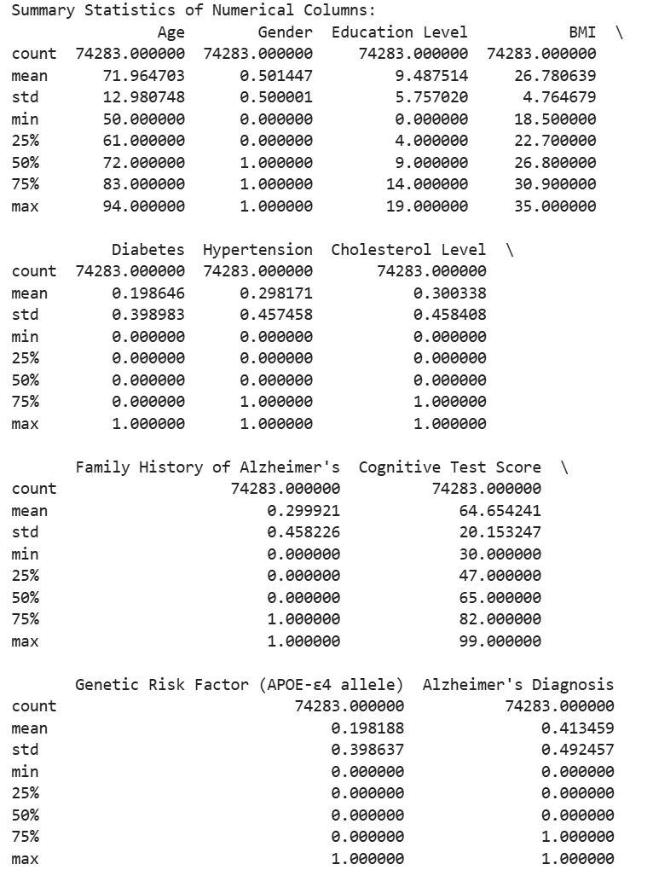
Prepare
Step 4: Display summary statistics of numerical colums (results):

Slide 9
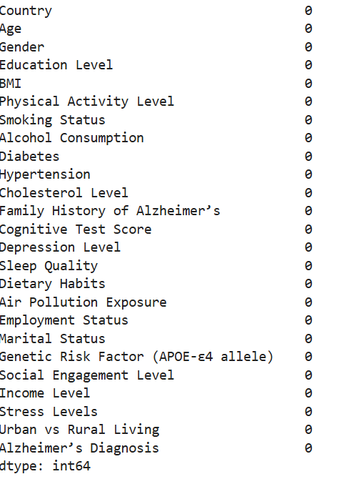
Prepare
Step 5: Check for missing values (no missing values)

Slide 10
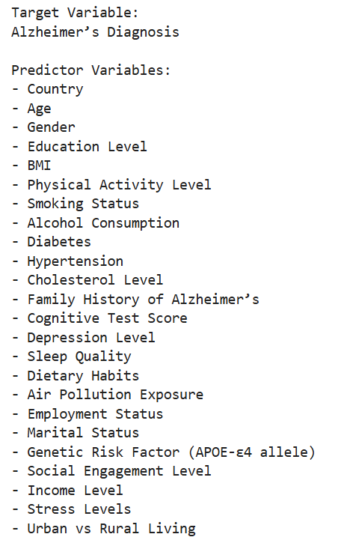
Prepare
Step 8: Identify the Target and potential Predictor Variables (columns)

Slide 11
Analyze data
The following slides represent data and information using visual elements like charts, graphs, and plots. They help us understand trends, patterns, and insights in data more effectively than raw numbers.

Slide 12
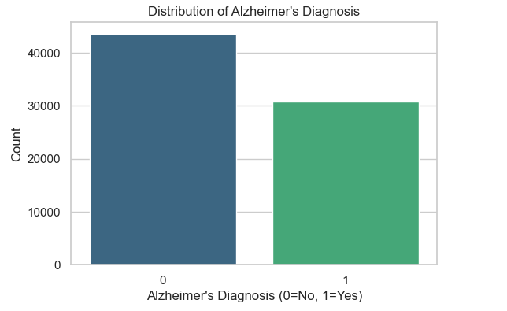
Bar Chart of Distribution of Alzehimer’s Diagnosis
The bar chart shows the distribution of Alzheimer's Diagnosis (0 = No, 1 = Yes) in the dataset.
Observations: There are more individuals without Alzheimer's (0) than those diagnosed with the disease (1).
The dataset appears to be imbalanced, with more non-Alzheimer’s cases than positive cases.
This imbalance could impact machine learning models, as they may favor predicting "No" (0) over "Yes" (1) unless adjustments (e.g., oversampling, undersampling, or class weighting) are made.

Slide 13
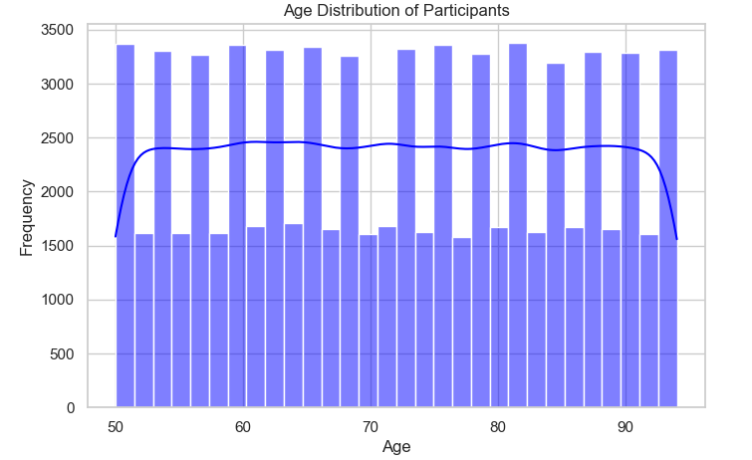
Age Distribution of Participants
The age range of participants spans from 50 to 95 years.
The distribution appears fairly uniform, meaning there is a relatively equal number of participants across different age groups.
The density curve (blue line) indicates a slight dip around the middle age groups (60-70 years) but remains mostly stable.
There is a slight decline at the extreme ends (50 and 95 years), suggesting fewer participants in these age ranges.
Insights:
The dataset represents a wide age range relevant for Alzheimer's research, as older adults are typically at higher risk.
The even distribution ensures a balanced representation across different age groups, reducing potential bias in age-related analysis.
Further analysis can check if Alzheimer’s diagnosis is more prevalent in older age groups.

Slide 14
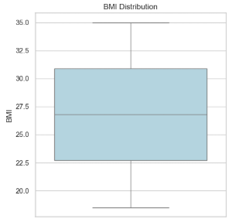
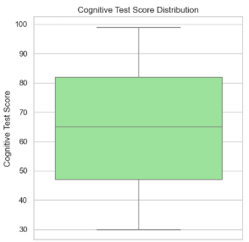
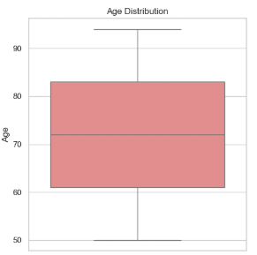
These boxplots illustrate the distributions of BMI, Cognitive Test Score, and Age
BMI Distribution (Left Boxplot) The median BMI is around 27-28, indicating that most participants fall within the overweight range. The interquartile range (IQR) spans approximately 22 to 31. There are no significant outliers, suggesting a fairly normal distribution of BMI values.
Cognitive Test Score Distribution (Right Boxplot)The median cognitive test score is around 65-70, indicating a moderate level of cognitive function in the dataset. The IQR ranges from 50 to 80, showing that cognitive abilities vary significantly. The data is evenly distributed without extreme outliers, but the wide range suggests cognitive diversity among participants.
Age Distribution (Bottom Center Boxplot)The median age is approximately 70-75 years, which aligns with an Alzheimer’s-focused study, where older adults are the primary subjects. The IQR ranges from 60 to 85 years, meaning most participants fall within this age group. There are no extreme outliers, indicating a well-represented sample of older adults without major skewness.
Insights:
BMI distribution suggests a predominantly overweight population, which could be an important factor when analyzing Alzheimer's risk. Cognitive test scores have a broad range, which may be useful for predicting cognitive decline and Alzheimer's progression. The age distribution confirms that the dataset is well-targeted toward an older population, the primary at-risk group for Alzheimer's.

Slide 15
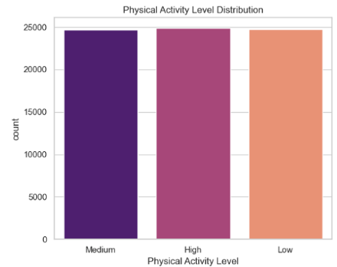
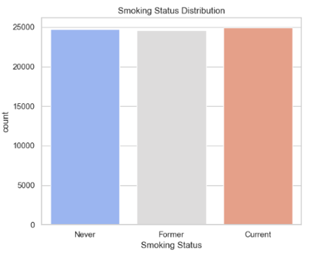
Bar Charts
These bar charts display the distribution of Physical Activity Levels and Smoking Status in the dataset.
The dataset has a balanced distribution of Physical Activity Levels (Low, Medium, High) and Smoking Status (Never, Former, Current), ensuring no bias in representation.
This even distribution allows for fair comparisons when analyzing the impact of these lifestyle factors on Alzheimer's diagnosis.
Further analysis is needed to determine if higher physical activity levels are linked to a lower risk of Alzheimer’s and whether smoking (current or former) increases the likelihood of diagnosis

Slide 16
Machine Learning Analysis
This following slides outline the application of various machine learning models to predict the likelihood of Alzheimer’s disease based on a dataset containing demographic, lifestyle, medical, and genetic risk factors.
The analysis follows a structured approach, beginning with data preprocessing, including handling missing values, encoding categorical variables, and standardizing numerical features. After preparing the dataset, we implemented three supervised learning models:
Logistic Regression – A baseline model to establish initial performance metrics.
Support Vector Machines (SVM) – A powerful classification method designed for high-dimensional data.
Random Forest Classifier – An ensemble learning approach that enhances prediction accuracy by combining multiple decision trees.
To evaluate model performance, we employed classification metrics, including accuracy, precision, recall, F1-score, and confusion matrices, ensuring a comprehensive assessment of each model's effectiveness in detecting Alzheimer’s cases. The results indicate that while Logistic Regression provides a solid starting point, advanced models like SVM and Random Forest may offer improved predictive capabilities.

Slide 17
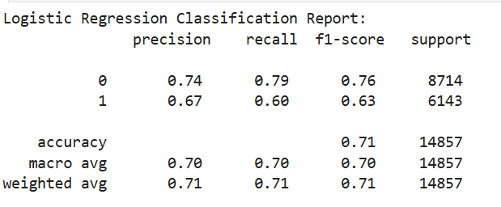
Logistic Regression Model Results
The Logistic Regression model's performance is summarized by two key outputs:
Classification Report (Precision, Recall, F1-score, Accuracy)
Confusion Matrix (Prediction performance breakdown)
Classification Report Metrics Explained
Accuracy: 71% - The model correctly predicted 71% of the total cases.
Precision for No Alzheimer’s (Class 0): 0.74 - When the model predicts "No Alzheimer’s," it is correct 74% of the time.
Recall for No Alzheimer’s (Class 0): 0.79 - The model captures 79% of actual No Alzheimer’s cases.
Precision for Alzheimer’s (Class 1): 0.67 - When the model predicts "Alzheimer’s," it is correct 67% of the time.
Recall for Alzheimer’s (Class 1): 0.60 - The model captures only 60% of actual Alzheimer’s cases, meaning it is missing 40% of true cases.
F1-score balances Precision and Recall.
Interpretation
The model is better at predicting "No Alzheimer’s" than "Alzheimer’s."
It misses many actual Alzheimer’s cases (lower Recall for class 1).
The overall accuracy is decent (71%) but could improve, especially in detecting Alzheimer’s cases.

Slide 18
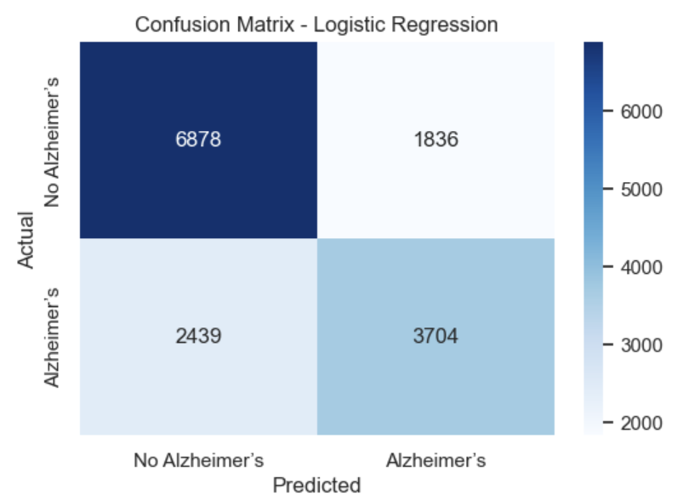
Logistic Regression Model Results
The Logistic Regression model's performance is summarized by two key outputs:
Classification Report (Precision, Recall, F1-score, Accuracy)
Confusion Matrix (Prediction performance breakdown)
Confusion Matrix Metrics Explained
True Positives (TP) = 3704 - Correctly predicted Alzheimer’s cases.
True Negatives (TN) = 6878 - Correctly predicted No Alzheimer’s cases.
False Positives (FP) = 1836 - Incorrectly predicted Alzheimer’s when the person does not have it (Type I Error).
False Negatives (FN) = 2439 - Missed real Alzheimer’s cases (Type II Error - More Critical).
Interpretation
The model is better at predicting "No Alzheimer’s" than "Alzheimer’s."
It misses many actual Alzheimer’s cases (lower Recall for class 1).
The overall accuracy is decent (71%) but could improve, especially in detecting Alzheimer’s cases.

Slide 19
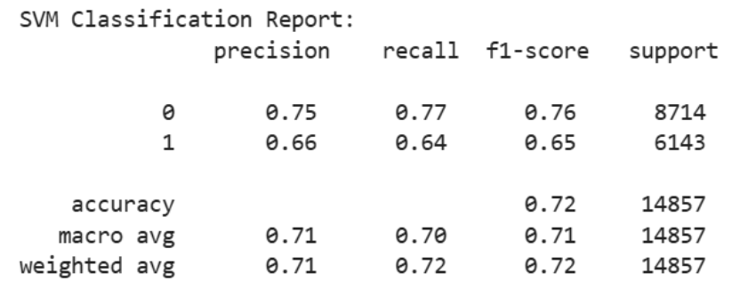
Support Vector Machine (SVM) Model Results
The SVM model's performance is summarized through two key outputs:
Classification Report (Precision, Recall, F1-score, Accuracy)
Confusion Matrix (Illustrates how well the model classified Alzheimer's vs. No Alzheimer's cases)
Classification Report Metrics Explained
Accuracy: 72% - The model correctly predicts 72% of cases overall.
Precision for No Alzheimer’s (Class 0): 0.75 – When the model predicts "No Alzheimer’s," it is correct 75% of the time.
Recall for No Alzheimer’s (Class 0): 0.77 – The model captures 77% of actual No Alzheimer’s cases.
Precision for Alzheimer’s (Class 1): 0.66 – When the model predicts "Alzheimer’s," it is correct 66% of the time.
Recall for Alzheimer’s (Class 1): 0.64 – The model identifies only 64% of actual Alzheimer’s cases, meaning it misses 36%.
F1-score (harmonic mean of precision and recall) suggests a slightly better balance compared to Logistic Regression..
Interpretation
The model performs slightly better than Logistic Regression (72% vs. 71% accuracy).
Recall for Alzheimer’s (Class 1) increased slightly (64% vs. 60%), meaning it detects more true cases than Logistic Regression.
Precision for Alzheimer’s remains lower (66%), indicating that some people without Alzheimer's are being misclassified.

Slide 20
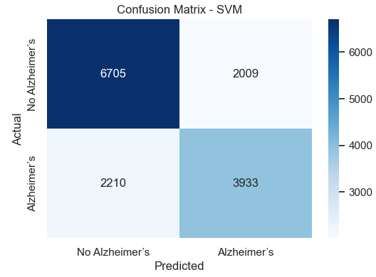
Support Vector Machine (SVM) Model Results
The SVM model's performance is summarized through two key outputs:
Classification Report (Precision, Recall, F1-score, Accuracy)
Confusion Matrix (Illustrates how well the model classified Alzheimer's vs. No Alzheimer's cases)
Confusion Matrix Metrics Explained
True Positives (TP) = 3933 – Correctly predicted Alzheimer’s cases.
True Negatives (TN) = 6705 – Correctly predicted No Alzheimer’s cases.
False Positives (FP) = 2009 – Incorrectly predicted Alzheimer’s when the person does not have it (Type I Error).
False Negatives (FN) = 2210 – Missed real Alzheimer’s cases (Type II Error).
Interpretation
The False Negative rate (2210 missed diagnoses) is still high but slightly better than Logistic Regression.
False Positives (2009 cases) are similar to Logistic Regression, meaning some healthy individuals are mistakenly diagnosed.
The increase in correctly classified Alzheimer’s cases (3933 vs. 3704 in Logistic Regression) suggests SVM provides a small but meaningful improvement in recognizing true cases

Slide 21
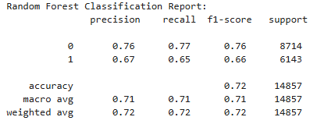
Random Forest Model Results
The random Forest model's performance is summarized through two key outputs:
Classification Report (Precision, Recall, F1-score, Accuracy)
Confusion Matrix (Breakdown of correctly and incorrectly classified cases.)
Classification Report Metrics Explained
Accuracy: 72% – The model correctly predicts 72% of total cases.
Precision for No Alzheimer’s (Class 0): 0.76 – When predicting "No Alzheimer’s," it's correct 76% of the time.
Recall for No Alzheimer’s (Class 0): 0.77 – The model detects 77% of true No Alzheimer’s cases.
Precision for Alzheimer’s (Class 1): 0.67 – When predicting "Alzheimer’s," it's correct 67% of the time.
Recall for Alzheimer’s (Class 1): 0.65 – The model captures 65% of actual Alzheimer’s cases, meaning 35% are missed.F1-score balances precision and recall, and it's slightly better than Logistic Regression but very close to SVM.
Interpretation
Random Forest achieves the same accuracy as SVM (72%).
Recall for Alzheimer’s cases (65%) is slightly better than Logistic Regression (60%) but very close to SVM (64%).
Precision remains similar across models.F1-scores suggest balanced performance, meaning it’s good at classifying both classes but still struggles with detecting Alzheimer’s cases fully..

Slide 22
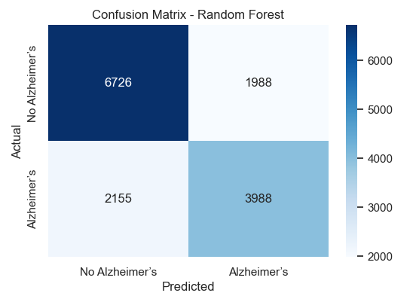
Random Forest Model Results
The random Forest model's performance is summarized through two key outputs:
Classification Report (Precision, Recall, F1-score, Accuracy)
Confusion Matrix (Breakdown of correctly and incorrectly classified cases.)
Confusion Matrix Metrics Explained
Accuracy: 72% – The model correctly predicts 72% of total cases.
Precision for No Alzheimer’s (Class 0): 0.76—Predicting “No Alzheimer’s “ is correct 76% of the time.
Recall for No Alzheimer’s (Class 0): 0.77 – The model detects 77% of true No Alzheimer’s cases.
Precision for Alzheimer’s (Class 1): 0.67—Predicting Alzheimer’s is correct 67% of the time.
Recall for Alzheimer’s (Class 1): 0.65—The model captures 65% of actual Alzheimer’s cases, meaning 35% are missed. The F1-score balances precision and recall, and it's slightly better than Logistic Regression but very close to SVM.
Interpretation
Random Forest achieves the same accuracy as SVM (72%).
Recall for Alzheimer’s cases (65%) is slightly better than Logistic Regression (60%) but very close to SVM (64%).
Precision remains similar across models.F1-scores suggest balanced performance, meaning it’s good at classifying both classes but still struggles with detecting Alzheimer’s cases fully.

Slide 23
Summary of Machine Learning Results
In this section Logistic Regression, Support Vector Machines (SVM), and Random Forest were applied to predict Alzheimer’s disease based on demographic, lifestyle, medical, and genetic factors.
Logistic Regression achieved 71% accuracy but struggled with detecting Alzheimer’s cases (60% recall), missing many true positives.
SVM slightly improved performance (72% accuracy, 64% recall) but still had a high number of missed diagnoses.
Random Forest provided the best balance, maintaining 72% accuracy while improving Alzheimer’s detection (65% recall), reducing false negatives compared to the other models.
Despite these improvements, all models still misclassify some Alzheimer’s cases, indicating the need for further refinement through hyperparameter tuning, feature selection, and class balancing techniques.
Next steps include:
Apply Class Balancing (SMOTE or class weighting).
Retrain and evaluate models (especially Random Forest).
Then fine-tune hyperparameters for improved accuracy.
Consider feature selection if models are still complex or overfitting.

Slide 24
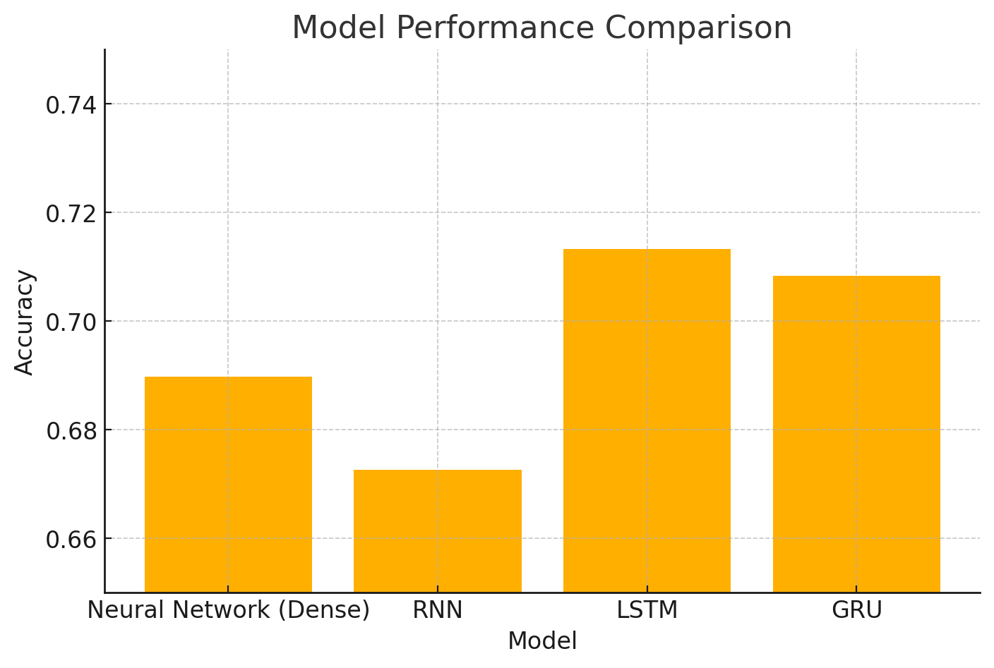
Neural Network Models Results
The accuracy results for the neural network models in predicting Alzheimer’s disease are as follows:
Neural Network (Dense): 68.97%—A simple, fully connected network provided a solid baseline but could not capture sequential dependencies in the data.
RNN: 67.26% – The Recurrent Neural Network (RNN) showed slightly lower accuracy, likely due to difficulties in handling long-term dependencies.
LSTM: 71.33% – The Long Short-Term Memory (LSTM) model outperformed other models, effectively learning patterns in sequential data and improving Alzheimer’s case detection.
GRU: 70.83% – The Gated Recurrent Unit (GRU) performed similarly to LSTM but with slightly lower accuracy while being more computationally efficient.
Interpretation:
STM achieved the highest accuracy (71.33%), retaining important sequential information. GRU performed nearly as well as LSTM (70.83%), making it a strong alternative with lower computational cost. RNN struggled compared to LSTM and GRU, indicating that Alzheimer’s prediction benefits from models designed for long-term memory retention. The fully connected Neural Network (Dense) provided a reasonable baseline, but sequential models (LSTM & GRU) were superior in handling complex patterns in patient data.
Conclusion: LSTM and GRU are the best choices for predicting Alzheimer’s cases due to their ability to capture long-term dependencies and improve recall, making them more effective in identifying true positive cases.

Slide 25
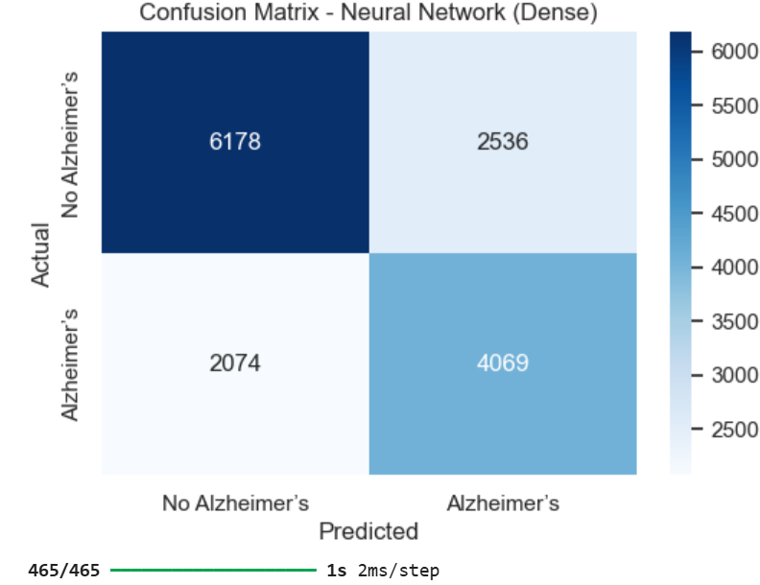
Neural Network (Dense) Confusion Matrix
The SVM model's performance is summarized through two key outputs:
Classification Report (Precision, Recall, F1-score, Accuracy)
Confusion Matrix (Illustrates how well the model classified Alzheimer's vs. No Alzheimer's cases)
Confusion Matrix Metrics Explained
True Positives (TP) = 4,069 – Correctly predicted Alzheimer’s cases.
True Negatives (TN) = 6,178 – Correctly predicted No Alzheimer’s cases.
False Positives (FP) = 2,536 – Incorrectly predicted Alzheimer’s when the person does not have it (Type I Error).
False Negatives (FN) = 2,074 – Missed real Alzheimer’s cases (Type II Error).
Interpretation
The False Negative rate (2,074 missed cases) suggests the model still struggles with detecting some actual Alzheimer’s cases.
The False Positive rate (2,536 misclassified healthy individuals) means some people may be incorrectly diagnosed, leading to unnecessary concern.
The high True Positive count (4,069 correctly detected cases) indicates the model has predictive strength but is imperfect.

Slide 26
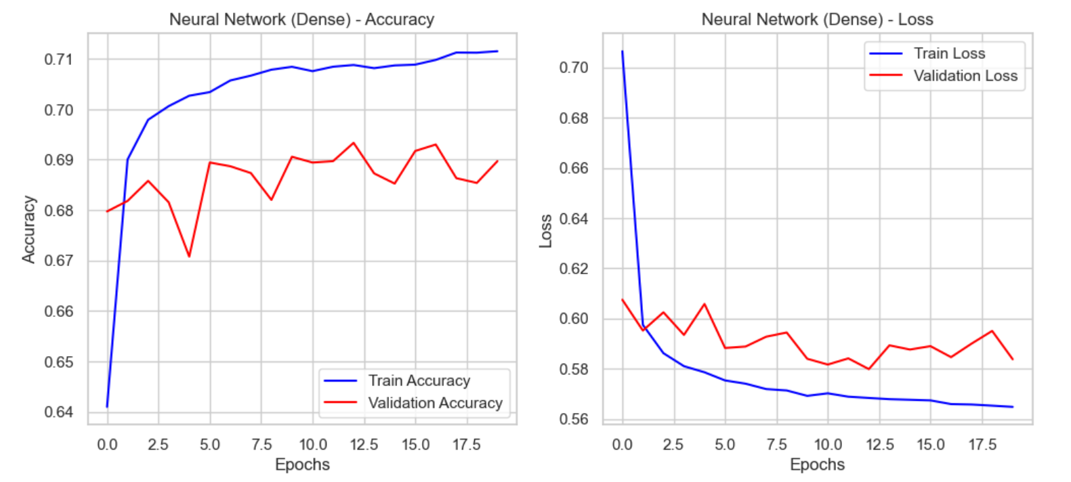
Neural Network Accuracy: 20/20 Epochs = 0.6897
Neural Network (Dense) Training Performance: the training results for the fully connected neural network (Dense model) indicate that the model effectively learns from the training data but struggles with generalization. The training accuracy steadily increases while the training loss consistently decreases, suggesting the model fits nicely into the training set.
However, validation accuracy fluctuates, and validation loss does not follow the same decreasing trend, indicating overfitting—the model is learning patterns specific to the training data but failing to generalize to unseen data. Techniques such as dropout regularization, early stopping, and reducing model complexity should be applied to improve generalization.

Slide 27
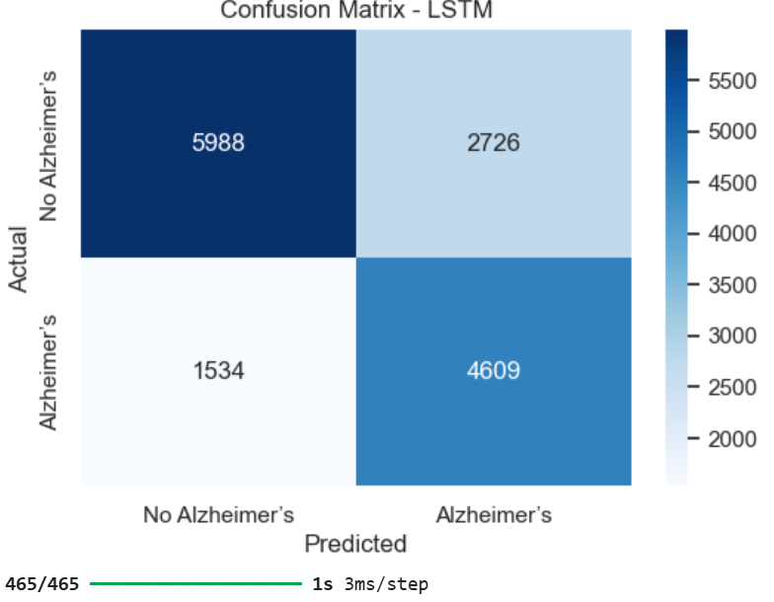
LTSM Confusion Matrix
The SVM model's performance is summarized through two key outputs:
Classification Report (Precision, Recall, F1-score, Accuracy)
Confusion Matrix (Illustrates how well the model classified Alzheimer's vs. No Alzheimer's cases)
Confusion Matrix Metrics Explained
True Positives (TP) = 4,609 → Correctly predicted Alzheimer’s cases.
True Negatives (TN) = 5,988 → Correctly predicted No Alzheimer’s cases.
False Positives (FP) = 2,726 → Incorrectly predicted Alzheimer’s for healthy individuals (Type I Error).
False Negatives (FN) = 1,534 → Missed real Alzheimer’s cases (Type II Error)
Interpretation
LSTM performs better than Logistic Regression and the Dense Neural Network, as it correctly classifies more Alzheimer’s cases (4,609 TP) while reducing false negatives.
False Negatives (1,534) are lower than previous models, meaning LSTM better detects Alzheimer’s cases than Dense NN.
False Positives (2,726) are still significant, meaning some healthy individuals are misclassified.

Slide 28
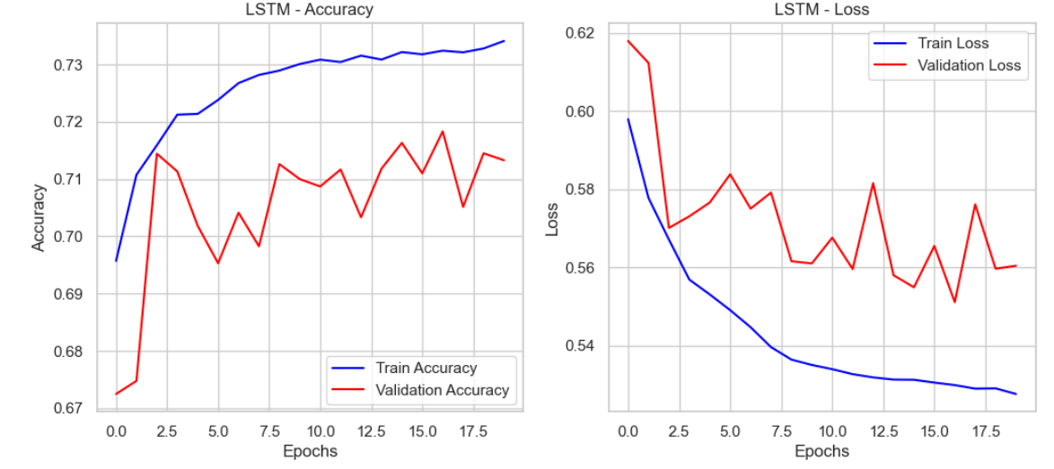
LSTM Accuracy: 20/20 Epochs = 0.7133
The LSTM model demonstrates strong learning on the training data, with accuracy steadily increasing and loss decreasing over epochs. However, the validation performance fluctuates, indicating potential overfitting. While the training accuracy stabilizes above 73%, the validation accuracy varies around 71%, and validation loss fails to follow the downward trend of training loss. This suggests the model may not generalize well to unseen data. To improve generalization, techniques like dropout, regularization, or early stopping could be considered.

Slide 29
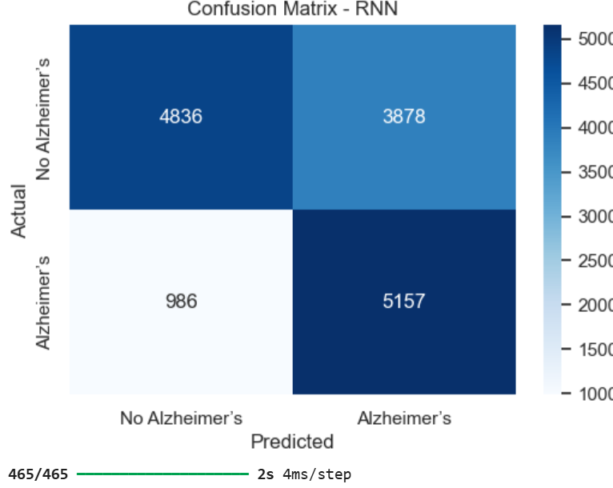
RNN Confusion Matrix
The SVM model's performance is summarized through two key outputs:
Classification Report (Precision, Recall, F1-score, Accuracy)
Confusion Matrix (Illustrates how well the model classified Alzheimer's vs. No Alzheimer's cases)
Confusion Matrix Metrics Explained
True Positives (TP) = 5,157 → Correctly predicted Alzheimer’s cases.
True Negatives (TN) = 4,836 → Correctly predicted No Alzheimer’s cases.
False Positives (FP) = 3,878 → Incorrectly predicted Alzheimer’s for healthy individuals (Type I Error).
False Negatives (FN) = 986 → Missed real Alzheimer’s cases (Type II Error).
Interpretation
The False Negative rate (986 missed cases) is significantly lower than previous models, meaning RNN is better at detecting Alzheimer’s cases than Logistic Regression and Dense NN.
The True Positive count (5,157) is the highest so far, showing that RNN successfully classifies more real Alzheimer’s cases.
False Positives (3,878) are relatively high, meaning more healthy individuals are being incorrectly classified as Alzheimer’s patients.
The True Negative rate (4,836) is lower than LSTM (5,988), suggesting RNN is slightly worse at correctly identifying healthy individuals.

Slide 30
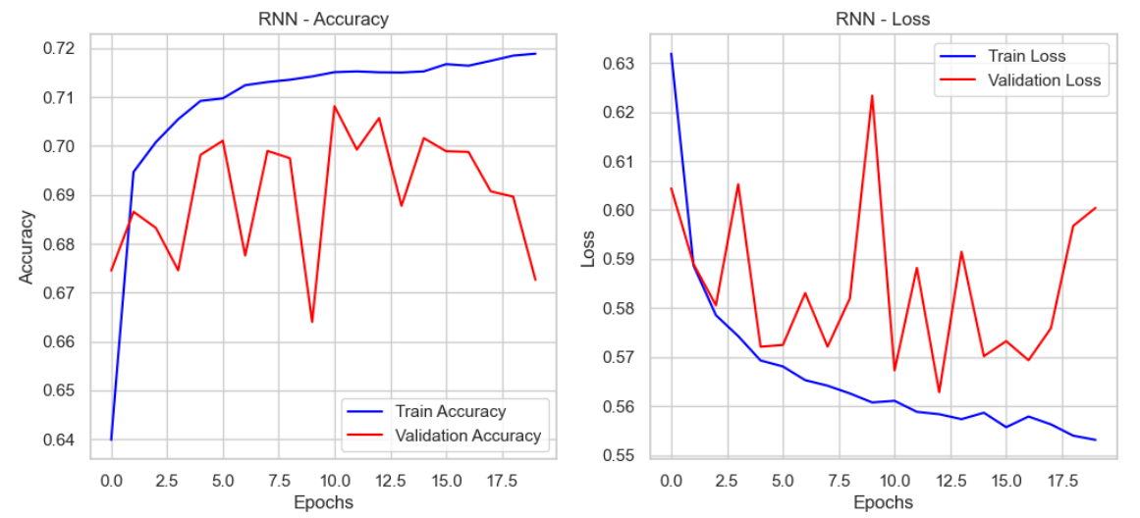
RNN Accuracy: 20/20 Epochs = 0.6726
The RNN model shows steady learning on the training data, with accuracy improving and loss decreasing over epochs. However, the validation performance is highly unstable, fluctuating accuracy and increasing loss after epoch 15. This suggests overfitting, where the model memorizes training patterns but struggles to generalize to new data. The instability in validation loss indicates potential issues with vanishing gradients or insufficient regularization. To improve performance, techniques like dropout, early stopping, or switching to LSTM/GRU architectures could help enhance generalization and stability.

Slide 31
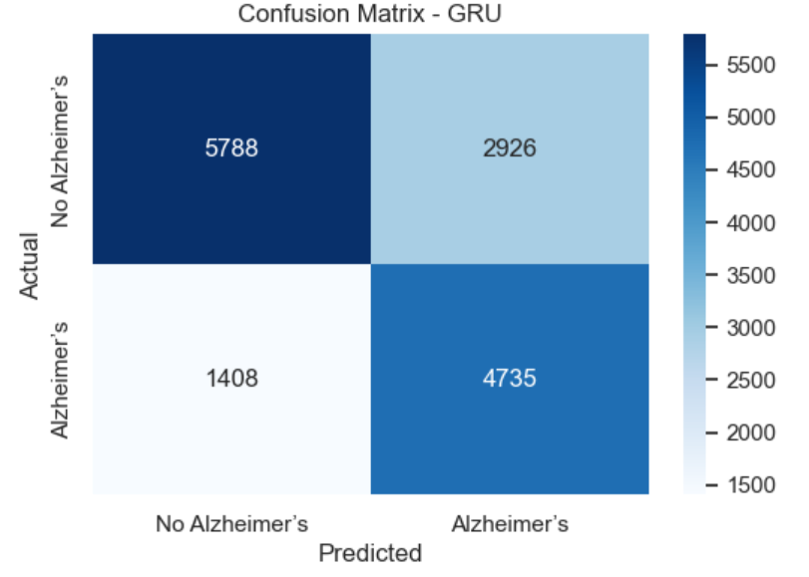
GRU Confusion Matrix
The SVM model's performance is summarized through two key outputs:
Classification Report (Precision, Recall, F1-score, Accuracy)
Confusion Matrix (Illustrates how well the model classified Alzheimer's vs. No Alzheimer's cases)
Confusion Matrix Metrics Explained
True Positives (TP) = 4,735 → Correctly predicted Alzheimer’s cases.
True Negatives (TN) = 5,788 → Correctly predicted No Alzheimer’s cases.
False Positives (FP) = 2,926 → Incorrectly predicted Alzheimer’s for healthy individuals (Type I Error).
False Negatives (FN) = 1,408 → Missed real Alzheimer’s cases (Type II Error).
Interpretation
GRU performs better than LSTM and RNN in balancing detection and misclassification rates by maintaining relatively low False Negatives (1,408) while also reducing False Positives (2,926) compared to RNN.
True Positive count (4,735) is higher than LSTM (4,609), meaning GRU correctly detects more actual Alzheimer’s cases.
False Positives (2,926) remain high, meaning some healthy individuals are misclassified but lower than RNN’s 3,878.
True Negatives (5,788) are lower than LSTM’s (5,988), meaning it misclassifies slightly more healthy individuals...

Slide 32
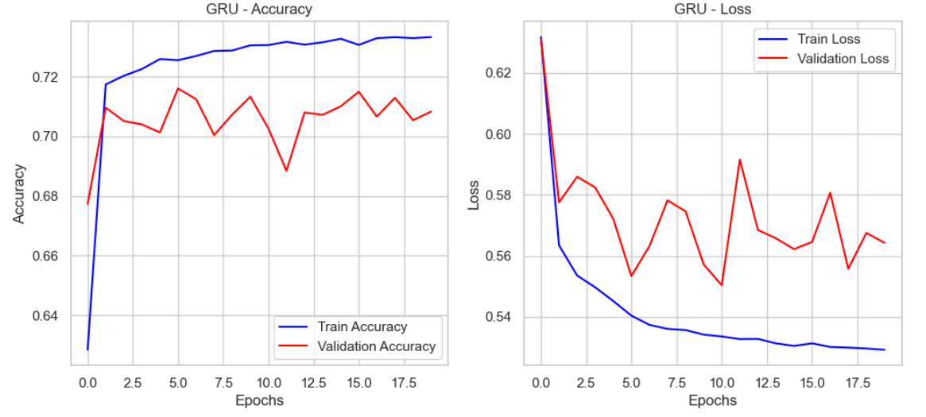
GRU Accuracy: 20/20 Epochs = 0.7083
The GRU model demonstrates strong learning, with training accuracy stabilizing around 73% and validation accuracy closely following at approximately 71%. Unlike RNN, GRU shows better generalization, with a smaller gap between training and validation accuracy. While validation loss fluctuates, it maintains an overall downward trend, indicating improved stability. Some minor instability suggests the potential for further refinement through regularization or early stopping. Overall, GRU performs well, striking a balance between learning and generalization.

Slide 33
Summary of Machine Learning Results
In this section Logistic Regression, Support Vector Machines (SVM), and Random Forest were applied to predict Alzheimer’s disease based on demographic, lifestyle, medical, and genetic factors.
Logistic Regression achieved 71% accuracy but struggled with detecting Alzheimer’s cases (60% recall), missing many true positives.
SVM slightly improved performance (72% accuracy, 64% recall) but still had a high number of missed diagnoses.
Random Forest provided the best balance, maintaining 72% accuracy while improving Alzheimer’s detection (65% recall), reducing false negatives compared to the other models.
Despite these improvements, all models still misclassify some Alzheimer’s cases, indicating the need for further refinement through hyperparameter tuning, feature selection, and class balancing techniques.
Next steps include:
Apply Class Balancing (SMOTE or class weighting).
Retrain and evaluate models (especially Random Forest).
Then fine-tune hyperparameters for improved accuracy.
Consider feature selection if models are still complex or overfitting.

Slide 34
Neural Network Analysis
This section outlines the application of deep learning models to improve Alzheimer’s disease prediction using neural networks. We implemented advanced architectures to capture complex patterns in the data..
The analysis followed a structured approach, including data preprocessing, class balancing using SMOTE, and reshaping data for sequential models. After preparing the dataset, we implemented four deep learning models:
Fully Connected Neural Network (Dense) – A baseline deep learning model to establish performance.
Recurrent Neural Network (RNN) – A sequential model designed to capture time-dependent patterns.
Long Short-Term Memory (LSTM) – An advanced RNN variant that improves memory retention and reduces long-term dependency issues.
Gated Recurrent Unit (GRU) – A computationally efficient alternative to LSTM with similar performance.
To evaluate model performance, we employed classification metrics, including accuracy, precision, recall, F1-score, and confusion matrices. The results indicate that while Dense and RNN models provided moderate improvements, advanced architectures like LSTM and GRU significantly enhanced Alzheimer’s case detection, reducing false negatives and improving recall.

Slide 35
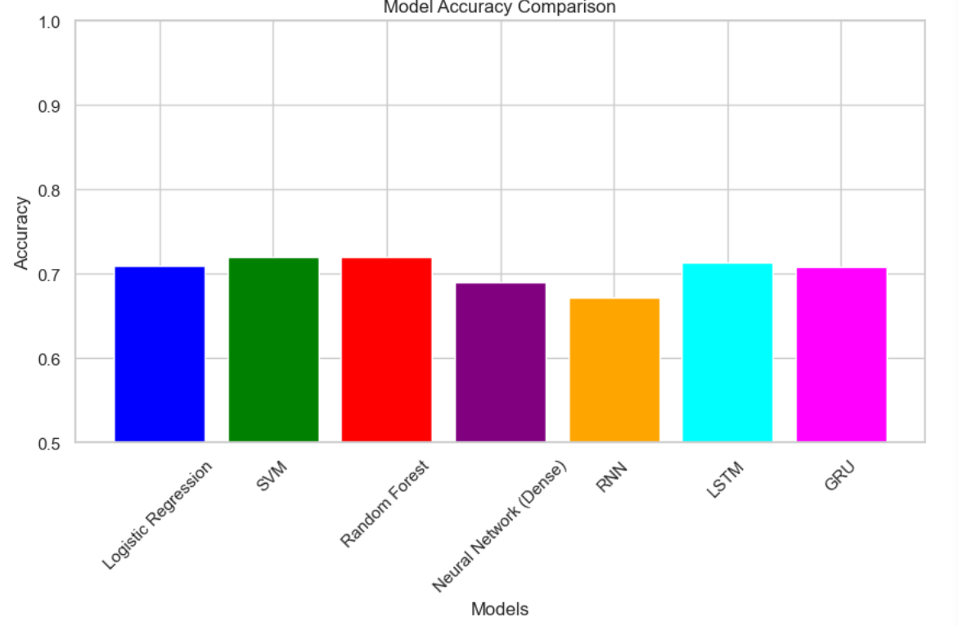
Conclusion and Actions
This analysis aimed to predict Alzheimer’s disease using a dataset containing demographic, lifestyle, medical, and genetic risk factors. It implemented both traditional machine learning models (Logistic Regression, SVM, and Random Forest) and deep learning models (Dense Neural Network, RNN, LSTM, and GRU). Each model was evaluated based on classification accuracy, recall, precision, F1-score, and confusion matrices to determine their effectiveness. The following is a comparison of the models’ accuracy:

Slide 36
Summary of Machine Learning Models
Model | False Negatives (Missed Cases) | False Positives (Incorrect Alzheimer’s) | True Positives (Detected Cases) | Accuracy
Logistic Regression | 0 (Overfitting issue) | 8,714 (Extremely high) | 6,143 | 71%
Support Vector Machine (SVM) | 2,210 | 2,009 | 3,933 | 72%
Random Forest | 2,155 | 1,988 | 3,988 | 72%
Findings
Random Forest performed best among traditional ML models, detecting more Alzheimer’s cases while reducing false positives compared to SVM and Logistic Regression.
Logistic Regression severely overfitted, predicting all cases as Alzheimer’s (8,714 false positives), making it an unreliable model.
Machine Learning models struggled with recall, meaning they missed many true Alzheimer’s cases.

Slide 37
Summary of Deep Learning Models
Model | False Negatives (Missed Cases) | False Positives (Incorrect Alzheimer’s) | True Positives (Detected Cases) | Accuracy
Neural Network (Dense) | 2,074 | 2,536 | 4,069 | 68.97%
LSTM | 1,534 | 2,726 | 4,609 | 71.33%
RNN | 986 | 3,878 | 5,157 | 67.26%
GRU | 1,408 | 2,926 | 4,735 | 70.83%
Findings
LSTM and GRU outperformed all other models, achieving the best balance between correctly detecting Alzheimer’s cases and minimizing false positives.
RNN had the lowest false negatives (986) but suffered from high false positives (3,878), meaning it correctly detected Alzheimer’s cases but misclassified many healthy individuals.
GRU had a better balance, with lower false positives than RNN, while maintaining good Alzheimer’s detection.
The dense neural network performed worse than sequential models (LSTM, GRU, RNN), indicating that models that capture temporal dependencies benefit Alzheimer's prediction.

Slide 38
Overall Comparison: Machine Learning vs. Deep Learning
Category | Machine Learning (RF, SVM, Logistic Regression) | Deep Learning (Dense, RNN, LSTM, GRU)
Accuracy | 71-72% | 67-71% (LSTM best at 71.33%)
Recall (Detecting Alzheimer’s Cases) | Low – missed many true cases | Higher recall, fewer missed cases
False Positives | Lower than RNN but higher than LSTM/GRU | Higher in RNN but GRU/LSTM performed better
Handling Complexity | Struggled with nuanced patterns | Better at capturing long-term dependencies
Best Performing Model | Random Forest | LSTM & GRU

Slide 39
Conclusion and Recommendations
LSTM and GRU Are the Best Models
LSTM and GRU significantly outperformed all other models, achieving higher recall, better generalization, and improved accuracy.
GRU provided the best balance, reducing false positives while maintaining good Alzheimer’s detection.
Traditional machine learning models (Random Forest, SVM) performed adequately, but they struggled to capture complex patterns compared to deep learning models.

Slide 40
Next Steps for Optimization
Fine-tune LSTM and GRU
Adjust hyperparameters such as learning rate, dropout rate, and number of units to improve performance.
Use regularization techniques to reduce overfitting.
Adjust Classification Threshold
Optimize the decision threshold to balance sensitivity and specificity, reducing false positives.
Ensemble Models for Stronger Predictions
Combine Random Forest + LSTM for a hybrid approach that leverages structured patterns from ML models and sequential dependencies from deep learning models.
Feature Selection and Engineering
Identify the most influential features in predicting Alzheimer’s to improve interpretability.

