Slide 1
Alzheimer’s Data Micro-Project 1 https://github.com/rdarnell55/Rdar
Ron Darnell
February 9, 2025

Slide 2
Problem Statement
Is there a relationship between education level, gender, and the likelihood of being diagnosed with Alzheimer's disease?

Slide 3
Hypothesis Formulation
H₀ (Null Hypothesis): Education level and gender do not significantly impact Alzheimer’s diagnosis.
H₁ (Alternative Hypothesis): Higher education levels are associated with a lower risk of Alzheimer’s, and there may be gender-based differences in prevalence.

Slide 4
Acquire
Dataset – Alzheimer Prediction: https://www.kaggle.com/code/borakol1/alzheimer-prediction/notebook
The dataset contains 74,283 records from 20 countries, providing insights into Alzheimer's disease risk factors. It includes demographic, lifestyle, medical, and genetic variables, with a biased distribution to reflect real-world disparities across regions. This dataset is useful for predictive modeling, epidemiological studies, and healthcare research on Alzheimer’s disease.

Slide 5
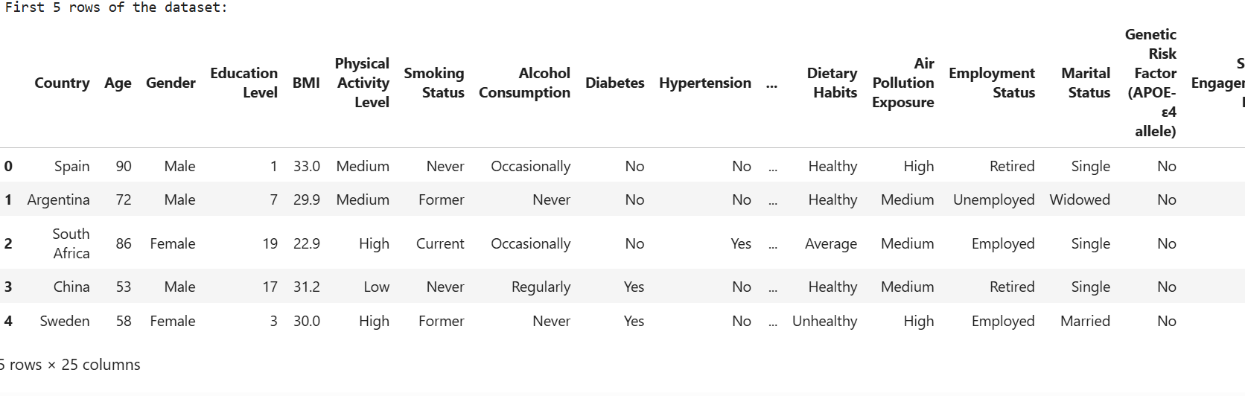
Prepare
Display the first few rows of the dataset:

Slide 6
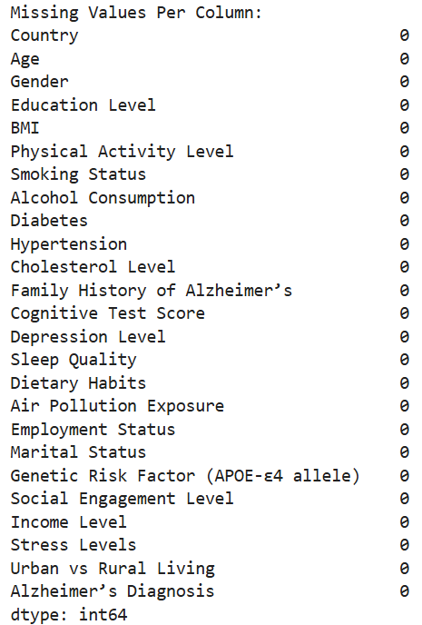
Prepare
Check for missing values:

Slide 7
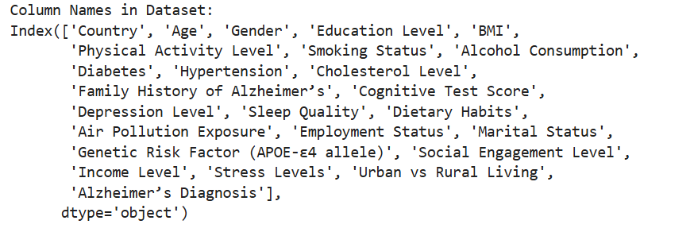
Prepare
Display column names in the data set:

Slide 8
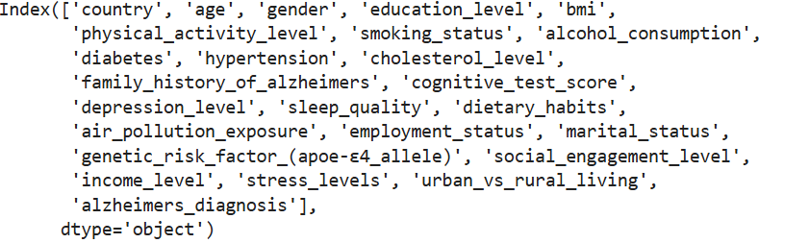
Prepare
Standardize column names: Convert to lowercase, replace spaces, and remove “’”
Update column selection with new names.

Slide 9
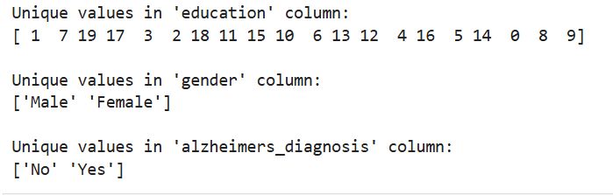
Prepare
Rename columns for consistency
Check unique values for categorical variables

Slide 10
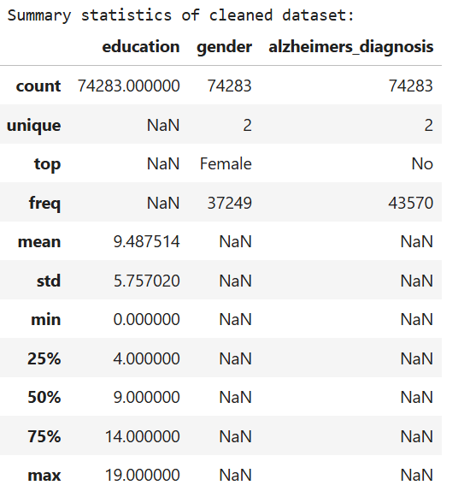
Prepare
Display Summary Statistics

Slide 11
Analyze data
<select analytical technique, build models>

Slide 12
Report
<communicate results>

Slide 13
Act
<apply results, connect results with the chosen problem statement or business question>

