Slide 1
Predicting Alzheimer’s Onset Micro-Project Module 2 https://github.com/rdarnell55/Rdar
Ron Darnell
February 16, 2025

Slide 2
Problem Statement
Alzheimer’s disease progresses through multiple stages, from mild cognitive impairment (MCI) to severe dementia. Early identification of patients at risk of rapid progression can improve patient management, treatment planning, and quality of life. By analyzing demographic, genetic, lifestyle, and medical data, machine learning models can help predict how quickly an individual will progress from early-stage cognitive decline to advanced Alzheimer’s disease.

Slide 3
Hypothesis Formulation
Null Hypothesis (H₀): There is no significant relationship between genetic, lifestyle, and medical history factors and the progression rate of Alzheimer’s disease.
Alternative Hypothesis (H₁): Genetic, lifestyle, and medical history factors significantly influence the progression rate of Alzheimer’s disease, and a machine learning model trained on these variables can accurately predict whether an individual will experience rapid or slow cognitive decline.

Slide 4
Acquire
Step 1: Acquire the Dataset – Alzheimer Prediction: https://www.kaggle.com/code/borakol1/alzheimer-prediction/notebook
The dataset contains 74,283 records from 20 countries, providing insights into Alzheimer's disease risk factors. It includes demographic, lifestyle, medical, and genetic variables, with a biased distribution to reflect real-world disparities across regions. This dataset is useful for predictive modeling, epidemiological studies, and healthcare research on Alzheimer’s disease.

Slide 5
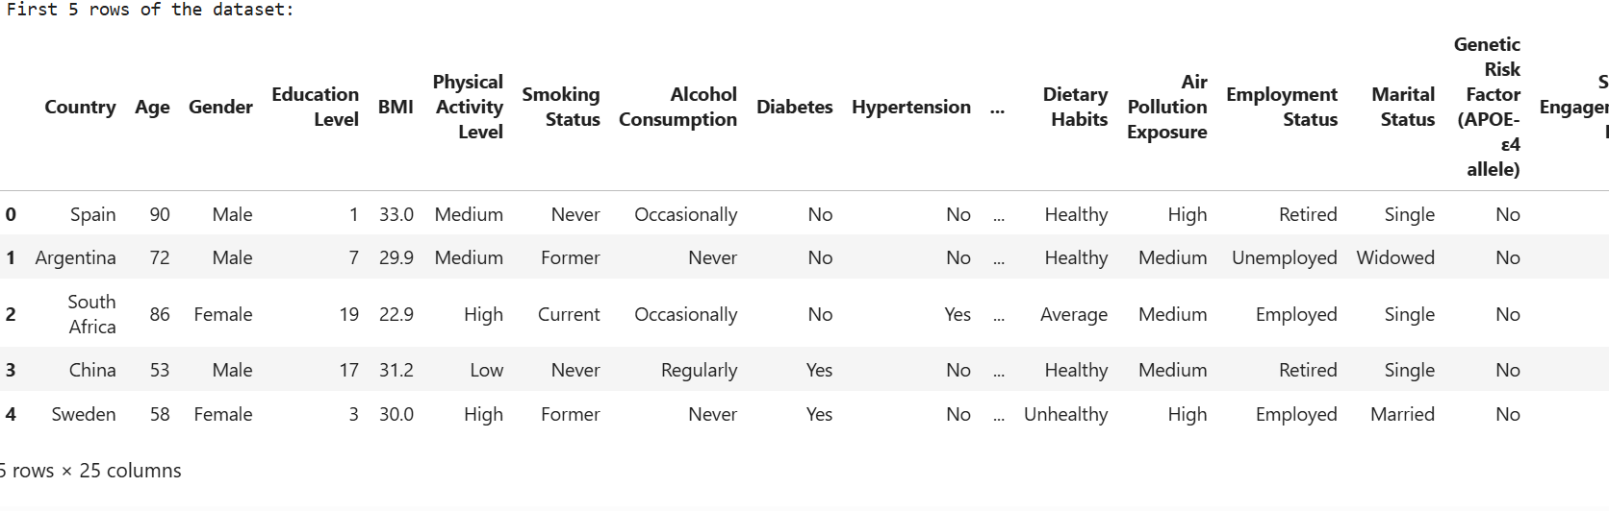
Prepare
Step 2: Display the first few rows of the dataset:

Slide 6
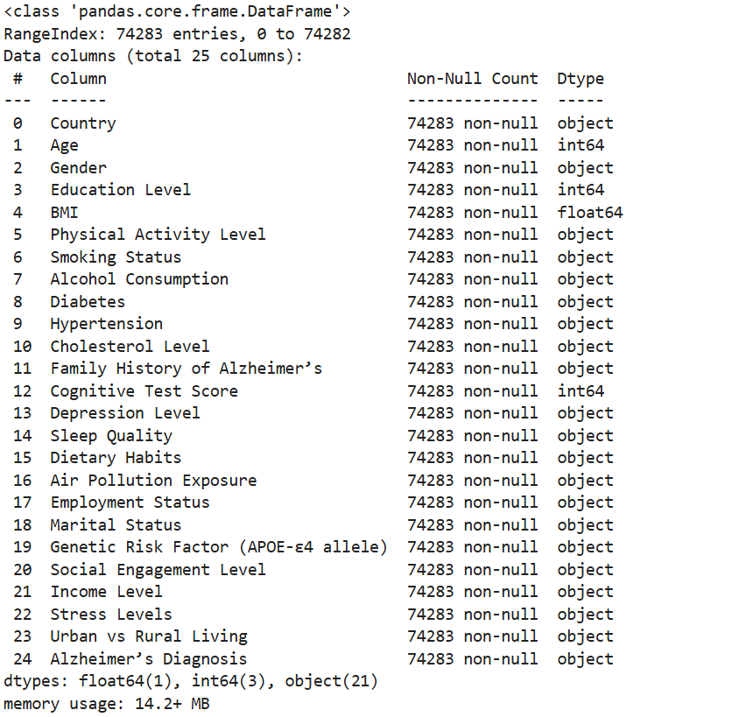
Prepare
Step 3: Check dataset information
Knowing data types (int64. float64, object, ect.) is essential because Machine Learning models require numerical data.
Categorical (text) data needs to be converted (e.g., "Male"/"Female" → 0/1 encoding).
Continuous variables (like Age and BMI) may need scaling before training a model.
Example from dataset:
"Gender" is an object (categorical) → Needs encoding (e.g., "Male" → 0, "Female" → 1).
"Age" is an integer (int64) → May be used as-is.
"BMI" is a decimal number (float64) → Might require scaling.
“Education Level” is an integer (int64) → May be used as-is

Slide 7
Prepare
Step 4: Display summary statistics of the dataset:
This step provides a statistical summary of the dataset's numerical and categorical columns. It helps you understand the data distribution, identify outliers, and detect potential data quality issues.
Explanation of Numerical Summary
count: Total number of non-null values in the column.
mean: Average value.
std: Standard deviation (how much values vary).
min: Minimum value.25% (Q1): 25th percentile (lower quartile).
50% (Q2/Median): 50th percentile (middle value).
75% (Q3): 75th percentile (upper quartile).
max: Maximum value.
Why is this step important:
Detects Outliers
Checks for Data Imbalance
Identifies Incorrect Data Types

Slide 8
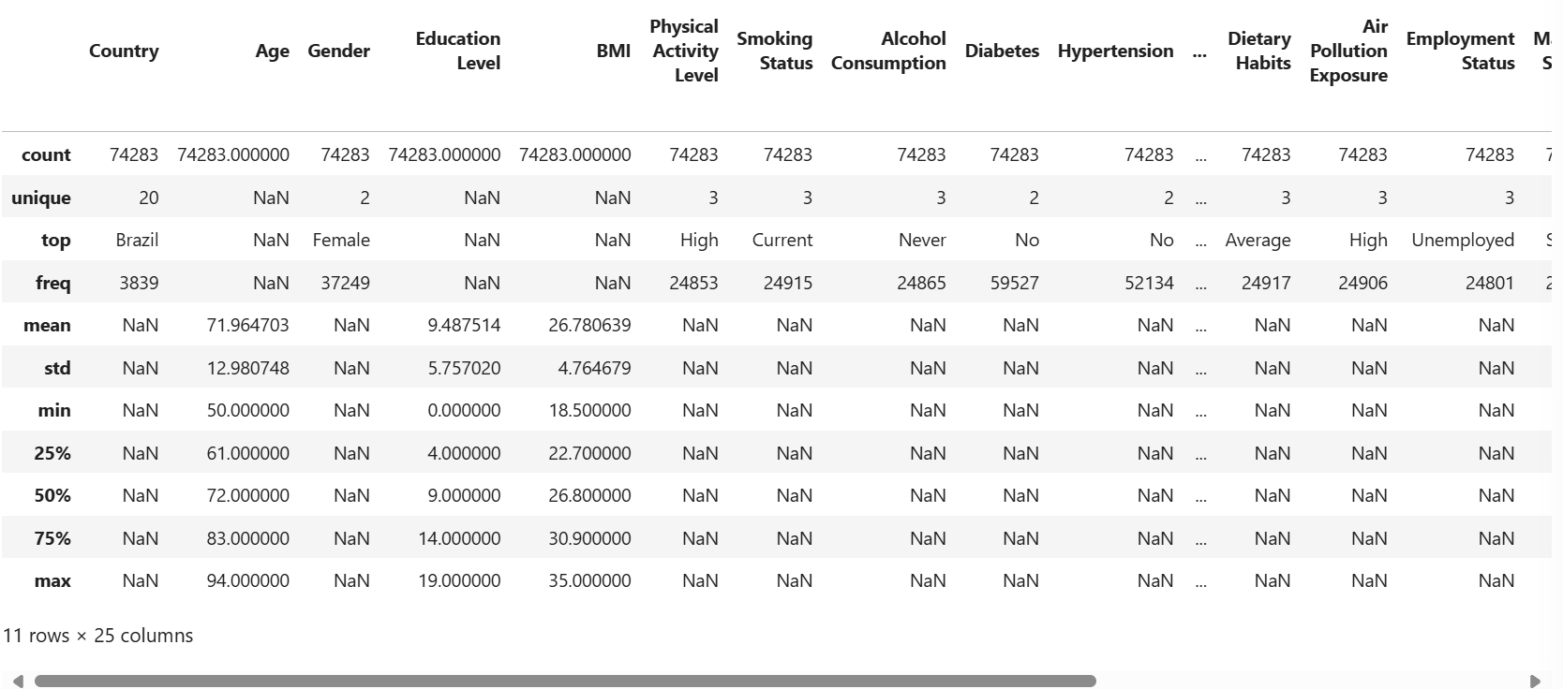
Prepare
Step 4: Display summary statistics of the dataset (results):

Slide 9
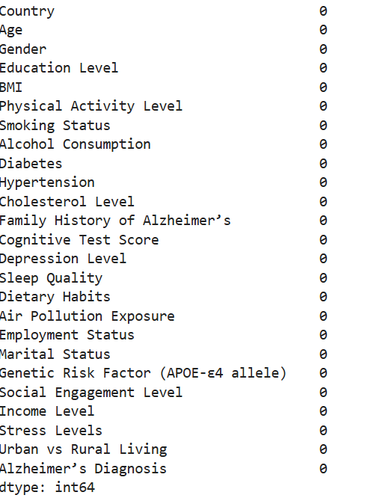
Prepare
Step 5: Check for missing values (no missing values)

Slide 10
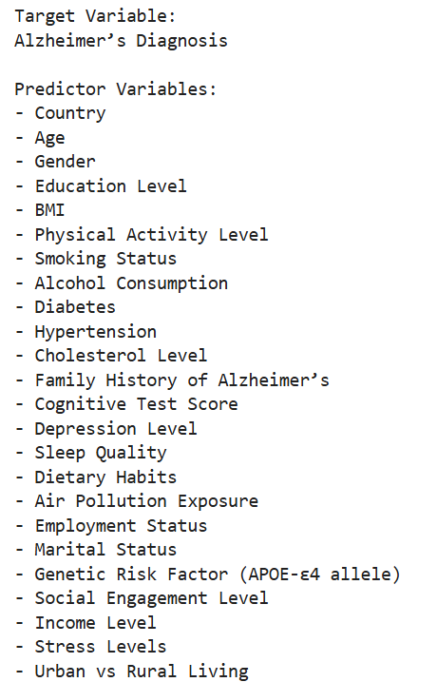
Prepare
Step 8: Identify the Target Variable and potential Predictor (columns)

Slide 11
Analyze data
The following slides represent data and information using visual elements like charts, graphs, and plots. They help us understand trends, patterns, and insights in data more effectively than raw numbers.

Slide 12
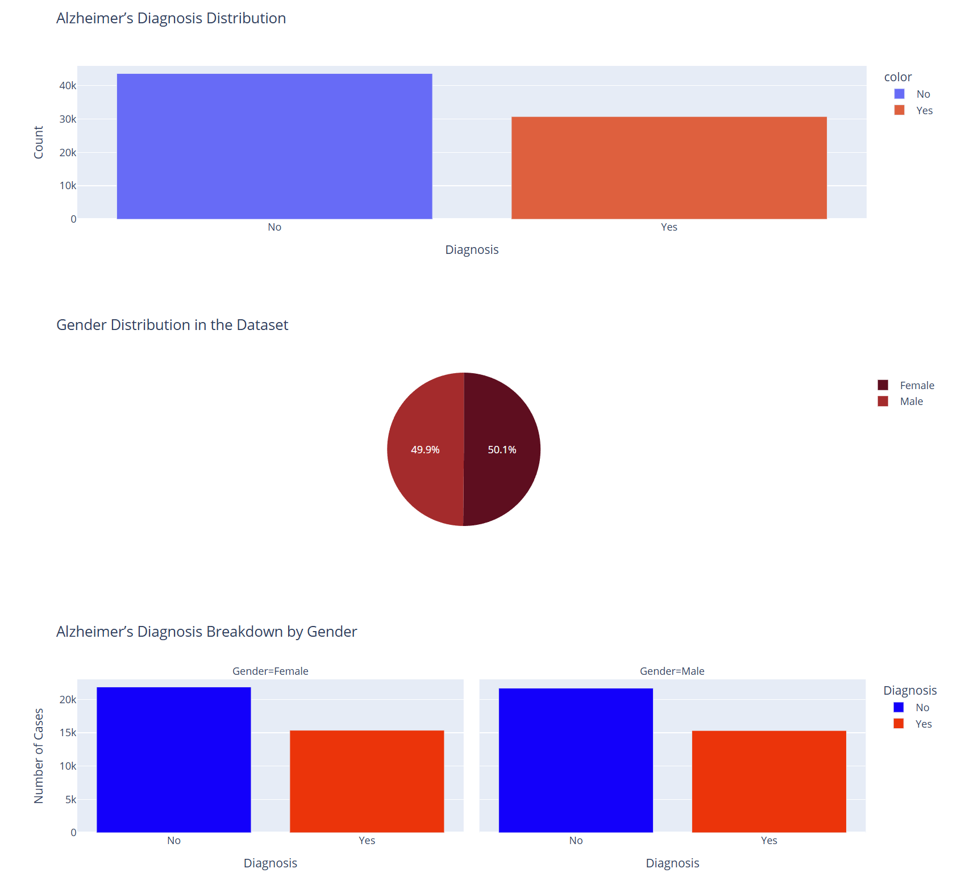

Slide 13
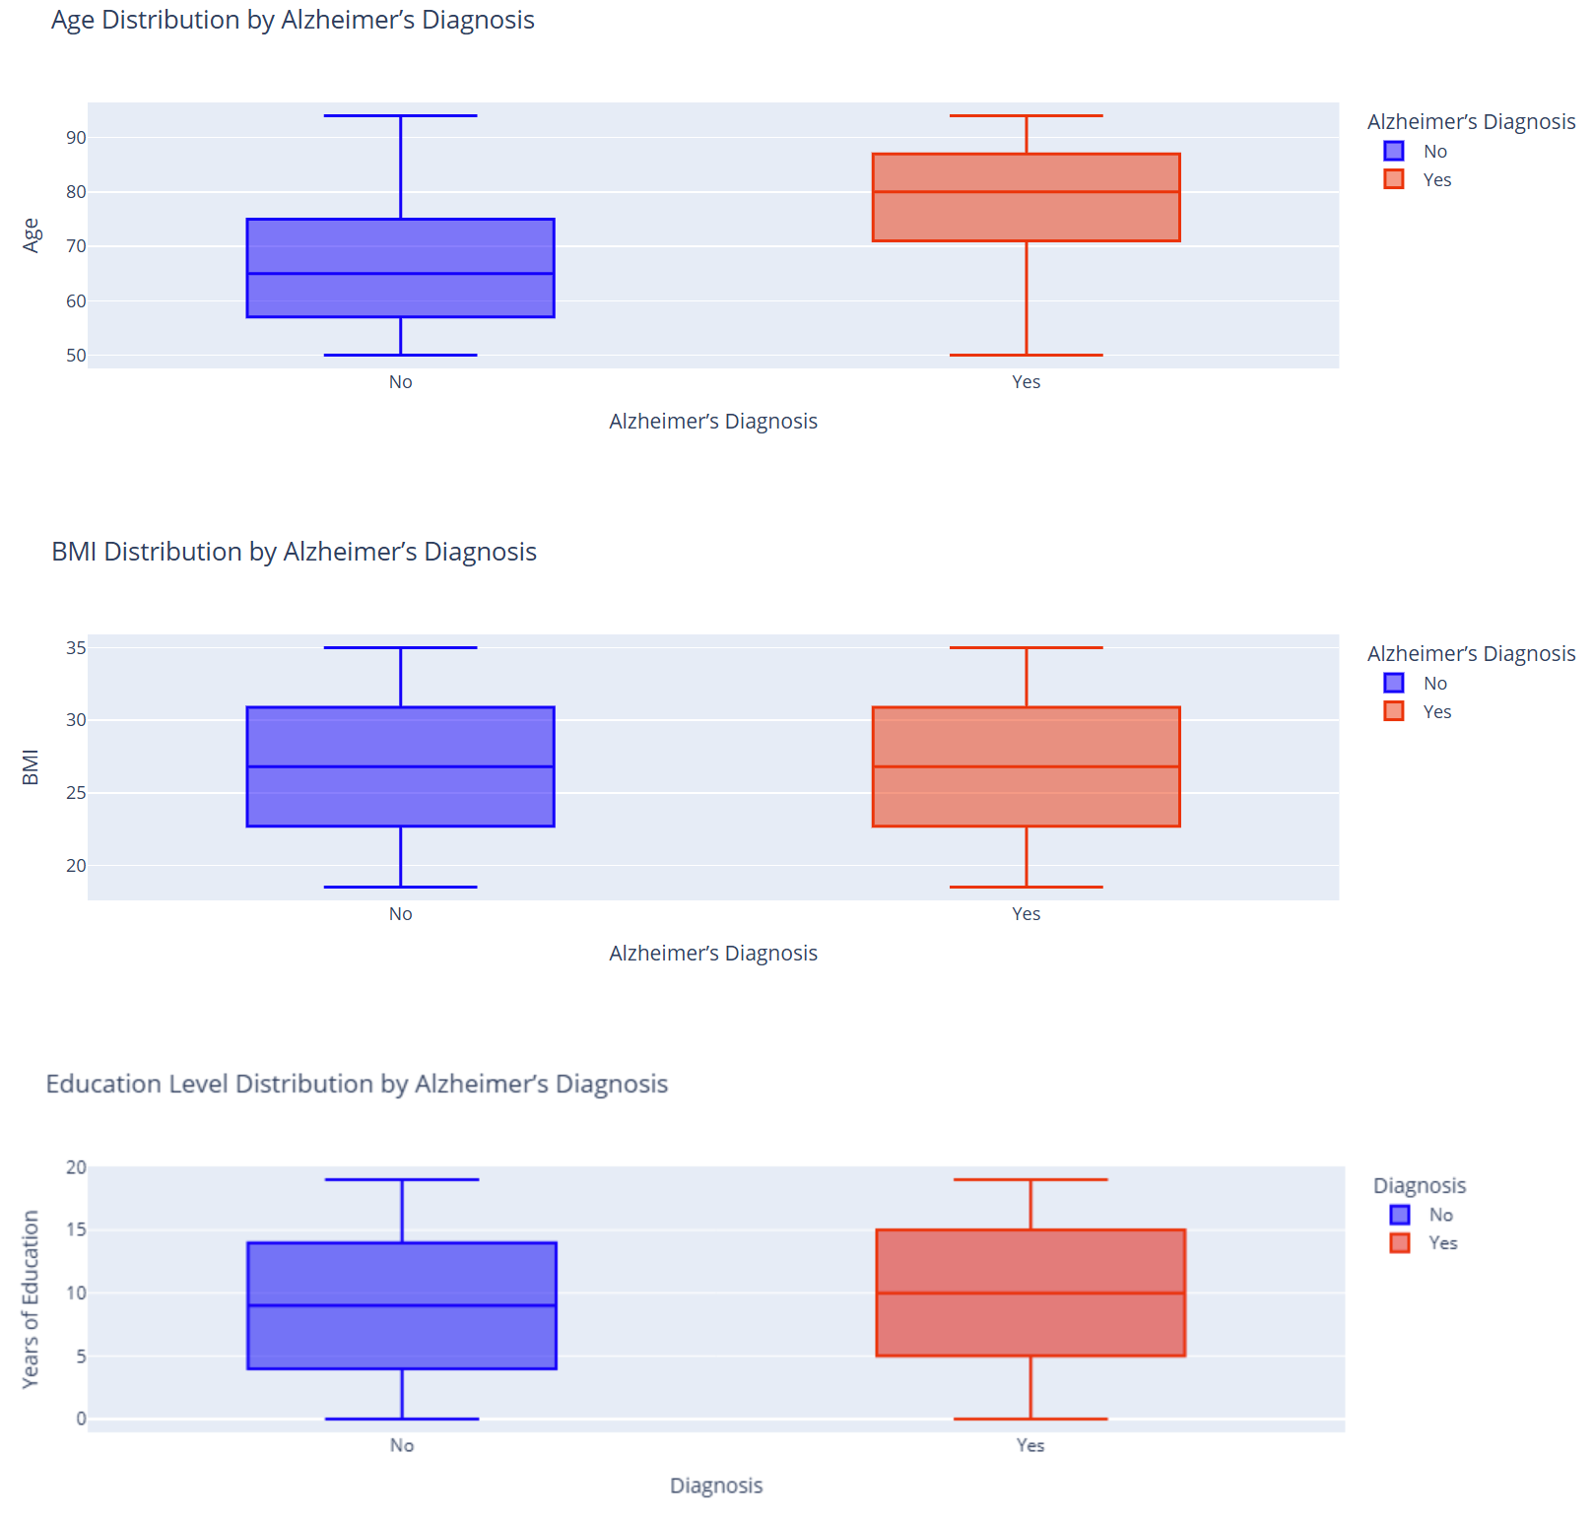

Slide 14
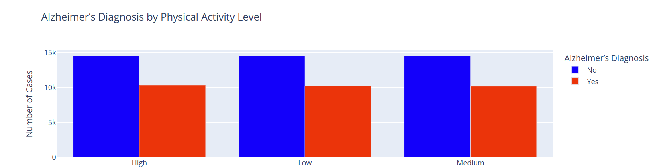
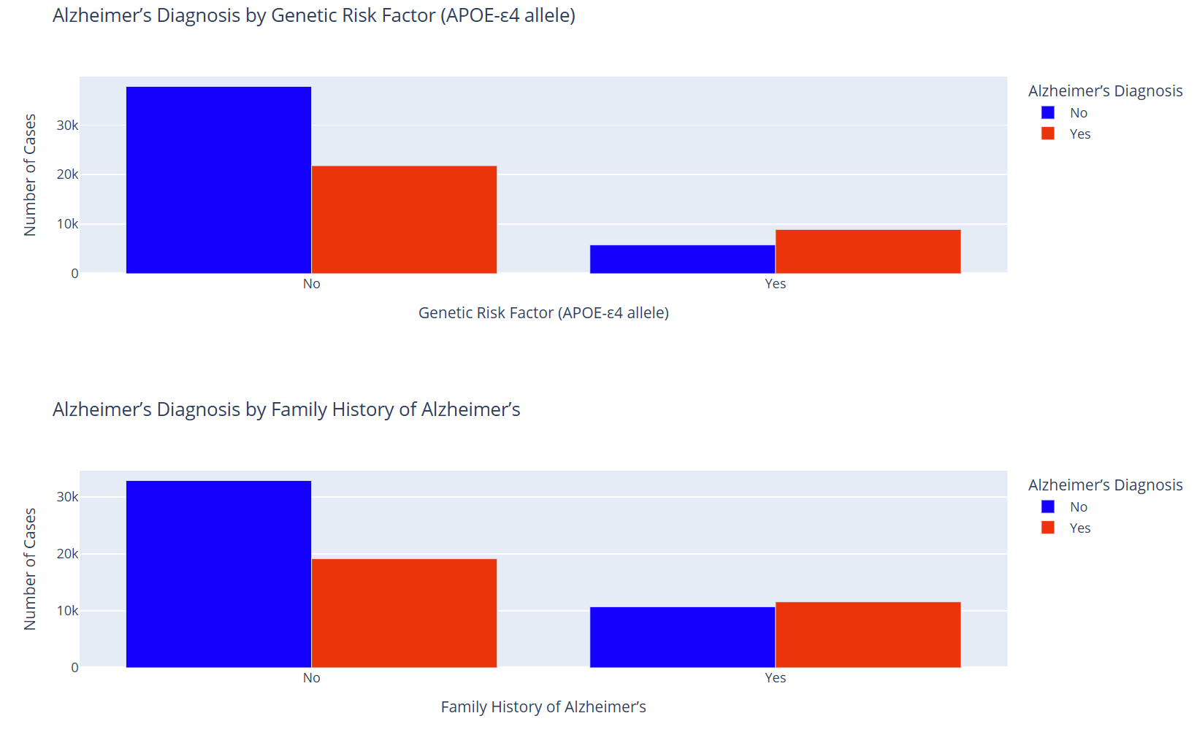

Slide 15
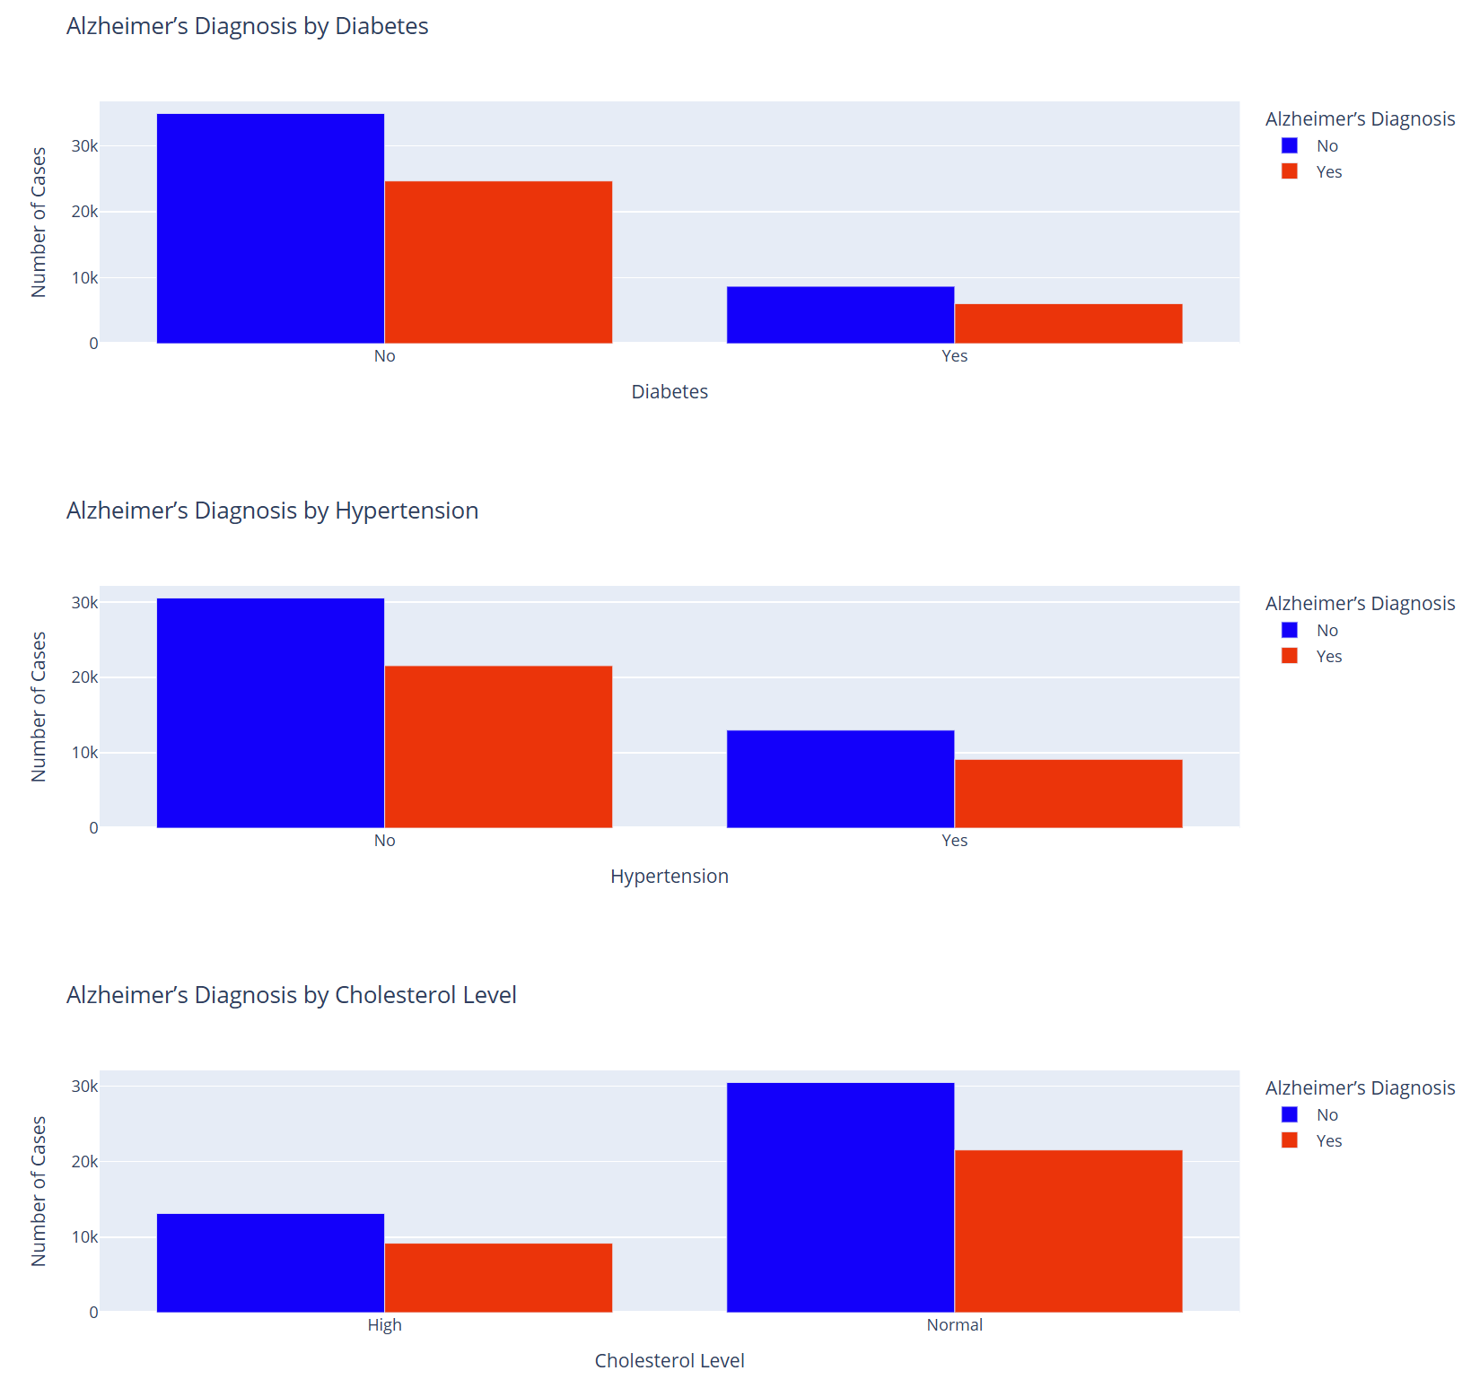

Slide 16
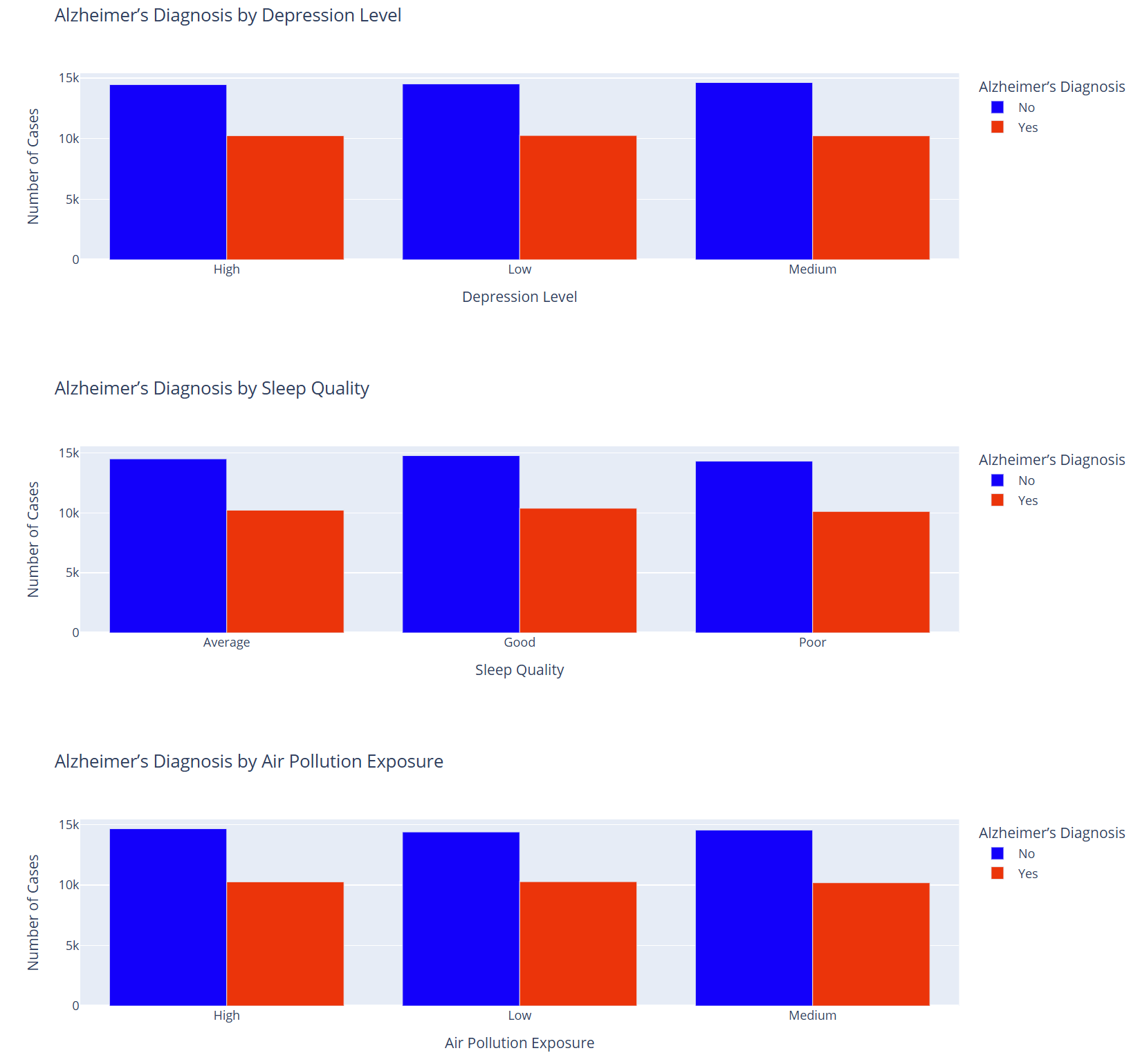

Slide 17
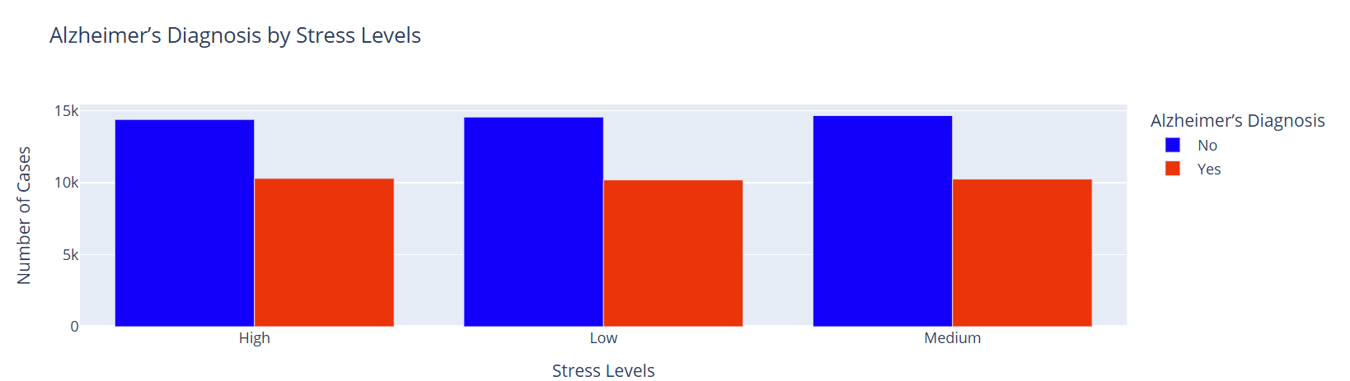

Slide 18
Report
<communicate results>

Slide 19
Act
<apply results, connect results with the chosen problem statement or business question>

