Slide 1
NEURAL NETWORKS
What’s a neural network?
Neural networks is a massively distributed parallel processor made up of simple processing units that has a natural propensity for storing experimental knowledge and making it available for use.
An extremely simplified model of the brain.
Essentially a function approximator.
Transforms inputs into outputs to the best of its ability

Slide 2
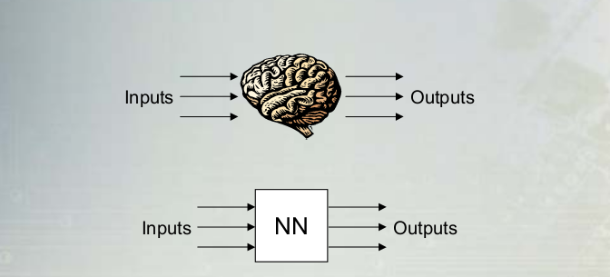

Slide 3
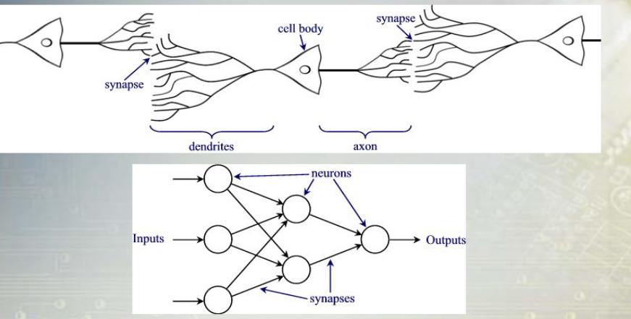
An artificial neural network is Composed of many “neurons” that co-operate to perform the desired function.

Slide 4
It resembles the brain in two respects :
Knowledge is acquired by the neural network from it’s environment through a learning process.
Inter neuron connection strength known as synaptic weights , are used to store the acquired knowledge.
A neuron is an inter-processing unit that is fundamental to the operation of a neural network.
A neural network derives its power through its massively parallel distributed structure and its ability to learn and therefore generalize .
Generalization refers to neural network’s production of reasonable outputs not encountered during training (learning).

Slide 5
These two inter processing capabilities make it possible for neural networks to find a good approximate solution to complex problems.
Neural networks provide solutions when integrated or when a complex problem is split into sub tasks that their inherent capabilities.
What Are They Used For?
● Classification
►Pattern recognition, feature extraction, image matching
● Noise Reduction
►Recognize patterns in the inputs and produce noiseless outputs
● Prediction
►Extrapolation based on historical data

Slide 6
Why Use Neural Networks?
● Ability to learn
►Determine their function based only upon sample inputs
►NN’s figure out how to perform their function on their own
● Ability to generalize
►i.e. produce reasonable outputs for inputs it has not been taught how to deal with

Slide 7
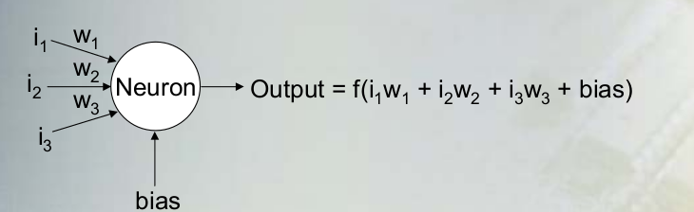
How Do Neural Networks Work?
The output of a neuron is a function of the weighted sum of the inputs plus a bias.
The function of the entire neural network is simply the computation of the outputs of all the neurons.
An entirely deterministic calculation

Slide 8
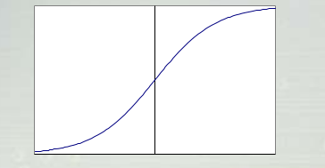
Activation Functions
Applied to the weighted sum of the inputs of a neuron to produce the output.
Majority of NN’s use sigmoid functions.
Smooth, continuous, and monotonically increasing
(derivative is always positive).
Bounded range - but never reaches max or min
Consider “ON” to be slightly less than the max and “OFF” to be slightly greater than the min

Slide 9
Activation functions
The most common sigmoid function used is the logistic function.
f(x) = 1/(1 + e -x )
Other sigmoid functions also used
►hyperbolic tangent
►arctangent
The exact nature of the function has little effect on the abilities of the neural network

Slide 10
Where Do The Weights Come From?
The weights in a neural network are the most important factor in determining its function.
Training is the act of presenting the network with some sample data and modifying the weights to better approximate the desired function
There are two main types of training
Supervised Training
Supplies the neural network with inputs and the desired outputs
Response of the network to the inputs is measured
The weights are modified to reduce the difference between the actual and desired outputs

Slide 11
Unsupervised Training
Only supplies inputs
The neural network adjusts its own weights so that similar inputs cause similar outputs
The network identifies the patterns and differences in the
inputs without any external assistance

Slide 12
Perceptrons
First neural network with the ability to learn
Made up of only input neurons and output neurons
Input neurons typically have two states: ON and OFF
Output neurons use a simple threshold activation function
In basic form, can only solve linear problems
Limited applications

Slide 13
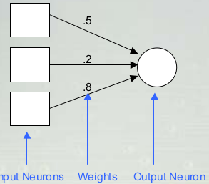

Slide 14
How Do Perceptrons Learn?
Uses supervised training
If the output is not correct, the weights are adjusted according to the formula:
w new = w old + α(desired – output)*input , α is the learning rate

Slide 15
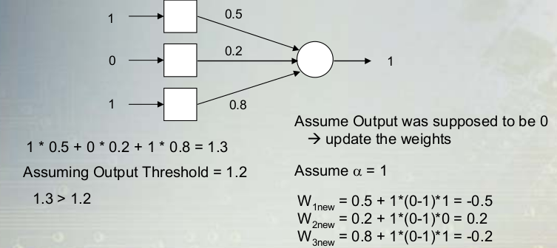
1 * 0.5 + 0 * 0.2 + 1 * 0.8 = 1.3 , Assume Output was supposed to be 0 update the weights
Assuming Output Threshold = 1.2 ,Assume α = 1,1.3 > 1.2
W 1new = 0.5 + 1*(0-1)*1 = -0.5
W 2new = 0.2 + 1*(0-1)*0 = 0.2
W 3new = 0.8 + 1*(0-1)*1 = -0.2

Slide 16
Types of Neural Networks
Feed forward neural network
This neural network is one of the simplest form of artificial neural network where data or input travels in one direction .The data passes through the input nodes and exit in the out put nodes. This neural network may or may not have hidden layers .
Application of Feed Forward
Computer vision
speech recognition

Slide 17
Recurrent Neural Network
Information flows in the cycle.
It allows bidirectional flow of data. Much more powerful than feed forward . They have directed cycles in their connection graph. What it means you can sometimes get back to where you started by following arrows. They are difficult to train because of their complicated dynamic in what they do. They are more biologically realistic. They have the ability to remember information in their hidden state for along time but hard to train them. It has the capability of using its internal memory to process arbitrary sequence of inputs. Example while typing the prediction of the next word.

Slide 18
Application
Its applied in text to speech conversion and prediction of the next text

Slide 19
Radio basis function neural network
It is similar to KNN model. Each neuron in Radio Basis Function neural network stores an example from the training set a prototype.
Application
Power restoration systems

Slide 20
Kohonen self organization
It is known for performing functions on unlabeled data to describe hidden structures in it.
Application
Used in recognition of patterns in the data , its application can be found in the medical analysis to cluster different categories.

Slide 21
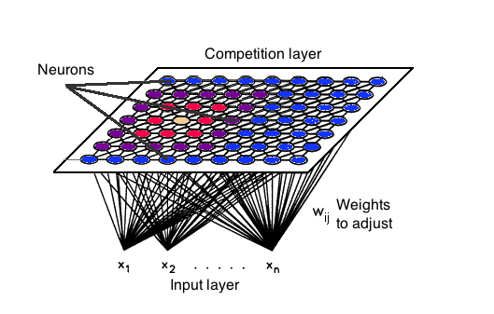

Slide 22
Convolution neural network
Similar to feed forward neural network , where neurons have learn-able weights and biases .Its application has been found in signal and image processing which takes one opencv in the field of computer vision

Slide 23
Modular neural network
It comprises of a series of independent neural network that are moderated by an intermediary. Each of these independent neural network works with separate inputs, accomplishing sub-tasks that make up the network as whole hopes to perform. The intermediary accepts the inputs of each of these individual neural networks, processes them and creates the final output for the modular NN. The independent neural network do not interact with each other.

Slide 24
Properties and capabilities of neural networks
Input – out put mapping – construct input-out put mapping for the problem at hand .
Adaptivity – Neural

