Slide 1
How to use a complete JavaScript tool chain in your Shiny development
David Hall
R/Pharma 2022

Slide 2
Modes of Participation
Passive
Watch for now
Work through exercises later
All materials available on GitHub
Active
Try to work through exercises now

Slide 3
Technical requirements for active participatoin
PC, laptop, or VM (not RStudio Server)
Windows, Mac, Linux should all work
RStudio
Node.js
VS Code
Git

Slide 4
Possible technical issues
If you are behind a corporate firewall, you may need to configure Node.js to utilize your proxy server. Here is a helpful article:
https://medium.com/@ogbemudiatimothy/using-npm-install-behind-a-corporate-proxy-server-db150c128899

Slide 5
Workshop setup
1. Open a terminal and ‘cd’ to a working directory:
cd <WORKING_DIR>
2. Clone workshop repo:
git clone https://github.com/rdavidhall3/r-pharma-js-toolchain-2022.git
3. Pull down JavaScript packages:
cd r-pharma-js-toolchain-2022
yarn install
cd srcreact
yarn install
Note: If you do not have yarn, you can use the npm command.
E.g., npm install

Slide 6
Instructor Bio: David Hall
Director Data Science, Novartis
Visual analytic apps and APIs (R/Shiny, JavaScript, Java, Python)
General data science
Previous companies
Rho (CRO)
Syngenta (Agricultural biotechnology)
Peopleclick (Software)
RTI International (CRO)

Slide 7
Workshop goals
1. Learn how to set up a proper JavaScript toolchain that is well-integrated with your R toolchain
2. Learn how to develop JavaScript inputs and outputs with this toolchain
3. Provide example code and jumping-off points for your continued technical learning

Slide 8
Disclaimers
There are many tools, packages, frameworks, etc.
The landscape changes continually and rapidly
I am presenting a reasonable set of popular tools that work well together
I make no claim that these are the best individual components for the job
You may be aware of better tools, and I encourage you to share your knowledge
I will try to provide individual help if needed, but need to balance this with completing the material in the allotted time

Slide 9
R/Shiny Value Proposition
Data scientists can create apps w/o having to become expert web devs
Rapid development of analytics apps
Convenient way for app to tap into power of R

Slide 10
R UI functions generate code the browser can understand
HTML
CSS
JavaScript
Images
R UI Code

Slide 11
Browser languages
HTML: Content
CSS: Layout and styling
JavaScript: Interactivity
(When we talk about client-side JavaScript development, we mean all of the above)

Slide 12
R functions can generate only a fraction of possible user experiences (UX)
HTML/CSS/JavaScript UI
R UI

Slide 13
What can JavaScript add to Shiny?
Greater range UI/UX designs
Greater levels of interactivity
Better performance for certain operations
Some “business logic” can be moved to client, reducing server round trips
Tap into the enormous collection of JavaScript packages

Slide 14
Augmenting R/Shiny with JavaScript
Option 1: Add CSS & JavaScript inline with R code
Option 2: Add CSS and JavaScript files (e.g., in /inst directory)
Option 3: Use a modular component framework
E.g., {htmlwidgets}
E.g., {reactR}
Option 4: JavaScript UI with a {plumbr} backend

Slide 15
JavaScript development: R Studio
Edit JS code
Restart R session
Restart app
Navigate to feature
Examine feature
Open browser JS tools
Inspect JS state

Slide 16
With JavaScript tool chain
Edit JS code
Restart R session
Restart app
Navigate to feature
Examine feature
Open browser JS tools
Inspect JS state
X
X
X
X

Slide 17
Tool chain comparison
Category | R | JavaScript
IDE | R Studio | VS Code
UI Framework | {shiny} | React
Package manager | {renv} | Yarn (npm also)
UI dev assistant |  | Storybook
Unit testing | {testthat} | Jest
Code bundler |  | Webpack
Package repository | CRAN | npm

Slide 18
JavaScript idioms used in workshop
Variable declaration
const x = 3
let y = ‘foo’
var x = 3
var y = ‘foo’
Don’t use var!
Arrow functions
function y(m, x, b) {
return m * x + b
}
const y = (m, x, b) => m * x + b
~same as...
Functional programming
const a = [3, 5, 9, 7]
const a2 = a.map(val => val * val)
const sum = a.reduce((accumulated, currentVal) => {
return accumulated + currentVal
})
a.forEach(val => console.log(val))
Used extensively in R
Apply
{purrr}
Etc.

Slide 19
React function-based components
const Hello = () => {
return <h1>Hello world!</h1>
}
class Hello extends React.Component {
render() {
return <h1>Hello world!</h1>
}
}
Nothing wrong with this! Good option for more complex components.

Slide 20
Exercises
reactR custom input
reactR/HTMLWidget custom output

Slide 21
How to do exercises
Option 1: Write/paste code
Option 2: Checkout branch
Step 1
Snippet 1
git checkout step_1
Step 2
Snippet 2
git checkout step_2
Step 3
Snippet 3
git checkout step_3
Step N
Snippet 4
git checkout step_n

Slide 22
General R/JS Workflow
Requirements
Mockups & Design
R component stub
JavaScript components
Finish R component

Slide 23
Exercise 1: “Super Select” Input
When there are a large number of options, selectors like selectInput() can lead to tedious scrolling
As a user, I would like
To able to select one or more lab params (tests) from a large list
All params are on the screen with no scrolling
Params to be grouped by panel
Panels to be arranged in columns
To be able to de/select individual params or entire panels
To be able to un/hide selector by clicking button

Slide 24
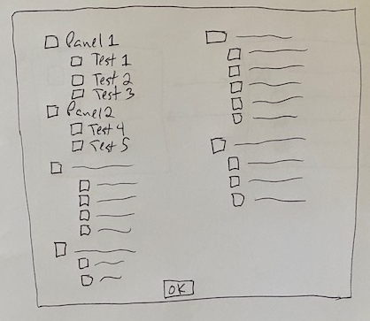
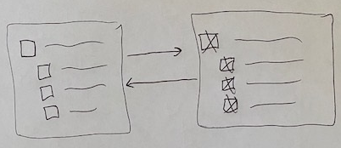
Mockups

Slide 25
React Components
Component 1: CheckBoxGroup
Layout/behavior of single panel
Component 2: CheckBoxGroups
Layout of multiple panels into columns
Component 3: SuperSelect
Modal dialog

Slide 26
Component nesting
SuperSelect
CheckBoxGroups
...
CheckBoxGroup
CheckBoxGroup
CheckBoxGroup

Slide 27
Exercise 1 Instructions
https://github.com/rdavidhall3/r-pharma-js-toolchain-2022/blob/main/workshop/exercise_1/exercise_1.md

Slide 28
Exercise 2: “Multi-Lab Viewer” Output
As a user, I would like
To be able to view one or more selected lab datasets longitudinally
Charts to take up as much of the screen as possible
Charts to be displayed on one screen with no scrolling
Charts to be interactive with hover text
Charts also display normal high and low range values

Slide 29
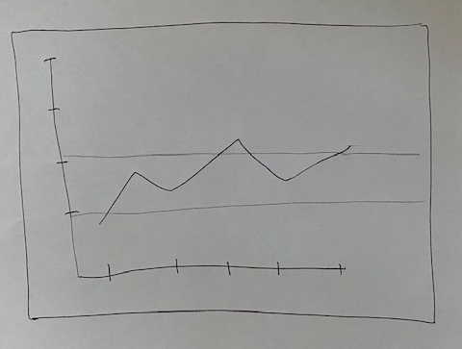
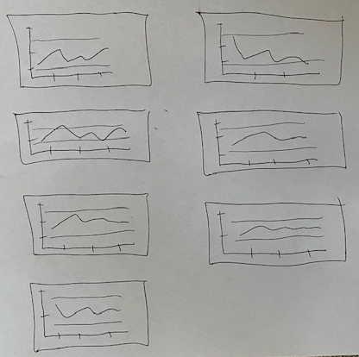
Mockups
One Param Selected
Many Params Selected

Slide 30
React component design
LabChart
MultiLabChart

Slide 31
Sending R data frames to JavaScript
foobar <- data.frame(
foo = c(...),
bar =c (...),
oof = c(...),
rab = c(...)
)
JavaScript object of arrays
foobar = {
foo: [...],
bar: [...],
oof: [...],
rab: [...]
}
foo
bar
oof
rab
(Will “transpose” to array of objects for easier manipulation)

Slide 32
Exercise 2 Instructions
https://github.com/rdavidhall3/r-pharma-js-toolchain-2022/blob/main/workshop/exercise_2/exercise_2.md

Slide 33
Recap
Category | Tool | Benefit
IDE | VS Code | Fit-for-purpose
UI Framework | React | Modularization of code HTML templating (JSX) Huge range of packages
Package manager | Yarn
UI dev assistant | Storybook | Rapid iteration Testing of individual components
Unit testing | Jest
Code bundler | Webpack
Package repository | npm

Slide 34


Thanks!!!
https://github.com/rdavidhall3/r-pharma-js-toolchain-2022
www.linkedin.com/in/rdavidhall3

