Slide 1

Predicting March Madness Through Simulation
By: Ruslan Adamovics-Davtian

Slide 2
Agenda
Project Objectives
Data Collection
Analysis Approach, Methods, and Simulation
Project Results

Slide 3
Project Objectives
Build a model to use in simulating march madness tournament brackets
Compete in Kaggle’s 2018 March Madness Tournament Challenge sponsored by Google Cloud

Slide 4
Data Collection
Google Cloud’s collected data used for Kaggle Competition
Offensive, Defensive Regular Season and Conference Tournament Games Data
Past March Madness Tournament Data (Region, Seed, Round)
Head Coaching Data
Web scraped Ken Pomeroy ranking data
Provides metrics such as offensive and defensive efficiency, tempo, and pace for each Division 1 team
Geography data
Longitude, Latitude, and Elevation of each game

Slide 5
Data Description
Regular season data since 1985
March Madness Tournament data since 2003
Each observation is a game or match-up (Team1 Variables, Team2 Variables)
Response variable is whether or not Team1 won
Final data set includes all march madness games from 2003-2017

Slide 6
Analysis Approach
Used data science approach
Maximize prediction accuracy
Not interested in making inference
Bracket Simulation
Use “best” model to simulate the tournament 10000 times, advancing winners of each matchup to the next round.
Kaggle Competition
Find “best” model to output predicted win probabilities of every possible pairwise matchup in the 2018 tournament.

Slide 7
Analysis Method
Aggregate and merge data sets
Regular season team averages, standard deviations, and differences
Strength of Schedule adjustments
Rank coaches based off number of appearances at each round
Team travel distances
Classification Problem
Logistic Regression
Minimize misclassification rate
Minimize Log loss error function

Slide 8
Analysis Method Cont.
Training/Testing
Train model using data from 2003-2013, 2003-2014, 2003-2015, 2003-2016
Test model using data from 2014-2017, 2015-2017, 2016-2017, 2017
Choose model that produced lowest log loss
Variable Selection Method
Lasso Regression
Penalizes unimportant variables in predicting game outcomes
Forces estimated coefficients of unimportant variables to zero
Choose lambda at which MSE is minimized

Slide 9
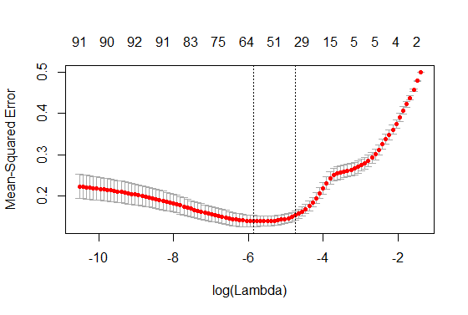
Model Output
MSE vs Lambda Lasso Plot
Most Positive Coefs. | Most Negative Coefs.
Team1_AVG_Numot | Team2_schedule_OppO
Team1_AVG_fga3 | Team1_Conf_Tourn_GP
Team1_AVG_defreb | Team2_Conf_Tourn_GP
Team1_AVG_ast | Team1_Penalize
Team2_AVG_pfoul | Team2_Penalize

Slide 10
Kaggle Competition
Use final model to predict all possible combinations of matchups
68 Total Teams
2 Teams in a matchup
68 choose 2 = 2278 possible matchups
Over 900 teams competed
Rank teams based on mean log loss error

Slide 11
Bracket Simulation
Use data set of all 2278 possible games for each tournament year
Given first round, region, seeding…
Iterate through each matchup and predict probability that Team 1 wins
Generate one random number between 0 and 100
If probability falls within region of the generated number, Team 1 advances
Otherwise, Team 2 advances
Repeat until a champion is predicted
Repeat tournament simulation 10000 times
Calculate each team’s proportion of advancing through each round

Slide 12
Results

Slide 13
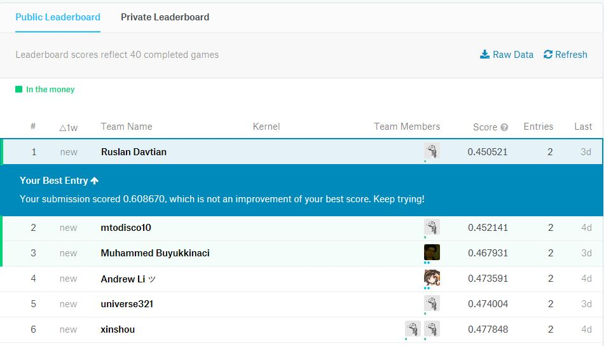

Slide 14
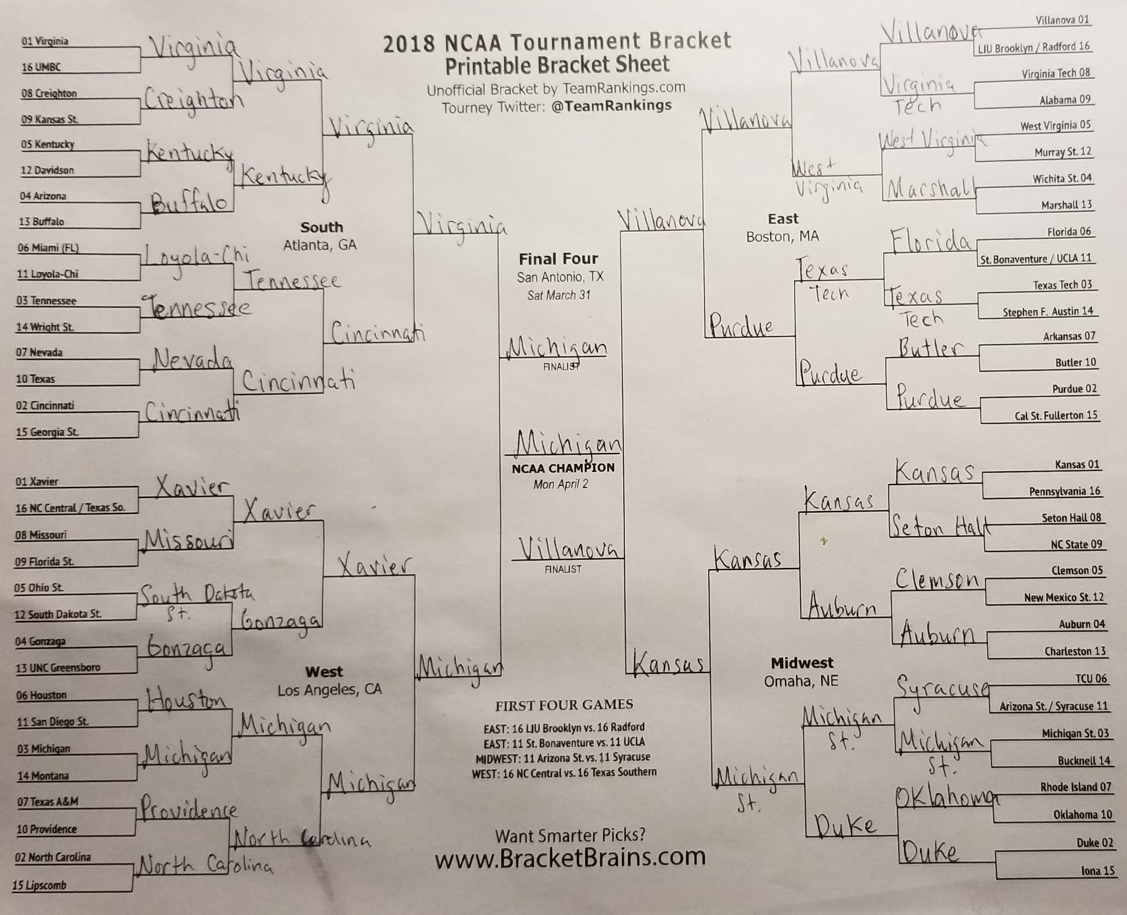

Slide 15
Future Works
Apply different techniques
Ranked data
Other variable selection methods
Other classification algorithms
Find more data
Keep making predictions every year

