Slide 1
Edge-AI Based Human and Animal Detection using ESP32-CAM
Presented By- Dhanush Babu Ravinuthala
Matriculate Nr. 1610103
Project Overview:
Traditional vision systems rely on powerful computers or cloud processing. This project demonstrates how object classification can run directly on a small microcontroller using Edge AI.
This project implements an Edge AI system using ESP32‑CAM to detect whether the captured image contains a human or an animal. The system uses a machine learning model trained with Edge Impulse and runs inference directly on the ESP32 device.

Slide 2
Objective
• Detect whether an image contains a human or an animal
• Run ML inference directly on ESP32‑CAM
• Train and deploy a lightweight ML model
• Demonstrate real‑time Edge AI capability

Slide 3
Dataset Collection
Two classes were used:
• Human
• Animal
Images were collected and uploaded to Edge Impulse for training.

Slide 4
Hardware Components
• ESP32‑CAM module
• ESP‑CAM‑MB programmer board
• USB cable
• Laptop for development
• WiFi connection (optional)

Slide 5
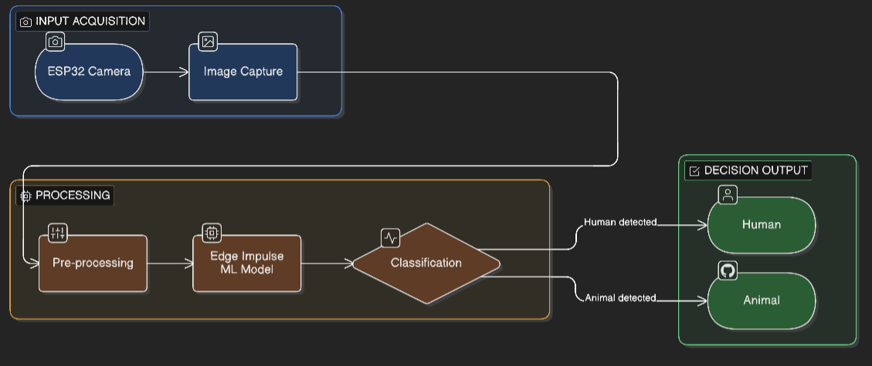
System Architecture
ESP32 Camera → Image Capture → Pre‑processing → Edge Impulse ML Model → Classification → Output (Human / Animal)

Slide 6
Software Tools Used
• Arduino IDE
• Edge Impulse Web Studio
• ESP32 Arduino Core
• Edge Impulse Inference SDK

Slide 7
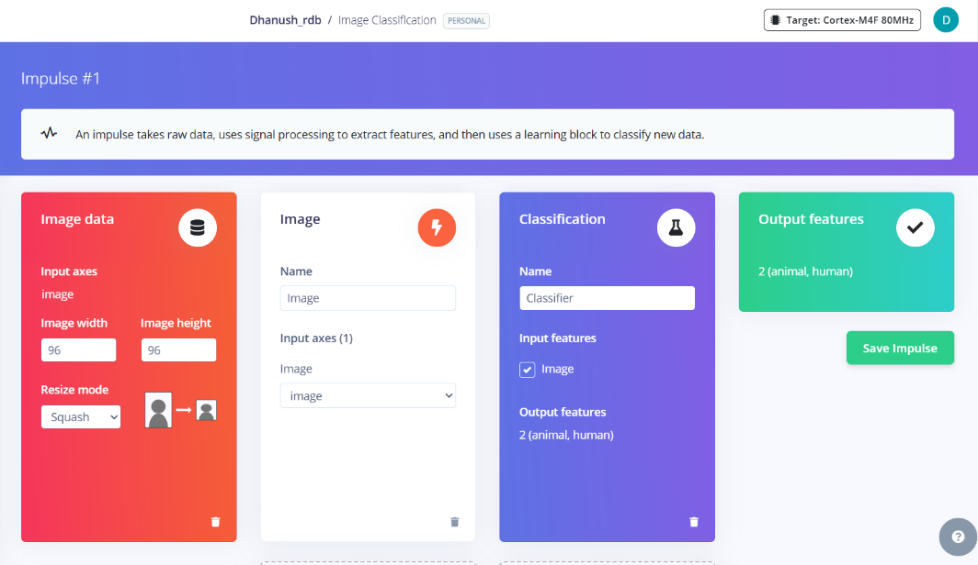
Impulse Design
Impulse blocks used:
• Image Input
• Image Processing
• Classification Neural Network
Resize mode: Squash
Image size used: 96 × 96 pixels

Slide 8
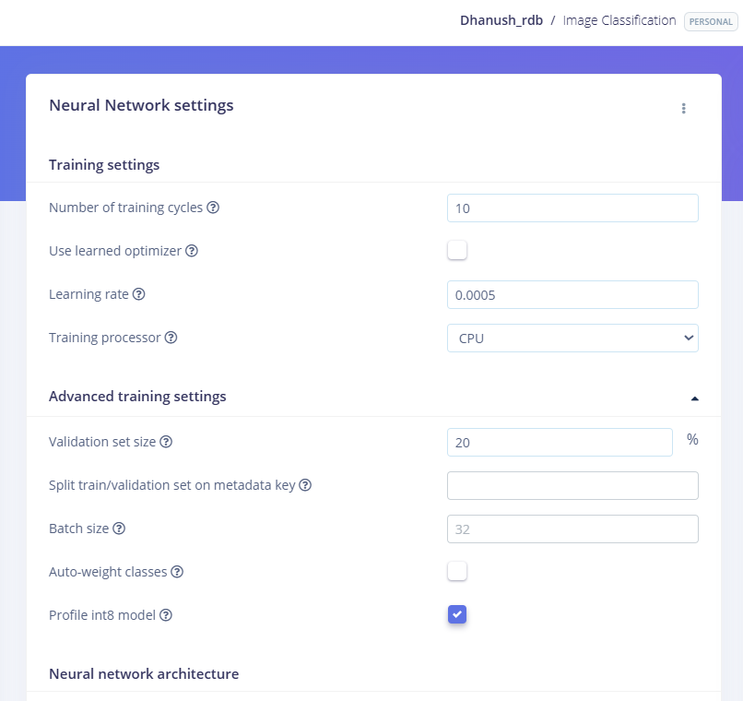
Model Training
The dataset was used to train a lightweight neural network model inside Edge Impulse. Training includes feature extraction and classification model optimization.

Slide 9
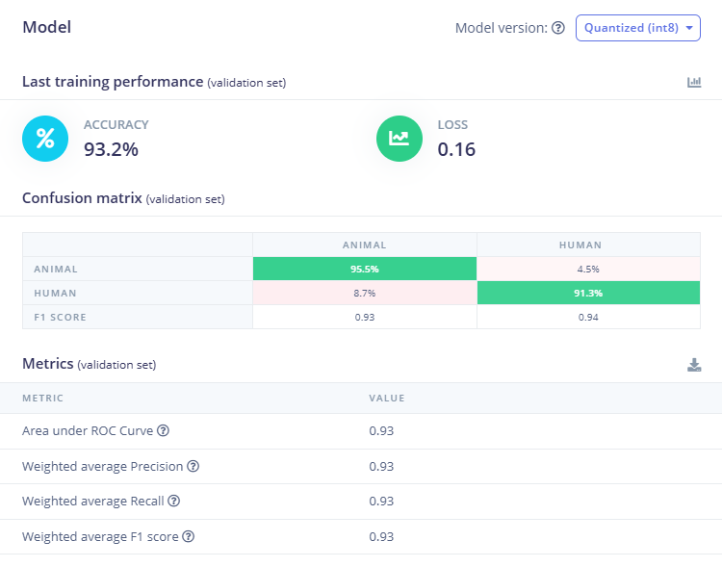
Model Deployment
The trained model was exported as an Arduino library and integrated into the ESP32‑CAM project.
Accuracy:
93.2 %
Additional metrics:
Weighted Precision ≈ 0.93
Weighted Recall ≈ 0.93
Weighted F1 Score ≈ 0.93

Slide 10
Implementation on ESP32
Steps:
1. Install Edge Impulse Arduino library
2. Upload inference code
3. Capture image using ESP32‑CAM
4. Run classification locally

Slide 11
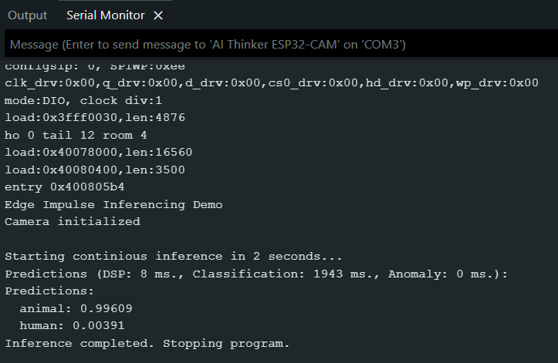
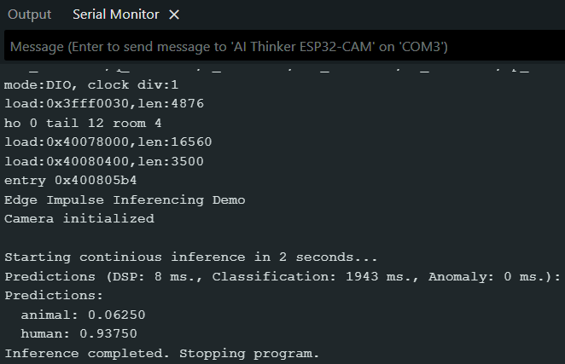
Prediction Output
The system outputs probabilities for each class:
Results are printed in the Serial Monitor.

Slide 12
Applications
• Smart security cameras
• Wildlife monitoring
• Smart farms
• Animal detection systems
• Edge AI research projects

Slide 13
Conclusion
This project demonstrates the power of Edge AI by running machine learning directly on an ESP32‑CAM device. The system can detect humans or animals efficiently without cloud processing.

Slide 14
Future Improvements
• Add real‑time camera streaming
• Improve model accuracy with larger datasets
• Add bounding box detection
• Integrate alert systems (LED / notification)

