Slide 1
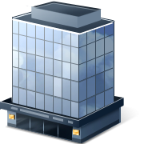
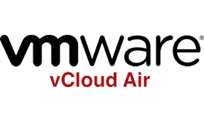



Developer Devops Demo (Open Source) Enables a developer to deploy and provision a vm to vCloud Air using a Enterprise Standard vm template and cookbooks
Synchronized Catalog of VM Images
Create
1
2
3
4
5
VDC
API
Cookbooks
Config Network
Provision
Deploy
EDGE GATEWAY
VM
Application
Code
Test
VCA-CLI Creates new VM from Corp Catalog
VCA-CLI Configures GW Access
Provision VM with Chef Knife Solo
Deploy App
Test

Slide 2






Devops Continuous Integration Demo (Open Source)
2
VDC API
1
3
EDGE GATEWAY
4
Spring Web App
5
Synchronized Catalog of VM Images
Ubuntu vApp
Developer Checks code into GitHub
GitHub Notifies Jenkins and Jenkins Checks out code
Gradle Builds product
Jenkins saves binary to artifactory
Jenkins uses chef client to create VM and boostrap the vm from chef server

