Slide 1


Slide 2
Continuous Integration with Jenkins on vCloud Air

Slide 3
What Is it?
A demo of open source DevOps tools running on vCloud Air
An Asset for the SE community to support customer discussions regarding DevOps.
The samples can be shared with customers.
How does it work?
The demo is hosted as the web site
It contains running servers for Jenkins, Chef, Selenium and Artifactory.
Each scenario describes a Continuous Integration workflow or a partial step of a workflow.
Each scenario can be run live through the Jenkins console.

Slide 4
Scenarios
Current Scenarios
Create an Ubuntu Server on vCloud Air using the Chef vCloud Air Knife plugin.
Create a Photon Server on vCloud Air using vCloud Air CLI
Deploy a Docker container on a Photon Server
Use chef to configure a Server as a standard Web Server
Continuous Integration of a Spring Boot Project

Slide 5
Demo Details
Available at http://devops.vcloudair.io
Packaged as a vApp, currently deployed to a subscription VDC
Accessible to anyone, but login required to run demo scenarios.
Login available to all SE’s latest credentials stored in vault.
Up to date credentials are available in a document on Vault.
(this keeps the credentials out of the git repo and available to SE’s with SSO Authentication)
Currently a private repo on GitHub (for now).
User ‘vcadevops’ has GitHub and vCloud Air Accounts.

Slide 6
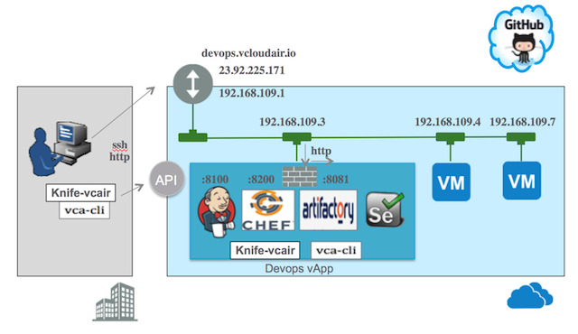
Demo Details

Slide 7
Next Steps
Add more scenarios
Add support for onDemand
Add a ‘last demo’ date time to the main page to warn of concurrent demos.
Expand Ansible and Artifactory scenarios.
Looking for SE volunteers to participate in making the demo even better.

Slide 8
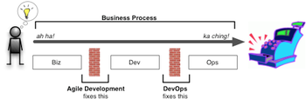
What is DevOps
Enabling Business Agility & IT Alignment
Frequent releases
Meet Business needs
Small Incremental changes
Keep Environments Stables
Reduce Risk, infrequent releases
Slow infrastructure provisioning
Formal handover
Continuous Delivery Pipeline
Develop
Build
Test
Stage
Release
Deploy
Manage
DevOps – Extending Agile principles beyond boundaries of code to the entire delivered service Essentially enabling infrastructure as code
Notes:
What is Devops?
Organization discipline - increases the co-operation and collaboration between Dev and Operations teams to improve the software development and delivery process
What is Continous Delivery
Continuous Delivery – Continuous Delivery is a software development discipline where you build software in such a way that the software can be released to production at any time.
“Martin Fowler Definition”
Implementing Continuous Delivery relies on a number of processes and capabilities
Continuous Integration
Configuration Management
Infrastructure Provisioning Automation

Slide 9
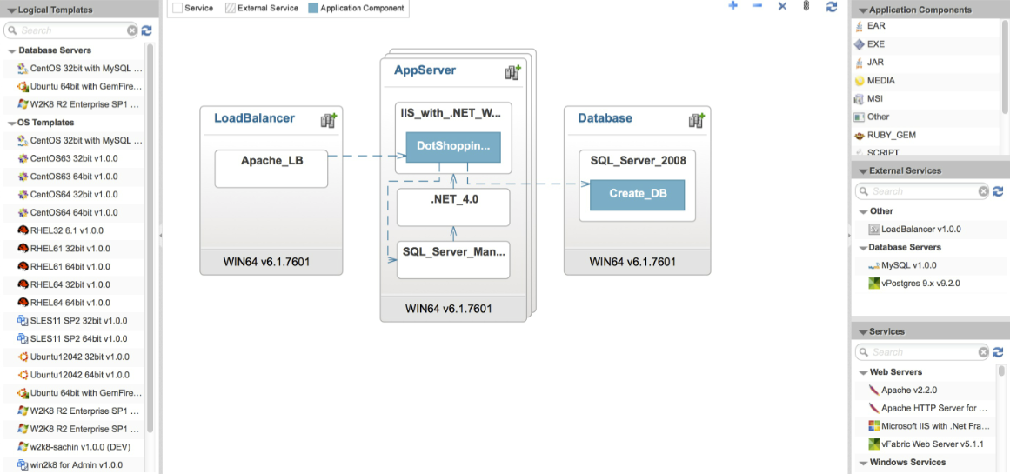


New Products - vRealize Code Stream
Extend the agility provided by
Continuous Integration into Continuous Delivery
CONTINUOUS DELIVERY
Release Pipeline
Development
Test
UAT
Production
Integrated Dev. Env.
Build & Integration
Package & Repository
Test Automation
Continuous
Integration
APP
APP
APP
APP
APP
APP
Notes:
Continuous Integration to keep software working
at all times
More frequent releases
Fewer bugs
Bugs caught earlier
Continuous Integration Requirements
Check in regularly, at least a couple of times a day
Create a comprehensive automated test suite
Keep the build and test process short
Manage your development workspace

Slide 10












Devops Continuous Integration Demo (Open Source)
VPN/Direct Connect
2
10
9
EDGE GATEWAY
3
1
Code replicated to cloud
4
5
7
Spring Boot Web App
11
8
6
CentOS Test VM
Ubuntu vApp
TODO: Add unit testing using spring and jenkins
Add catalog sync to to on-premise
Developer Checks in code
GitHub Notifies Jenkins
Jenkins Checks out code
Gradle Builds product and artifactory resolves dependencies
Jenkins saves binary to artifactory
Jenkins signals chef to create VM
Chef creates VM
Chef deploys App
Jenkins signals HipChat
Hipchat notifies developer build deploy complete
Developer tests code

Slide 11
Devops Continuous Integration Demo (Open Source)
VPN/Direct Connect
2
10
9
EDGE GATEWAY
3
1
Code replicated to cloud
4
5
7
Spring Boot Web App
11
8
6
CentOS Test VM
Ubuntu vApp
TODO: Add unit testing using spring and jenkins
Add catalog sync to to on-premise

Slide 12





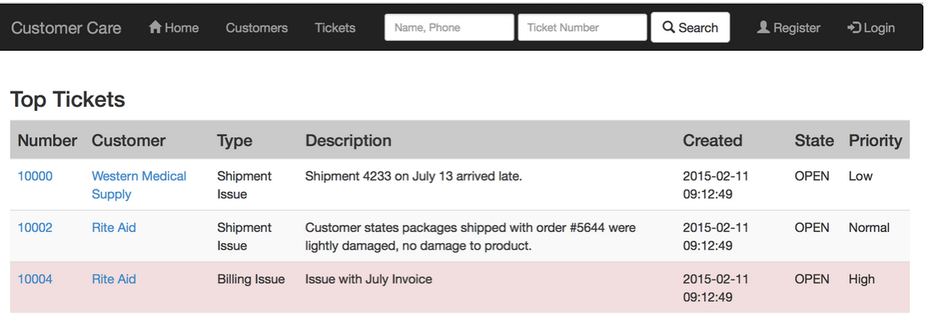
Continuous Integration Pivotal Cloud Foundry on vCloud Air
A web app deployed on PCF is managed with Continuous Integration
1) The Developer commits changes to GitHub
2) GitHub notifies Jenkins
3) Jenkins co-ordinates
- Code Checkout from GitHub
- Builds the new version of the app
- Deploys new and old versions side by side
- Unit Test new version
- If tests succeed, cutover to new app version
4) Developer has access to new version
2
1
3
mCare
4

Slide 13
2
EDGE GATEWAY
3
1
4
5
Spring Boot Web App
7
6
UbuntuTest VM
Ubuntu DevOps vApp

Slide 14


sb2
devops.vclair.us
2,3
1
8
4,5,6,7
API
Knife-vcair
Devops vApp

Slide 15
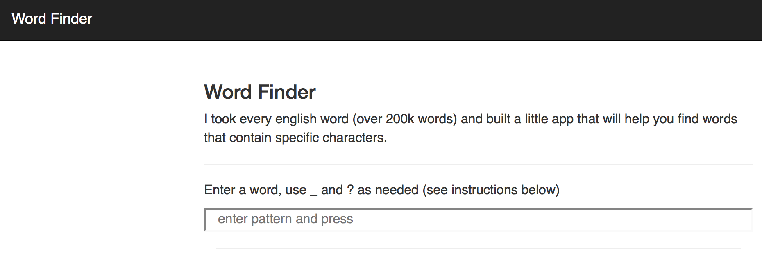
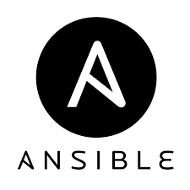
Jenkins on vCloud Air Continuous Integration Example
A developer commits code to the source code repository
GitHub notifies the Jenkins Server
DNAT 23.92.225.131 -> 192.168.109.101
Jenkins checks out latest application code
1
192.168.109.101
Jenkins calls the CLI to create a new VM from the cloud catalog. (if a test vm is not already present)
Ubuntu 1
Jenkins calls the CLI to configure internet access for the VM. (if needed)
Optionally replicate on premise templates
NodeJS
Jenkins calls Ansible to configure the new VM with App dependencies. (if needed)
Word-finder
Jenkins deploys the App to the test server.
Jenkins calls Selenium to perform web UI validation tests against the app. Jenkins sends an email if the tests fail
A new version of the application is available to all developers.

Slide 16
Devops Continuous Integration Demo (Open Source)
Environment_old
devops.vcloudair.io
23.92.225.171
192.168.109.1
192.168.109.3
192.168.109.4
192.168.109.7
ssh
http
http
API
:8100
:8200
:8081
Knife-vcair
Knife-vcair
Devops vApp
Portal

Slide 17



Devops Continuous Integration Demo (Open Source)
Environment OLD with GITLAB and PUPPET
SECURE GATEWAY
devops.vcair.us
23.92.225.171
192.168.109.1
192.168.109.3
192.168.109.2
192.168.109.4
http /ssh
ssh
http
API
s1pho
s2ubu
s3ubu_c
s4ubu_c
s5ubu_c
S6ubu_p
s7cor
s8ubu
Synchronized Binary Assets and VM Templates
Portal

Slide 18
Devops Continuous Integration Demo (Open Source)
Environment
SECURE GATEWAY
devops.vcair.us
107.189.120.86
192.168.109.1
192.168.109.2
192.168.109.3
http /ssh
ssh
http
API
s1pho
s2ubu
s3ubu_c
s4ubu_c
s5ubu_c
S6ubu_p
s7cor
s8ubu
Synchronized Binary Assets and VM Templates
Portal

Slide 19
Scenarios
Scenario | vApp | vm | Create/provision
Photon Server Create | vApp1 | s1pho | vca-cli / None
Docker Photon Deploy | vApp1 | s1pho | None / ssh
Chef config Web Server | vApp3 | s3ubu_c | Vca-cli / knife bootstrap
CI Java Spring Boot | vApp4 | s4ubu_c | Vca-cli / knife ssh
Chef Knife Plugin Prov | vApp5 | s5ubu_c | Chef-knife
CI NodeJs Word Search | vApp2 | s2ubu | Vca-cli / ansible
? |  |  | Vca-cli / Puppet

Slide 20
Devops Continuous Integration Demo (Open Source)
ck
devops.vcair.us
API
Knife-vcair
v
u
w

Slide 21
Devops Continuous Integration Demo (Open Source)
ck
devops.vcair.us
Knife-vcair

Slide 22


Devops Continuous Integration Demo (Open Source)
an
devops.vcair.us
y
xy
192.168.109.3
x
API
uvw
Portal

Slide 23
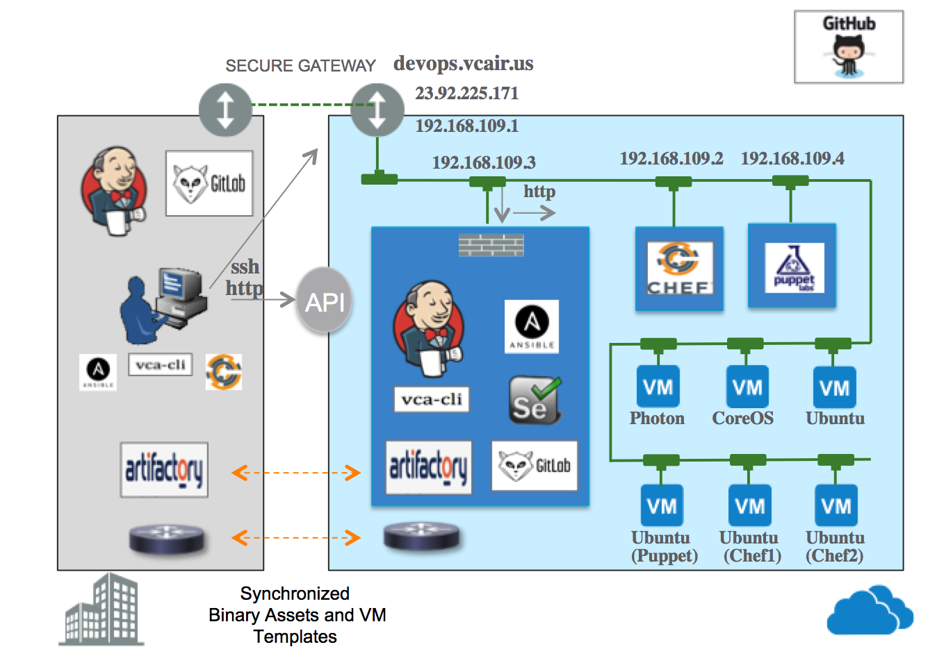
uvw

Slide 24

Devops Continuous Integration Demo (Open Source)
CL1, and docker_photon
devops.vcair.us
v
API
u
Portal

Slide 25
Devops Continuous Integration Demo (Open Source)
ck
devops.vcloudair.io
1,2
192.168.109.3
192.168.109.4
API
Knife-vcair
3
Devops vApp
Portal

Slide 26
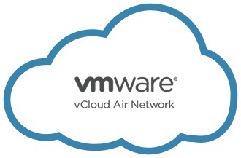
DevOps Demo

Slide 27
50.4.227.75
d2p3-ext
23.92.200.151
EDGE GATEWAY
192.168.109.1
M93300-4000- default-routed
192.168.109.3
My VDC
vCloud Air Data Center

Slide 28
Continuous Integration
DNAT 23.92.225.131 -> 192.168.109.101
A developer commits code to the source code repository
1
192.168.109.101
GitHub notifies Jenkins Server
Jenkins checks out latest application code
Ubuntu 1
Jenkins calls the CLI to create a new VM from the cloud catalog, if a test vm is not already present
NodeJS
The CLI configures internet access for the VM, if needed
Word-finder
Jenkins calls Ansible to configure the new VM with App dependencies, if needed
Jenkins deploys the App to the test server.
Jenkins calls Selenium to perform web UI validation tests against the app. Jenkins sends an email if the tests fail
A new version of the application is available to all developers.

Slide 29








Word finder
DNAT 23.92.225.131 -> 192.168.109.101
1
192.168.109.101
Ubuntu 1
Word-finder
Word-finder
NodeJS

Slide 30
u
Create Vapp / VM
VDC API
v
SSH into VM
192.168.109.3
192.168.109.7
192.168.109.2
EDGE
GATEWAY
ssh Proxy VM
23.92.225.177
Hairpin NAT
Connection Refused if not configured correctly
Chef Client Bootstraps to Chef Server
w

