Slide 1
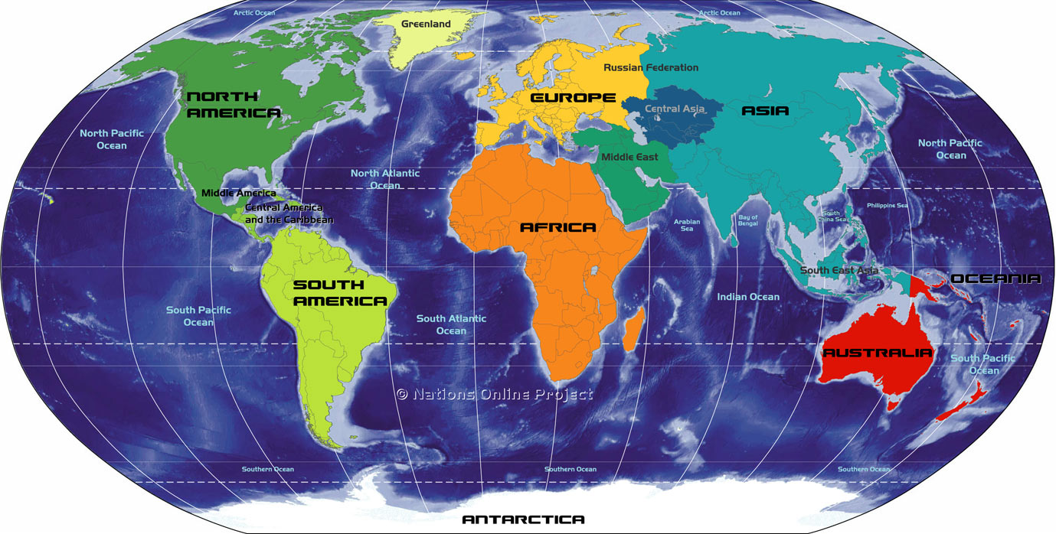
General Wealth Analysis by Country Across the World
Seattle OG
Shucheng Zhang
Weihua Pan
Yufei Sun
Rishabh Chawla

Slide 2
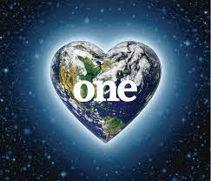
Introduction
The analysis of general wealth of countries around the world is a complex and multifaceted problem, requiring the integration of economic, social, and political factors.
Here we have designed a application which can analyze the annual economic situation of almost all countries in the world over the past 23 years. We hope that this can serve as a good tool and reference for analyzing future economic trends. Beyond the economic, this application also includes the data from the nature such as agriculture and fishery.
Using this data and analysis to adjust a country's policies on environmental governance is also a practical and effective approach. The combination of three types of analysis method can fulfill most of situations.
For example, we can generate a time series reference by using the trend analysis for the nature capital: Timber over Asia continent for recent 10 years. It will give us a clear look that which country developed.
Notes:
Intro:
The analysis of general wealth of countries around the world is a complex and multifaceted problem.
Economic, social, and political factors must be integrated to gain a complete understanding of a country's economic situation.
There is no single comprehensive measure of general wealth, but by using a combination of different indicators and metrics, we can gain a more complete picture.
Our team has created an R shiny app that analyzes the economic situation of almost all countries in the world over the past 23 years.
The app also takes into account environmental factors like agriculture and fishery, providing a more holistic view of a country's economic situation.
The use of technology and data analysis can help us make more informed decisions and policies based on accurate and relevant information.

Slide 3
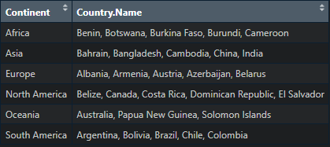
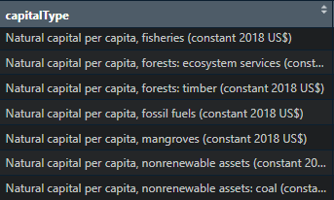
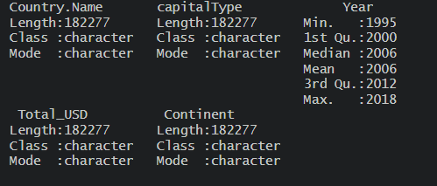
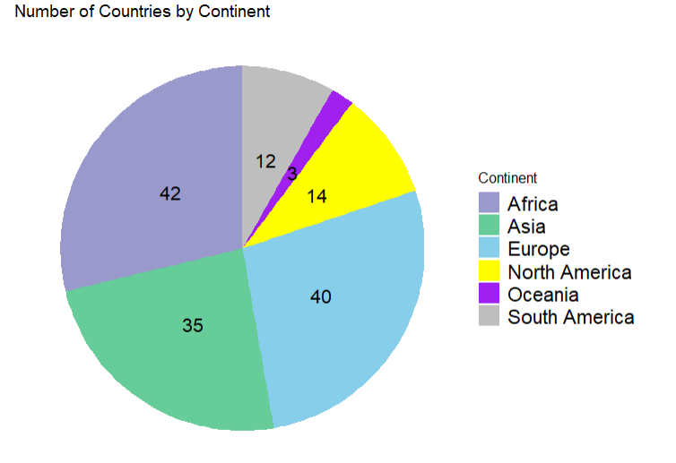
Dataset & EDA
This a public dataset named wealth account from the World Bank.
https://databank.worldbank.org/source/wealth-accounts#
The dataset consists 182277 rows and 5 columns after cleaning the missing value, unrecognized characters, and useless columns. There are 146 countries group by 6 continents, 17 capital types through year from 1995 to 2018.

Slide 4
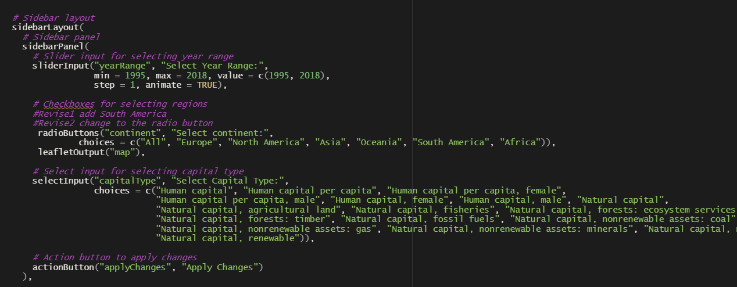
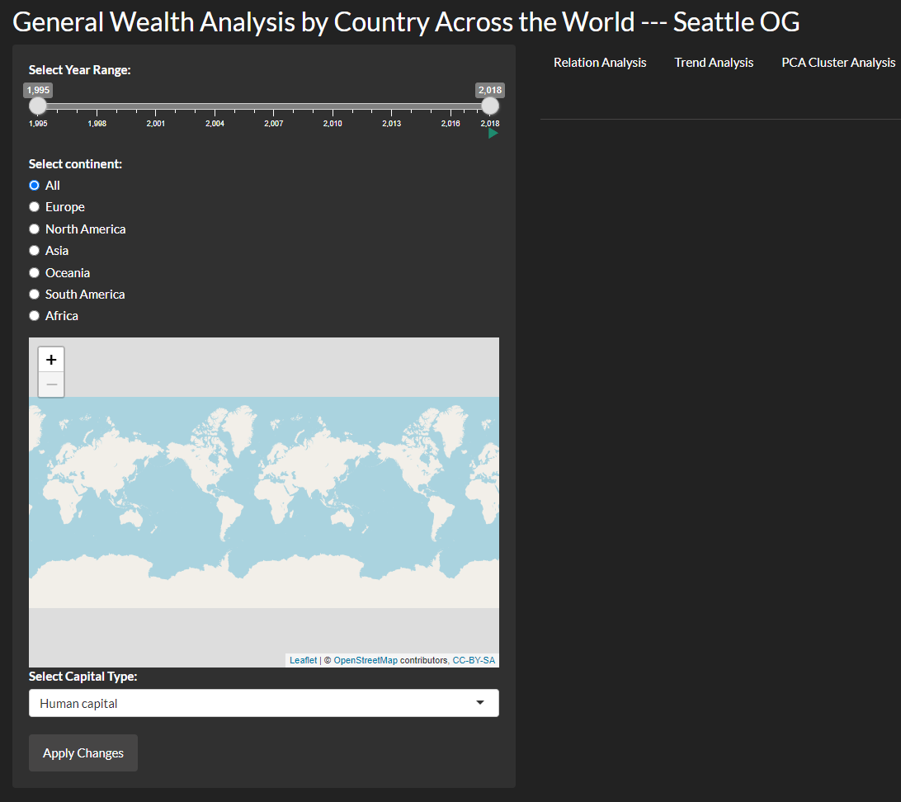
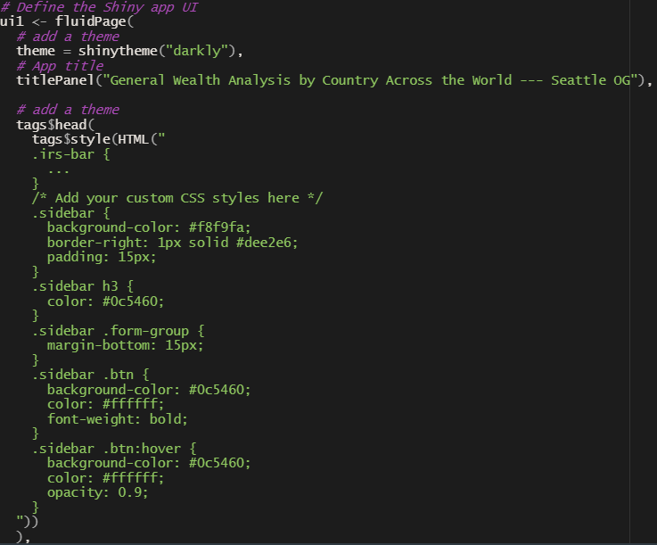
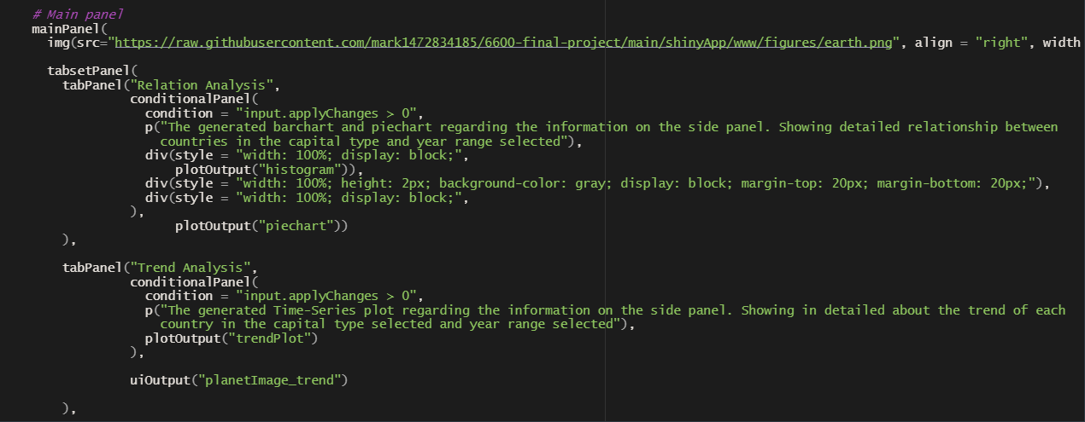
UI & Server

Slide 5
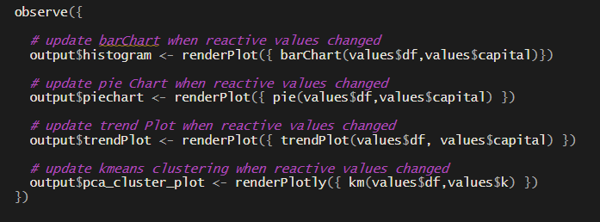
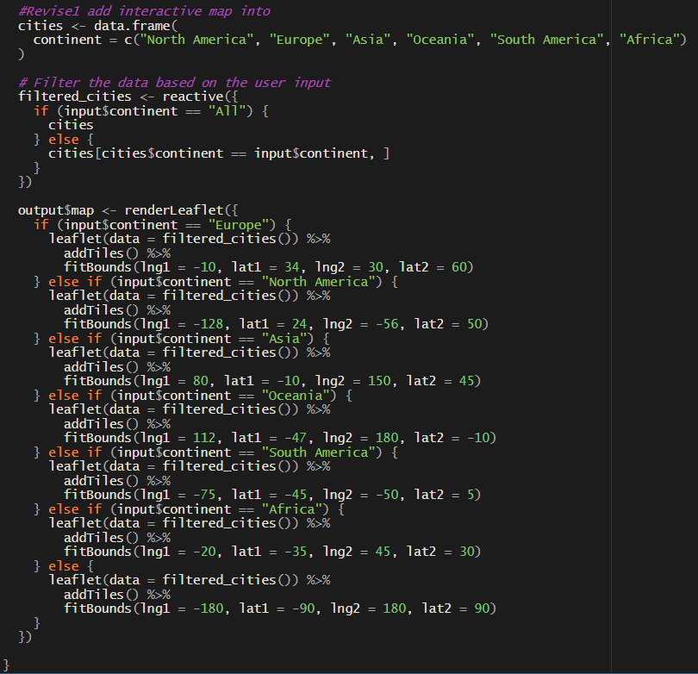
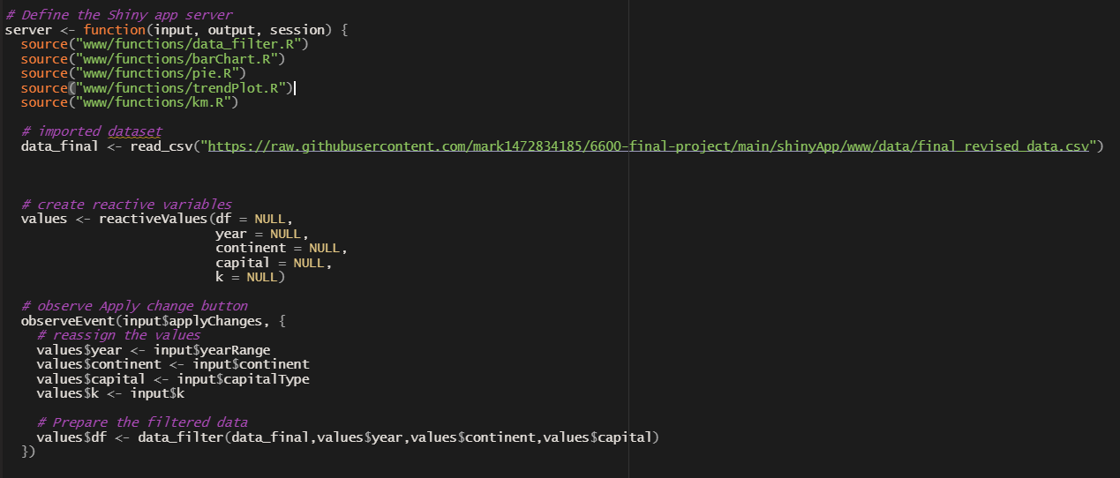
UI & Server

Slide 6
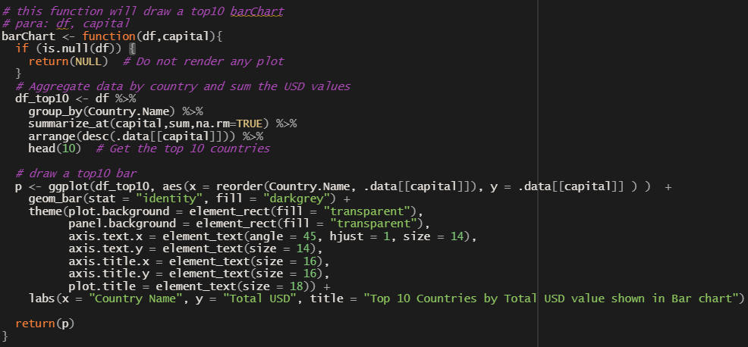
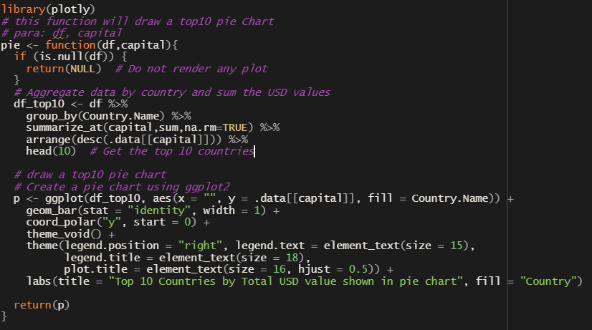
Algorithm & Function

Slide 7
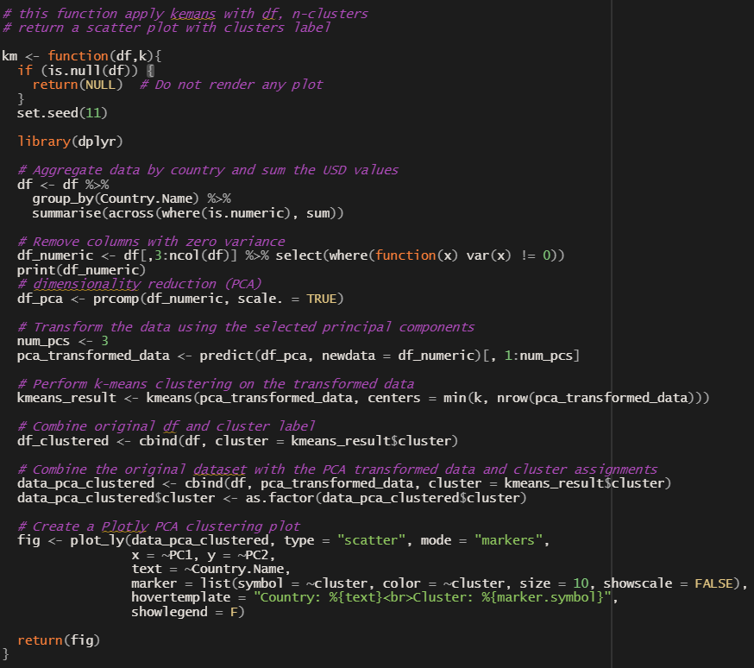
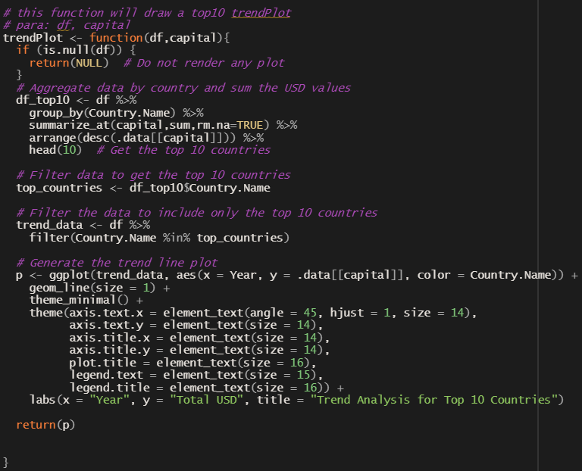
Algorithm & Function

Slide 8
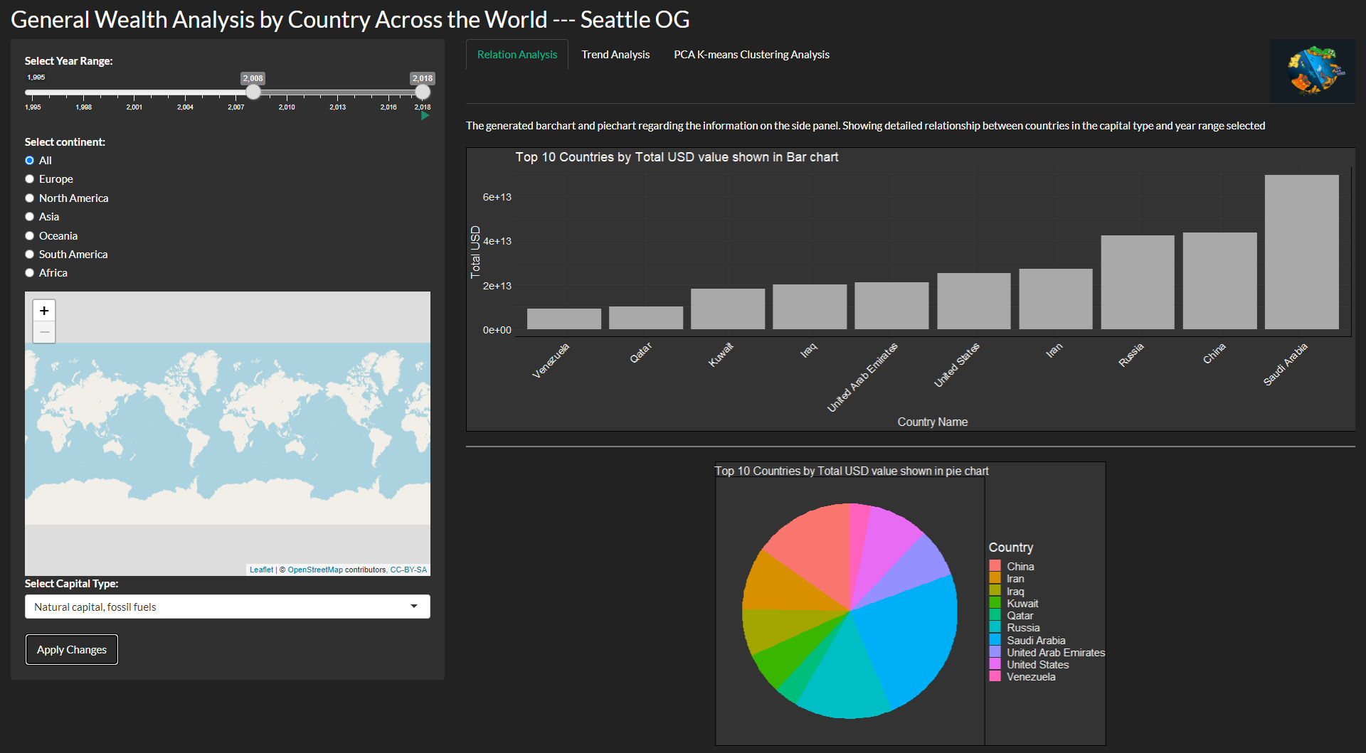
Result & Real World Examples

Slide 9
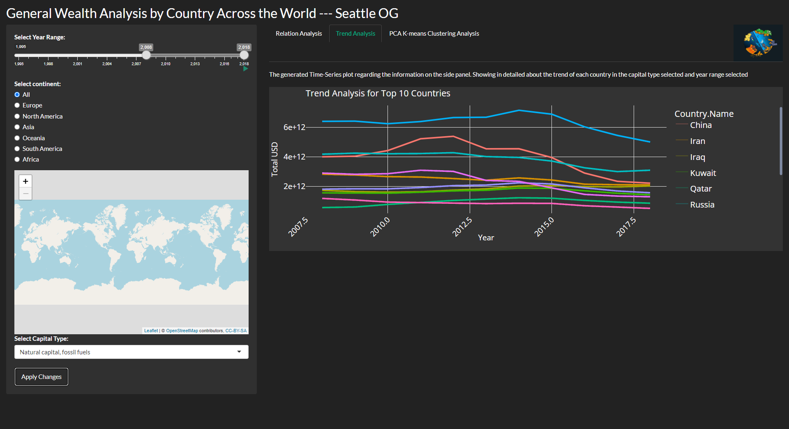
Result & Real World Examples

Slide 10
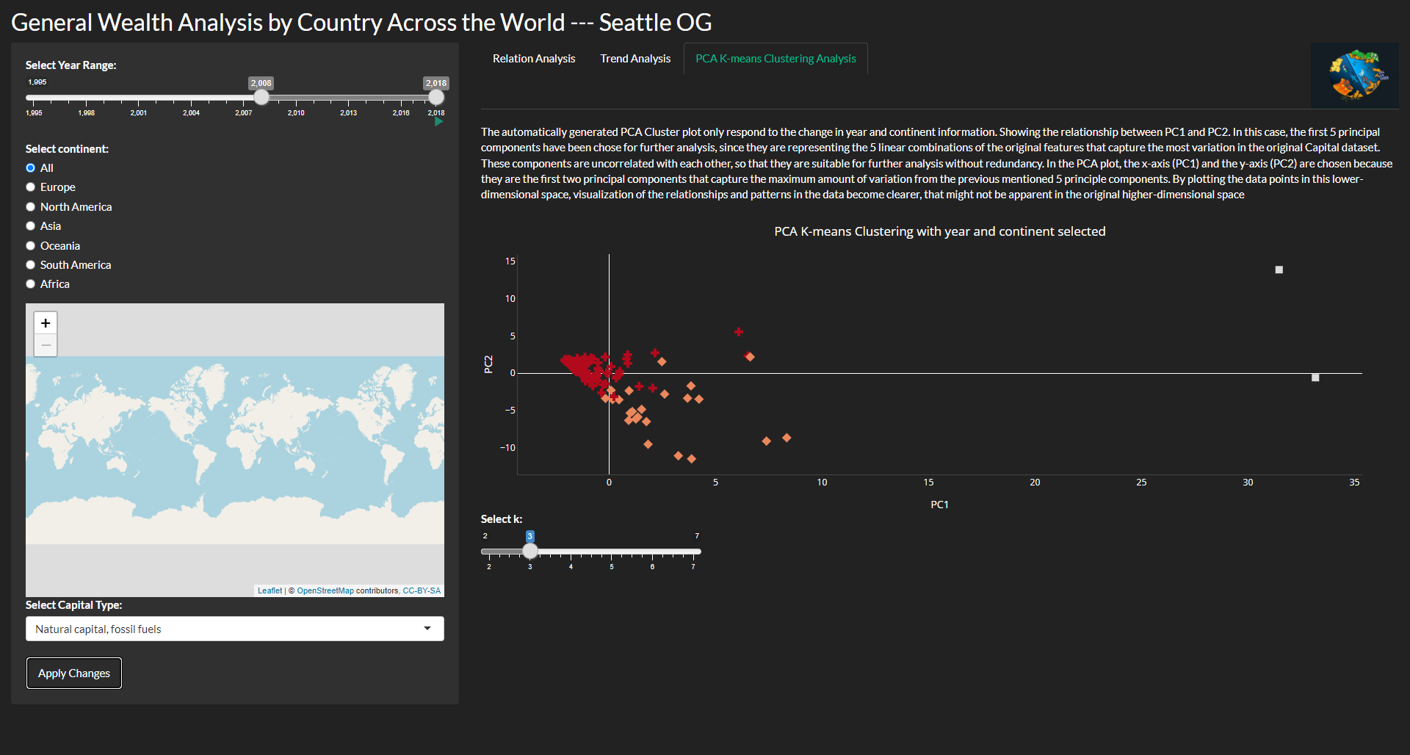
Result & Real World Examples

Slide 11

App Showcase

Slide 12
Discussion & Conclusion
General wealth analysis is a process of examining the existing economic climate, identifying its strengths and weakness, and discovering the opportunities for improvement.A country or region that aspires to move forward is necessary to review past data and compare its performance with other countries or regions.
The R shiny app provides a comprehensive analysis of the economic situation of almost all countries in the world over the past 23 years. The app also takes into account environmental factors like agriculture and fishery, which is an important aspect of economic analysis.
However, it's important to keep in mind that there are potential limitations to the data and analysis provided by our app. For example, the dataset may not capture all aspects of a country's economic situation, and there may be factors that are not easily quantifiable or measurable. Additionally, the use of technology and data can have potential negative consequences, such as privacy concerns or biases in the data.
By using technology to analyze and visualize data, we can gain a better understanding of the economic situation of countries around the world and make more informed decisions for a sustainable future.
Notes:
Discussion & Conclusion:
Our R shiny app provides a comprehensive analysis of the economic situation of almost all countries in the world over the past 23 years.
By using a combination of different indicators and metrics, we can gain a more complete picture of a country's economic situation.
The app also takes into account environmental factors like agriculture and fishery, providing a more holistic view of a country's economic situation.
However, there are potential limitations to the data and analysis provided by the app, and it's important to keep in mind that there may be factors that are not easily quantifiable or measurable.
Overall, our project highlights the importance of taking a holistic approach to economic analysis, considering both environmental and social factors alongside traditional economic indicators.
By using technology to analyze and visualize data, we can gain a better understanding of the economic situation of countries around the world and make more informed decisions for a sustainable future.

Slide 13
Contributions & Reference
https://databank.worldbank.org/home: Original data set and reports collected
https://chat.openai.com: Definitions of some terms, R functions info

