Slide 1

GameCo
2017 Marketing Budget Plan
Robert Cheadle

Slide 2
Contents
Overview
Context
Objective
Tools, Skills, Methodologies
Data
Process
Results and Recommendations

Slide 3


Overview
Perform a descriptive analysis of a video game data set to gain insights of how video games developed by GameCo, a fictional video game company, would fare in the market.

Slide 4
Context
Gameco would like a complete analysis that walks GameCo through a problem, including understanding the business problem, grouping and summarizing data, formulating hypotheses, using data to (dis)confirm those hypotheses, and visualizing and presenting the insights you’ve uncovered.
Objective
GameCo executives are open to hearing any insights gained from the data but are specifically interested in these questions:
● Are certain types of games more popular than others?
● What other publishers will likely be the main competitors in certain markets?
● Have any games decreased or increased in popularity over time?
● How have their sales figures varied between geographic regions over time?

Slide 5
Data
Tools, Skills, Methodologies
Excel
Grouping data
Summarizing
data Descriptive analysis
Visualizing results in Excel
Presenting results
Video Game Sales Data
It tracks the total number of units of games sold (not financial figures) from 1980 to 2016.
The numbers represent units sold in millions. When you see the number “1.2,” for instance, this represents a total of 1.2 million units sold.

Slide 6



Process
Understanding your Data Set
Cleaning Your Data
Grouping & Summarizing Your Data
Conducting a Descriptive Analysis
Developing Insights
Visualizing Insights
Produce a presentation that tells an analytical story.

Slide 7


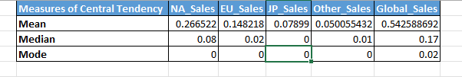
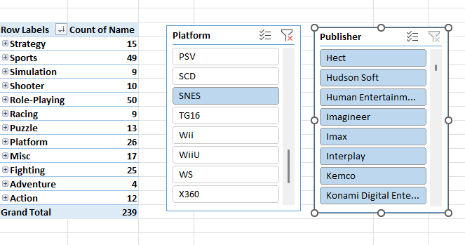

Understanding your Data Set
Grouping & Summarizing Your Data
Descriptive Stats for North American Sales
Pivot table with slicers to group and summarize data for analysis
Top 10 selling publishers in north America from 2012-2016.
Visualizing Insights

Slide 8

Results and Recommendations
Gameco Project Link

