Slide 1

Determining Staffing Needs in US States During Influenza Season
Robert Cheadle

Slide 2
Contents
Overview
Context
Objectives
Tools, Skills, Methodologies
Data
Process
Results and Recommendations

Slide 3
Overview
To help a medical staffing agency that provides temporary workers to clinics and hospitals on an as-needed basis. The analysis will help plan for influenza season, a time when additional staff are in high demand. The results will examine trends in influenza and how they can be used to proactively plan for staffing needs across the country.

Slide 4
Context
The United States has an influenza season where more people than usual suffer from the flu. Some people, particularly those in vulnerable populations, develop serious complications and end up in the hospital. Hospitals and clinics need additional staff to adequately treat these extra patients. The medical staffing agency provides this temporary staff.
Objective
Provide information to support a staffing plan, detailing what data can help inform the timing and spatial distribution of medical personnel throughout the United States.
● Determine whether influenza occurs seasonally or throughout the entire year. If seasonal, does it start and end at the same time (month) in every state?
● Prioritize states with large vulnerable populations. Consider categorizing each state as low, medium-, or high-need based on its vulnerable population count.
● Assess data limitations that may prevent you from conducting your desired analyses.

Slide 5
Data
Tools, Skills, Methodologies
Excel
Translating business requirements
Data cleaning
Data integration
Data transformation
Statistical hypothesis testing
Visual analysis Forecasting
Storytelling in Tableau
Presenting results to an audience
Influenza deaths by geography, time, age, and gender(CDC)
Population data by geography(US Census Bureau)

Slide 6
Process
Designing a Data Research Project
Data Profiling & Integrity
Data Quality Measures
Data Transformation & Integration
Conducting Statistical Analyses
Statistical Hypothesis Testing
Create Interim Report
Composition & Comparison Charts in Tableau
Temporal Visualizations & Forecasting in Tableau
Statistical Visualizations: Histograms & Box Plots in Tableau
Statistical Visualizations: Scatter Plots & Bubble Charts in Tableau
Spatial and Textual Analysis in Tableau
Publish your analysis as a Tableau Storyboard
Record a video presentation for your stakeholders.

Slide 7
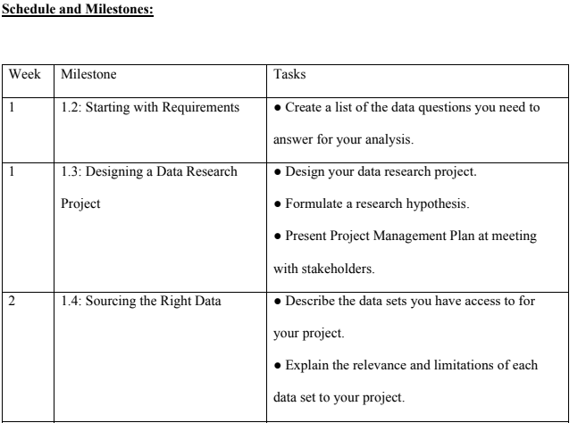
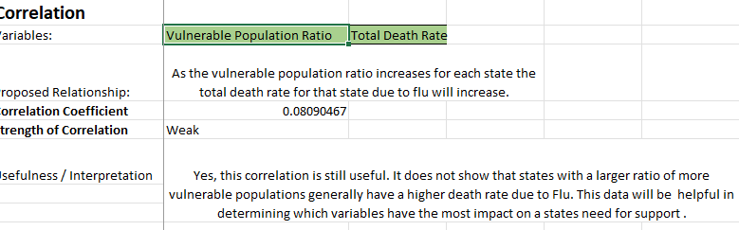
Designing a Data Research Project
Link to Project Management Plan
Statistical Hypothesis Testing
Link to Statistical Hypothesis Testing

Slide 8
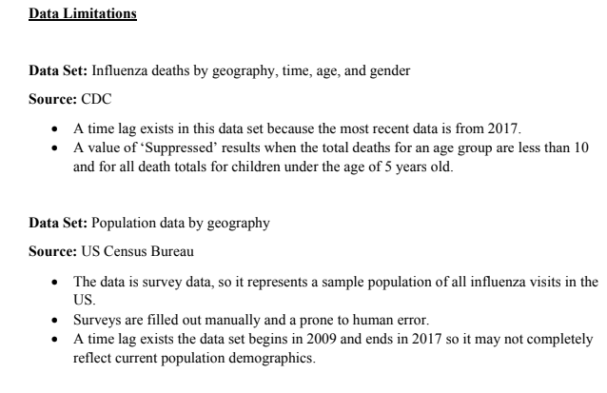
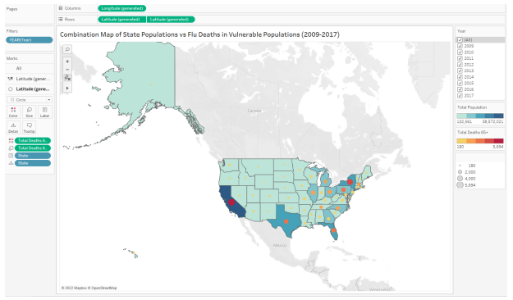
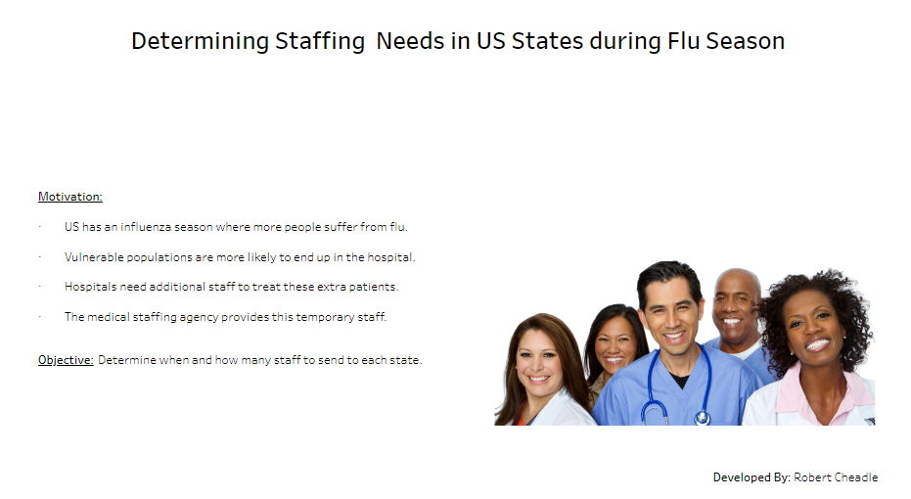
Create Interim Report
Link to Interim Report
Spatial and Textual Analysis in Tableau
Publish your analysis as a Tableau Storyboard
Spatial Analysis: Combination Map
Link to Project Storyboard (Tableau)

Slide 9
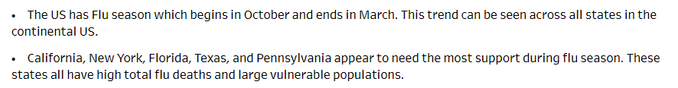
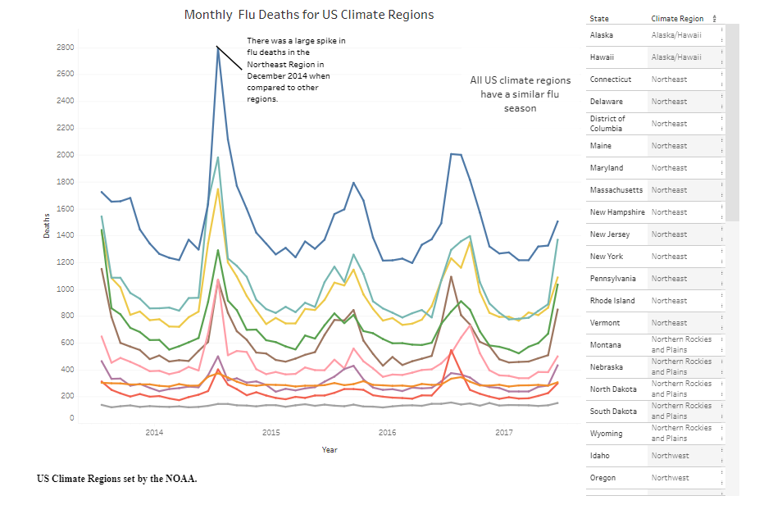
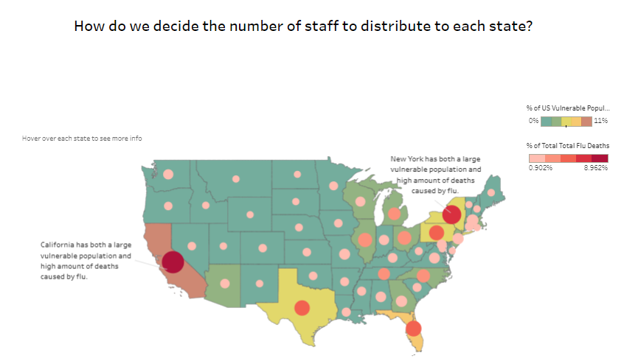
Results and Recommendations

