Slide 1

NSERC Application Summaries
Predicting Funding Levels
A Data Analytics Capstone Project
by Ryan Dearing

Slide 2

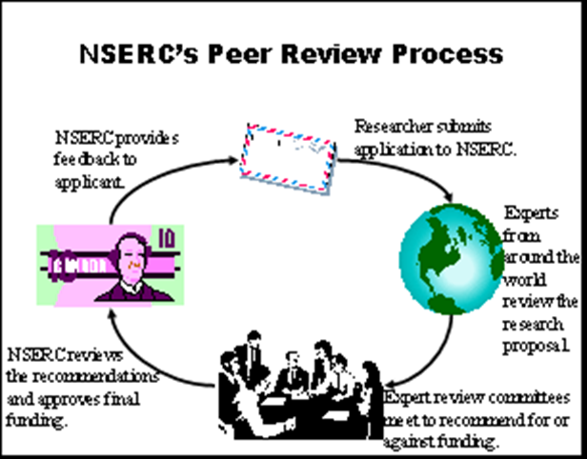
The NSERC Review Process
Submit an application
Includes a 1500 word summary
Reviewed by peers
Content = Funding
Amazing science happens!

Slide 3
Issues and Criticisms
The review process itself is too expensive
It does not produce quality research
It is biased towards a researcher’s reputation
Research Questions
Does the content of an NSERC funding application matter?
Does word usage in application summaries predict grant size?

Slide 4

The Data
Available on Open Data Canada in CSV format
Used data from the years 2005-2014
About 240,000 records with 36 attributes
Main attributes of interest
“ApplicationSummary” – text, 1500 word maximum
“AwardAmount” – integer, funding amount in CAD
Target data -> English application summaries

Slide 5
Approach
Step 1 – Load, Consolidate, and Explore the Data
Step 2 – Label each Record with a Classifier
Step 3 – Apply NLP Techniques
Step 4 – Build and Evaluate the Model(s)

Slide 6

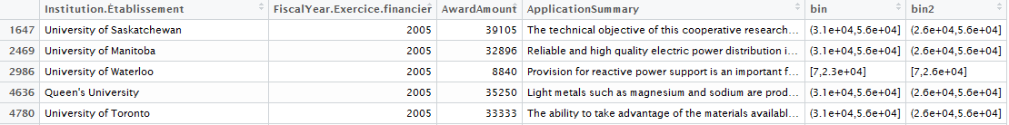
Step 1 and 2 – Load, Clean, and Classify
Bind the ten CSV files together
Filter our blank summaries and assign N/A values
Filter out French summaries. But how??? … ->
Find appropriate classification levels
Bin the data (S,M,L? just S,L?)

Slide 7
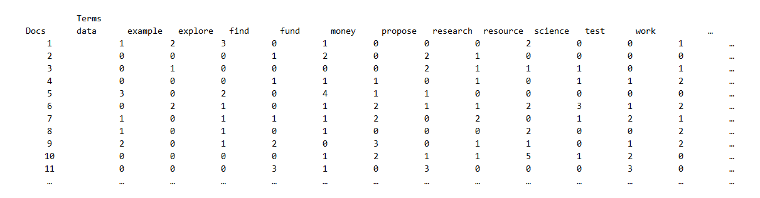
Step 3 – Apply NLP Techniques
Transform: convert characters to lower case
Remove: numbers, stop-words, punctuation, and white-space
Stemming: reduce words to their root form - ex. “searched” -> “search”
Document Term Matrix

Slide 8


Step 4 – Build and Evaluate Classifiers
Support Vector Machines
Naïve Bayes
Consumed more resources
Took longer to run, many unsuccessful interactions
Couldn’t split into test-train
Built Model at 70% sparsity
Accuracy suffered – 39%
Consumed less resources
Ran quickly and successfully
65/35 test-train split
Built Model at 99% sparsity
Model was much more accurate
To be explored further in a moment

Slide 9
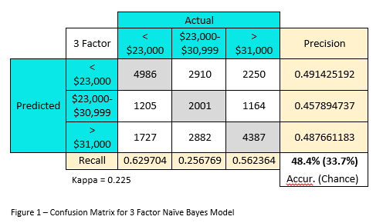
Results & Analysis – Naïve Bayes
Important Details
Confusion Matrix
Training Data
65% of the source data
Testing Data
35% of the source data
Term Sparsity
99% (must have > 1% occurrence)
No Information Rate
33.7%
Significant at p < 0.001
Balanced Accuracy
61.2%

Slide 10
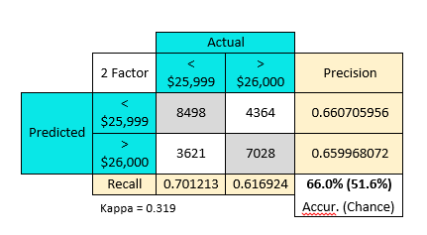
Results & Analysis – 2-Factor Naïve Bayes
Important Details
2-Factor Confusion Matrix
Training Data
65% of the source data
Testing Data
35% of the source data
Term Sparsity
99% (must have > 1% occurrence)
No Information Rate
51.6%
Significant at p < 0.001
Balanced Accuracy
65.9%

Slide 11
Summary and Conclusions
In this instance, Naïve Bayes is prefer of Support Vector Machines
Size of the data set, availability of computer resources
NSERC data is more accurately predicted when split into Small and Large awards
Accuracy, Model Simplicity
Research Questions
Conclusions
Does the content of an NSERC funding application matter?
Does word usage in application summaries predict grant size?
Yes – It appears that what researchers propose in their application summaries does have an effect on the size of the funding they receive
Yes – Word usage can predict grant size at a rate better than chance. Although there is a lot of room for improvement

Slide 12












That’s great… but why is this useful?
I have a marvelous research proposal! I think I’ll submit an NSERC application and see if I can get some cash!!!
But what do I write? How much will I get? Is there someway to know in advance? Can I get any feedback? Oh… I wish there was an app for that….

Slide 13
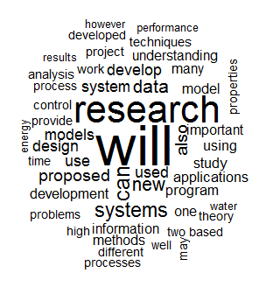

Extras – Word Clouds
Small Awards (< $26,000)
Large Awards (< $26,000)
Shared Words - "will","research","can","new","also","systems"

Slide 14
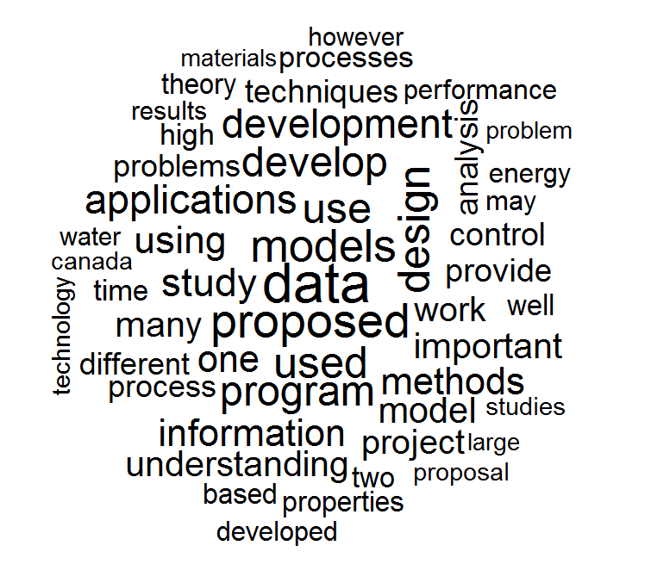
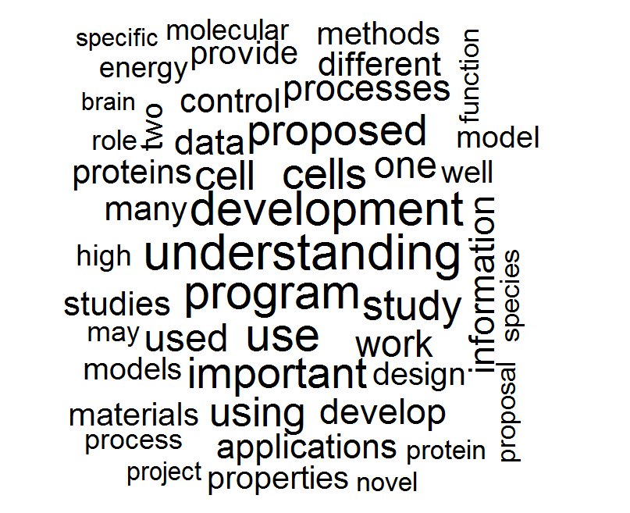
Extras – Word Clouds
Small Awards (< $26,000)
Large Awards (< $26,000)

Slide 15
Thank You for Your Time
Any Questions?
Ryan Dearing, BSc, MSc
rdearing@ryerson.ca

