Slide 1
Location guide for art dealer conference
2020 06 30
Sungyun KIm

Slide 2
1. Introduction
New York is one of culture center of the world, and Manhattan is the heart of New York.
Quite fitting place for the exquisite art dealers’ gathering
Guidance of conference location for optimal neighborhood can be useful

Slide 3
2. Data
Basic two needs of art dealer conference visitors: accommodation needs and business needs
For accommodation needs: Hotel data
For business needs: art galleries and art museums data
Data were gathered using foursquare API

Slide 4
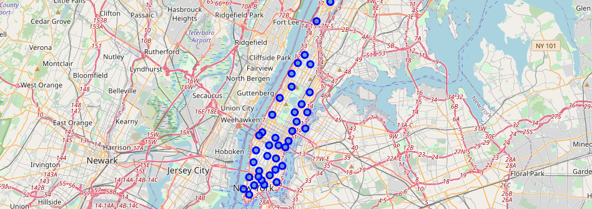
Manhattan neighborhood map
Fig 1

Slide 5
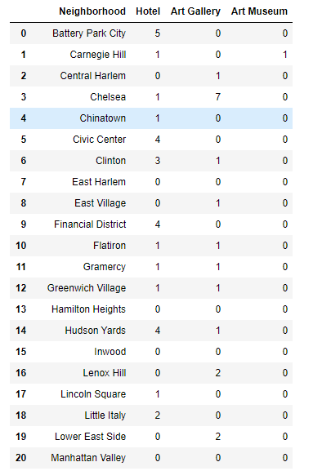
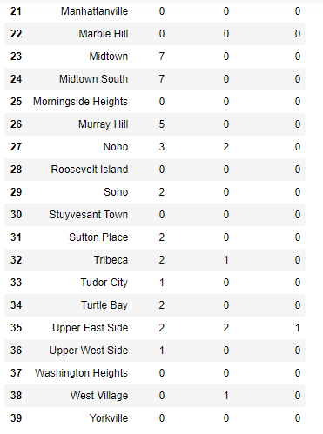
Table 1. All 40 Manhattan neighborhoods with number of hotels, art galleries and art museums

Slide 6
3. Methodology
The determination process for the optimal conference : by decision tree logic
Most important need for visitors: accommodations.
Next important needs: business needs
With two main needs categories ‘Hotel’ and ‘Arts’ , the neighborhoods with no hotel or no Arts venues were removed. Then neighborhoods were sorted by first important category ‘Hotel’. ‘Arts’ needs are considered next.

Slide 7
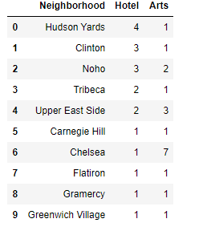
4. Results
Table 2. Manhattan neighborhoods with most hotels
with arts venues

Slide 8
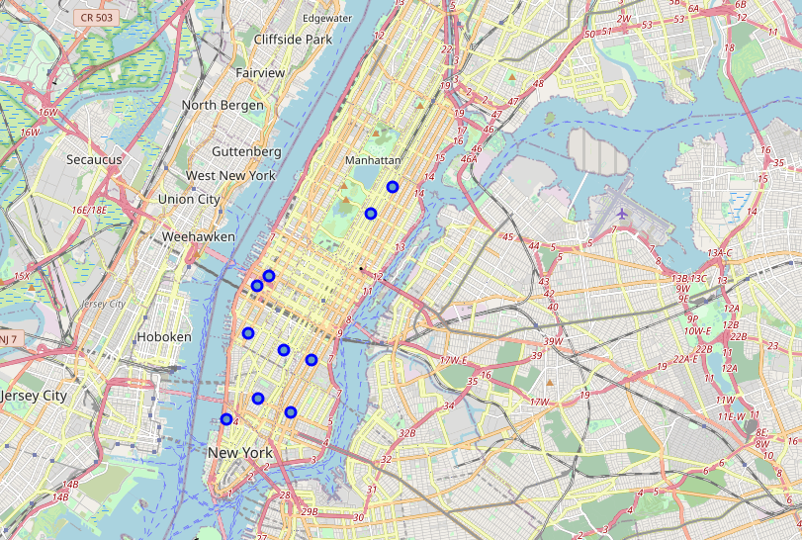
Fig 2. Map of Table 2. Manhattan neighborhoods with most hotels with arts venues

Slide 9
5. Discussion
The average number of hotel rooms: 85.
vacancy rate of the hotel: 1/4 ( conservative estimation ).
Hudson Yards is first with 4 hotels with 1 art venue
Noho has 3 hotels with 2 art venues
Upper East Side has 2 hotels with 3 art venues
Chelsea has has 2 hotels with 7 art venues

Slide 10
6. Conclusion
Conference with more than 60 people : Hudson Yards
Conference with 40~60 people : Noho
Conference with 20~40 people : Upper East Side
Conference with less than 20 people : Chelsea

