Slide 1
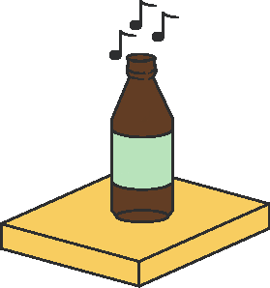
The
Shelf
By the Munich Maker Lab guys

Slide 2
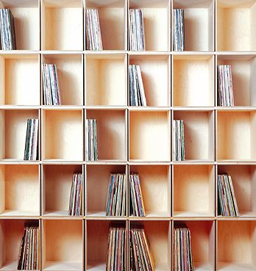

Slide 3
