Slide 1
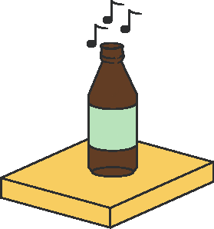
The
Shelf
By the Munich Maker Lab guys

Slide 2
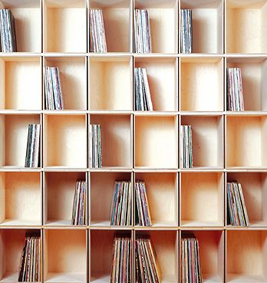
https://rdehorna.github.io/academichackathon/

Slide 3
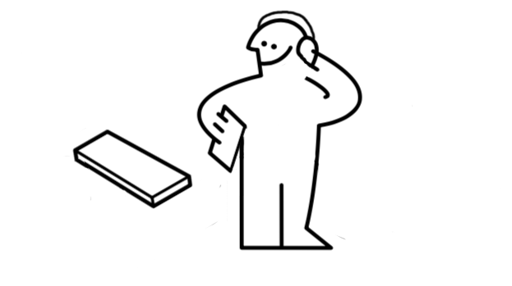
https://rdehorna.github.io/academichackathon/

Slide 4
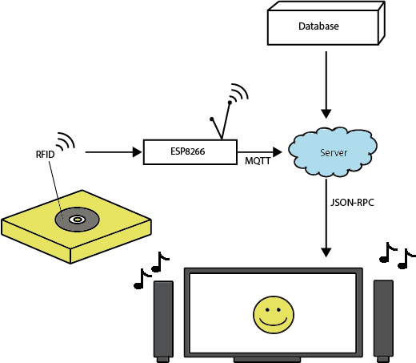
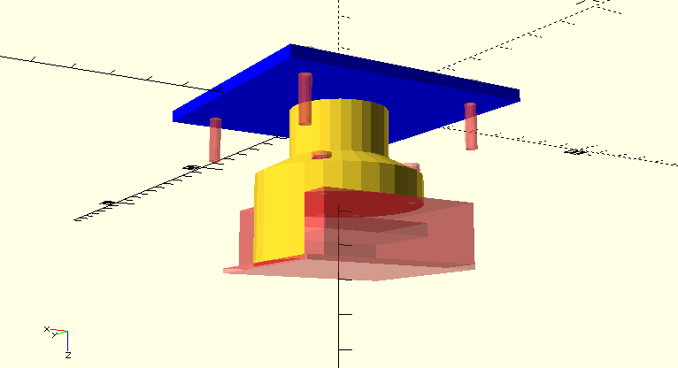
https://rdehorna.github.io/academichackathon/

Slide 5
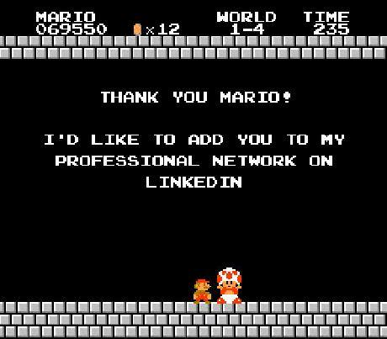

https://rdehorna.github.io/academichackathon/
info@munichmakerlab.de

