Slide 1

Trading Card shop
Robert Del Papa & Reece Herron

Slide 2

Trading Card Shop Database Overview
Our project models the data requirements for a fictional trading card shop.
This includes managing: • Card suppliers • Inventory levels • Customers • Orders and order items
The system supports queries like: • Checking if a card is in stock • Daily revenue calculations • Identifying top-spending customers

Slide 3

Use case
A trading card shop needs to manage cards, track stock levels, and handle customer purchases.
Business operations include: • Receiving card stock from suppliers • Storing inventory data • Processing customer orders and purchases
Common questions the database helps answer: • "Do we have this card in stock?" • "How much money did we make today?" • "Who are our best customers?"

Slide 4
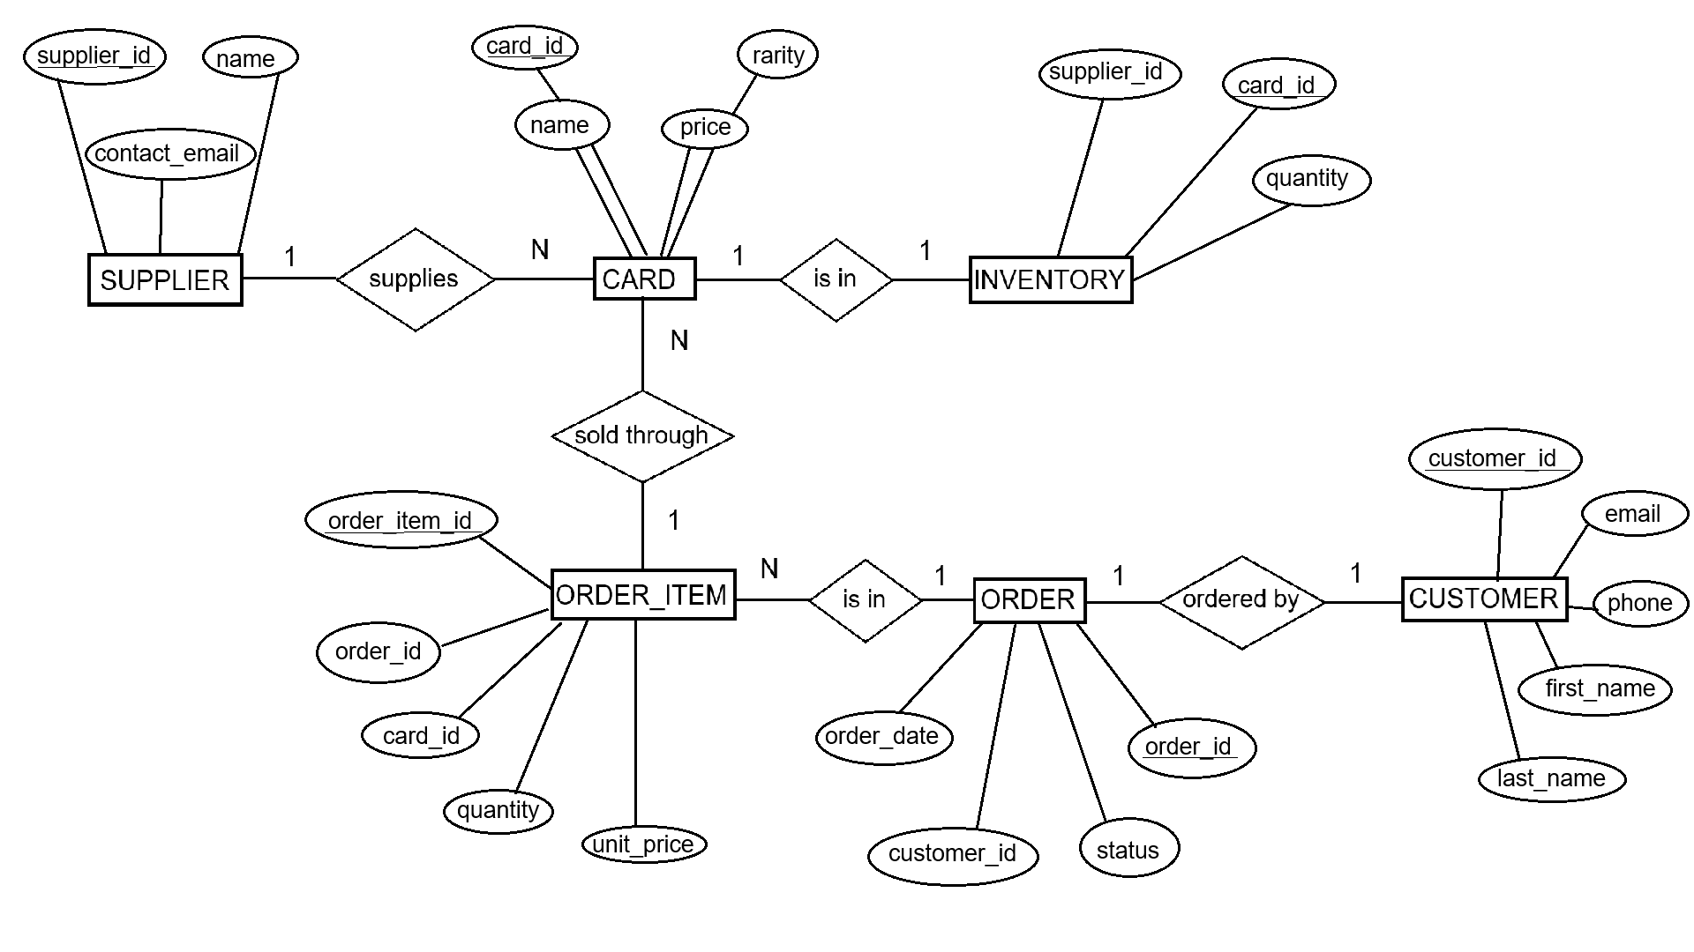
ER TCG Diagram

Slide 5

Key Entity Descriptions
SUPPLIER
Tracks supplier ID, name, and contact email
CARD
Stores card ID, name, rarity, and price
INVENTORY
Links suppliers to cards and quantity in stock

Slide 6
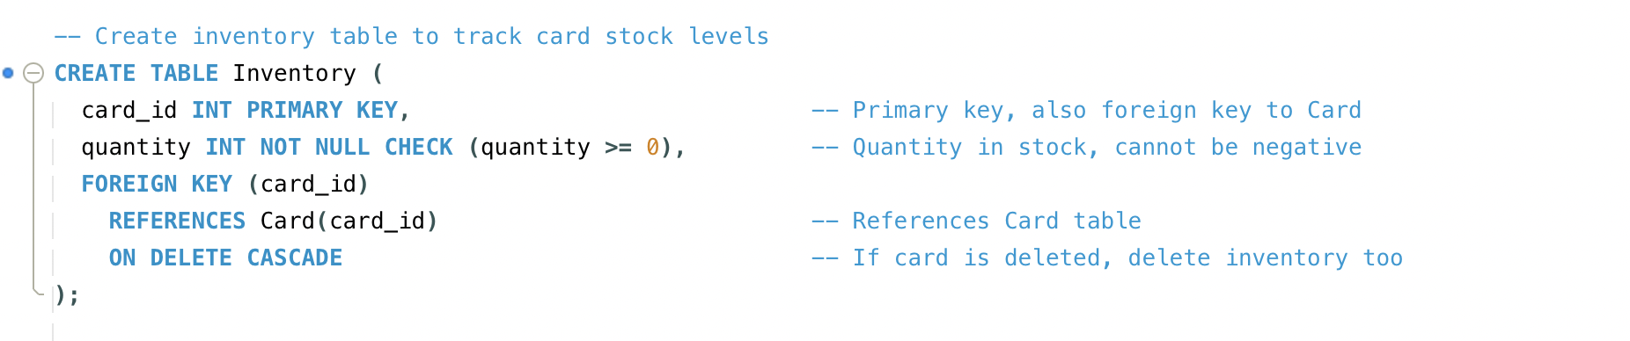
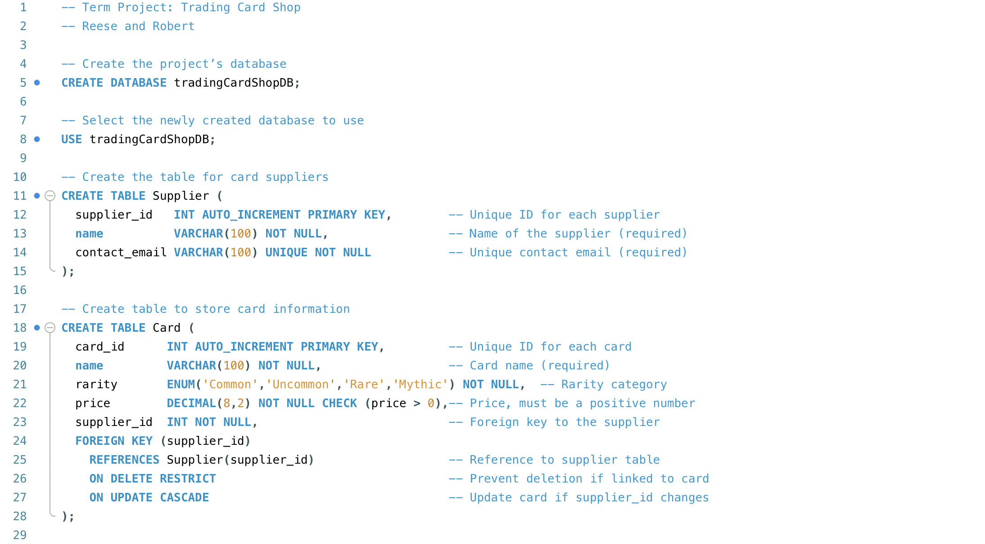

Slide 7

Order and Customer Flow
CUSTOMER
Stores customer ID, contact info, and name
ORDER
Tracks order date, status, and customer ID
ORDER_ITEM
Line items for each card in an order with quantity and unit price

Slide 8
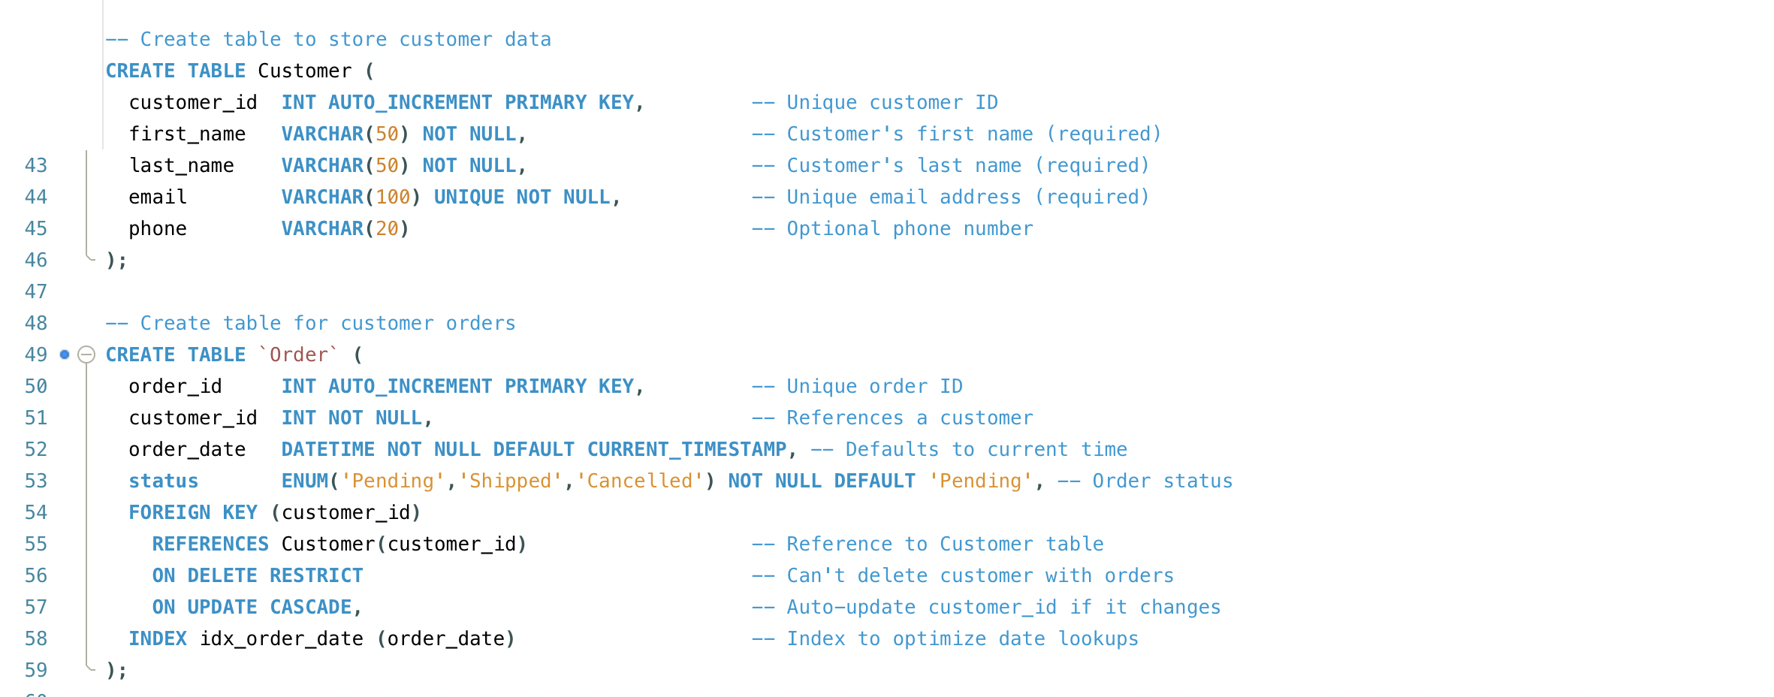
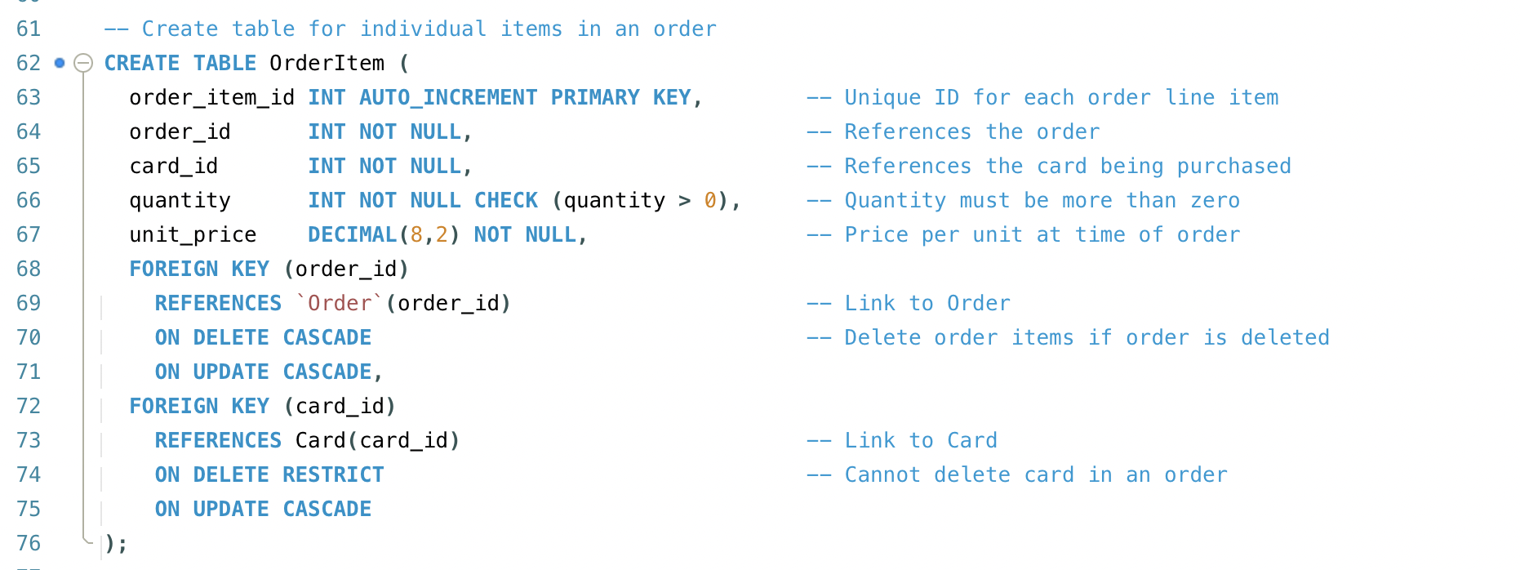

Slide 9

Implementation Details
Database is in Boyce-Codd Normal Form (BCNF)
Foreign keys connect: • CARD to INVENTORY • ORDER_ITEM to CARD and ORDER • ORDER to CUSTOMER
Constraints: • Price and quantity must be ≥ 0
Indexes improve performance on key search fields

Slide 10
Sample Queries
6 complex queries implemented:
Join: Show all cards in an order with customer name
Subquery: Find top 3 customers by spending
Window Function: Rank customers by order volume
Transaction: Insert into order and order items
Update: Adjust inventory quantity after sale
Delete: Remove order and its order items

Slide 11
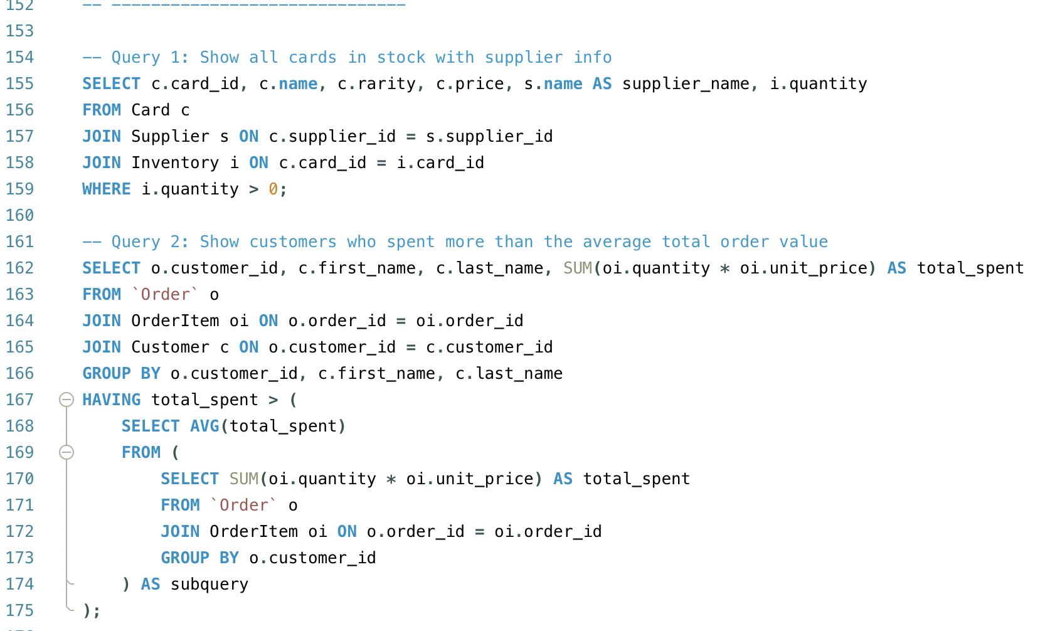

Slide 12
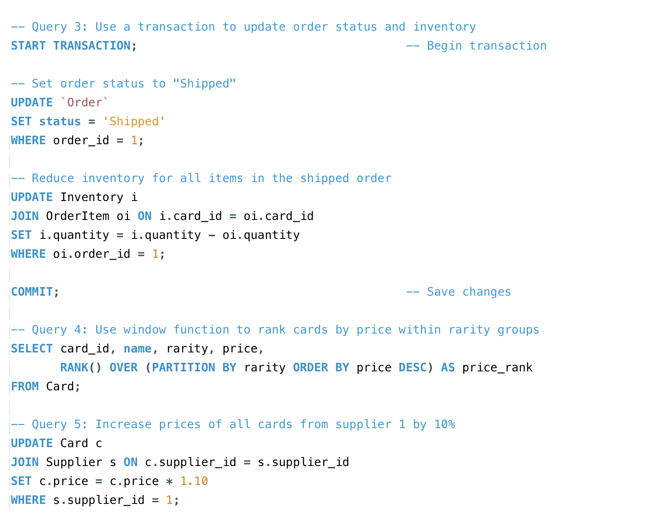
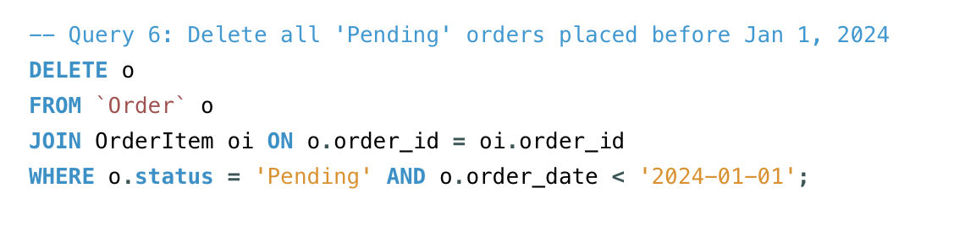

Slide 13
Final notes
The database design is scalable for future growth (e.g. card types, promotions).
Could be extended with features like: • Employee accounts • Card trading between customers • Discount tracking

Slide 14

Thank you

