Slide 1

Trading Card shop
Robert Del Papa & Reece Herron

Slide 2

Trading Card Shop Database Overview
Our project models the data requirements for a fictional trading card shop.
This includes managing: • Card suppliers • Inventory levels • Customers • Orders and order items
The system supports queries like: • Checking if a card is in stock • Daily revenue calculations • Identifying top-spending customers

Slide 3
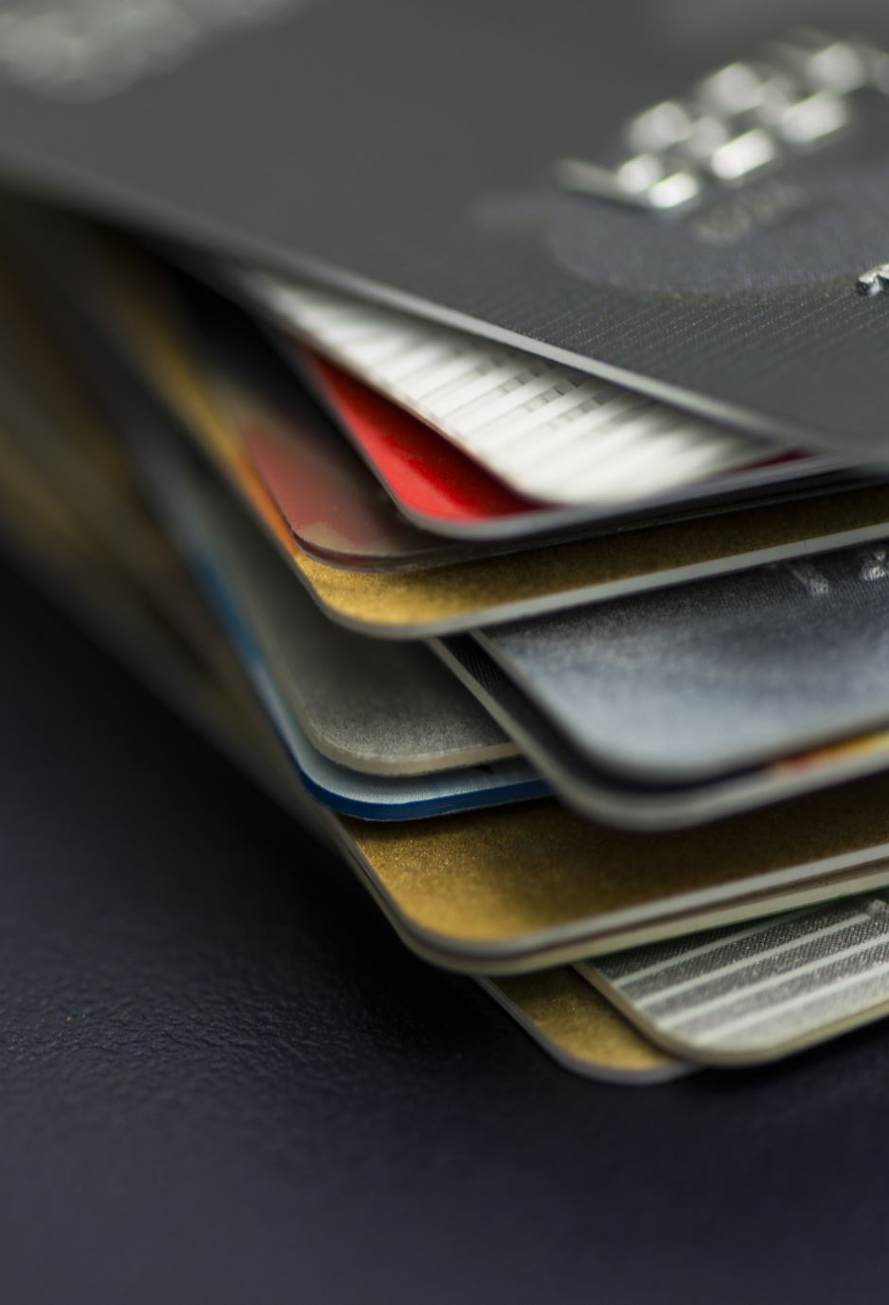
Use case
A trading card shop needs to manage cards, track stock levels, and handle customer purchases.
Business operations include: • Receiving card stock from suppliers • Storing inventory data • Processing customer orders and purchases
Common questions the database helps answer: • "Do we have this card in stock?" • "How much money did we make today?" • "Who are our best customers?"

Slide 4
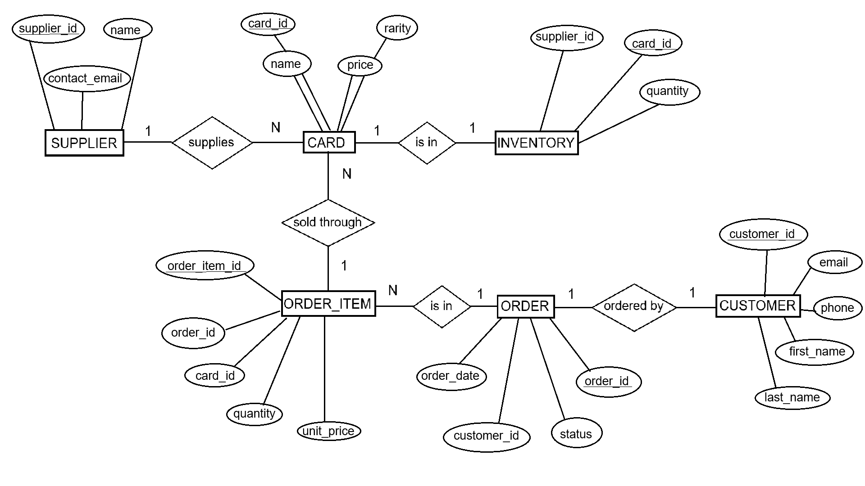
ER TCG Diagram

Slide 5

Key Entity Descriptions
SUPPLIER
Tracks supplier ID, name, and contact email
CARD
Stores card ID, name, rarity, and price
INVENTORY
Links suppliers to cards and quantity in stock

Slide 6

Order and Customer Flow
CUSTOMER
Stores customer ID, contact info, and name
ORDER
Tracks order date, status, and customer ID
ORDER_ITEM
Line items for each card in an order with quantity and unit price

Slide 7

Implementation Details
Database is in Boyce-Codd Normal Form (BCNF)
Foreign keys connect: • CARD to INVENTORY • ORDER_ITEM to CARD and ORDER • ORDER to CUSTOMER
Constraints: • Price and quantity must be ≥ 0
Indexes improve performance on key search fields

Slide 8
Sample Queries
6 complex queries implemented:
Join: Show all cards in an order with customer name
Subquery: Find top 3 customers by spending
Window Function: Rank customers by order volume
Transaction: Insert into order and order items
Update: Adjust inventory quantity after sale
Delete: Remove order and its order items

Slide 9
Final notes
The database design is scalable for future growth (e.g. card types, promotions).
Could be extended with features like: • Employee accounts • Card trading between customers • Discount tracking

Slide 10

Thank you

