Slide 1















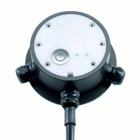



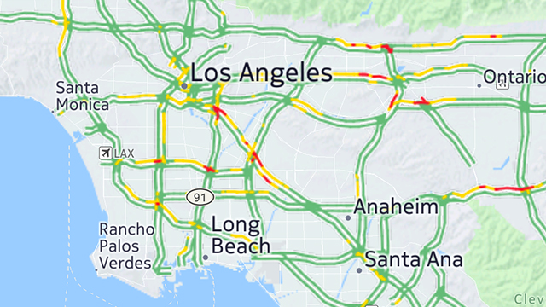
Prediction API
OBE
OBE
Vehicle
Reported State
Desired State
Vehicle
Traffic Incident Service
Shadow Topic
Rules Engine
Situation Data Stream
Notification Function
Notification Topic
Rules Engine
Partner Topic
Reported State
Desired State
RSE
GIS
DMS
Traffic Information Center

Slide 2

















IOT Simple Icons
Thing:
Thing Generic
Various Things
Factory
Wind Farm
Door Lock
Police Emergency
Lightbulb
Home
Automobile
Bicycle
Water Utility
Shopping Cart
Medical Emergency
Bank/Finance
Thermostat
Camera
Coffee Pot
Airplane

Slide 3





















IOT Simple Icons
Simulator
Sensor
Servo
Actuator
Reported State
Desired State
Policy
IOT Hardware Board Variations
Rule
Action
Topic
Shadow
Reported State Alternate
Desired State Alternate
Policy Alternate
Certificate
MQTT Protocol
HTTP Protocol
HTTP/2 Protocol
MQTT Protocol Alternate
HTTP Protocol Alternate
HTTP/2 Protocol Alternate

Slide 4
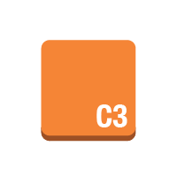










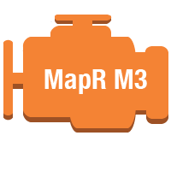


Compute & Networking
Amazon Elastic Compute Cloud
Amazon EC2
instance
instances
AMI
DB on instance
instance with CloudWatch
Elastic IP
optimized
instance
new!
Amazon Elastic MapReduce
Amazon EMR
cluster
MapR M3 engine
MapR M5 engine
MapR M7 engine
engine
new!
new!
new!
new!
AWS Simple Icons: Compute & Networking

Slide 5


Compute & Networking
Kinesis
Amazon WorkSpaces
Amazon Kinesis
Kinesis-enabled app
Amazon WorkSpaces
new!
AWS Simple Icons: Compute & Networking

Slide 6


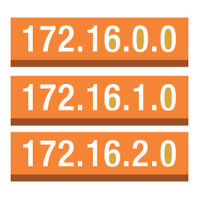









Compute & Networking
Amazon Route 53
Elastic Load Balancing
AWS Direct Connect
Amazon Route 53
hosted zone
route table
Elastic Load
Balancing
AWS Direct Connect
Amazon Virtual Private Cloud
Amazon VPC
router
Internet gateway
customer gateway
virtual private gateway
VPN connection
VPC peering
new!
AWS Simple Icons: Compute & Networking

Slide 7


Compute & Networking
Auto Scaling
Elastic Network Instance
Auto Scaling
elastic network instance
AWS Simple Icons: Compute & Networking

Slide 8












Storage & Content Delivery
Amazon Simple Storage Service
AWS Import/Export
Amazon S3
bucket
bucket with objects
object
AWS Import/Export
Amazon Elastic Block Store
AWS Storage Gateway
Amazon EBS
volume
snapshot
AWS Storage Gateway
non-cached volume
cached volume
virtual tape library
new!
new!
new!
AWS Simple Icons: Storage & Content Delivery

Slide 9







Storage & Content Delivery
Amazon Glacier
Amazon Glacier
archive
vault
Amazon CloudFront
CloudFront
download distribution
streaming distribution
edge location
AWS Simple Icons: Storage & Content Delivery

Slide 10













Database
Amazon DynamoDB
DynamoDB
table
item
items
attribute
attributes
global secondary index
new!
Amazon Relational Database Service
Amazon RDS
RDS DB instance
RDS DB instance standby (Multi-AZ)
RDS DB instance read replica
MySQL DB instance
Oracle DB instance
MS SQL instance
new!
new!
new!
AWS Simple Icons: Database

Slide 11














Database
Amazon Relational Database Service Cont.
Amazon ElastiCache
PostgreSQL instance
SQL master
SQL slave
PIOP
ElastiCache
cache node
Redis
Memcached
new!
new!
new!
new!
new!
new!
Amazon SimpleDB
Amazon Redshift
Amazon SimpleDB
domain
Amazon Redshift
solid state disks
DW1 Dense Compute
DW2 Dense Compute
new!
new!
new!
AWS Simple Icons: Database

Slide 12










Deployment & Management
AWS Elastic Beanstalk
Amazon CloudWatch
AWS Data Pipeline
Elastic Beanstalk
application
deployment
CloudWatch
alarm
AWS Data Pipeline
AWS CloudFormation
AWS CloudTrail
AWS CloudFormation
template
stack
AWS CloudTrail
AWS Simple Icons: Deployment & Management

Slide 13










Deployment & Management
AWS Identity and Access Management
IAM
IAM add-on
AWS Security Token Service
data encryption key
encrypted data
permissions
role
new!
new!
new!
new!
long-term security credential
temporary security credential
MFA token
new!
new!
new!
AWS Simple Icons: Deployment & Management

Slide 14









Deployment & Management
AWS OpsWorks
AWS OpsWorks
stack
layers
instances
apps
deployments
monitoring
new!
new!
new!
new!
new!
new!
resources
permissions
new!
new!
AWS Simple Icons: Deployment & Management

Slide 15








App Services
Amazon CloudSearch
Amazon Simple Email Service
Amazon CloudSearch
SDF metadata
Amazon SES
email
Amazon Simple Notification Service
Amazon SNS
email notification
HTTP notification
topic
AWS Simple Icons: App Services

Slide 16






App Services
Amazon Simple Queue Service
Amazon Simple Workflow
Amazon SQS
queue
message
Amazon SWF
decider
worker
Amazon Elastic Transcoder
Elastic Transcoder
AWS Simple Icons: App Services

Slide 17














Non-Service Specific
AWS cloud
AWS Management Console
virtual private cloud
forums
client
mobile client
multimedia
Internet
user
users
traditional server
corporate data center
disk
generic database
tape storage
AWS Simple Icons: Non-Service Specific

Slide 18





On-Demand Workforce
Amazon Mechanical Turk
Amazon
Mechanical Turk
Human Intelligence Tasks (HIT)
assignment/
task
workers
Requester
Mechanical Turk vs. Amazon Mechanical Turk
Do not use simple "Mechanical Turk" to refer to Amazon Mechanical Turk. Use Amazon Mechanical Turk to describe the entire system, Amazon Mechanical Turk website for the worker website, and Amazon Mechanical Turk web service to describe the product.
AWS Simple Icons: On-Demand Workforce

Slide 19













SDKs
Java
JavaScript
Python (boto)
PHP
.NET
Ruby
Node.js
new!
iOS
Android
AWS Toolkit for Visual Studio
AWS Toolkit for Eclipse
AWS Tools for Windows PowerShell
AWS CLI
AWS Simple Icons: SDKs

Slide 20
Groups
Auto Scaling group
Availability Zone
region
security group
Elastic Beanstalk container
EC2 instance contents
VPC subnet
server contents
AWS Simple Icons: Groups

Slide 21
Groups
virtual private cloud
AWS cloud
corporate data center
AWS Simple Icons: Groups

Slide 22


Example 1: 2-Tier Auto-scalable Web Application Architecture in 1 AZ
www.example.com
media.example.com
CloudFront
distribution
web app
server
root volume
logs
Elastic Load Balancing
EC2 instance
security group
data volume
Amazon EBS snapshot
Amazon S3 bucket
Auto Scaling group
security group
Availability Zone #1
AWS Simple Icons: Example 1

