Slide 1
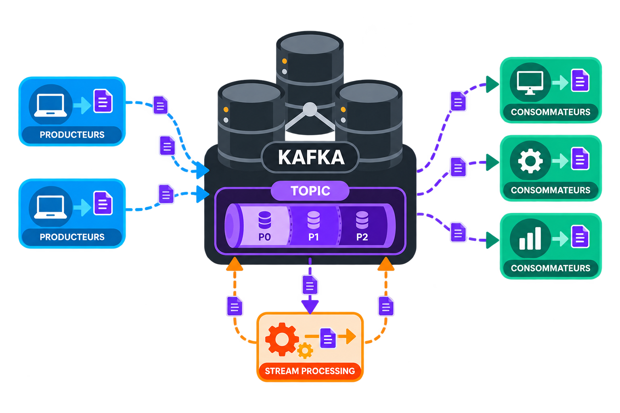
Stream Processing and EDA Resilience
Kafka Engineering Guide
From the first published message
to EDA resilience
A learning Sandbox …
Spring Boot · Nuxt · Kafka · Flink · Hazelcast
Learning path in English | October 2026
Notes:
Note:
Introduce the principles and technical concepts of building an EDA architecture.
This presentation follows the project's English documentation.
The appendices serve as reference material without interrupting the main journey.

Slide 2
INTRODUCTION
KAFKA ENGINEERING GUIDE
EDA architecture best practices
This guide presents a concrete project (with a Sandbox-style implementation) that integrates best practices.
01
Underestimation
02
Distributed Kafka
03
External partners
Delivery teams generally underestimate the complexity of integrating with EDA.
The distributed nature of the Kafka architecture must be taken into account.
Our partners have very little expertise in this area — this is simply a fact.
04
Sandbox-style project
05
Introduction and concept walkthrough with implementation
A concrete project that demonstrates an EDA architecture implementation.
We will present best practices for implementing a resilient architecture with concrete examples — through the learning Sandbox.
More than 40 journey slides + a few orientation and deep-dive appendices.
Kafka Engineering Guide · EDA Project
02
Notes:
Note:
Underestimates the complexity of EDA.
We want to rely on external partners (they don't have the expertise).
Transfer/communicate/share the expertise of resources who have actually implemented resilient systems.

Slide 3
LEARNING PATH
FROM CONCRETE WORK TO GUARANTEES
Six steps for knowledge transfer
One common thread: publish a request, produce a business effect, then control/corroborate that effect.
01
Discover the Sandbox
02
Understand EDA/Kafka
03
Make effects reliable
Application, data, and the journey of a request (message).
Topics, partitions, keys, and business ordering.
Delivery, transactions, idempotence, DLT, and Outbox.
04
Explore Flink
05
Operate and distribute
06
Prove and choose
Checkpoint, savepoint, and runtime boundaries.
Parallelism, shutdown, probes, and elasticity.
Observability, governance, corroboration, and TCO/ROI.
GITHUB Project: https://github.com/rdemers/org-rd-fullstack-springboot-eda
Kafka Engineering Guide · EDA Project
03
Notes:
Note:
This presentation outline is a progression through continuous learning.
We start with the application and the data.
Kafka comes next, to understand where messages travel.
Failures justify transactions, idempotence, and persistence patterns.
Flink becomes another execution model to compare.
Distribution leads to operations and elasticity.
Finally, observability, governance, corroboration, and the ETL/SOA/EDA choice close the loop.

Slide 4
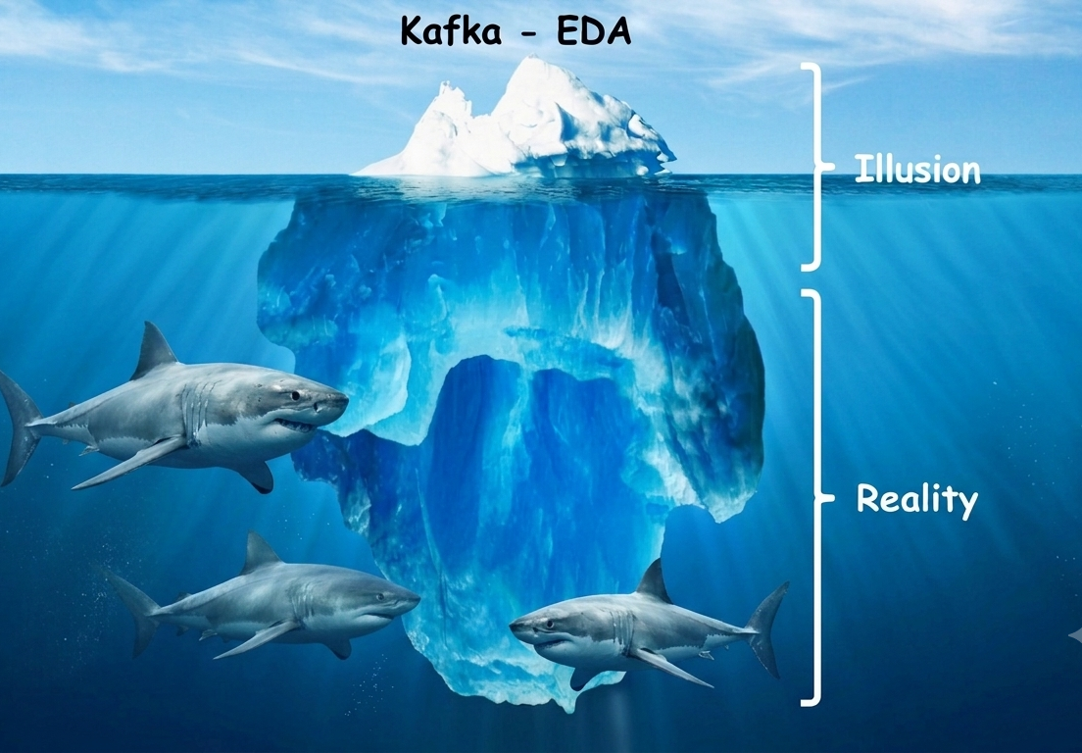
01 / DISCOVER
GUIDE FRAMING
Publishing a message is not enough to build an EDA platform
EDA: event-driven architecture. Transport makes exchange possible; by itself, it does not guarantee the reliability of the effects.
01
Transport
Publish, store, and consume normalized messages.
02
Accuracy
Order, deduplicate, and validate effects (idempotence).
03
Trust
Observe, govern, control, and corroborate the data.
Our sharks: Bronze, silver, and gold — our medallion architecture specialists.
Kafka Engineering Guide · EDA Project
04
Notes:
Note:
Use the iceberg provided in the guide as a metaphor for complexity. The visible part is publishing and consuming. The less visible part includes ordering, partial failures, duplicates, transactions, operations, and data verification.
Do not present this image as a measure of cost or volume. It introduces the central idea of the conclusion: complexity does not disappear, it moves. Opening question: what lets you say that a sale has actually been applied?

Slide 5
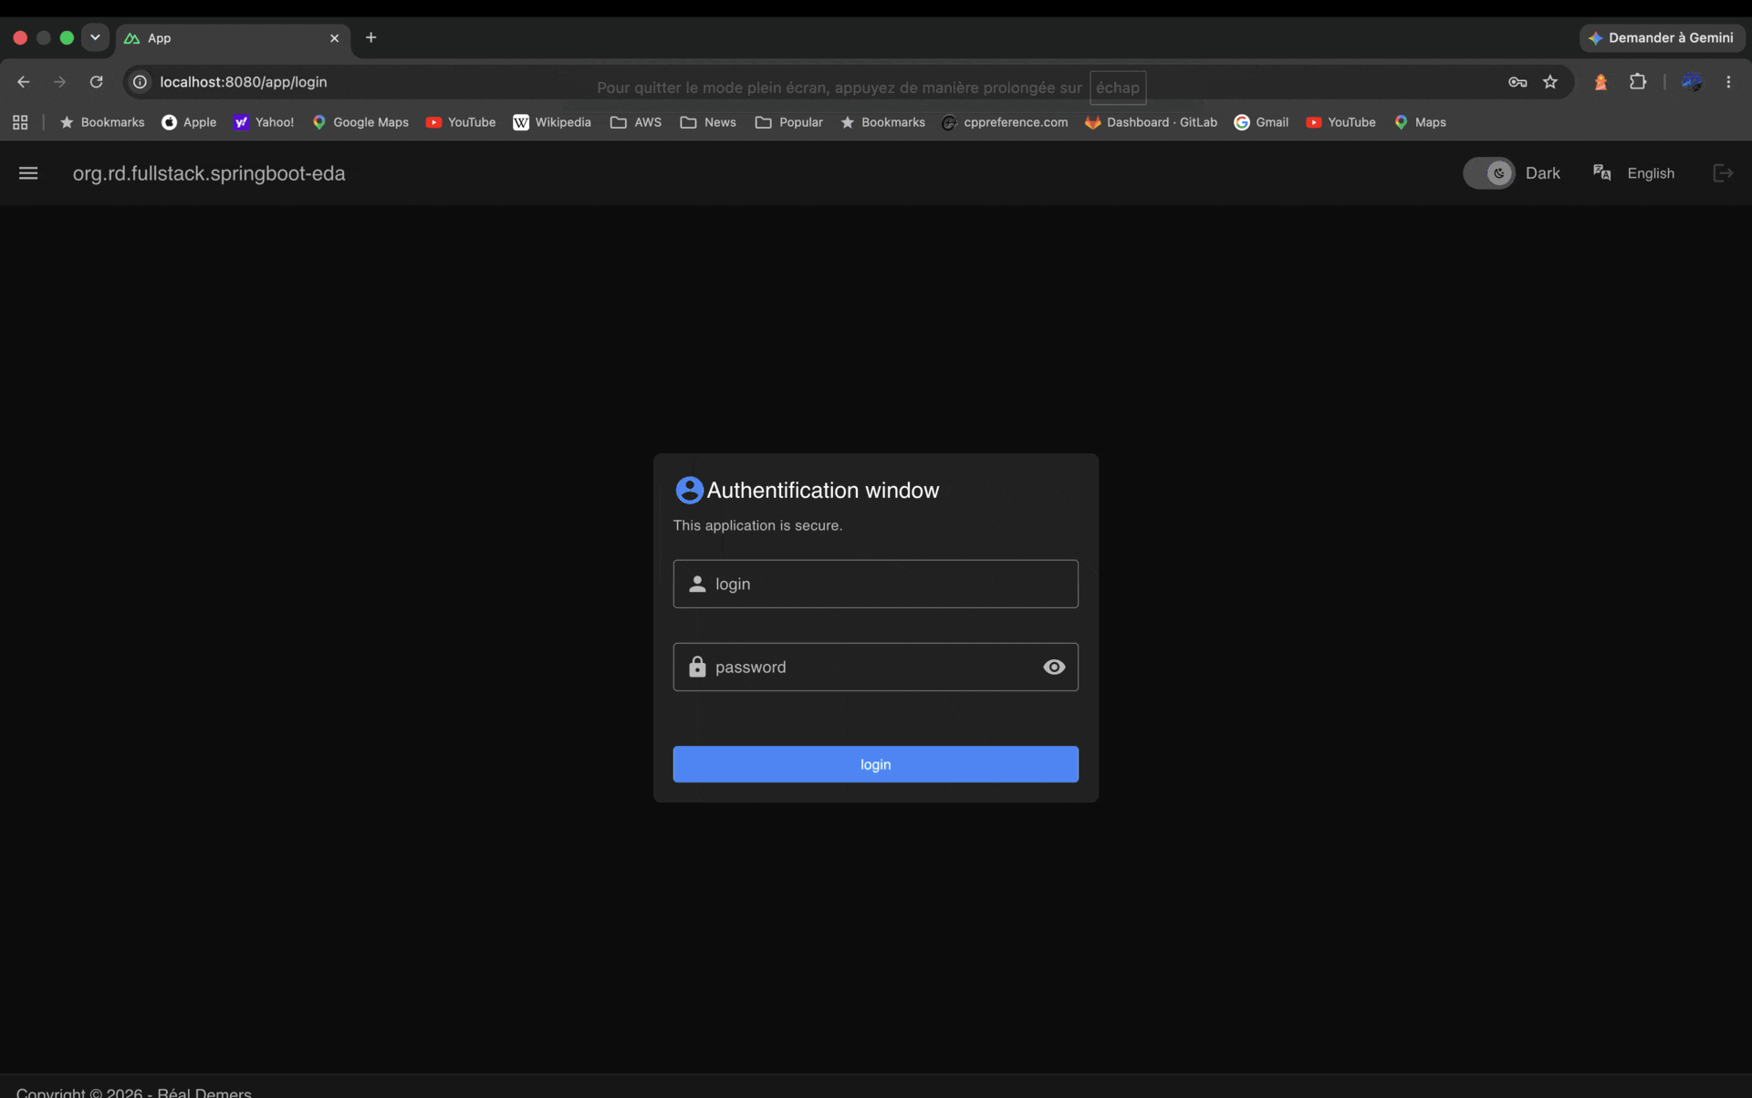
01 / DISCOVER
IN THE SANDBOX
A standalone application for observing effects/trade-offs/decisions
The static Nuxt frontend and the Spring Boot backend are packaged in a single deployable artifact.
Browser
STANDALONE APPLICATION ARTIFACT
Nuxt interface
Spring Boot + Nuxt
Kafka
Flink
BFF API and static resources
Configuration, transactions
and business logic
Hazelcast
HSQLDB
Educational Sandbox: an execution convenience, not a production topology.
Kafka Engineering Guide · EDA Project
05
Notes:
Note:
Nuxt provides the interface and Spring Boot exposes the BFF services while also serving the static resources.
Kafka, Flink, and Hazelcast are embedded to make experimentation easier; the database is HSQLDB.
The documentation explicitly states that this project is educational.
Unified packaging is not a universal recommendation: here it serves a goal of local simplicity.
Infrastructure components should generally become external services in production.
This separation will be revisited later.

Slide 6
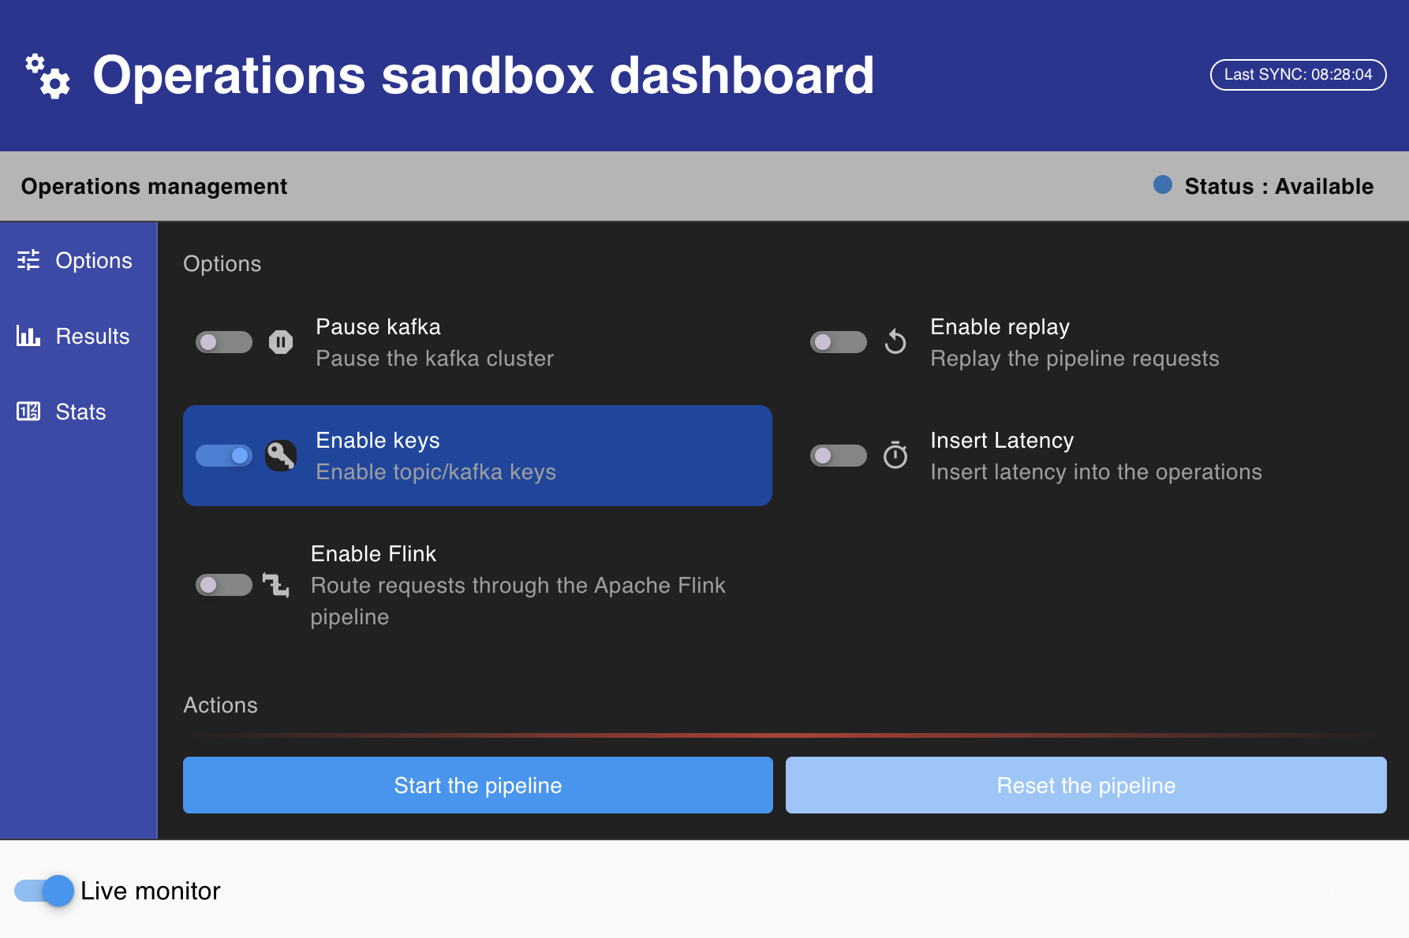
01 / DISCOVER
BUSINESS THREAD
A request connects a person, a product, and an inventory
Processing must evolve the balance, inventory, and request result coherently.
01
Key + Latency
PRODUCT
PERSON
Make the effect of parallelism visible.
The buyer and
their balance
The product and
its unit price
02
Pause + Replay
REQUEST
INVENTORY
Observe progress and recovery.
Operations
to perform
Available
inventory
03
Flink option
JRN_EVENT
Flink alternative for processing.
Event
consumption (idempotence)
Journey invariant: inventory must never become negative. The operations screen is the experimentation station.
Kafka Engineering Guide · EDA Project
06
Notes:
Note:
Keep the project's terminology:
CREDIT corresponds to a sale and removes stock;
DEBIT adds stock and credits the customer back.
The meaning can seem counter-intuitive (we take the inventory's perspective), hence the need to clarify it.
REQUEST is the request to process, PERSON holds the balance, PRODUCT the price, and INVENTORY the available quantity. The PENDING, BACK_ORDER, EXECUTED, and ERROR results will be reused in the idempotence and corroboration explanations. The non-negative stock invariant is a business goal, not a guarantee already enforced in every Sandbox mode. The options:
Key activation,
Artificial latency,
Replay,
Flink alternative,
Pause
Startup and reset actions.
To compare two runs, keep the same dataset and change only one variable. The expected effects are those described in the guide, not a new measurement. Do not reset a batch that is still in progress during the demonstration. Prepare and verify the version used before class.

Slide 7
01 / DISCOVER
KAFKA PATH
Follow a request (message) end to end
Each component carries a distinct responsibility; the validation boundaries come next.
Periodic
Snapshots
(Reconciliation)
Nuxt
PipelineSrv
Kafka/Flink
Listener
ProcessorSrv
Start
the pipeline
Publish
requests
Keep
the messages
Receive
and delegate
Process
in transaction
Producer
Publication: REQUEST.
Consumer
Update: REQUEST, INVENTORY, PERSON.
Topic/Partitions
Message
A received request is not immediately a validated business effect.
Kafka Engineering Guide · EDA Project
07
Notes:
Note:
In order:
The interface submits the action;
PipelineSrv publishes the requests to the direct path's topic;
the listener receives each record;
PipelineSrv.handle coordinates, then ProcessorSrv.process applies the business work.
The listener acknowledges after the transactional processing returns. Both the Kafka and Flink modes will share this business core. Ask the audience where a failure could occur: each arrow opens a question that the next sections will address.

Slide 8
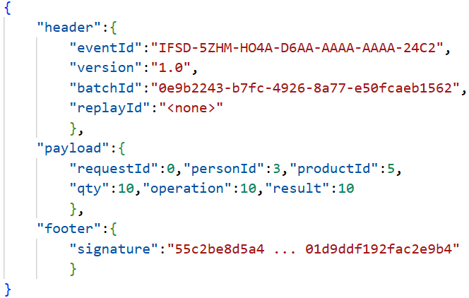
02 / UNDERSTAND KAFKA
NORMALIZATION
Data normalization
The topic carries messages from a producer. A message has a payload and metadata. Normalization must not depend on the technology and must be understandable by all present and future consumers.
01
Normalization
Very important. Non-falsifiable.
“Zero Trust” principle.
Normalization aims to make the message accessible/understandable to consumers — durable over time.
02
Metadata
Should be UUIDs.
OK for a Sandbox.
Allows the consumer to know the context and obtain the unique identifier. Alternative: payload hash … if there is a timestamp field.
03
Integrity
A consumer must be able to validate message integrity BEFORE processing.
Technology: metadata must not depend on MOM-specific features.
Kafka Engineering Guide · EDA Project
08
Notes:
Note:
Normalizing the information to be transported is essential.
This activity helps determine:
the best partition key.
The number of partitions.

Slide 9


02 / UNDERSTAND KAFKA
TOPIC DESIGN
Neither a universal topic nor uncontrolled multiplication
The goal is to find a balance around aggregates, responsibilities, and contracts.
Fat pipe
Thin pipes
By aggregate
A topic for heterogeneous events.
Risk: unclear contract and unnatural (or impossible) key.
Makes message consumption exponentially more complex.
Specialized topics by type.
Trade-off: inter-topic ordering and operations.
Ideal for selecting a partition key.
An explicit intent and contract.
Group events whose order is related.
May be difficult to determine a good partition key.
A topic is an intentional contract, not just a transport pipe.
Kafka Engineering Guide · EDA Project
09
Notes:
Note:
Present the two extremes, then the possible trade-off.
A Fat pipe mixes events together and complicates responsibility, filtering, schemas, and key choice.
Specialized Thin pipes clarify contracts, but fragment sequences across topics and increase operational surface.
The proposed orientation is to group events from the same entity or aggregate when their order matters, while isolating data when its requirements demand it.
Important:
The Sandbox's topics focus on request processing and its DLT; the project does not model an entire enterprise catalog.
Note:
The chosen orientation also serves to determine:
the best partition key.
The number of partitions.

Slide 10
02 / UNDERSTAND KAFKA
FOUNDATIONS
A Kafka topic … Partitions allocate horizontal elasticity
The topic organizes messages; the partition provides order (when keyed); the offset marks a position; the group shares the work.
TOPIC
CONSUMER GROUP
Partition 0
0
1
2
3
Process/Thread
Consumer A
Process/Thread
Consumer D
Partition 1
0
1
2
3
Process/Thread
Consumer B
Receives no messages.
Partition 2
0
1
2
3
Process/Thread
Consumer C
Without a key ... All threads can write to the same record — no ordering.
Offsets: positions local to each partition
Order is guaranteed only within a partition (when a partition key is used), not globally across all partitions.
Kafka Engineering Guide · EDA Project
10
Notes:
Note:
A topic contains partitions. Each partition is an ordered log. The offset is a record's position within that partition; the group's committed offset marks its recovery point.
Within a group, a partition is assigned to only one active consumer at a time. The diagram deliberately simplifies the number of partitions and consumers; it does not represent the archive's actual configuration values.
Do not talk about an exactly-once guarantee yet: ordering and position tracking are not a guarantee on SQL effects.

Slide 11
02 / UNDERSTAND KAFKA
HOT PARTITIONS
An imbalanced key can neutralize horizontal elasticity
Throughput can remain limited by a single partition, even when other consumers are available.
IMBALANCE DIAGRAM
01
Measure distribution
Observe lag by partition, not just the total.
Partition 0
02
Locate the bottleneck
Partition 1
Key, lock, database, or external resource.
Partition 2
03
EKS – Kafka rebalance
An inactive (underactive) pod is removed, continuously causing partition rebalances toward other pods ... Ouch!
A dominant key concentrates the work.
Distributing more is useful only if business ordering and invariants remain preserved.
Kafka Engineering Guide · EDA Project
11
Notes:
Note:
The diagram illustrates an imbalance.
A very dominant key concentrates traffic on one partition (or a few partitions).
Increasing the number of consumers does not split that partition's work.
Before changing the partitioning, go back to the per-entity ordering requirement.
Distribution, locks, the SQL database, and external calls must be considered together.
Several mitigations are possible, but the deck does not turn them into a universal recipe: the trade-off between ordering and throughput must be made explicit.

Slide 12
02 / UNDERSTAND KAFKA
ORDER BY ENTITY
The Kafka key must express the desired business ordering
In the project, the “productId” key provides message ordering for the inventory invariant.
Without a key
With “productId” as the key
The same product may appear in several partitions.
Multiple threads may act on the same inventory.
Product requests go to the same partition.
The direct path preserves sequential processing by product.
However, this ordering does not address synchronization of the person balance.
Design decision: order events where the business requires it.
Kafka Engineering Guide · EDA Project
12
Notes:
Note:
The Sandbox uses productId as the partition key.
With an unchanged number of partitions, requests for the same product land on the same partition.
In the direct path shown, they are processed sequentially by the consumer that owns that partition.
Without a key, they can end up on several partitions and run in parallel. Do not turn this local guarantee into global ordering.
The Sandbox documentation also notes that changing the number of partitions remaps keys and requires planning.
The question of key choice therefore comes before the question of the number of pods.

Slide 13
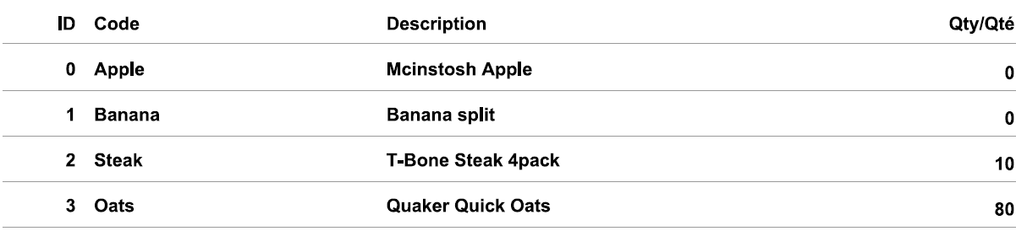
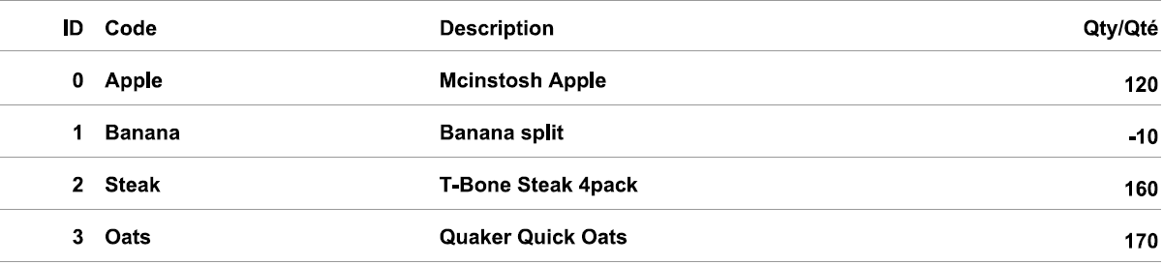
02 / UNDERSTAND KAFKA
PROVIDED REPORTS
Only one option changes; the invariant can break
The two reports in the project documentation use the same initial inventory and the same requests, with or without a key.
WITH KEY
WITHOUT KEY or key on “personId”.
Banana : 0
Banana : -10
Illustrated result: non-negative stock.
Illustrated result: silent overselling.
Documentation excerpts: the comparison must focus on business effects, not only on data flow.
Kafka Engineering Guide · EDA Project
13
Notes:
Note:
This slide presents the reports included in the Sandbox project.
It is not a new run, nor a prediction of the figure obtained on every attempt.
With the key, the report documents non-negative quantities and BACK_ORDER requests when stock is insufficient.
Without the key, Banana sits at -10.
Question:
Would a dashboard showing that messages were consumed be enough to detect this business anomaly?
Expected answer: no, you have to observe the state and its invariants.

Slide 14
02 / UNDERSTAND KAFKA
SANDBOX CONCURRENCY
Protect the person and the product
The Hazelcast lock is indexed on PERSON_ID; the INVENTORY row is ordered by PRODUCT_ID.
Process / Thread
Product A / Person 1
The race
Hazelcast
Read the person balance
Validate the balance and modify it.
Two processing flows can pass the same balance validation.
Adding “personId” to the current key will not work!
Person 1
In-memory lock — person 1
One row for the balance
Process / Thread
Product B / Person 1
The scope of a protection must match the invariant it is intended to protect.
Kafka Engineering Guide · EDA Project
14
Notes:
Note:
The “check-then-act” race as documented: two requests targeting the same person will read the same balance.
Both read the same person's balance, pass the check, and then each applies its own balance adjustment.
The per-person in-memory “Datagrid” lock is the solution.

Slide 15
02 / UNDERSTAND KAFKA
SANDBOX CONCURRENCY
Alternative - Protect PERSON or INVENTORY using SQL locking
The SQL approach ... an alternative that does not preserve ordering.
Pessimistic locking
Optimistic locking
Conditional update
Lock the row on read so others wait. In SQL: SELECT ... FOR UPDATE.
Process waiting on the database. “sleep mode”.
Less elasticity and an impact on the lifecycle of a pod.
A @Version column; the update succeeds only if the version is unchanged, otherwise the application must retry.
Spins in circles ... consumes $$$ resources. Fight between pods (Process/Thread)!!!
Delegate the balance check to the database write (where clause).
Business logic moves down into the SQL query — breaks the JPA cache.
Protects only the invariants explicitly guarded, without automatically protecting the entire entity from all concurrent changes.
Breaks horizontal elasticity, generates DLT, consumes resources, and can cause repeated retries.
This alternative does not preserve ordering!!!
Kafka Engineering Guide · EDA Project
15
Notes:
Note:
The traditional “SQL” approach is not the right one: pessimistic locking, optimistic locking, or a conditional UPDATE (where clause).
Breaks horizontal elasticity.
Generates DLT.
Consumes resources. Causes rebalance storms.

Slide 16
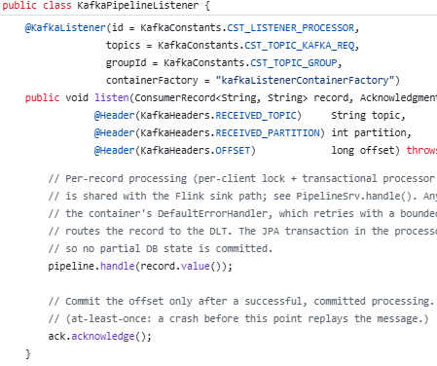

03 / MAKE EFFECTS RELIABLE
DELIVERY SEMANTICS
Three guarantees, but always a boundary to define
The question is not only how many times a message arrives, but which effects become visible.
Guarantee
Principle
Trade-off
At-most-once
Validate the position before processing.
Loss is possible and will occur!!!
At-least-once
Validate after successful work.
Duplicates are possible. Idempotence must be implemented.
Exactly-once
Atomic Kafka results
and source offsets.
External effects are not included. Note: checkpoint!
At-least-once.
Sandbox project choice: at-least-once + idempotent business processing.
Kafka Engineering Guide · EDA Project
16
Notes:
Note:
There are three possible guarantees:
At-most-once accepts a possible loss when the position is committed before the work.
At-least-once accepts redelivery when the work is committed before the offset.
Kafka EOS makes the Kafka results and source offsets atomic within a read-process-write loop, but does not automatically cover the SQL database or a remote call.
The Sandbox project's choice: at-least-once plus idempotent processing. Publication durability also depends on producer configuration and replication; no wording here should become an absolute promise of no loss.

Slide 17
03 / MAKE EFFECTS RELIABLE
KAFKA PUBLICATION AND VISIBILITY
Three different mechanisms work together
Producer idempotence, Kafka transaction, and consumer isolation do not answer the same question.
Idempotent producer
Kafka transaction
Isolated consumer
Avoid duplicates caused by producer retries.
enable.idempotence=true
Commit or abort a set of publications in Kafka.
commit / abort
Transactional messages: read only after commit.
isolation.level=
read_committed
These Kafka mechanisms do not replace SQL effect atomicity or idempotence.
Kafka Engineering Guide · EDA Project
17
Notes:
Note:
A few facts:
Producer idempotence protects against duplicates from its own retries, not against two application-level publications of the same fact.
A Kafka transaction defines a set of publications that is committed or aborted as a whole.
read_committed prevents the consumer from returning messages from aborted transactions, and waits for their outcome.
The guide documents this combination for the direct path. Do not infer a SQL commit from it, nor assume that every Kafka client built separately inherits the same configuration.
Each source/consumer must be examined within its own scope.

Slide 18
03 / MAKE EFFECTS RELIABLE
SQL COMMIT AND OFFSET
The business commit must precede the acknowledgement
A failure between the two commits causes redelivery: that is exactly why idempotence is needed.
Read the message
Process + commit
Failure window
Acknowledge (ACK)
Kafka
SQL Transaction
The offset
has not advanced
Offset Kafka
Offset before SQL
SQL before offset
Risk: the business effect may be lost.
Failure/Shutdown – No redelivery.
Exception – No redelivery.
Risk: the effect may be attempted again.
Failure/Shutdown – Redelivery.
Exception – Redelivery.
A delivery duplicate must become a non-event for the data — processing MUST BE IDEMPOTENT.
Kafka Engineering Guide · EDA Project
18
Notes:
Note:
Do not confuse flush, method return, and commit!!!
The processing is invoked through its transactional proxy; the listener acknowledges after that processing returns.
If the SQL commit succeeded but the process stops before the acknowledgement, the message will come back.
An acknowledgement placed before a SQL commit that is ultimately rolled back could, conversely, lose the expected effect.
The afterCommit callback makes the order explicit, but does not remove the failure window.
Question:
Should every redelivery be prevented, or should its effects be made safe? Answer: design the processing to be idempotent.

Slide 19
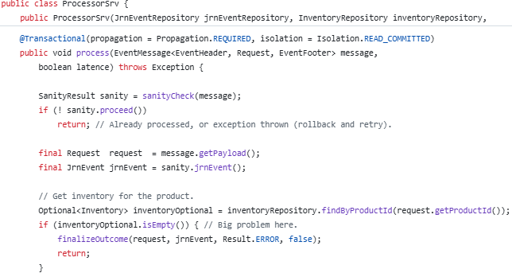
03 / MAKE EFFECTS RELIABLE
INBOX / JRN_EVENT / OUTBOX
Recognize the event (the message) — Idempotence
The same event delivered multiple times must apply the business effect only once.
A single transaction.
ONE SQL TRANSACTION
1
Verify / record the identity
Verify
idempotence.
JRN_EVENT : (CONSUMER_ID, EVENT_ID)
2
Apply, then record the outcome
Journal reference for the update.
INVENTORY + balance + REQUEST + JRN_EVENT
A uniqueness constraint remains the authority for deduplication under concurrency. It is not the commit. Keep identity, processing type, and result distinct.
Thus ... start of the business logic.
Deduplication marker and business effects: commit together, or roll back together.
Kafka Engineering Guide · EDA Project
19
Notes:
Note:
The business result indicates whether the request is still PENDING or BACK_ORDER, or already settled.
When a header is present, the journal is looked up on the composite key CONSUMER_ID, EVENT_ID.
Inserting or updating this marker and the business effects belong to the same SQL transaction.
A uniqueness constraint remains the deduplication authority under concurrency.
It is not the commit. Keep identity, processing type, and its result distinct.

Slide 20
03 / MAKE EFFECTS RELIABLE
RETRY / DLT / REPLAY
An error must follow an explicit path
Retry a transient incident, isolate a persistent failure, then organize a controlled replay.
Failure
Bounded retry
DLT
Replay
Identify the cause
Wait, then retry
Failure topic
After analysis and correction
Context
Event identity, topic, partition, offset, and failure cause.
Procedure
How to perform the replay … A message in DLT is not a final state.
A DLT must have an owner and a handling procedure (do not turn the DLT into a black hole).
Kafka Engineering Guide · EDA Project
20
Notes:
Note:
DLT stands for Dead Letter Topic:
A topic dedicated to failures that need analysis.
A retry processes a failure again, under a bounded policy.
A redelivery can occur after a failure and an offset recovery.
A replay is a reprocessing decision and must respect business rules and idempotence.
Both the Kafka and Flink paths have DLTs.
A durable failure must retain enough context for analysis.
Do not turn the DLT into a way to forget about errors:
Governance and operations must define who analyzes, fixes, and relaunches.
Do not present here a universal guarantee about non-retryable exceptions; their classification must be verified in the version being used.

Slide 21
04 / EXPLORE FLINK
TWO SANDBOX PATHS
Flink changes the transport, not the business intent
The Flink button selects the publication topic; both paths converge to the same processing.
Direct Kafka
Listener
APP-Kafka-Requests
Spring Kafka
PipelineSrv
Business
Publication
handle()
process()
Flink path
Job Flink
APP-Flink-Requests
ProcessorSink
The same SQL effect, but different progress and recovery boundaries.
Kafka Engineering Guide · EDA Project
21
Notes:
Note:
The direct mode uses APP-Kafka-Requests, then KafkaPipelineListener. The Flink mode uses APP-Flink-requests, a Flink job, and ProcessorSink.
Both then delegate to the PipelineSrv.handle core and the transactional processor.
The documentation describes the sandbox's job as a source and a sink, with no intermediate transformation. This simplicity makes it possible to compare the progress and recovery model.

Slide 22
04 / EXPLORE FLINK
CHECKPOINT AND EXTERNAL EFFECT
A Flink checkpoint is not a SQL commit
The last completed checkpoint sets the Flink recovery point, not the state already committed in SQL.
Commit SQL r1
Commit SQL r2
Commit SQL r3
DIRECT PATH
then ACK
then ACK
then ACK
Commit SQL r1
Commit SQL r2
Checkpoint
FLINK PATH
Recover from the last completed checkpoint
Note: idempotence must also be considered for counters and side effects (see Dashboard).
Kafka Engineering Guide · EDA Project
22
Notes:
Note:
A checkpoint keeps a recovery point, including the source's offsets, within its state.
The essential point is the recovery boundary:
The last completed checkpoint.
The sink's SQL commits happen per record, independently of that boundary.
After a failure, some SQL effects that were already committed can therefore be requested again. Idempotence protects the business state; it does not automatically make every counter idempotent. The guide explicitly flags this limitation for completion statistics.

Slide 23
04 / EXPLORE FLINK
EXPLICIT GUIDE LIMITS
The in-JVM bridge is not a distributed integration
A remote TaskManager shares neither Spring beans, nor JPA repositories, nor the application’s static state.
Local Sandbox
Distributed architecture
MiniCluster and Spring share one JVM.
The bridge resolves the service at runtime.
The value-only path drops keys and headers.
Separate the runtimes.
Share Java rules, not active beans.
Choose a connector or a remote contract.
Choose the deployment model before choosing the integration mode.
Kafka Engineering Guide · EDA Project
23
Notes:
Note:
The bridge between the sink and the Spring service is an educational shortcut that is valid within the MiniCluster's JVM.
It cannot be carried over as-is to remote TaskManagers.
The documented options include emitting to Kafka followed by a Spring consumer, a supported native sink, or a service call.
Another documented limitation of the value-only path: the Kafka key and headers do not cross the Flink boundary as-is.
These differences must remain visible in the comparison.

Slide 24
05 / OPERATE AND DISTRIBUTE
PODS / THREADS / PARTITIONS
The number of partitions sets the limits of horizontal elasticity
Adding pods only adds parallelism if there are still partitions to assign to them.
Useful parallelism = min(partitions, pods × threads per pod)
Example: 8 partitions
Requested threads
Maximum active threads
1 pod × 2 threads
2
2
4 pods × 2 threads
8
8
5 pods × 2 threads
10
8 (2 inactive threads)
Excess threads create neither partitions nor useful capacity.
Kafka Engineering Guide · EDA Project
24
Notes:
Note:
The pod, the consumer thread, and the partition.
Useful parallelism is the minimum between the number of partitions and pods multiplied by threads per pod.
The table is a sizing example with eight partitions.
It does not certify the actual configuration values of every version of the project.
Ask how many threads are useful with five pods and two threads each:
Eight out of ten, at most.

Slide 25
05 / OPERATE AND DISTRIBUTE
EDA LATENCY AND LAG
Latency and Lag … The EDA pain point
Two complementary measures: lag indicates backlog volume; latency indicates the real time impact.
PRODUCER
KAFKA
CONSUMER
PROCESSING
SRC
JRN
SNK
APP
Lag = Latest available offset − Latest ACKed offset
E2E latency = time between production and completed processing
Key takeaway: Lag = backlog in messages/offsets. Latency = delay in processing time. Correlated, but not equivalent.
Kafka Engineering Guide · EDA Project
25
Notes:
Note:
The two concepts are related but different. In an EDA architecture — particularly with Kafka — lag can be an indirect indicator of latency, but it is not latency itself.
Lag
Consumer lag generally measures a position gap.
Kafka holds messages up to offset `10,000`, while the consumer is at `9,500` → lag = 500 messages.
Lag answers the question: how many messages is the consumer behind by?
Latency
Latency measures a duration.
How long does it take for an event to be processed end to end?
The relationship between the two
High lag can cause high latency, but the relationship is not direct:
Conversely, a consumer can have a lag of just 1 message but high latency if processing that message takes 30 seconds.
Lag is not a latency measure in the strict sense. It measures a consumer's processing backlog. However, its increase is often an indicator of degraded processing capacity and can lead to higher end-to-end latency.
For EDA observability, lag and latency are complementary: lag shows the accumulation of backlog, while latency shows the actual time impact on events.

Slide 26
05 / OPERATE AND DISTRIBUTE
REBALANCING
Changing consumers changes partition ownership
Elasticity, restart, and failure are part of a group’s normal operation.
Triggers
Effects
Protections
A pod arrives.
A pod stops.
A consumer exceeds a timeout.
Partition reassignment.
Possible interruption and recovery from the committed position.
Idempotent processing.
Appropriate batches and timeouts.
Stabilized elasticity.
Appropriate group strategy.
Partition reassignment
Reassignment will route reprocessing (duplicates).
An elastic system must know how to change owners without corrupting state.
Kafka Engineering Guide · EDA Project
26
Notes:
Note:
Rebalancing redistributes partitions when the group's composition changes. It can cause an interruption and the redelivery of unacknowledged records; its impact depends on the protocol and strategy. Batch and timeout tuning must reflect the work's duration. Cooperative mechanisms, stable identity, and scaling stabilization reduce some of this churn, without removing the need for idempotence. Do not state a universal rebalancing duration.

Slide 27
05 / OPERATE AND DISTRIBUTE
ELASTICITY ON EKS
EKS/EDA horizontal elasticity
Horizontal elasticity for EDA consumers depends on knowing the LAG.
Kafka / Topic
EKS
External services
CPU 40%
CPU 40%
CPU 40%
Available
SOA
ETC
DB
KEDA
HPA/Karpenter
Horizontal elasticity
CPU/memory HPA fails: high lag without high CPU, partition ceiling ignored, no scale-to-zero.
HPA/Karpenter manages machine instances; KEDA manages lag and consumption.
Kafka Engineering Guide · EDA Project
27
Notes:
Note:
Horizontal elasticity
The trap with an EDA/Kafka architecture: CPU is not a good load signal for a Kafka consumer. A consumer can build up a huge lag (processing backlog) while CPU stays low, because it spends its time waiting on the broker, a distributed lock, or a DB commit — I/O, not compute. Result: HPA/CPU doesn't scale at the right time, and can even scale for the wrong reasons (unnecessary rebalances, pods sitting idle beyond the number of partitions, since a group can only have one active consumer per partition).
This is where KEDA comes in: it adds a scaler able to drive the number of replicas from an external business metric — here, the Kafka consumer group's lag — instead of CPU. Under the hood, KEDA still generates an HPA, but one fed by this external metric.
Why Karpenter alone is not enough
Karpenter never creates pods itself — it reacts to scheduling pressure already created by something else (HPA, KEDA, or a manual deployment). Without KEDA (or an HPA), nothing tells Kubernetes how many consumer replicas are needed; Karpenter then has no signal to observe. And a classic CPU-based HPA would be a poor proxy for lag, as explained above, on top of ignoring the hard ceiling imposed by the number of Kafka partitions.

Slide 28
05 / OPERATE AND DISTRIBUTE
KAFKA LISTENER CONTROL
Pausing is not stopping the consumer
To temporarily suspend work without leaving the group, the sandbox uses pause() / resume().
A console to control operations is not optional!!!
Action
Consumption
Group membership
pause()
Suspend consumption.
The consumer remains a member.
resume()
Resume consumption.
The same instance continues.
stop()
Stop the container.
Exiting triggers a rebalance (possible reprocessing).
start()
Start the container.
Entering triggers a rebalance (possible reprocessing).
Kafka: lightweight container pause. Flink/Sandbox: stop with savepoint (checkpoint). A rebalance triggers reprocessing!!!
Kafka Engineering Guide · EDA Project
28
Notes:
Note:
A distinction specific to the Spring Kafka container. pause suspends requesting new records while keeping the consumer alive in the group. stop stops the container and causes a change in group composition.
This does not mean pause can guarantee the absence of any rebalance caused elsewhere in the cluster; it means that, by itself, it does not require leaving the group. In the sandbox, pause events decouple the pipeline's core from the transport components. Have the audience compare this with Flink's savepoint-based pause to consolidate both mental models.

Slide 29
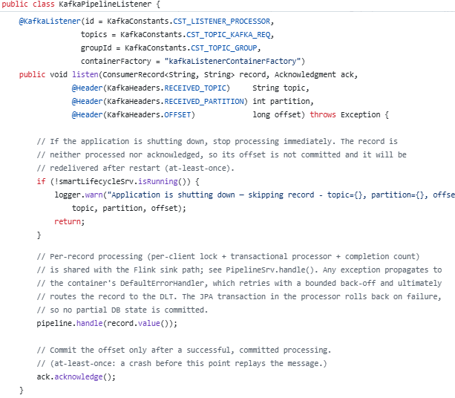
05 / OPERATE AND DISTRIBUTE
GRACEFUL SHUTDOWN
Shutdown is part of system adjustments
The grace period must allow in-flight work to finish and resources to close in the right order.
1
2
3
4
Remove traffic
Signal shutdown
Finish
in-flight work
Close
resources
Readiness / drainage
preStop / SIGTERM
Commit / Ack
Before the grace period ends
#
server:
shutdown: graceful
#
lifecycle:
timeout-per-shutdown-phase: 45s
#
application.yml
Shutdown in progress.
For Kafka producers and consumers, graceful shutdown is
a critical requirement, not an optional optimization.
A clean shutdown reduces reprocessing; idempotence makes reprocessing possible.
Kafka Engineering Guide · EDA Project
29
Notes:
Note:
Follow the operational sequence without promising that it covers a machine failure. The platform removes the pod from traffic, optionally runs preStop, sends SIGTERM, then forces SIGKILL if the deadline expires.
The application must stop accepting new work, let in-flight work finish, commit the effects and then the corresponding offsets, and close producers/consumers. The overall deadline includes preStop and the application's shutdown phases.
An abrupt stop can prevent any cleanup; recovery semantics and idempotence therefore remain necessary.

Slide 30
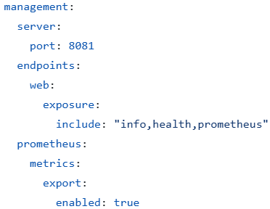
05 / OPERATE AND DISTRIBUTE
PROBES AND AVAILABILITY
Three probes answer three different questions
A service access failure and an unrecoverable process do not call for the same reaction.
Startup
Liveness
Readiness
Has startup completed?
Do not judge a JVM too early during initialization.
Is the process healthy?
A failure can cause it to restart.
Can it receive traffic?
A failure removes the pod from the service endpoints.
File: application.yml.
For Kafka producers and consumers.
Internal state management is a critical requirement.
Health: a quick decision. Metrics: a measure of behavior over time.
Kafka Engineering Guide · EDA Project
30
Notes:
Note:
Startup, liveness, and readiness must be distinguished.
Startup protects the startup phase.
Liveness concerns the process's health and can lead to its restart.
Readiness concerns its ability to receive service traffic, and removes the pod from the endpoints without stopping it.
Health indicators must be fast; durations, counters, and gauges belong to metrics. The project provides commands to toggle liveness/readiness and observe Actuator. Stress that HTTP readiness does not replace explicit control over Kafka consumption.

Slide 31
06 / PROVE AND CHOOSE
TOPIC GOVERNANCE
A contract turns a topic into an understandable interface
Governance makes the meaning of the data, responsibilities, and usage conditions explicit.
Business meaning
Ownership
Schema
Definition and event examples.
Responsible team and support.
Version and compatibility rules.
Dependencies
Service
Protection
Producers, consumers, and lineage.
Freshness, availability, and quality.
Access, classification, and retention.
A topic without a contract or owner creates a dependency that is difficult to operate.
Kafka Engineering Guide · EDA Project
31
Notes:
Note:
Present this sheet as a governance template drawn from the guide, not as the inventory of an already-deployed catalog.
Document the meaning, the owner, the schema, producers/consumers, service objectives, and access/retention rules.
Schema compatibility and the contract's lifecycle must be explicit.
The Data Mesh/Data Fabric documentation notes that the sandbox's Java types form an implicit contract; an enterprise platform must externalize discovery, metadata, and governance.
Question: who is responsible if a message stays stuck in the DLT? That owner belongs to the operational contract.

Slide 32
06 / PROVE AND CHOOSE
DATA MESH / DATA FABRIC
Ownership and platform are complementary
The guide does not present Data Mesh and Data Fabric as two competing products.
Data Mesh: who and why?
Data Fabric: how to connect?
Domain ownership.
Data as a product.
Self-service platform.
Federated governance.
Integration and connectors.
Catalog and lineage.
Policies and quality.
Shared access and observability.
Kafka can support these approaches; it replaces neither ownership nor governance.
Kafka Engineering Guide · EDA Project
32
Notes:
Note:
Data Mesh is about the operating model: domain ownership, data as a product, a self-service platform, and federated governance.
Data Fabric is about the shared capabilities that connect distributed data: integration, metadata, quality, access, and observability.
The documentation explains that a hybrid model can combine both, and that Kafka is not mandatory for every data product.
A topic does not automatically become a product, and a Kafka cluster alone does not make a Fabric. The sandbox remains an educational application; it is neither one nor the other at enterprise scale.

Slide 33
06 / PROVE AND CHOOSE
DATA CORROBORATION
A consumed message does not prove that the state is correct
Corroboration compares representations of the same facts and looks for discrepancies.
Processed requests
Expected state
Persisted state
Quantities, operations
and results
Cumulative effect
of processing
Inventory and balances
to compare
Concrete control: do executed requests reconcile
with inventory movements and the customer balance?
Idempotence: do not apply twice. Corroboration: verify the overall result (integrity).
Kafka Engineering Guide · EDA Project
33
Notes:
Note:
Go back to Banana: a pipeline can consume all its messages while still committing an incorrect quantity.
Corroboration complements idempotence and delivery guarantees.
In this database-centric project, the relational tables are the system of record; Kafka triggers their mutations.
The sandbox should therefore not be presented as an event-sourcing implementation.
Compare executed requests, their quantities and operations, with the expected inventory movements.
Counts by result are a first signal; they are not enough to prove every invariant.

Slide 34
06 / PROVE AND CHOOSE
CORROBORATION STRATEGY
Data corroboration in EDA
Event delivery never guarantees that systems remain consistent with each other.
01
Frequent
Process sequence
Result counts.
Checksums.
Detect
→
Locate
→
Classifier
Processed requests
02
Periodic
State snapshots.
Business invariants.
Expected/actual comparison.
Expected state
↓
Repair
→
Audit
(Log)
03
Deep-dive
Persisted state
Reconciliation replay.
Ghost consumer.
Gap audit.
Repair without losing the audit trail; replay without reapplying effects twice.
Kafka Engineering Guide · EDA Project
34
Notes:
Note:
There is no single miracle check.
Counts and checksums quickly flag a discrepancy.
Snapshots and invariants provide periodic checkpoints.
Replay and ghost consumers allow a deeper comparison, in particular for a migration.
Hashes require state that is represented deterministically.
A discrepancy must be located, classified, repaired, and then logged.
Eventual consistency: rebalances, crashes, and network failures create silent discrepancies
Layered techniques: checksums, snapshots, event replay, ghost consumers
Business invariants (stock never negative) as the first visible symptom of drift

Slide 35
06 / PROVE AND CHOOSE
ETL / SOA / EDA
They are not three rungs on a maturity ladder
The documentation compares complementary integration styles that place complexity in different locations.
Dimension
ETL (batch)
SOA (synchronous)
EDA / Kafka
Interaction
Scheduled tasks.
Request-response.
Publication and consumption.
Sought value
Bulk movements
and preparation.
Immediate result
for the requester.
Independent consumers, buffer, and replay.
Complexity to master
Schedules, lineage
and quality.
Availability, calls
and compensation.
Ordering, duplicates, DLT
and eventual consistency.
The right question: which mechanism meets the need with manageable complexity?
Kafka Engineering Guide · EDA Project
35
Notes:
Note:
Keep the conclusion chapter's framing: here, ETL mainly means batch integration, and SOA mainly means synchronous interactions through services/APIs.
These definitions set the scope of the comparison; they are not exhaustive definitions.
ETL organizes schedules, transformations, and quality controls. SOA organizes interfaces, calls, and availability dependencies. EDA organizes events, contracts, recovery, and asynchronous effects.
EDA reduces some coupling, but keeps semantic and platform coupling. The guide recommends choosing a mechanism that is sufficient for each interaction, and considers a hybrid model.

Slide 36
06 / PROVE AND CHOOSE
TCO ET ROI
Justify EDA by its value, not by the platform choice
Compare options over the same horizon and make assumptions, costs, and benefits explicit.
TCO: the full cost
ROI: measurable benefits
Platform and environments.
Engineering and operations.
Accuracy, testing, and reconciliation.
Governance and security.
Faster reaction.
Event reuse.
Independent evolution.
Replay, audit, and restoration.
Architecture: needs + options + guarantees + TCO/ROI + owners + review criteria.
Kafka Engineering Guide · EDA Project
36
Notes:
Note:
The TCO/ROI chapter does not provide a costed business case for this project; it provides a decision framework.
Costs include the platform, engineering, operations, accuracy, and governance — not just Kafka.
Benefits can come from event reuse, responsiveness, decoupling, and replay. They must be tied to measurable outcomes and compared against a simpler option.
The ADR records the need, the guarantees, the assumptions, the responsibilities, and the criteria for re-evaluation.
Do not invent an ROI percentage or financial gains.

Slide 37
06 / PROVE AND CHOOSE
FROM LAB TO OPERATIONS
The sandbox makes limits visible; it does not erase them
Ease of local execution and production architecture guarantees are two distinct objectives.
For local learning
Toward a production target
Embedded engines and database.
External services, shared state, and explicit durability.
In-JVM Flink bridge and temporary storage.
Target runtime, connectors, and validated restore.
Educational options and dashboards.
Security, contracts, monitoring, and operable procedures.
Intentional concurrency anomalies.
Protected invariants and tested failure scenarios.
Every guarantee must be tied to a scope, an assumption, and a proof.
Kafka Engineering Guide · EDA Project
37
Notes:
Note:
This slide summarizes the limitations the documentation explicitly acknowledges.
The engines and the database are embedded for learning purposes. Configuration values and in-JVM shortcuts are not production contracts.
The Outbox, the catalog, state sharing, security hardening, and elasticity all require design and validation specific to the target environment.
Do not turn this list into an audit report: the findings and fixes from the earlier code review are not the subject of this deck. The goal is for students to be able to distinguish a reproducible experiment from a complete operational architecture.

Slide 38
HANDS-ON PRACTICE
WORKSHOP PROPOSAL
Four experiments to connect concepts to observations
Demo
Prepare a comparable starting state, change only one variable, and explain what is observed.
01
With / without key
Does ordering by product change inventory?
02
Replay and idempotence
Which effect must not be applied twice?
03
Replay and idempotence
Which effect must not be applied twice?
04
Business verification
Do the requests explain the final inventory?
Observe → formulate a hypothesis → modify one variable → explain the result (perform manual corroboration).
Kafka Engineering Guide · EDA Project
38
Notes:
Note:
An educational proposal built from the documentation's experiments, not a test procedure already carried out.
Compare with and without the key on the same dataset: observe ordering and quantities, then explain the race.
Test an authorized replay and observe the statuses and the journal: identify what must not be applied twice.
Compare the direct pause with the Flink pause: distinguish group membership from a savepoint.
Examine the processed requests and the stock: show why transport alone does not prove correctness.
Prepare the corrected version and the scenarios before the session; do not trigger a reset while a batch is still active.

Slide 39
CONCLUSION
KEY TAKEAWAYS
A resilient EDA is built end to end
The value of the project is to make visible the responsibilities that transport alone does not handle.
Delivering a message, applying an effect, and proving the result
are three distinct responsibilities.
01
Order by entity
02
Define atomicity boundaries
03
Tolerate duplicates
04
Prepare recovery
05
Verify the data
06
Justify complexity
Discussion: what guarantee are you claiming, and how would you demonstrate it?
Kafka Engineering Guide · EDA Project
39
Notes:
Note:
Revisit the six takeaways without adding any new guarantee.
The key expresses business ordering.
The transactional boundary defines what is atomic.
Idempotence makes it possible to tolerate redelivery.
The runtime and the partitions bound parallelism and recovery.
Observability and corroboration distinguish functioning from correctness.
Finally, governance and TCO/ROI bring the technology choice back to the actual need.
Closing question: for a new integration, what evidence would you ask for before calling its processing reliable?
The appendices provide reference points for further reading and for preparing technical discussions.

Slide 40
APPENDIX A
SOURCES / FOUNDATIONS
Find the journey chapters in the project
Paths are relative to doc/. Each slide also has detailed sources in the notes.
Project presentation
Architecture and topics
README.md
architecture_and_topic_design.md
Data and journal
Report comparison
database.md
reports.md
Delivery and reliability
Acknowledgement and idempotence
reliability_and_delivery_semantics.md
consumer_acknowledgement_and_idempotency.md
Persistence and transactions
Embedded Kafka, Flink, and Hazelcast
persistence_and_transaction_patterns.md
sandbox_guides.md
References for this deck: project documentation.
Kafka Engineering Guide · EDA Project
40
Notes:
Note:
This reading map makes it possible to return to the original documentation after the presentation.

Slide 41
APPENDIX B
SOURCES / DEEP DIVES
Continue from technical resilience to trust
The progression links execution mechanisms, operations, governance, and architecture choice.
Sandbox Flink path
Flink / Spring Boot integration
flink_guides.md
flink_springboot.md
Lifecycle and operations
Distribution and shutdown
lifecycle_and_operations.md
dist_scale_and_shutdown.md
EKS elasticity
Governance and observability
horizontal_elasticity_keda_karpenter.md
governance_and_observability.md
Corroboration
Data Mesh / Data Fabric
data_corroboration.md
datamesh_datafabric.md
ETL / SOA / EDA choices and TCO/ROI
conclusion_etl_soa_eda_tco_roi.md
References for this deck: project documentation.
Kafka Engineering Guide · EDA Project
41
Notes:
Note:
This reading map makes it possible to return to the original documentation after the presentation.

Slide 42
APPENDIX C
IDEMPOTENCE
Read JRN_EVENT without confusing its responsibilities
The journal distinguishes a processing identity, correlation, nature, and outcome.
Field
Question it answers
JRN_EVENT__ID
Primary key. Is this the surrogate key?
CONSUMER_ID + EVENT_ID
Which consumer processed which event?
BATCH_ID
Which publication does it belong to?
EVENT_TYPE
First delivery or deliberate replay?
RESULT
PENDING, BACK_ORDER, EXECUTED, or ERROR?
PAYLOAD_HASH / dates
What content and processing chronology?
Kafka Engineering Guide · EDA Project
42
Notes:
Note:
This appendix relies on the JRN_EVENT schema, not on a new interpretation of the replay headers.
CONSUMER_ID and EVENT_ID form the business key (UNIQUE constraint), used for lookups.
JRN_EVENT_ID is the technical primary key (identity), distinct from that business key.
BATCH_ID correlates a publication.
EVENT_TYPE indicates a first delivery or a replay.
RESULT indicates the outcome.
PAYLOAD_HASH and the dates enrich traceability.

Slide 43
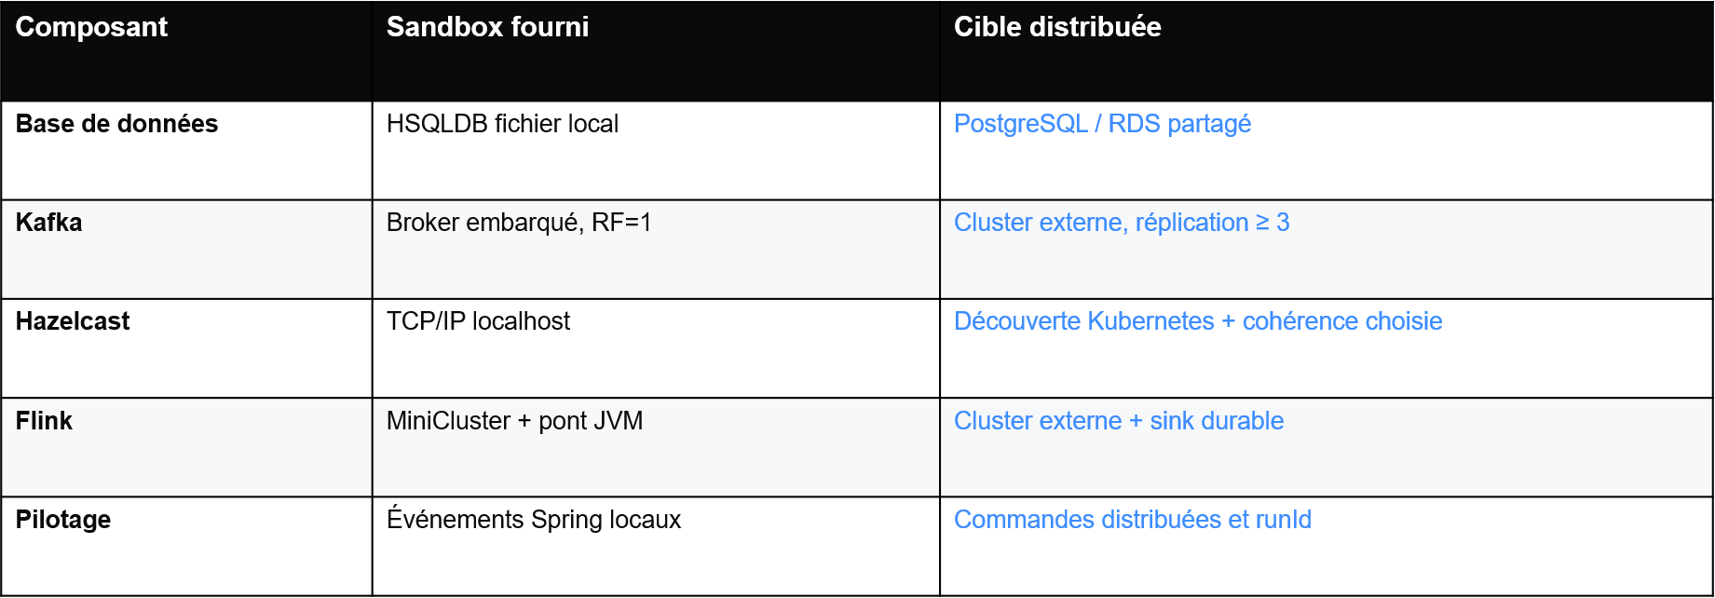
APPENDIX D
EXTERNAL DEPENDENCIES
Local dependencies to replace in production
The sandbox project is an educational tool.
Kafka Engineering Guide · EDA Project
43
Notes:
Note:
A Sandbox remains an educational tool.

Slide 44
APPENDIX E
CHOICES AND LIMITATIONS
Sandbox limitations
The sandbox project is an educational tool. Some choices were made to facilitate learning and/or implementation.
Limitation
Description
Pause
The pause feature assumes a single process. The implementation must be refined for PROD.
Replay
Replay is very simplistic and intended for demonstration, not a real implementation. To be refined for PROD.
RDBMS Model
The model is intentionally simplistic. Customer: customer, account, balance, trx. Inventory: category, model, etc.
Sandbox
Only the Kafka Sandbox is production quality. Flink is a base, and Hazelcast requires refactoring: Datagrid Sandbox.
Flink / In-JVM
Exploratory in-JVM implementation to avoid having to redo the implementation in Spring Boot.
Token / EVT
To facilitate implementation of the “replay”. The token does not contain the “version” field.
Security
The security is intentionally simplistic, with hard-coded values. The JWT token is stored in the browser.
Kafka Engineering Guide · EDA Project
44
Notes:
Note:
A Sandbox remains an educational tool.

