Slide 1
Technosphere
BW2 foreground database:
FG act.
Custom act.
Modified act
Foreground
Activity
Production Device 1
Life cycle Device 2
…
Foreground
V1
Custom act:
IC backend
IC frontend
Die-casted aluminium
…
Modified act:
PCB
Abstraction level:
…
Background
“component”
IC
Diode
PCB
BW2 LCA original
database
(ecoinvent
3.9.1_cutoff)
“material”
Wafer
Gold
Copper
FR4
Alu
…
“transport”
Truck transport
…
…
Elec
Water
Life cycle inventory
Biosphere
BW2 biosphere database
Elementary flows
Carbon dioxide, Air …
Arsenic ion, Water …
Zinc II, Water …

Slide 2
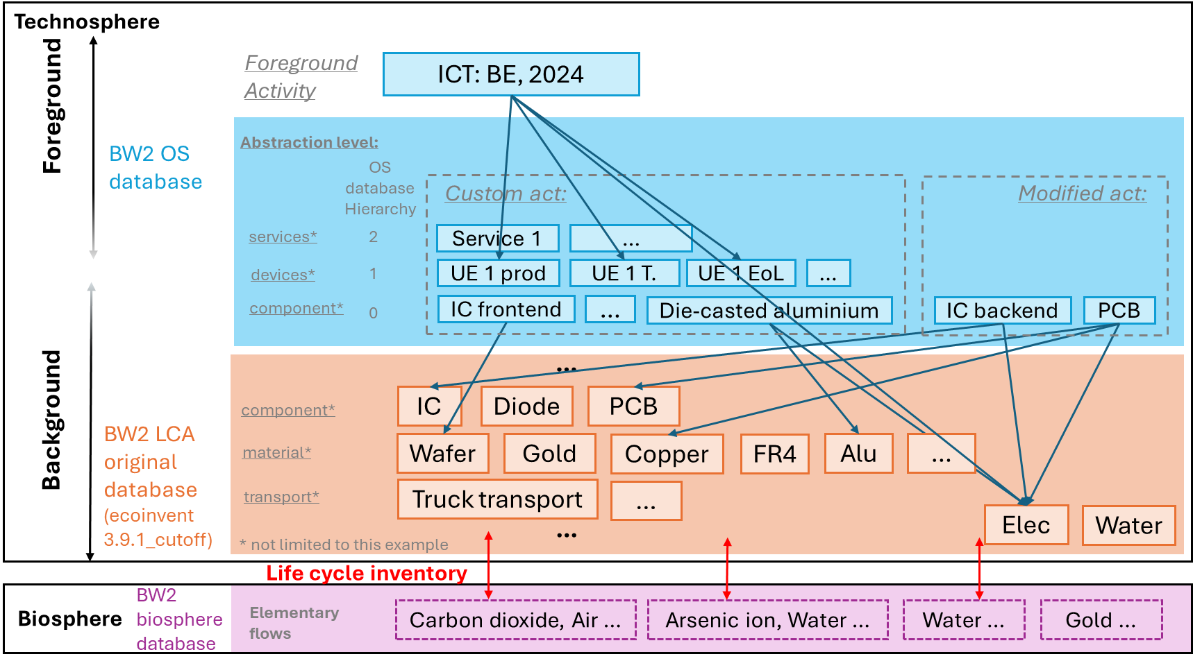
Technosphere
Foreground
Activity
ICT: BE, 2024
Foreground
BW2 OS
database
Abstraction level:
V2
OS database Hierarchy
Custom act:
Modified act:
services*
2
Service 1
…
devices*
1
UE 1 prod
UE 1 T.
UE 1 EoL
…
component*
0
IC frontend
…
Die-casted aluminium
IC backend
PCB
…
Background
component*
IC
Diode
PCB
BW2 LCA original
database
(ecoinvent
3.9.1_cutoff)
material*
Wafer
Gold
Copper
FR4
Alu
…
transport*
Truck transport
…
…
Elec
Water
* not limited to this example
Life cycle inventory
BW2 biosphere database
Biosphere
Elementary flows
Carbon dioxide, Air …
Arsenic ion, Water …
Water …
Gold …

Slide 3
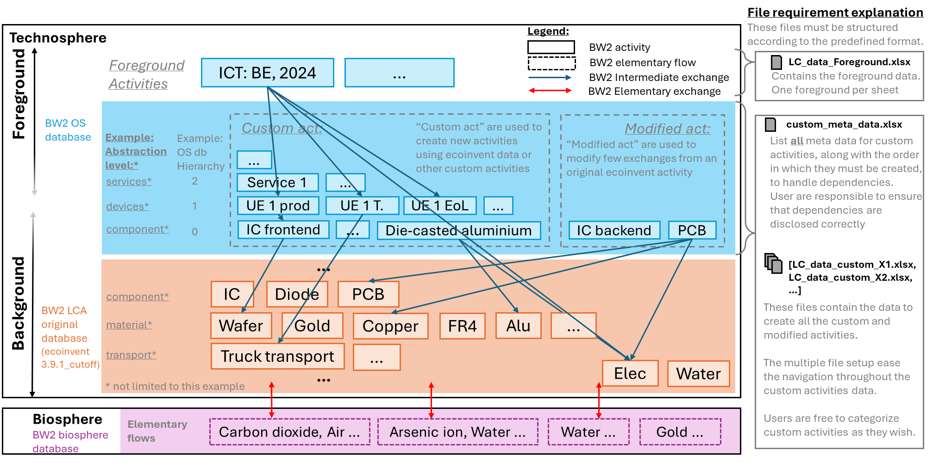

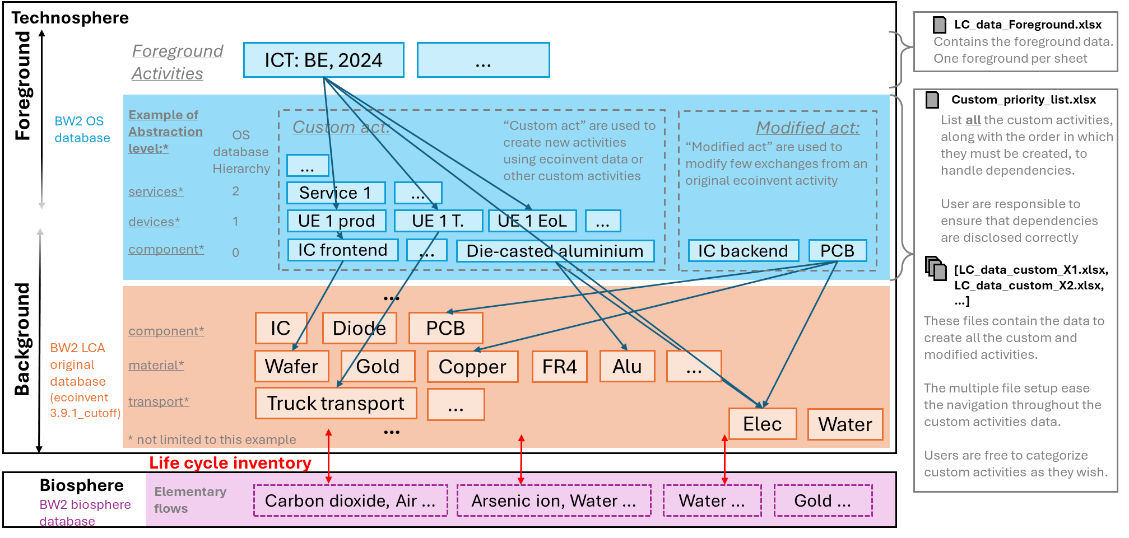
File requirement explanation
These files must be structured according to the predefined format.
Technosphere
Legend:
BW2 activity
Foreground
Activities
ICT: BE, 2024
…
BW2 elementary flow
LC_data_Foreground.xlsx
BW2 Intermediate exchange
Contains the foreground data. One foreground per sheet
Foreground
BW2 Elementary exchange
BW2 OS
database
Custom act:
“Custom act” are used to create new activities
using ecoinvent data or other custom activities
Modified act:
custom_meta_data.xlsx
Example:
Abstraction level:*
Example:
OS db Hierarchy
“Modified act” are used to modify few exchanges from an original ecoinvent activity
List all meta data for custom activities, along with the order in which they must be created, to handle dependencies.
User are responsible to ensure that dependencies are disclosed correctly
…
services*
2
Service 1
…
devices*
1
UE 1 prod
UE 1 T.
UE 1 EoL
…
component*
0
IC frontend
…
Die-casted aluminium
IC backend
PCB
…
[LC_data_custom_X1.xlsx,
LC_data_custom_X2.xlsx,
…]
Background
component*
IC
Diode
PCB
BW2 LCA original
database
(ecoinvent
3.9.1_cutoff)
These files contain the data to create all the custom and modified activities.
The multiple file setup ease the navigation throughout the custom activities data.
Users are free to categorize custom activities as they wish.
material*
Wafer
Gold
Copper
FR4
Alu
…
transport*
Truck transport
…
…
Elec
Water
* not limited to this example
Biosphere
Elementary flows
BW2 biosphere database
Carbon dioxide, Air …
Arsenic ion, Water …
Water …
Gold …

