Slide 1
Design Review of Software Detailed Design for ArcLight Automation Map Bundle Testing
Prepared By: Michael Wolff
June 22, 2015
Revision: 02

Slide 2
Revision History
Date | Version | Summary
5/26/2015 | 01 | For Review
6/22/2015 | 02 | Added Minutes and minor updates; see SDD docx for as-built

Slide 3
Agenda
SDD Review
Recap from SSDD
1. Scope, 2. References, 3. CSCI, 4. Architectural Design
High-Level Design
4.1 CSCI Components, 4.2 Concept of Execution,
4.3 Interface Design
GUIs and APIs
Low-Level Design
Algorithms and Pseudo-Code sufficient for coding
Project Planning
Functional Aggregation, Risks, Contingencies
Schedule
WBS
Sprint Milestones

Slide 4
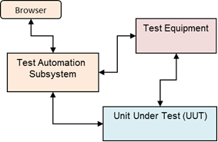
1. Scope
1.1 Identification
This document is the Software Design Description (SDD) for the Test Automation Subsystem Software Product Configuration Items (CSCI), product number [TBR], developed for the ArcLight program. This document describes the detailed design for the design specified in the ArcLight Automation for Map Bundles Testing SSDD, for the ArcLight Automation for Map Bundles Testing program.
1.2 System Overview
The Test Automation Subsystem will control Test Equipment and the ArcLight Unit Under Test to provide integrated automated/repeatable regression testing for Map Bundles, specifically Trickle Download of Map Bundles Verification, Map Bundle Upload via Terminal Webpage Verification, Precedence Verification of Map Bundles and Forward Link Lock Verification of Map Bundles.
The Test Automation Subsystem will support a simple “LAMP” (Linux, Apache, MySQL, PHP/Python) web-stack for external Browser based test launch management (very basic) interface and test results review.

Slide 5
2. References
Identifier (number or short mnemonic) | Document Number | Document Title | Date
REF-21-01 | DI-IPSC-81435A | Software Design Description (SDD) | 15 Dec 1999
Identifier (number or short mnemonic) | Document Number | Document Title | Date
REF-22-01 |  | https://dev.mysql.com/doc/refman/5.7/en/linux-installation-rpm.html
Identifer (number or short mnemonic) | Document Number | Document Title | Date
REF-23-01 |  | //Arclight/ArcLight/AcceptanceTest/ Automation/ MapTesting/ AL_Automation_SSDD.pptx
REF-23-02 |  | //Arclight/ArcLight/AcceptanceTest/ Test_Procedures/ AL1_Mapbundles_TestProcedure.docx

Slide 6
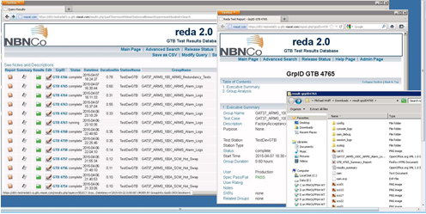
3 CSCI-WIDE DESIGN DECISIONS
Implementation will be a phased approach with core functionalities rapidly developed and integrated according to the WBS.
Precedence processing will not be done as a group of N-maps all at once, but rather will be a group of N-results of individual precedence tests.
Existing scripts for a ViaSat general purpose Selenium wrapper are available in python for use as-is, and should be used as the base class for deriving any additional functionality, i.e., new member functions.
Existing scripts for ReDa come with many GUI based advantages such as Results presentation and phpMyAdmin which make porting the exiting code a net advantage to the project; see Figure 2 and Figure 3. The updates are minor, but a slight re-work to the GUI entry-point, i.e. index.html, is needed to support both ReDa and the ArcLight Test GUI.
Existing ReDa library API’s are available in other scripting languages which also include other unneeded project specific extras; these models can be used as a guide to adapt to ArcLight automation.

Slide 7
3.1 Unresolved Design Decisions
The following design decisions need further investigation and resolution to complete the design,
Generating map coordinates on the Linux based server
Is Matlab licensing for Linux easily available with existing license for Windows?
What is LOE for updating scripts for GNU Octave as an alternative to Matlab?
Generating kml file on the Linux based server
Is Matlab licensing for Linux easily available with existing license for Windows?
What is LOE for updating scripts for GNU Octave as an alternative to Matlab?
Human decisions WRT Google Earth of .kml

Slide 8
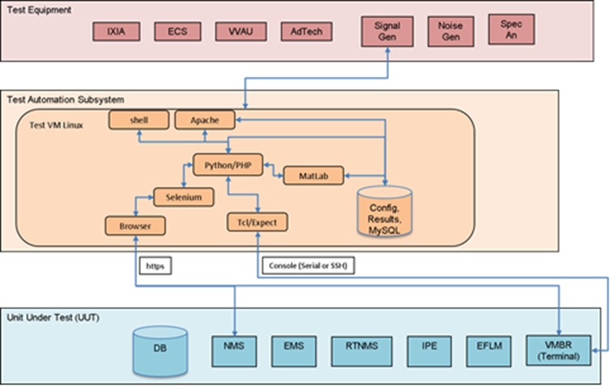
4 CSCI ARCHITECTURAL DESIGN
Defines software architecture at the component level
Focuses on the inter-component interactions, i.e. the software high-level design.
Diagram shows COTS products perspective of system architecture from which the software architecture is derived.
The Apache, MySQL, and Python/PHP elements, all running on Linux, provide the framework for external browser based command and control of the test system.
The Python/PHP, Matlab [TBR], Selenium, Browser, Tcl/Expect elements provide the framework for control of the ArcLight system (unit under test).

Slide 9
4.1 CSCI Components
ArcLight Test GUI manages simple set of html webpages for launching tests and getting results
(ArcLight Test Cases is a conceptual CSCI)
ArcLight Automation Manager, which manages and controls test case execution that can be launched from AL Test GUI or Linux shell.
Common configuration of test database and files
Utilize API layers to manage devices during execution of test procedures
Extensible for additional test cases
Follows standardized results logging API (or ReDa)
Map Bundles Test Cases, which is a collection of scripts/objects for executing the map bundles test suite
mapBun Trickle
mapBun Terminal Upload
mapBun Precedence
mapBun FL Lock
Any other added Test Cases
ArcLight GUI is a collection of scripts/objects for automating ArcLight NMS/EMS and Terminal GUI actions through the ViaSat Selenium CSCI or the Selenium Library.
ViaSat Selenium is an existing collection of common scripts/objects for automating ViaSat browser based GUI actions.
ArcLight Devices is a collection of scripts/objects for automating ArcLight devices through console interfaces, i.e. serial or ssh based CLI.
GTAF Devices is a collection of scripts/objects for automating test equipment and providing a layer of common drivers for serial or ssh communications.
ArcLight Database is a collection of scripts
MySQL is the customization scripts for the COTS component.

Slide 10
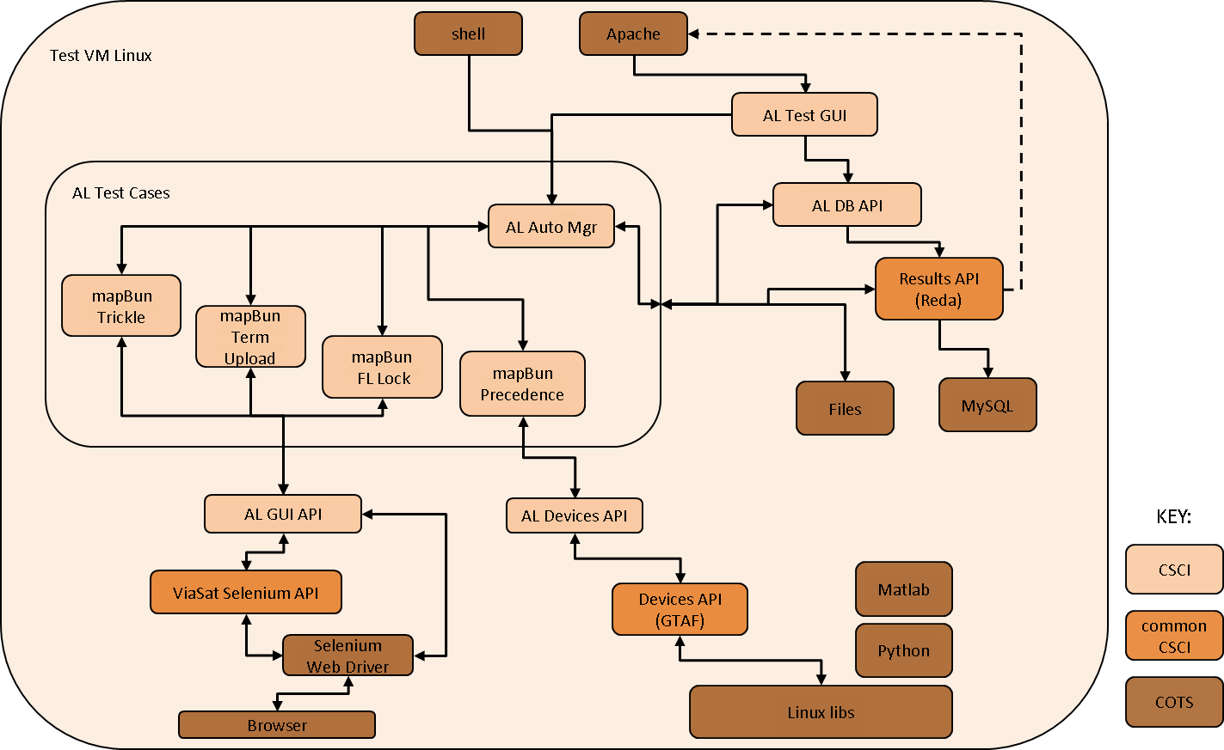
CSCI Components Interaction

Slide 11
4.2 Concept of Execution (per Trickle Test Use Case diagram)
The user at external browser creates the initial action with an HTTP GET (http interface) seen at the Apache server, thereby triggering a processing thread (Python/PHP script call).
After initial configuration is set and stored in MySQL (sql interface), the test case (trickle) is started.
The AL Test manager
invokes the mapbunConf API to configure the instance
invokes the mapbunTrickle API to execute the trickle of the bundle data associated with the instance
mapbunTrickle uses ALGUI API’s that drive Selenium to
Login to the NMS
Upload the Map to NMS
Configure the download on NMS
At that point the UUT will download the bundle to the VMBR
Login to the Terminal
Get bundle version Status from the Terminal
Verify that status for pass/fail of the trickle
Invoke ALDB APIs that Store the results in MySQL
The user views test results through the test results menus of the GUI

Slide 12
Trickle Test Use Case

Slide 13
4.3 Interface Design
Describe the interface characteristics of each software units.
Apache - HTTP
MySQL - SQL
All other CSCI - API
Describe the API of each CSCI component as a Unix style Manual Page
4.3.2.1 Apache Interface
Apache will be configured to permit CGI execution, but must also support location(s) compatible with ReDa; ReDa scripts will be deployed to the “DocumentRoot” location specified in httpd.conf
As such, the file /etc/httpd/conf /httpd.conf will contain the following items:
ServerRoot "/etc/httpd"
LoadModule cgi_module modules/mod_cgi.so
ScriptAlias /cgi-bin/ "/var/www/cgi-bin/"
DocumentRoot "/var/www/html“
4.3.2.2 AL Test GUI Interface
The ArcLight Test GUI CSCI provides scripts responsible for managing the Human Machine Interface. This section describes the screens available and the URL requests that will be sent to the AL Test Linux device
See GUI screens below

Slide 14
4.3.2.2.1 Screens Interface
Main (Homepage) - Contains buttons to the launch, results and configuration pages, see Figure 7 - Homepage
Test Execution - Contains ability to launch test case(s), see Figure 8 - Test Launch Screen
Test Results - Contains the executed test case status and results, see Figure 9 - Test Results Screen
[TBR] Results screen will be replaced with ReDa screen or deferred until ReDa can be ported.
Test Configuration - Contains all parameters and will be saved in database with the exception of database parameters saved in a configuration file, see Figure 10 - Configuration Screen
Map Bundles Test Configuration Form - Contains following parameters needed for the map bundles testing
Map bundle zip file [from email/perforce]
Forward Link Profile Name
Satellite Name
NMS/EMS Connection - The IP, Port username and password needed for ArcLight NMS/EMS GUI access.
Terminal Connection - The IP, Port username, password, and Terminal Name needed for ArcLight Terminal GUI access, and ssh/serial, and Terminal console name (if serial), for console/CLI access
Tuning Parameters - Runtime parameters used by the various Test Automation algorithms, e.g. map precedence duration

Slide 15
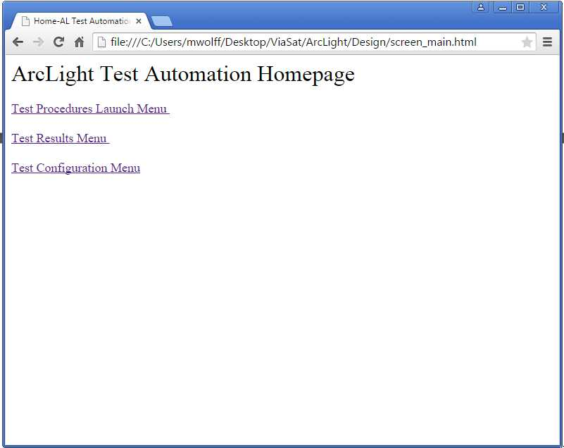
Automation Homepage

Slide 16
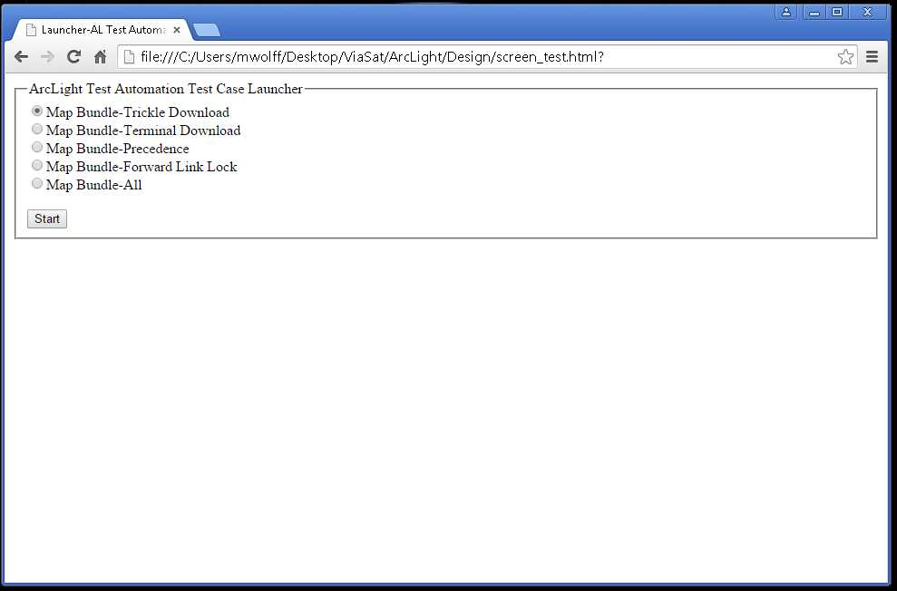
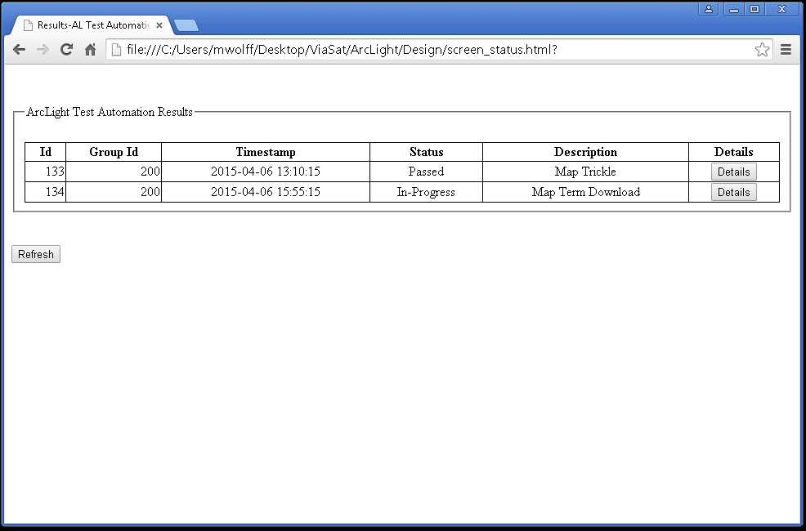
Test Launch and Results

Slide 17
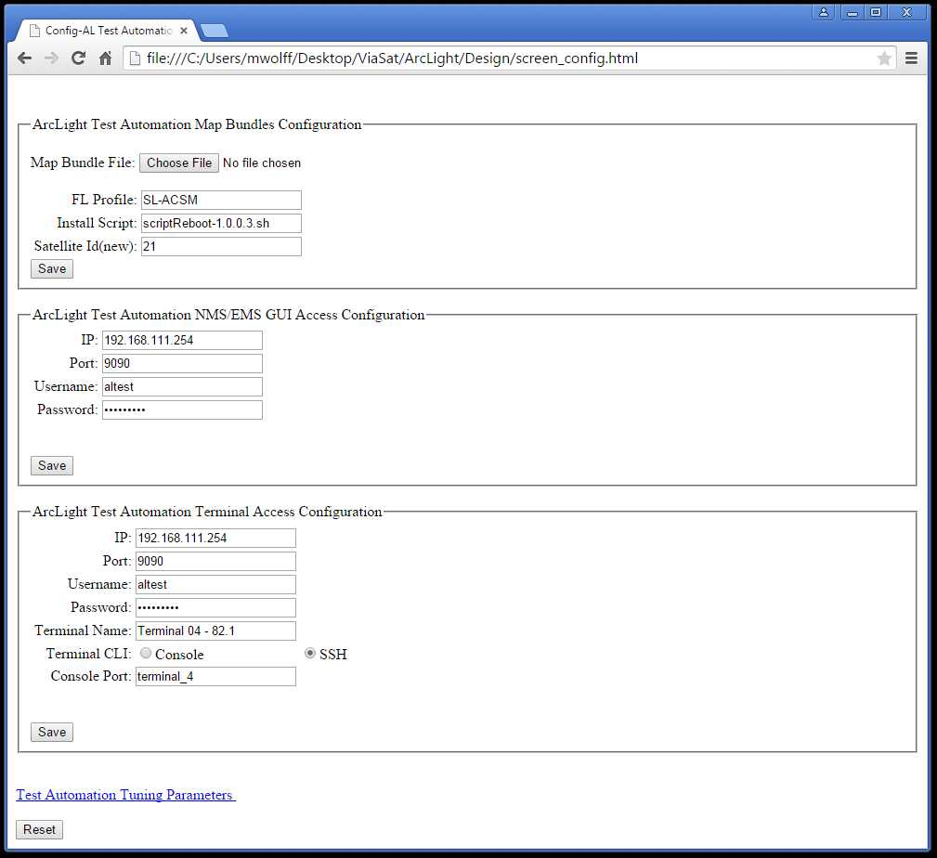
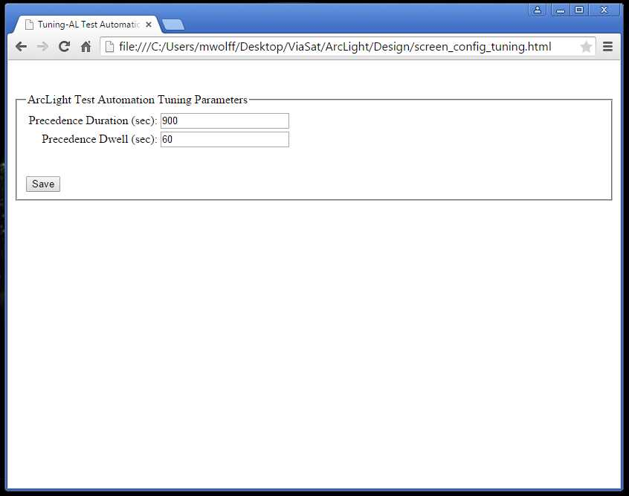
Configuration Screens

Slide 18
4.3.2.2.2 AL Test GUI Scripts Interface
This section defines the ArcLight Test GUI “web services” interface, including the expected parameters passed into action scripts from Apache. This definition provides the necessary ICD information needed for scripts as well as for HTML launched from the Test GUI Browser (encoded in the scripts). Unless otherwise specified, the access is a GET.
http://altest.allab.viasat.com /index.html
http://altest.allab.viasat.com/altgTest.php?
http://altest.allab.viasat.com/ altgTestStart.php? Test=<TEST>
where <TEST> is one of
mapTrickle
mapTerminal
mapPrecedence
mapFllock
mapAll
http://altest.allab.viasat.com/altgConfig.php?
http://altest.allab.viasat.com/ altgConfigMap.php?
$_FILES
Map Bundles zip file
mapProfile=
mapScript=
mapSatellite=
http://altest.allab.viasat.com/altgConfigNms.php?
nmsIp=
nmsPort=
nmsUsern=
nmsPassw=
http://altest.allab.viasat.com/altgConfigTerm.php?
termIp=
termPort=
termUsern=
termPassw=
http://altest.allab.viasat.com/altgConfigTuning.php?
TBR
http://altest.allab.viasat.com/altgStatus.php?
http://altest.allab.viasat.com/ altgStatusDetails.php?TestId=<VALUE>\

Slide 19
4.3.2.3 AL DB Interface
Several parameters are needed to make a database connection and will be stored in a user config file, initially as a Python formatted import file that is intuitively a tag/value format, to overcome the “chicken or the egg” problem with storing database connection info in the database. The parameters are: database name, hostname, port number, username, and password, and will be managed by the aldbConn and aldbConnConfig package(s) with member functions for retrieving by scripts for database access.
Additionally, the ArcLight Database Model is managed by this package/layer. In general, the GUI sets configuration items that the AL Test Cases (Automation Manager) accesses (gets/retrieves) to execute tests according to the configuration.
SYNOPSIS
ALDB - ArcLight Database API
SYNTAX
from aldbConn IMPORT *
from aldbConnConfig IMPORT *
from aldbConf IMPORT *
def aldbConnParmsGet():
return { ‘dbname’:dbname, ‘dbhostname’:dbhostname, ‘dbportnum’:dbportnum, ‘dbusername’:dbusername, ‘dbpassw’:dbpassw }
class aldbConf(object):
def __init__(self, groupId):
def aldbConfNmsGuiSet(self, ip, port, usern, passw):
def aldbConfNmsGuiGet(self)
return(‘ip’:ip, ‘port’:port, ‘usern’:usern, ‘passw’:passw):
def aldbConfTermGuiSet(self, ip, port, usern, passw, name):
def aldbConfTermGuiGet(self):
return(‘ip’:ip, ‘port’:port, ‘usern’:usern, ‘passw’:passw, ‘name’:name):
def aldbConfMapbunSet(self, filename, profile, script, satid):
def aldbConfMapbunGet(self)
return(‘filename’:filen, ‘profile’:profile, ‘script’:script, ‘satId’:satid):
def aldbConfMapbunDetailedSet(self, signed, sedver, sscfver, rlcver, gdrmver):
def aldbConfMapbunDetailedGet(self)
return{ ‘sedVersion’:sedver, ‘sscfVersion’:sscfver, ‘rlcVersion’:rlcver, ‘gdrmVersion’:gdrmver}
def aldbConfDirsGet():
return { ‘groupId’:groupId, ‘baseDir’:baseDir, ‘configDir’:configDir, ‘resultDir’:resultDir}:
DESCRIPTION
The ALDB API provides methods for managing the database for the ArcLight Automation device, by providing a common layer most notably accessed by the AL GUI and the AL Test Cases
The aldbConnConfig.py file is the user customizable file with the following format:
dbname=altest
dbhostname=localhost
dbportnum=1234
dbusername=al1
dbpassw=Viasat123

Slide 20
4.3.2.4 AL Test Cases
SYNOPSIS
ALAM - ArcLight Automation Manager API
SYNTAX
from alAutoMgr IMPORT *
class alam(object):
def __init__(self):
def alamTestStart(self, testType, testId, groupId):
DESCRIPTION
The ALAM package provides methods for configuring and starting automated tests.
alamTestStart() launches the test of testType for testId and groupId. testType dictionary is {‘trickle’:1, ‘upload’:2, ‘fllock’:3, ‘precedence’:4, ‘all’:5}
SYNOPSIS
MAPBUN - Map Bundles API
SYNTAX
from mapBundles IMPORT *
class mapbun(object):
def __init__(self, groupId):
def mapbunConf(self):
def mapbunTrickle(self, testId):
def mapbunUpload(self, testId):
def mapbunFLLock(self, testId):
def mapbunPrecedence(self, testId):
DESCRIPTION
The MAPBUN package contains common methods for setup and management of files, checksums and other test collateral needed by all map bundles tests, as well as specific methods for executing the Map Bundles test suites for trickle, upload, forward-link lock and precedence.
__init__()associates the manpbun instance to a specific results Group Id for accessing all configuration for the suite of tests to a common set of data.
mapbunConf() installs the configuration data (bundles zip file) to the config-results and builds out the extracted files and computes the md5 checksums.
mapbunTrickle() executes the trickle download test using the map bundle associated with the group id of the class/instance. The NMS/EMS is configured and the map is verified at the terminal.

Slide 21
4.3.2.5 AL GUI Interface
SYNOPSIS
ALG - ArcLight GUI API
SYNTAX
from alGui IMPORT *
class algElements(viasatSelenium):
__init__(self, resultsDir):
def algClickMenuTab(self, TAB):
def algClickSubMenuLink(self, LINK):
def algSelectTableRow(self, COLUMN_NUM, TARGET):
def algLogin(self)
def algLogout(self)
def algScreenShot(self, filename)
class algNms(algElements):
def __init__(self, url, user, pw, resultsDir):
def algNmsLogin(self)
def algNmsLogout(self)
def algNmsDnldMapUpload(self, file, isSigned, antennaType)
def algNmsDnldMapProfile(self, enabled, defBitRate, fl, script, dnldBitRatePercent, vmtList)
def algNmsDnldMapStatus(self)
return{ ‘percentage’:perc, ‘errors’:numErr, ‘done’:done, ‘installed’:installed }
class algEms(algElements):
def __init__(self, url, user, pw, resultsDir):
def algEmsLogin(self)
def algEmsLogout(self)
def algEmsAcsmFlUpdate(self, profileName, hub, txIf, rxFreq, chip)
def algEmsAcsmFlSelectProfile(self, TARGET_FL_PROFILE):
def algEmsAcsmFlName(self, FL_PROFILE):
def algEmsAcsmFlHub(self, HUB_NAME):
def algEmsAcsmFlHubCenterFreq(self, HUB_FL_CENTER, TERM_FL_CENTER):
def algEmsAcsmFlRfBand(self, RF_BAND):
def algEmsAcsmFlChipRate(self, FL_CHIP_RATE):
def algEmsAcsmFlRolloffFactor(self, ROLLOFF):
def algEmsAcsmFlPilot(self, PILOT):
def algEmsAcsmFlPbr(self, PBR_IP_1, PBR_IP_2, PBR_IP_3, PBR_IP_4):
def algEmsAcsmFlMcast(self, MCAST_IP):
def algEmsAcsmFlState(self, ACSM_ADAPT):
def algEmsAcsmFlModcode(self, MODCODE):
def algEmsAcsmFlExpandAdvanced(self):
class algTerm(algElements):
def __init__(self, url, user, pw, resultsDir):
def algTermLogin(self)
def algTermLogout(self)
def algTermMapUpload(self, sedfile, sscffile, rlcfile, gdrmfile)
def algTermConfVersion(self)
return{ ‘sedVersion’:sedver, ‘sscfVersion’:sscfver, ‘rlcVersion’:rlcver, ‘gdrmVersion’:gdrmver}
def algTermStatusFLLock(self)
return{ ‘waveForm’:waveform, ‘flState’:flState, ‘dlFreq’:dlFreq, ‘esno’:esno, ‘amplitude’:amplitude, ‘agc’:agc,
‘modcod’:modcod, ‘modul’:modul, ‘lbandFreq’:lbandFreq, ‘lnbloFreq’:lnbloFreq, ‘rfFreqOff’:rxFreqOff }
def algTermStatusVersion(self)
return{ ‘sedVersion’:sedver, ‘sscfVersion’:sscfver, ‘rlcVersion’:rlcver, ‘gdrmVersion’:gdrmver}
DESCRIPTION
The ALG package provides APIs for automating operator actions on the ArcLight GUI for NMS, EMS and Terminal with the algNms, algEms and algTerm classes, respectively. All of those classes support login and logout member functions; the remainder functions are defined as follows:
algNmsDnldMapUpload(), algNmsDnldMap(), and algNmsDnldMapStatus()support the NMS GUI portions of the map bundle trickle test to upload the file, initiate the FL download and check the trickle status from NMS perspective, respectively.

Slide 22
4.3.2.6 ViaSat Selenium Interface
The ViaSat Selenium (VSEL, or VSELENIUM) layer abstracts the Selenium libraries to create general purpose GUI operations intuitive across all platforms, i.e. click a button, or select an item from a list. This interface can be used for helping to automate any ViaSat browser-based GUI product with Selenium.
VSEL is derived (copied) from the Surfbeam Automation Manager code-base, specifically from the file //Broadband/TestTools/SAM/core/lib/Selenium2.py
SYNOPSIS
VSEL (or VSELENIUM) - ViaSat Selenium API
SYNTAX
from viasatSelenium IMPORT *
class vselenium(Selenium2):
def __init__(self, browserType, testResultsDir):
def findElementByLocator (self, locator):
def findClickableElement (self, locator):
def clickElement (self, locator):
def doubleClickElement (self, locator):
def isElementPresent(self, locator):
def isTextPresent(self, text):
def connectToServer(self, url, titleString):
def saveScreenshot(self, filename):
def disconnectFromServer(self):
def searchByText(self, locator, searchString):
def closeOpenedTabs(self):
def setTextField(self, locator, textString):
def submitForm(self, locator):
def selectMenuOption(self, menuLocator, optionLocator):
def isTextPresentInTextField(self, locator, textString):
def findElementsByLocator (self, locator):
def clickElementFromList(self, commonLocator, position):
# Extensions:
def timestamp(self):
def clickButton(self, TEXT):
def tearDown(self):
DESCRIPTION
The VSEL package provides general purpose GUI methods for locating, selecting, clicking browser objects as well as creating test artifacts by taking screenshots. This package can be used for helping to automate any ViaSat browser-based GUI product with Selenium.

Slide 23
4.3.2.7 AL Devices Interface
The ArcLight Devices Interface provides methods for controlling non-gui interfaces of ArcLight Equipment
The Terminal Console Interface provides methods for executing ArcLight Terminal commands whether connected via the serial port or ssh.
NOTE: Currently, the existing library handles via serial port; as such, some of these classes should be moved to the GTAF devices layer where a serial or ssh transport path can be chosen independently.
SYNOPSIS
TERMCON - ArcLight Terminal Console API
SYNTAX
from TermSerialCom IMPORT *
class TermCmd(object):
def __init__(self, tl):
def login(self, user, password):
def logout(self):
def setLatLong(self, lat, lon):
def getAttenuator(self):
def termcfg(self):
def termcfgVersion(self):
def termcfgStatus(self):
def termcfgRLConfig(self):
def getAttenLimit(self):
def reboot(self):
def reboot_error(self):
def waitConsoleTerm(self):
### Extensions
def setAntenna(self, antennaType)
FILES
//Arclight/ArcLight/AcceptanceTest/Automation/GTAF_TIDE/Scripts/utils/TermSerialCom.py

Slide 24
4.3.2.9 Results Database Interface
The ReDa API can be converted from the existing TCL package at //Broadband/TestTools/SAM/core/source/lib/RedaLibrary.tcl
SYNOPSIS
REDA - Results Database API
SYNTAX
from redaLib IMPORT *
class redaLib:
def __init__(self, deleteDbLog):
def addGroup(self, testStation, groupName) :
def updateGroupConfig(self, grpid, fields) :
def updateGroupResult(self, grpid, fields) :
def addVersionInfo(self, grpid, name, type, vers) :
def editReleaseCycle(self, grpid, yesNo) :
def addLogData(self, grpid, file, fields) :
def deleteLogData(self, grpid, fileFormat) :
def addSmConsoleLogData(self, grpid, file, mac, fields) :
def deleteSmConsoleLogData(self, grpid) :
def addTest(self, grpid, testName) :
def updateTestConfig(self, grpid, tstid, fields) :
def updateTestResult(self, grpid, tstid, fields) :
def getTestSpecPassFail(self, grpId) :
def getGroupNames(self) :
def getTestNames(self) :
def addGroupName(self, gName) :
DESCRIPTION
The REDA package provides methods for managing results data in the (MySQL) database.
FILES
//Arclight/ArcLight/AcceptanceTest/Automation/NMS/redaLib.py

Slide 25
4.3.2.10 MySQL Interface
MySQL is an open source database that will be used as a COTS tool for this project. The product will be installed on the AL Test Linux device according to the instructions for RPM installation specified by reference document REF-22-01 in Section 2.2 - Commercial Standards.
Once installed, the database will be configured with a login (managed by the database connection object defined in Section 4.3.2.8.1) and the tables shown in Figure 12, which will be created using an SQL initialization script according to the definitions detailed in Section 5.9.
The ReDa GUI interface supports phpMyAdmin which can be used to initialize and maintain the MySQL database [TBR]. Initially the SQL interpreter (command line) of MySQL will be used to create, configure and display tables; some with scripts.

Slide 26
5 CSCI DETAILED DESIGN
5.1 Apache
Apache will launch the AL Test GUI scripts according to the URL and html from the index.html starting point.
5.2 AL Test GUI
The functions in this section implement the API specified in Section 4.3.2.2.2 AL Test GUI Scripts Interface and handle the html and processing as described below.
5.2.1 Main Homepage
This page is controlled by the index.html script
<!DOCTYPE html>
<html>
<head>
<title>Home-AL Test Automation</title>
</head>
<body>
ArcLight Test Automation Homepage
<form action="altgTest.php">
<br>
<input type="submit" value="Launch">
</form>
<form action="altgStatus.php">
<br>
<input type="submit" value="Results">
</form>
<form action="altgConfig.php">
<br>
<input type="submit" value="Config">
</form>
</body>
</html>

Slide 27
5.3 AL Database
###############################################
### aldbConfMapbunSet ()
### write MAPBUN_CONF to database
###
###############################################
def aldbConfMapbunSet(self, filename, profile, script, satid):
cnx = mysql.connector.connect(host=self.connParms[‘dbhostname’], port=self.connParms[‘dbportnum’], database=self.connParms[‘dbname’], user=self.connParms[‘dbusername’], password= self.connParms[‘dbpassw’])
cursor = cnx.cursor()
### NOTE: Table constraint “ADD UNIQUE groupId”
add_mapbun_conf =
("INSERT INTO MAPBUN_CONF "
"(groupId, filename, profile, script, satId)"
"VALUES (%(groupId)s, %(filename)s, %(profile)s, %(script)s, %(satId)s)"
“ON DUPLICATE KEY UPDATE VALUES (%(filename)s, %(profile)s, %(script)s, %(satId)s) )
### Insert mapbun_conf information
data_mapbun_conf = {
‘groupId’: self.groupId,
'filename': filename,
'profile': profile,
'script': script,
'satId': satid,
}
cursor.execute(add_mapbun_conf, data_mapbun_conf)
# Make sure data is committed to the database
cnx.commit()
cursor.close()
cnx.close()
###############################################
### aldbConfMapbunGet ()
### read MAPBUN_CONF from database
###
###############################################
def aldbConfMapbunGet(self)
cnx = mysql.connector.connect(host=self.connParms[‘dbhostname’], port=self.connParms[‘dbportnum’], database=self.connParms[‘dbname’], user=self.connParms[‘dbusername’], password= self.connParms[‘dbpassw’])
cursor = cnx.cursor()
### NOTE: Table constraint “ADD UNIQUE groupId”
query_mapbun_conf =
("SELECT filename, profile, script, satid FROM MAPBUN_CONF"
"WHERE groupId=%s")
cursor.execute(query_mapbun_conf, self.groupId)
for (filename, profile, script, satid) in cursor:
result = (‘filename’:filename, ‘profile’:profile, ‘script’:script, ‘satId’:satid)
cnx.commit()
cursor.close()
cnx.close()
return result

Slide 28
5.4 AL Test Cases
5.4.1 AL Automation Manager
5.4.1.1 Pseudo-Code
The AL Automation manager is invoked from the AL Test GUI to launch test case(s).
class alam(object):
def __init__(self):
###############################################
### alamTestStart ()
### <add description here>
###
###############################################
def alamTestStart(self, testType, testId, groupId):
map = mapbun(groupId)
map.mapbunConf(testid)
if (testId = ALAMTESTTYPE[‘trickle’] OR testId = ALAMTESTTYPE[‘all’]):
map.mapbunTrickle(testId)
if (testId = ALAMTESTTYPE[‘upload] OR testId = ALAMTESTTYPE[‘all’]):
map.mapbunUpload(testId)
if (testId = ALAMTESTTYPE[‘fllock] OR testId = ALAMTESTTYPE[‘all’]):
map.mapbunFlLock(testId)
if (testId = ALAMTESTTYPE[‘precedence] OR testId = ALAMTESTTYPE[‘all’]):
map.mapbunPrecedence(testId)
return

Slide 29
5.4.2 Map Bundles
5.4.2.1 __init__
5.4.2.1.1 Pseudo Code
mapbun class initialization of the sets the following member data for use within the class:
groupId
conf (aldbConf for the groupId)
nmsConf (aldbNmsConfGui for the groupId)
termConf (aldbTermConfGui for the groupId)
mapConf (aldbConfMapbunDetailed for the groupId)
mapDirConf (aldbConfDirs for the groupId)
nms (algNms class instance)
ems (algEms class instance)
term (algTerm class instance)
### IMPORT the classes used by the mapbun object
from aldbConn IMPORT *
from aldbConnConfig IMPORT *
from aldbConf IMPORT *
from viasatSelenium IMPORT *
from alGui IMPORT *
from TermSerialCom IMPORT *
###############################################
### __init__ ()
### <add description here>
###
###############################################
def __init__(self, groupId):
self.grpId = groupId
self.conf = aldbConf(self.grpId)
self.nmsConf = self.conf.aldbNmsConfGuiGet()
self.termConf = self.conf.aldbTermConfGuiGet()
self.termMapverConf = self.conf.aldbConfMapbunDetailedGet()
self.mapConf = self.conf.aldbConfMapbunGet()
self.mapDirConf = self.conf.aldbConfDirsGet()
self.nms = algNms(“http://”+ str(self.nmsConf[‘ip’]) + “:” + str(self.nmsConf[‘port’]), self.nmsConf[‘usern’], self.nmsConf[‘passw’],
self.mapDirConf[‘resultsDir’])
self.ems = algEms(“http://”+ str(self.nmsConf[‘ip’]) + “:” + str(self.nmsConf[‘port’]), self.nmsConf[‘usern’], self.nmsConf[‘passw’],
self.mapDirConf[‘resultsDir’])
self.term = algTerm((“http://”+ str(self.termConf[‘ip’]) + “:” + str(self.termConf[‘port’]),,self.termConf[‘usern’], self.termConf[‘passw’], self.mapDirConf[‘resultsDir’])

Slide 30
5.4.2.3 mapbunConf
The mapbunConf member function prepares the configuration of the mapbun instance by:
Copying the map bundle over to the destination associated with the Group Id
Run a script that
prepares the bundle for the NMS and Terminal uploads by
unziping the bundle; removes certificate and leaves zip file used for NMS
unzipping the bundle; gives SED, SSCF, GDRM and RLC files for Term
prepares each file by copying and strips out checksum
Copy sed.csv.agt to sed.csv, sscf.csv.agt to sscf.csv, rlc.txt.agt to rlc.txt and gdrm.txt.agt to gdrm.txt
Remove the checksum line from each file and save it as the included checksum
Run md5 and update database with md5 checksum and compare to the included checksum
Generates a kml Google Earth map file using sed2kml.exe
Run a script file utilizing sed/awk on the sed.csv map file to extract antenna type and based on the satellite the frequency (for computing FL and Term RF frequencies) and chip rate
sed.csv
Record Type 1 is Name,
Record Type 3 is Freq
Record Type 9 is Chip Rate
Example:
#
# ASTRA-2E_223(26.55/Y/A) Satellite #21
#
21,0,3,3,0
21,1,1,ASTRA-2E_223(26.55/Y/A),2820,0,1
21,3,H,144750,116750,H,144750,116750
21,9,26550,0,2,A011,0001,A011,0002,1,0,2,200001,17e097,1
Run the script that generates the map coordinates files
Run matlab on linux in nodesktop mode; can the license be used?
So that the Latitude/Longitude can be determined
And the files will be available for the precedence test
//Arclight/ArcLight/AcceptanceTest/Automation/Scripts/Maps/find_coords/find_coords.m
This method sets the following private member data items:
zipFile
isSigned
version
antennaType
antennaLoFreq
emsTxFreq
termRxFreq
termLbandFreq
chipRate
latitude
longitude
NOTE: If the groupId has already been processed, then mapbunConf will set the private member data items (but not recreate the already unzipped files)

Slide 31
5.4.2.3.1 mapbunConf Pseudo-Code
###############################################
### mapbunConf()
### <add description here>
###
###############################################
def mapbunConf(self):
### Extract the files
### Strip out the checksum for the files
### Generate kml file for this bundle
cmd = “mapbunPrepFiles.sh ” + str(self.mapConf[‘filename’]) + “ “ + self.mapDirConf[‘configDir’]
result = os.system(cmd)
self.conf.aldbConfMapbunDetailedSet(result)
### Extract parameters from sed file
cmd = “mapbunSedParmExtract.sh “ + str(self.mapConf[‘satId’])
result = os.system(cmd)
self.emsTxFreq = result[‘emsTxFreq’]
self.termRxFreq = result[‘termRxFreq’]
self.chipRate = result[‘chipRate’]
self.antennaType = result[‘antennaType’]
self.antennaLoFreq = antennaLoFreqGet(self.antennaType)
self.termLband = self.termRxFreq - self.antennaLoFreq
### Generate Coordinate Files
### [TBR - Add pseudo-code]
### Extract parameters from coordinate files
cmd = “mapbunCoordParmExtract.sh “ + str(self.mapConf[‘satId’])
result = os.system(cmd)
self.latitude = result[‘latitude’]
self.longitude = result[‘longitude’]
#!/bin/sh
###############################################
### mapbunPrepFiles.sh
### <add description here>
###
###############################################
filedir=$1
myhome=`pwd`
cd $filedir
if [ -e gdrm.txt.agt ] && [ ! -e gdrm.txt]; then
md5sed=`tail -1 sed.csv.agt | sed <TBD>`
sed '$ d' sed.csv.agt > sed.csv
fi
if [ -e gdrm.txt.agt ] && [ ! -e gdrm.txt]; then
md5Sccf=`tail -1 sscf.csv.agt | sed <TBD>`
sed '$ d' sscf.csv.agt > sscf.csv
fi
if [ -e rlc.txt.agt ] && [ ! -e rlc.txt]; then
md5Rlc=`tail -1 rlc.txt.agt | sed <TBD>`
sed '$ d' rlc.txt.agt > rlc.txt
fi
if [ -e gdrm.txt.agt ] && [ ! -e gdrm.txt]; then
md5gdrm=`tail -1 rlc.txt.agt | sed <TBD>`
sed '$ d' gdrm.txt.agt > gdrm.txt
fi
cd $myhome

Slide 32
5.4.2.4 mapbunTrickle
The mapbunTrickle member function completely executes the trickle test by:
Using the map associated with the class
Uploading to NMS
Downloading to the Terminal, use reset script
Verifying that the correct map version is running after terminal relocks onto FL
Handling normal and error case results reporting
###############################################
### mapbunTrickle()
### <add description here>
###
###############################################
def mapbunTrickle(self, testId):
result = FAILED
state = START
self.nms.algNmsLogin()
self.term.algTermLogin()
self.nms.algNmsDnldMapUpload(self.zipFile, self.isSigned, self.antennaType)
state = UPLOAD
self.nms.algNmsDnldMapProfile(enabled, defBitRate, fl, self.mapConf[‘script’], dnldBitRatePercent, vmtList)
state = DOWNLOAD
### Wait for the trickle download to complete
while !timeout:
if self.nms.algNmsDnldMapStatus[‘done’]:
state = SENT
break
### Wait for the terminal to reset and re-acquire
### [TBR - monitor the terminal with tail –f /test/syslogmsg]
if state == SENT:
while !timeout:
termFLStatus = self.term.algTermStatusFLLock()
if termFLStatus[‘flState’] == ‘Locked’:
state = LOCKED
break
### Verify the new map bundle is operative
if state == LOCKED:
termVerStatus = self.term.algTermStatusVersion()
if termVerStatus [‘sedVersion’] == termMapverConf [‘sedVersion’] AND
termVerStatus [‘sscfVersion’] == termMapverConf [‘sscfVersion’] AND
termVerStatus [‘rlcVersion’] == termMapverConf [‘rlcVersion’] AND
termVerStatus [‘gdrmVersion’] == termMapverConf [‘gdrmVersion’]:
result = PASSED
else
result = FAILED
### Take a screenshot of the versions and place into results
self.term.saveScreenshot((self.mapDirConf[‘resultDir’] + “/mapbunTrickleTermVers.png”))
self.nms.algNmsLogout()
self.term.algTermLogout()
### Post results for the group/test
### [TBR]
### return status
return(result, state)

Slide 33
5.4.2.5 mapbunUpload
The mapbunUpload member function completely executes the Terminal Upload test by:
Uploading the maps (.csv, .txt) associated with the class through the Terminal GUI connected to local LAN port
Configuration Tab-> Satellite (Left Pane)->SED [SSCF | RLC | GDRM] file->Choose File
Choose Upload button
Verifying upload with “Read File” name versions
###############################################
###
### mapbunUpload()
### <add description here>
###
###############################################
result = FAILED
state = START
### Login to the Terminal
self.term.algTermLogin()
### Upload the map files to the terminal
result = mapbunTermFilesGet()
algTermMapUpload(result[‘sedfile’], result[‘sscffile’], result[‘rlcfile’], result[‘gdrmfile’])
### Verify the new map bundle versions displayed
if state == LOCKED:
termVerConf = self.term.algTermConfVersion()
if termVerConf [‘sedVersion’] == self.termMapverConf [‘sedVersion’] AND
termVerConf [‘sscfVersion’] == self.termMapverConf [‘sscfVersion’] AND
termVerConf [‘rlcVersion’] == self.termMapverConf [‘rlcVersion’] AND
termVerConf [‘gdrmVersion’] == self.termMapverConf [‘gdrmVersion’]:
result = PASSED
else
result = FAILED
### Take a screenshot of the versions and place into results
term.saveScreenshot((self.mapDirConf[‘resultDir’] + “/mapbunUploadVers.png”))
### Logout of the terminal
term.algTermLogout()
### Post results for the group/test
### [TBR]

Slide 34
5.4.2.6 mapbunFLLock
The mapbunFLLock member function completely executes the Forward Link Lock test by:
Reconfiguring the EMS to use the new Forward Link frequency and chip rate
Reconfiguring the Terminal to a Latitude/Longitude within the new beam
Reconfiguring the Terminal to the antenna specified in sed.csv
Rebooting the terminal
Verifying the Terminal locks to the FL for the correct beam
(BR-Cband Spectral inversion check FWL test procedure)
Note, use //Arclight/ArcLight/AcceptanceTest/Automation/Scripts/Maps/SED_SSCF_bundtest.py as a working example for using the TermCmd object.
###############################################
### mapbunFLLock()
### <add description here>
###
###############################################
def mapbunFLLock (self, testId):
result = FAILED
state = START
self.ems.algEmsLogin()
self.ems.algEmsAcsmFlUpdate(self.mapConf[‘profile’], hub, self.emsTxFreq, self.termRxFreq, self.chipRate)
state = FLTX
### Set the terminal lat/long and reboot to force the FL search
### TBR - setup the console/terminal class
termCmd.login
termCmd.setLatLong(self.latitude, self.longitude)
termCmd.setAntenna(self.antennaType)
termCmd.reboot()
state = REBOOT
### Wait for the terminal to reset and re-acquire
### [TBR - monitor the terminal with tail –f /test/syslogmsg]
if state == REBOOT:
self.term.algTermLogin()
while !timeout:
termFLStatus = self.term.algTermStatusFLLock()
if termFLStatus[‘flState’] == ‘Locked’:
state = LOCKED
break
### Verify the correct satellite/beam is locked
if state == LOCKED:
if termFlStatus [‘lbandFreq’] == self.termLbanFreq:
result = PASSED
else
result = FAILED
### Take a screenshot of the versions and place into results
self.term.saveScreenshot((self.mapDirConf[‘resultDir’] + “/mapbunTrickleTermVers.png”))
self.nms.algNmsLogout()
self.term.algTermLogout()
### Post results for the group/test
### [TBR]
### return status
return(result, state)

Slide 35
5.5 AL GUI
The ALGUI routines use Selenium libraries to automate the browser actions needed to control the ArcLight NMS, EMS and Terminal GUI’s per the map bundle test procedure [REF-23-02].
class algElements(viasatSelenium):
__init__(self, resultsDir):
self.viasatSelenium(“chrome”, resultsDir)
class algNms(algElements):
def __init__(self, url, user, pw, resultsDir):
self.algElements(resultsDir)
self.url = url
self.usern = user
self.passw = pw
self.resultsDir = resultsDir
class algEms(algElements):
def __init__(self, url, user, pw, resultsDir):
self.algElements(resultsDir)
self.algElements(resultsDir)
self.url = url
self.usern = user
self.passw = pw
self.resultsDir = resultsDir
class algTerm(algElements):
def __init__(self, url, user, pw, resultsDir):
self.algElements(resultsDir)
self.algElements(resultsDir)
self.url = url
self.usern = user
self.passw = pw
self.resultsDir = resultsDir

Slide 36
5.6 ViaSat Selenium
The ViaSat Selenium library (VSEL) is derived (copied) from the Surfbeam Automation Manager code base file //Broadband/TestTools/SAM/core/source/lib/Selenium2.py along with member function extensions.
from Selenium2 IMPORT *
class vselenium(Selenium2):
def timestamp(self):
return datetime.datetime.fromtimestamp(time.time()).strftime('%Y-%m-%d-%H-%M-%S')
def clickButton(self, TEXT):
self.clickElement (“xpath=”+TEXT):
def tearDown(self):
self.driver.quit()

Slide 37
5.7 AL Devices
Update the existing TerminalSerialCom.py located in perforce at
//Arclight/ArcLight/AcceptanceTest/Automation/GTAF_TIDE/Scripts/utils/TermSerialCom.py to support additional member functions, e.g. setAntenna()
@defer.inlineCallbacks
def setAntenna(self, antennaType)
"""Set the Antenna Type of the terminal image
antennaType - id of antenna, e.g. 7 ViaSat VR12 Ka-Band Antenna
"""
yield self.login()
yield self.termcfg()
# enter General Parameters menu
yield Cmd(self.tl, '0', self.resp_termcfgPrompt).send()
# select the Antenna Type menu
yield Cmd(self.tl, 'I', 'x.xx\):').send()
yield Cmd(self.tl, antennaType, 'menu item: ').send()
# exit the Antenna menu
yield Cmd(self.tl, 'x', 'menu item: ').send()
# exit termcfg
yield Cmd(self.tl, 'x', '\(y/n\)\?').send()
# save the settings
yield Cmd(self.tl, 'y', '\(y/n\)\?').send()
# don't reboot the VMT
yield Cmd(self.tl, 'n', self.resp_shellPrompt).send()
defer.returnValue(True)

Slide 38
5.10 MySQL
This section defines the specific details of the database table definitions. The database tables are created by calling the SQL script once.
Add the following special table constraints to simplify coding:
Set unique keys with “ALTER TABLE <table> ADD UNIQUE <column>”
The SQL from //Broadband/TestTools/ReDa/performance/source/setup/performance.sql with the tables to be altered highlighted as per Figure 12 - Database Tables
--
-- Table structure for table `GroupInfo`
--
DROP TABLE IF EXISTS `GroupInfo`;
CREATE TABLE `GroupInfo` (
`GrpID` int(11) NOT NULL auto_increment,
`Results` varchar(60) default NULL,
`Datetime` datetime default NULL,
`DurationHrs` float(5,2) default NULL,
`Station` varchar(40) default NULL,
`User` varchar(40) default NULL,
`TestCase` varchar(80) default NULL,
`TestTool` varchar(40) default NULL,
`Product` varchar(40) default NULL,
`CpeID` int(11) default NULL,
`BrowserID` int(11) default NULL,
`Status` enum('complete','running','invalid') default NULL,
`Description` text,
`Notes` text,
PRIMARY KEY (`GrpID`)
) ENGINE=MyISAM DEFAULT CHARSET=latin1;
--
-- Dumping data for table `GroupInfo`
--
/*!40000 ALTER TABLE `GroupInfo` DISABLE KEYS */;
LOCK TABLES `GroupInfo` WRITE;
UNLOCK TABLES;
/*!40000 ALTER TABLE `GroupInfo` ENABLE KEYS */;

Slide 39
Project Planning
Main Areas of Functionality
Database
MySQL
Configuration
Status/Results
Test GUI
Apache
HTML
Test Cases, i.e. UUT Monitor and Control
Selenium
ALGUI
TermCfg
Map bundle scripts
Matlab
Coordinates
Precedence
Components will be implemented in a phased, prioritized approach
Stub out certain CSCI API’s in order to create an initial core functionality
Avoid delays with scalability features including migration of complex bundles, e.g. ReDa
Step 1: Vertically develop core Main Areas
Step 2: Integrate Main Areas
Step 3: Periodic Sprints to enhance functionality
3 Dedicated Resources
Core Components
AL Auto Mgr
mapBundles
AL GUI API
ViaSat Selenium
AL Devices API
Risks and Contingencies
Matlab on Linux
Contengicy
Use cygwin on PC for Matlab and copy over files
Add files to Test GUI Configuration
Linux Command Line, alternative to
AL Test GUI
Apache
Stubbing Out AL Database, alternative to
MySQL
ReDa
Delayed Components
Test Devices API
ReDa
Port the library
Instrument the mapBundles code with API calls

Slide 40
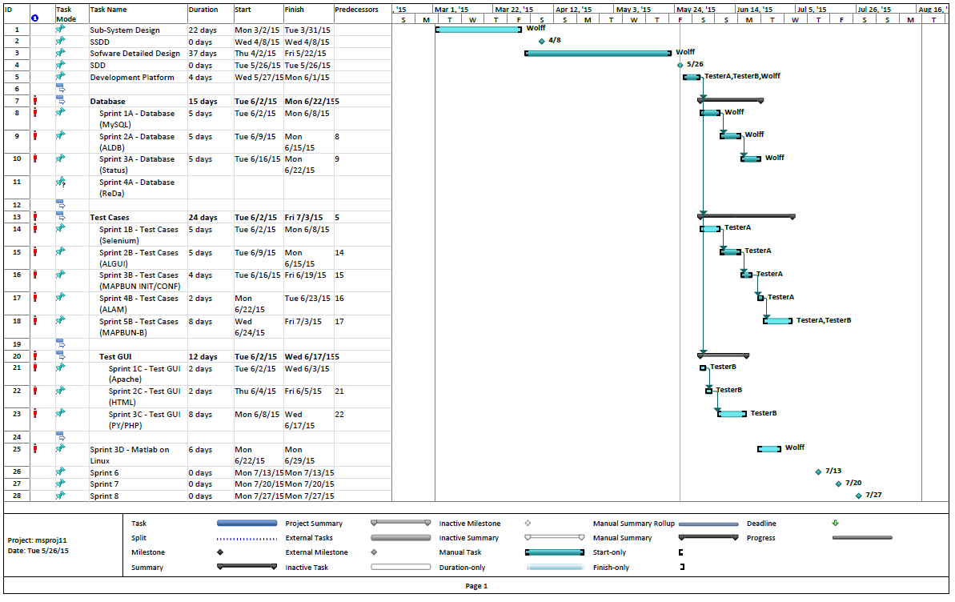
Schedule - WBS with Sprint Milestones

Slide 41
Minutes from Review on 5/26/2015
Meeting Minutes from ArcLight Automation of Map Bundles Software Detailed Design (SDD) Review
Date: 5/26/2015, 3:30-5pm EDT
Attendees: Shaudi Kheradmand, Dan Alger, Bryan Workman, Bobby Chiu, Brent Mundt, Michael Wolff
Location: CR – Germantown - 121 B2 with WebEx
Subject: Review of //Arclight/ArcLight/AcceptanceTest/Automation/MapTesting/AL_Automation_SDD_Review.pptx
NOTES:
Check out MatLab Wiki (https://wiki.viasat.com/display/Engineering/MATLAB+Tool?src=search) to help in resolving MatLab for Linux issues. (There is no MatLab cross-compile, so any executable must be created on native Linux installation)
Ensure Test Name/Id tracking
Need to backup existing map configuration before starting test, and restore at end of test. Note: Trickle test may cause the loss of Terminal access due to tuning away from FL.
Need to maintain security of passwords; should not be un-covered in files or database
Future consideration: Some functionality is common to NMS & EMS GUI which is outside of exisiting algNMS*/algEMS* API model.
Need better definition of code failure and error handling; expound upon results state information
[Shaudi] Investigate using SGT tool as a substitute for Precedence test or as extra sanity check – consult with Tom Zhang
Additional resource Matthew will be starting 6/8/2015 – update schedule accordingly
Update deployment configuration to use VLANs for Hub VM’s and Terminals; will just move RF
Flag user and/or results is signal generator prevents Forward Link Lock; requires saving Signal Generator Frequency to configuration (from AL Test GUI)

Slide 42
Automation Support for Network Terminal Login (NLG) Design Slides

Slide 43
Updates for NLG
ALTG Updates
NLG Updates
Test selection
Check Boxes
Mapbun
Tests
NLG
Stop/Start
Operator Triggered VMT Commands
VMT Logout
VMT Relogin
VMT Reboot
VMT Beam Redirect
Configuration
Hubs for RTNMS syslog retrieval
Results
Status Database Export
NLG Poller Start
NLG Poller Terminal-Only Start
NLG Poller Stop
NLG VMT Logout
NLG VMT Relogin
NLG VMT Reboot
NLG VMT Beam Redirect
NLG Status
PID
Post Processing Scripts
Terminal Syslog
RTNMS Syslog

Slide 44
Updates For NLG
ALG API Updates
MYSQL Updates
NMSPM
VMT Status
VMT Charts
VMT Summary Status
Terminal
Status
NMS
VMT Fleet
Command Control
New Tables
NMSPM Status
Column for each VMT status display field
named by screen label
Terminal Status
Superset of columns for all terminal info (General, FL, RL, ACU)
named by screen label with prefix indicating page/section
NLG Status
PID
Hubs
hub1Name, hub2Name – for RTNMS Syslog retrieval
RTNMS Conf
Login credentials
Keyed by hubName

Slide 45
ALDB Updates For NLG
NMS PM Status Set/Get
Terminal Gen Status Set/Get
Terminal FL Status Set/Get
Terminal RL Status Set/Get
Terminal ACU Status Set/Get
NLG Status Set/Get
PID
Hubs Set/Get
Table Get Column Name
Table Get Keylist in Range
Table Get Bulk From Keylist
Table Get Bulk in Range
Export Data To CSV
(Table, Range, Filename)

Slide 46
NLG Status Poller
Turn On/Off from ALTG
On
Launched to background from ALAM
Save Linux Task Id (in NLG db)
Off
Signal to Linux Task Id
Config
Mode
Terminal
Both Terminal & NMSPM
Tuning Parameters static in alDefaults
Terminal Poll Rate
NMSPM Poll Rate
Inputs
Poll Timeout
Terminal
NMSPM
Signal
SIGUSR1
Save files and exit
Outputs
ALDB API
Save Terminal Status; key=group, time
Save NMSPM Status; key=group, time
Results
File Save of status data during test duration as CSV
Save Charts as PNG; select period based on test duration
Syslogs
Post Processed as events in CSV file
Compress Syslogs
AL TG
AL AM
NLG Poller
AL DB API
AL GUI API

Slide 47
POST PROCESSING Terminal Syslog
Use script with grep/sed/awk to parse terminal syslog into CSV of events
Header Row Example
Timestamp, SAT_SRCH, SAT_LOCK, BRL_Login, CRL_Login, CMD_Relogin, CMD_Logout, CMD_Reboot
Each row has “1” in Column to indicate which event, and other Columns are “0”
Event to Syslog Message mapping
Satellite Search (SAT_SRCH)
daemon.debug CCD: [SSM:NO COVER:03] SAT #Avail: 1
Satellite Lock (SAT_LOCK)
daemon.info CCD: [SSM:SAT LOCK:01] SATSRCH STATE CHANGE: ** SAT LOCK **
(BRL_Login)
daemon.info CCD: Received CRL PCM after Login response PCM Ack sent - Assume officially logged in via BRL now (t=1432912130 csec)
(CRL_Login)
daemon.info CCD: [LSM:07:01] LOGIN STATE CHANGE: ** Terminal Logged In (CRL) **
Logout Command (LOGOUT_CMD)
CCD: \[ACP:10:03\] ACP Command Message -- LOGOUT CMD --
Reboot Command (REBOOT_CMD)
CCD: \[ACP:10:01\] ACP Command Message -- REBOOT CMD –
Relogin Command (RELOGIN_CMD)
CCD: \[ACP:10:02\] ACP Command Message -- RELOGIN CMD --
Time of Day Reset (TOD_RESET)
CCD: Time of Day Reset.
Set Antenna (SET_ANT)
CCD: \[SSM:NO COVER\] Set Antenna State sat:“
Dwell Expired
daemon.debug CCD: [SSM:HandleDwellTimerExp] SEARCH: entering
daemon.info CCD: [SSM]:next satsearch
Handover
daemon.info CCD: [SSM] Satellite Handover, satDistance
State Changes
daemon.info CCD: [RLC:00:01] RLC MSG STATE CHANGE: FAIL
daemon.info CCD: [BBM:00:01] BB MSG STATE CHANGE: FAIL
daemon.info CCD: [LSM:00:01] LOGIN STATE CHANGE: Wait for Login Info
daemon.info CCD: [TSM:03:01] TERM STATE CHANGE: ** TX Enable **
daemon.info CCD: [TSM:00:01] TERM STATE CHANGE: Non-Valid
Others
daemon.info CCD: UpdateAntennaTxbSettings - FlRf:120425 FlLo:106000 FlLband:14425 SI:0 loSel:00 RlRf:144857 RlLo:130500 AlmSt:0000 AcuSt:GOOD
daemon.info CCD: SendAntSatUpdateUnconditional - FlRf:119750 FlLo:106000 FlLband:13750 SI:0 loSel:00 RlRf:144782 RlLo:130500 AlmSt:0000 AcuSt:GOOD
daemon.info CCD: Mode Change Event:Login State

Slide 48
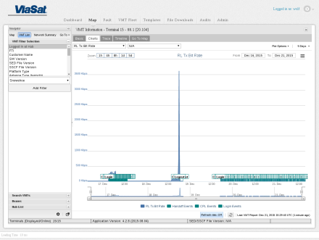
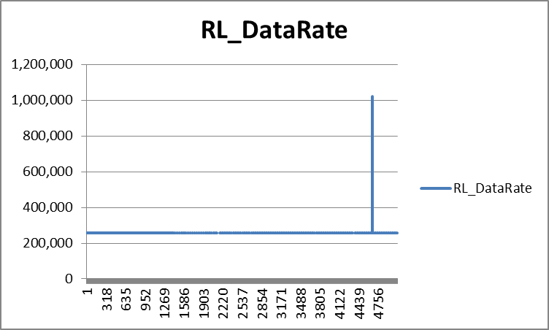
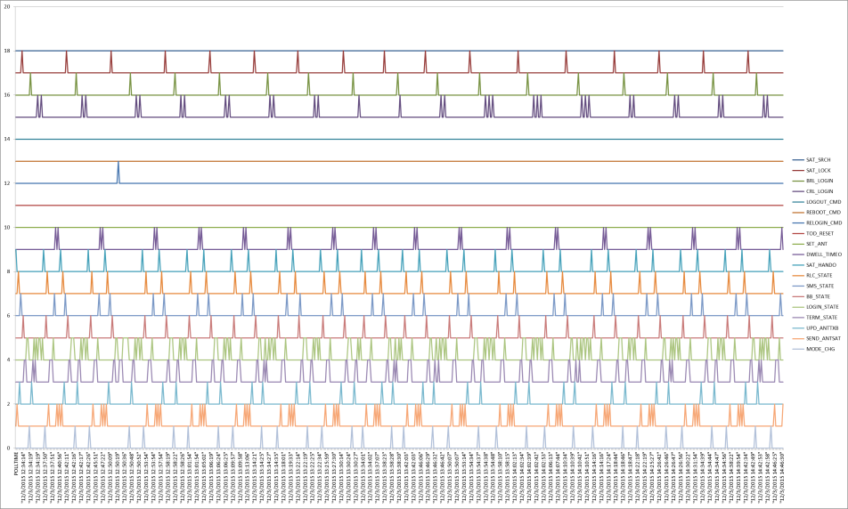
Data Analysis
Status CSV file(s)
Import into EXCEL
Plot column(s) to see changes during test
Correlate NMS charts to data reported.
Validates display at Term matches data at NMSPM
Syslog CSV file(s)
Generated by post-processor
Specific Events indicated in column
Plot several columns over same time period and offset to see “triggers” over time
NOTE: CRL Bug revealed (3 peaks)

