Slide 1
System/Subsystem Design Description for ArcLight Automation Map Bundle Testing
Prepared By: Michael Wolff
August 31, 2015
Revision: 07

Slide 2
Revision History
Date | Version | Summary
3/25/2015 | 01 | Initial Check-in
3/31/2015 | 02 | Updates based on Desk Review with Shaudi Kheradmand
4/2/2015 | 03 | Minor updates prior to distribution for review
4/15/2015 | 04 | Added Design Review Minutes (at end) and incorporated updates from review
6/2/2015 | 05 | Updates based on SDD, project planning, minor as-built updates
6/22/2015 | 06 | Latest updates for development environment
8/31/2015 | 07 | Final updates for Map Bundle as-built

Slide 3
Contents (as per ViaSat SSDD template)
1-Scope
1.1-Identification
1.2-System Overview
1.3-Document Overview
2-Referenced Documents
3-System-Wide Design Decisions
4-System Architectural Design
System Design Overview
4.1-System Components
4.2-Concept of Execution
4.3-Interface Design
4.3.1-Interface Identification and Diagrams
4.3.2-Project-Unique Identifier of Interface
5-Requirements Traceability
6-Notes
6.1-Acronyms
6.2.-Development Environment
Additional Slides (at end)
Source Diagrams
Design Review Minutes
Action Items

Slide 4
1-Scope
1.1-Identification
This document applies to the ArcLight Automation software for the AL1/AL2 Acceptance Test system in Germantown
The Phase 1 effort, hence the initial scope of this document, applies to a dedicated ArcLight Map Bundles automated testing subsystem
1.2-System Overview
See details below
1.3-Document Overview
This document contains the necessary information to proceed with
The Software Detailed Design (SDD) for ArcLight Automation of Map Bundle Testing
The dedicated Map Bundles subsystem development environment.
Lab/Equipment layout
Perforce

Slide 5
1.2-System Overview
Test Automation Subsystem controls Test Equipment and Unit Under Test
Provides integrated automated testing to produce repeatable regression testing for Map Bundles.
Trickle Download of Map Bundles Verification
Map Bundle Upload via Terminal Webpage Verification
Precedence Verification of Map Bundles
Forward Link Lock Verification of Map Bundles
Supports simple “LAMP” (Linux, Apache, MySQL, PHP/Python) web-stack for external Browser based test launch management (very basic) interface
Provides Test Results for test suite
System will be developed at the ViaSat Germantown facility
Browser
Test Equipment
Test Automation
Subsystem
Unit Under Test (UUT)

Slide 6
System Overview-UUT Test Interfaces
SQL Query
(SSH)
GUI
(HTTP)
Black-box/White-box testing through Interfaces
GUI (HTTP)
NMS
NMS Configuration Screens
including Map File upload (via Trickle)
EMS Configuration Screens
Forward Link
Frequency, Chip Rate
Status Screens
Terminal
Configuration Screens
including Map File upload
Status Screens
Forward Link Lock
CLI CMD (Serial)
Control of Terminal
syslog inspection
Precedence verification
Validation of map files
Linux (SSH)
Validation
scp of files
CLI via SSH
Same functionality as CLI CMD)
SQL Query (SSH) – Future, N/A
Database
sqlplus
Scripts for Validation of data
Unit Under Test (UUT)
NMS
Term
DB
CLI CMD
(Serial)
Linux
(SSH)

Slide 7
Deployment Configuration
Perforce, Share-point, …
Lab Switch/PBR
NetInstall-open SuSE
192.168.136.41
(u:root/p:viasat)
Corp
LAN
S4 Catalyst
<testerA>-wxp
192.168.136.6-#2 (E2442)
136.6-#8 (E2448)
192.168.142.58
(VLAN-142)
(u:root/p:1204_@vsat)
Console Server
192.168.136.82
EFLM
<testerB>-wxp
Map Test Appliance – Supermicro Blade #2
VSwitch
192.168.136.13
(port: terminal_1-N)
Auto(RedHat) Virtual M-5
EMS (SuSE) Virtual M-2
SIG GEN
<testerC>-wxp
NMS (SuSe) Virtual M-1
RtNMS(SuSE) Virtual M-3
SER-1
IF-SMA-RG6
EFLM-Tx
VMBR-Rx
VMBR1520
Configuration Notes:
/etc/sysconfig/network
./routes: route add default gw 192.168.142.1 eth0
./ifcfg-eth0
/etc/udev/rules.d/70-persistent-net.rules: (force eth0)
S4 – Trunk Port (V2, V142, V8xx)
PBR – Tag Subnet 142.x as VLAN 142
IPE (SuSeE Virtual M-4
(VLAN-803-81x)
192.168.136.92 192.168.142.5 (VLAN-142)
192.168.136.142 192.168.142.8 (VLAN-142)
192.168.142.18 (VLAN-142)
(u:arclight | u:root / p:Viasat123 | p:viasat | p:Coolsys1)

Slide 8
Deployment Configuration
Corporate Access for services, i.e. Perforce, Remote Desktop for developers
Blade Server Hardware
Uses Virtual OS (VMware ESXi) with Virtual Machines (VM)
NMS, EMS, RtNMS, IPE, Linux VM (for test automation controller); (SuSE/Redhat)
Ethernet
ETH1-Lab Switch
Internal virtual networks to each VM
ETH2-Terminal
2nd Port on PowerEdge to VMBR sub-net
Internal virtual network to:
Term Win-PC w/ETH2
Test Linux VM w/ETH2
Terminal Sever
Access to VMBR (remote terminal) CLI
EFLM
EHC with EFLM software
EFLM Tx-RF to Signal Generator with SMA connection
Signal Generator will shift the FL frequency from EFLM
Signal Generator to VMBR Rx-RF L-Band with SMA connection
SW Tools
Linux VM Tools
Test VM
Selenium
Python
PHP (TBR)
Apache
MySQL
P4V
Chrome/FF Browser
Windows 7
Chrome/FF Browser
tool-wxp
VMware vSphere Client
Alternative Configurations
VMBR might be accessible from Lab Switch by VLAN if common resource switched between testbeds.
Use PowerEdge COM1 serial port to connect directly to VMBR serial and eliminate console server
Connect ETH-2 to Lab Switch if VMBR are shared resources
Java, Java Script
Firewall/Router

Slide 9
2-Referenced Documents
ID | Name/Description | Location (Perforce, URL, etc.)
REFD010 | AL1_Mapbundles_TestProcedure | //Arclight/ArcLight/AcceptanceTest/Test_Procedures/AL1_Mapbundles_TestProcedure.docx
REFD020 | Automation Plan (as of September 2014) | //Arclight/ArcLight/AcceptanceTest/Automation/Presentation/AL_Automation_Plan.pptx
REFD030 | Selenium Primer | //Arclight/ArcLight/AcceptanceTest/Automation/Presentation/Selenium_Training_Slides.pptx
REFD031 | Selenium Examples | //Arclight/ArcLight/AcceptanceTest/Automation/NMS/
REFD032 | Leapfrog Selenium Example | //Broadband/TestTools/web_performance_automation/selserverstarterhub.py
REFD040 | Existing ArcLight Generic Test Automation Facility (GTAF) scripts | //Arclight/ArcLight/AcceptanceTest/Automation/GTAF_TIDE/
REFD041 | GTAF Wiki Info | https://wiki.viasat.com/pages/viewpage.action?pageId=26443937
REFD050 | Map bundle Precedence example | //Arclight/ArcLight/AcceptanceTest/Automation/Scripts/Maps/find_coords/find_all_coords.m
REFD051 | Map bundle FL Lock example | //Arclight/ArcLight/AcceptanceTest/Automation/Scripts/Maps/maps_bundle.py
REFD060 | Results Database (Reda) | https://wiki.viasat.com/display/Proj/Reda
REFD061 | Reda Examples | //Broadband/TestTools/Reda/
REFD070 | Surfbeam Automation Manager (SAM) | https://wiki.viasat.com/display/Proj/SAM
REFD071 | SAM Examples | //Broadband/TestTools/SAM/

Slide 10
3-System-Wide Design Decisions
Use Selenium to control Browser based GUIs
Selenium IDE for Firefox Browser available for record and play
Can be exported into Python*, PHP, Java
Linux browser can control Terminal (VMBR)
Use Chrome per NMS/EMS/Terminal compatability
Provide subsystem integration level testing of Map Bundles; not necessary to explicitly re-verify each test point functionality, e.g.
FL Lock proves EFLM/VMBR tuning.
Data persistence validates database, so no sqlplus for this phase.
Coalesce test results for easy inspection of outcome
MySQL
Files
Selenium screen captures
Status, including file upload, through Browser Interface (TBR)
Parameterization
Runtime
Paths

Slide 11
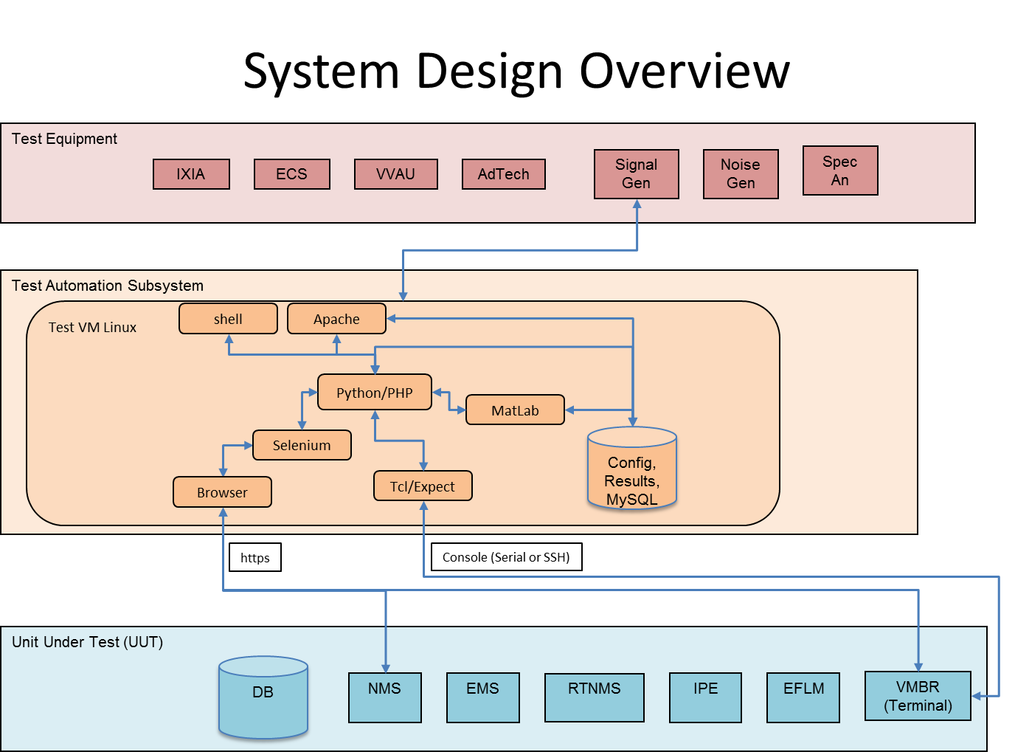
4-System Architectural Design
System Design Overview
HWCIs
As per Deployed Configuration
CSCIs
Existing ArcLight software for all UUT components
Test VM (Linux) for NMS and Terminal GUI control via Browser
Terminal (VMBR) on separate subnet
Python scripts to access Selenium library; see REFD030 – Selenium Examples
May substitute or augment with PHP
Apache (LAMP web-stack) to support browser based Automation GUI (very basic) for launching test suite and viewing results.
MySQL for test results and configuration
Control Test Equipment
Signal Generator for Forward Link Lock

Slide 12
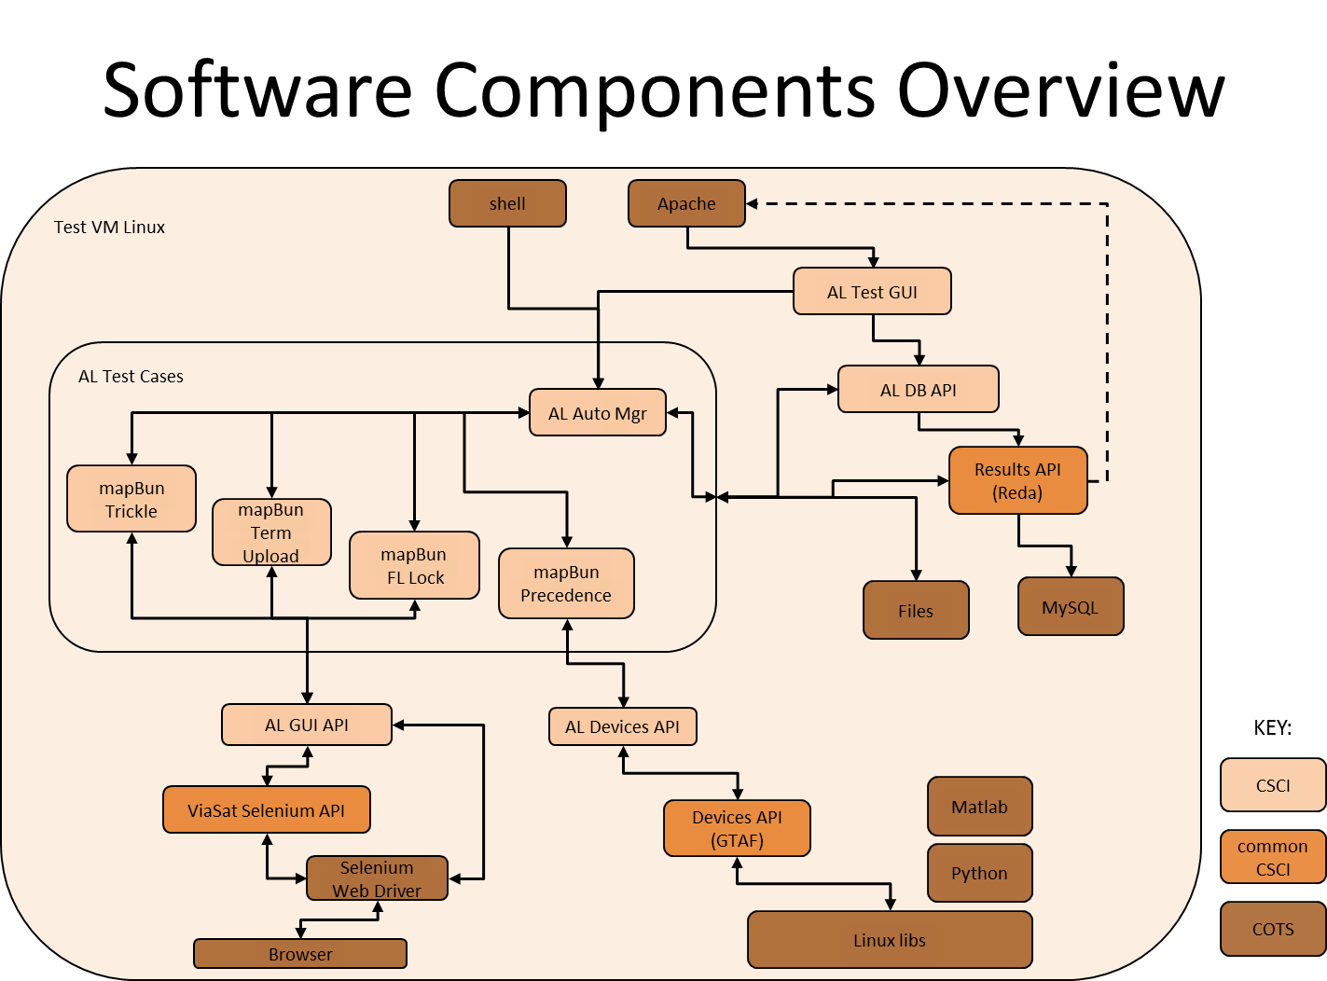
4.1-System Components
Software Components Overview (CSCI)
ArcLight Test GUI
Manages simple set of html webpages for launching tests and getting results
ArcLight Test Cases
ArcLight Automation Manager
Launch script(s) from AL Test GUI or Linux shell
Common configuration of test database and files
Utilize API layers to manage devices during execution of test procedures
Launched from Linux
Extensible for additional test cases
Follow standardized results logging
API (or Reda)
mapBun Trickle
mapBun Terminal Upload
mapBun Precedence
mapBun FL Lock
ArcLight GUI, Devices and Database APIs
Abstractions for project specific customizations
Common/Generic API layers for abstracting Selenium, Devices, and MySQL
Leverage test equipment support (GTAF)
Add support for additional test devices
Does not preclude the use of GTAF and/or Reda, rather provides for re-use or snap-in replacement.

Slide 13
4.2-Concept of Execution
ArcLight Test GUI
Main Menu
http://altest.allab.viasat.com/index.html
Hyperlinks to other screens
Initiate Test
Checkbox list
mapBun Trickle
mapBun Terminal Upload
mapBun Precedence
mapBun FL Lock
Start Button
Test Configuration (TBR)
Set test parameters
Upload test files
Test Status w/Results
ArcLight Automation Manager
Common/Single entry point for launching test script(s)
Initializes database for test
Initializes test directories/files
e.g., KML result files placed here
AL GUI API
Common ArcLight GUI Routines
Make selenium calls underneath
Example: setGuiObjVal(gui {nms|ems}, screen {bundle | etc…}, obj {filename | etc…}, value {string})
ViaSat Selenium API
Example:
clickHere(buttonID)
enterText(inputId)
enterNumber(inputId)
AL Devices API
Common ArcLight Device Abstractions
AL Terminal CLI
Devices API
Abstracts non-ArcLight devices, e.g. Console Server, Ixia, Linux, ssh
AL Database API
Common ArcLight Database Abstractions
Results Records
Configuration Records
Results API
Generic Automation Testing API
May have Apache connector for Results query

Slide 14
Concept of Execution
mapBun Trickle
mapBun Terminal Upload
NMS
Copy bundle
trickle to download the bundles
Both signed and unsigned
Verification
successful file transfer to Terminal
Terminal GUI
Load maps through GUI
CLI
Get md5 checksum
Verification
md5 checksum matches for both signed and unsigned

Slide 15
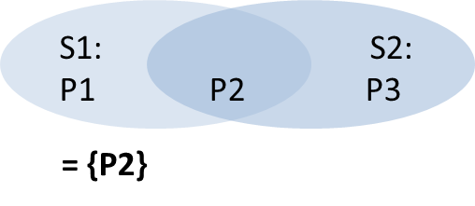
Concept of Execution
mapBun Precedence
mapBun FL Lock
Test Controller
Generate kml file
Find all coordinates
Update existing Matlab scripts, uses inpolygon
//Arclight/ArcLight/AcceptanceTest/Automation/Scripts/Maps/find_coords/
Use single, unique coordinate for overlapping regions
In diagram below, Lat/Long “P2” verifies satellite beam S1 and S2
Store in db/file; use environment variable
Verification
Visually inspect KML File
NMS
Set FL frequency based on map coordinates
EMS Configuration
Set Frequency, Chip Rate
Compute FL frequency
Formula:
Terminal
Load SED/SSCF file bundles
Optimize if loaded from previous portion of test
Change the lat/long coordinates of the terminal and turn sat search on.
Clear syslogMsgs file
Reboot the system
grep the syslogMsgs file
Save satellites locked onto
Verify the TWP show lock
Parse the tempLog file (console outputs) printed to the syslogMsgs file
Terminal reads in coordinates file
Verification
Examine satellite locking order for correctness

Slide 16
4.3-Interface Design
4.3.1-Interface Identification and Diagrams
4.3.2-Project-Unique Identifier of Interface
TBR
Coordinates File Format
CSV
Latitude, Longitude Pairs
One pair per line
Map Files
sed
sscf
Runtime Parameters
Format
TLV, possibly XML
Variables
Bundle File
Coordinate File
AL NMS/EMS GUI URL
Terminal IP
Password(s)

Slide 17
5-Requirements Traceability
Id | Description | Section
1.0.0 | Create Isolated Testbed for Map Bundles Testing | 1.2 Deployed Configuration
1.1.0 | Install all hardware in stand-alone setup | 1.2 Deployed Configuration
1.1.1 | Install One Server with ESXi and the following VMs: NMS, EMS, RtNMS, IPE, Windows 7 VM (for PC co-located to Terminal), Linux (Ubuntu) VM (for test automation controller) | 1.2 Deployed Configuration
1.1.2 | Install EFLM | 1.2 Deployed Configuration
1.1.3 | Install VMBR1520 Modem | 1.2 Deployed Configuration
1.1.4 | Install ASA | 1.2 Deployed Configuration
1.2.0 | Install all ArcLight Software | 1.2 Deployed Configuration
1.3.0 | Verify Terminal(s) can achieve satellite lock | 1.2 Deployed Configuration
2.0.0 | Create Automated Tests for Map Bundles Testing | 4.1 System Components
2.1.0 | Create Trickle Download Test | 4.1 System Components
2.2.0 | Create Terminal Download Test | 4.1 System Components
2.3.0 | Update scripts Find unique coordinates in overlap regions | 4.2 Concept of Execution
2.3.1 | Find points within a contour is the function inpolygon | 4.2 Concept of Execution

Slide 18
Requirements Traceability
Id | Description | Section
2.3.2 | Clean up all of these scripts so that it flows better. | SDD
2.3.3 | Input of this script should be the name of satellites of interest to find unique coordinates. | SDD
2.3.4 | Output should be a .txt file that has the unique coordinates. | SDD
2.3.5 | The goal is to have a single unique coordinate for overlapping regions | 4.2 Concept of Execution
2.4.0 | Terminal Precedence | 4.1 System Components
2.4.1 | Shall account for any type of password, i.e. password for any terminal build. | 4.3.2-Project-Unique Identifier of Interface
2.4.2 | Make script generic so that any terminal password will be automatically chosen as appropriate to run the script | 4.3.2-Project-Unique Identifier of Interface
2.5.0 | Forward Link Lock | 4.1 System Components
2.5.1 | Automate the NMS GUI so that the FL parameters can be entered via selenium | 4.2 Concept of Execution
3.0.0 | General Automation Requirements
3.0.1 | Parameters should be able to be read from a database file (i.e. a csv file) and FL parameters configured accordingly on the NMS GUI. | 4.2 Concept of Execution
3.0.2 | Should be able to poll terminal webpage with selenium to see if terminal has achieved Sat Lock. Once SAT Lock achieved, move onto performing FL lock test for next satellite | 4 System Architectural Design

Slide 19
Requirements Traceability
Id | Description | Section
3.0.3 | Centralize results for post-processing | 4.1 System Components

Slide 20
6-Notes
6.1-Acronyms
Development Environment
Perforce
Action Items
Deployment Notes
Open Issues
Other Notes

Slide 21
6.1-Acronyms
Acronym | Definition | Comments
ECS | Enhanced Channel Simulator | Used to simulate satellite delay
EFLM | Enhanced Forward Link Modulator | Used for VCSM Forward Link
EHC | Enhanced Hub Canceller | Enhanced Hub Canceller used for PCMA
IPE | IP Encapsulator | Used to encapsulate IP packets
RTNMS | Real-Time Network Management Server | Used to control and manage remote terminals
VMBR | ViaSat Mobile Broadband Router | Remote Terminal used in ArcLight Hub
GTAF | Generic Test Automation Facility | In-house libraries for controlling test devices, i.e. IXIA
CSCIs | Computer Software Configuration Items
HWCIs | Hardware Configuration Items

Slide 22
Development Environment – Perforce
Perforce // Arclight /ArcLight /AcceptanceTest /Automation/…)
MapTesting
Maps
find_coords
GTAF_TIDE
Script
utils
TerminalSerialCom.py
src
alam
aldev
altg
apache
mysql
alg
aldb
docs
Scripts
misc
vsel
mapbun
SSDD
SDD

Slide 23
Development Environment Action Item Details
Acquisition of Lab Items
PowerEdge
VMBR
EFLM
Signal Generator
Cables
SMA
Ethernet TP
Power Strips
Lab Location
Mounting Rack
Firewall
Router

Slide 24
Deployment Notes
/
MySQL
Apache
/home/altest
Python
Selenium
Define file organization of installed software
TBR

Slide 25
Issues
OPEN
CLOSED
None
For NMS/EMS GUI, rely on screenshot PNG files from scripts since test is not interactive with human
Test Cases
FL Lock (Closed – added Signal Generator)

Slide 26
Source Diagram Slides

Slide 27
System Design Overview
Test Equipment
IXIA
ECS
VVAU
AdTech
Signal Gen
Noise Gen
Spec An
Test Automation Subsystem
Test VM Linux
shell
Apache
Python/PHP
MatLab
Selenium
Config,
Results, MySQL
Browser
Tcl/Expect
https
Console (Serial or SSH)
Unit Under Test (UUT)
DB
VMBR
(Terminal)
NMS
EMS
RTNMS
IPE
EFLM

Slide 28
Software Components Overview
Test VM Linux
shell
Apache
AL Test GUI
AL Test Cases
AL DB API
AL Auto Mgr
mapBun Trickle
Results API
(Reda)
mapBun Term Upload
mapBun
FL Lock
mapBun Precedence
Files
MySQL
AL GUI API
AL Devices API
KEY:
Matlab
CSCI
ViaSat Selenium API
Devices API
(GTAF)
Python
commonCSCI
Selenium Web Driver
Linux libs
COTS
Browser

Slide 29
Software Components Overview (v2)
Test VM Linux
shell
Apache
AL Test GUI
AL Test Cases
AL DB API
AL Auto Mgr
mapBun
Results API
(Reda)
NLG
Files
MySQL
AL Devices API
AL GUI API
KEY:
Matlab
CSCI
ViaSat Selenium API
Devices API
(GTAF)
Python
commonCSCI
Selenium Web Driver
Linux libs
COTS
Browser

Slide 30
Miscellaneous Diagrams
S1:
P1
S2:
P2 P3
= {P2}

Slide 31
Use Case

Slide 32
Design Review Minutes
Date: 4/8/2015, 4-5pm EDT
Attendees: Shaudi Kheradmand, Dan Alger, Bryan Workman, Bobby Chiu, Leyla Mosavati, Bryant Schussler, Tom Zhang, Michael Wolff
Location: CR – Germantown - 121 B2 with WebEx and VTC
Subject: Review of //Arclight/ArcLight/AcceptanceTest/Automation/MapTesting/AL_Automation_SSDD.pptx
NOTES:
NMS/EMS GUI Testing
Must use Chrome
http only; https is future
rely on screenshot files from scripts as results artifacts since test is not interactive with human
Forward Link Lock Test
ECS not necessary for closed loop
Corner case requires a signal generator since the terminal frequency may be out of the EFLM transmit frequency range.
Must support additional Map bundles formats, specifically GDRM and RLC when present.
Verify that signed and unsigned match checksum
Provide contour verification
If too many points, then intervene with manual points
For NMS/EMS GUI, Reda has many scripts that are PHP (and TCL based), so may use/adapt those wherever possible.
Some direct API calls to Reda
PHP may make integration with Apache and MySQL easier/faster, so may use that instead.
Action Items:
(Wolff) Proceed to detailed design. Have informal interim review of high-level portion of SDD in about 2-3 weeks.
(Shaudi) Acquire Lab equipment specified on SLIDE - Development Environment Action Item Details

Slide 33
Project Planning
See SDD Review Slides

