Slide 1
Users Manual for ArcLight Automation Appliance
Prepared By: Michael Wolff
February 29, 2016
Revision: 05

Slide 2
Revision History
Date | Version | Summary
12/14/2015 | 01 | Initial Check-in
12/15/2015 | 02 | Added Info on NLG/Collection
01/12/2016 | 03 | Added more details about NLG/Collection Data Analysis
01/18/2016 | 04 | Added Syslog details about NLG/Collection Data
02/29/2016 | 05 | Added ReDa and Test Utilities details

Slide 3
Contents
Scope
System Overview
Theory Of Operation
Deployment Configuration
Command and Control
Home Page
Test Launch
Configuration
Results
Data Generation
Status
Database Export
Utilities
ReDa
Use Cases
Maps
Process
Training
Data Collection
VMT Commands
Map Testing Process
Map Bundle Training Exercise
NLG Data Analysis
Syslog File Formats

Slide 4
Scope
This Users Manual addresses the operation of the ArcLight Automation Appliance for Map Bundles and AL1 Acceptance Test testing in Germantown
Core capabilities
Phase 1 - dedicated ArcLight Map Bundles automated testing subsystem
Phase 2 – VMT Data Collection from GUI
Phase N – Tools to aid in testing
Detailed training for Map Bundle Testing

Slide 5
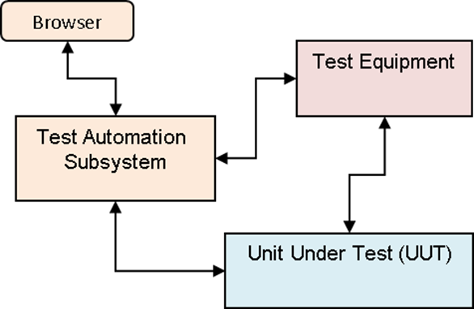
System Overview
Describes how the AL Test Automation Appliance works from the Users perspective

Slide 6
System Overview
Test Automation Subsystem controls Test Equipment and Unit Under Test
Provides integrated automated testing to produce repeatable regression testing for Core Functional Areas
Map Bundles
Based on Test Procedure: //Arclight/ArcLight/AcceptanceTest/Test_Procedures/AL1_Mapbundles_TestProcedure.docx
Map Bundle Upload via Terminal Webpage Verification
Trickle Download of Map Bundles Verification
Precedence Verification of Map Bundles
Forward Link Lock Verification of Map Bundles
VMT Data collection
Provides Test Results for test suite
Accessible through AL automation and ReDa webpages
*GROUP
Each configuration is organized into a “group” which defines the specific NMS, Terminal and Map for those tests

Slide 7
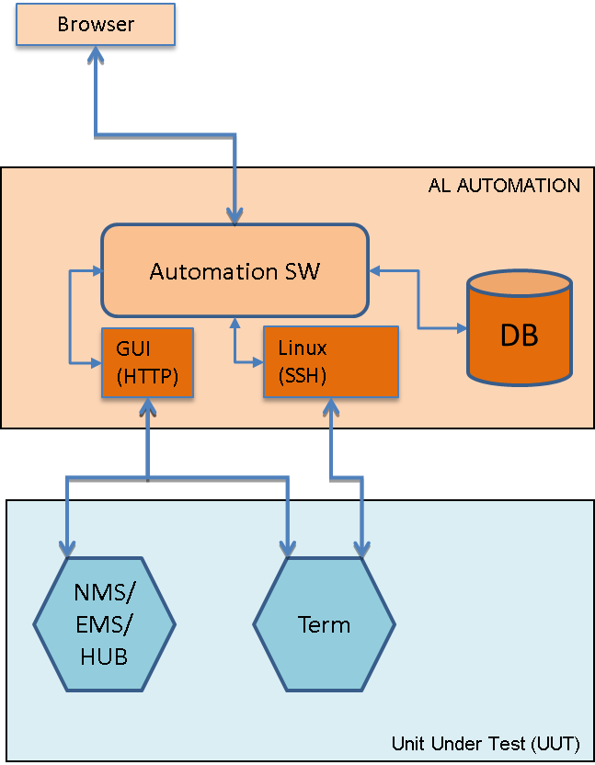
Theory of Operation
Describes how the AL Test Automation Appliance works internally to control the Unit Under Test

Slide 8
Theory of Operation
Unit Under Test (UUT)
Controlled by Automaton Appliance
NMS/EMS GUI
NMS Configuration/Status Screens
File upload (Trickle)
MAPS
NMSPM VMT
VMT Fleet
Commands (ReLogin)
EMS Configuration Screens
Forward Link
Frequency, Chip Rate
Hub Tx Enable/Disable
Terminal GUI
Configuration Screens
Map File upload
Configuration upload
Baseline for Trickle
Status Screens
General, FL, RL, ACU
Terminal CLI/Shell
termcmd
Control of Terminal
Antenna
Lat/Long
syslog
Precedence verification
Upload via scp
Automation Browser
User Interface to control automated tests and review results
Supports simple “LAMP” (Linux, Apache, MySQL, PHP/Python) web-stack for external Browser based test management interface
Uses Selenium and Chromedriver to automate GUI operations
Configuration
Includes tuning parameters
Test Launcher (Controller)
Results
Utilities
Map Bundle Test Report
ReDa
ViaSat “Standard” Status and Results web interface

Slide 9
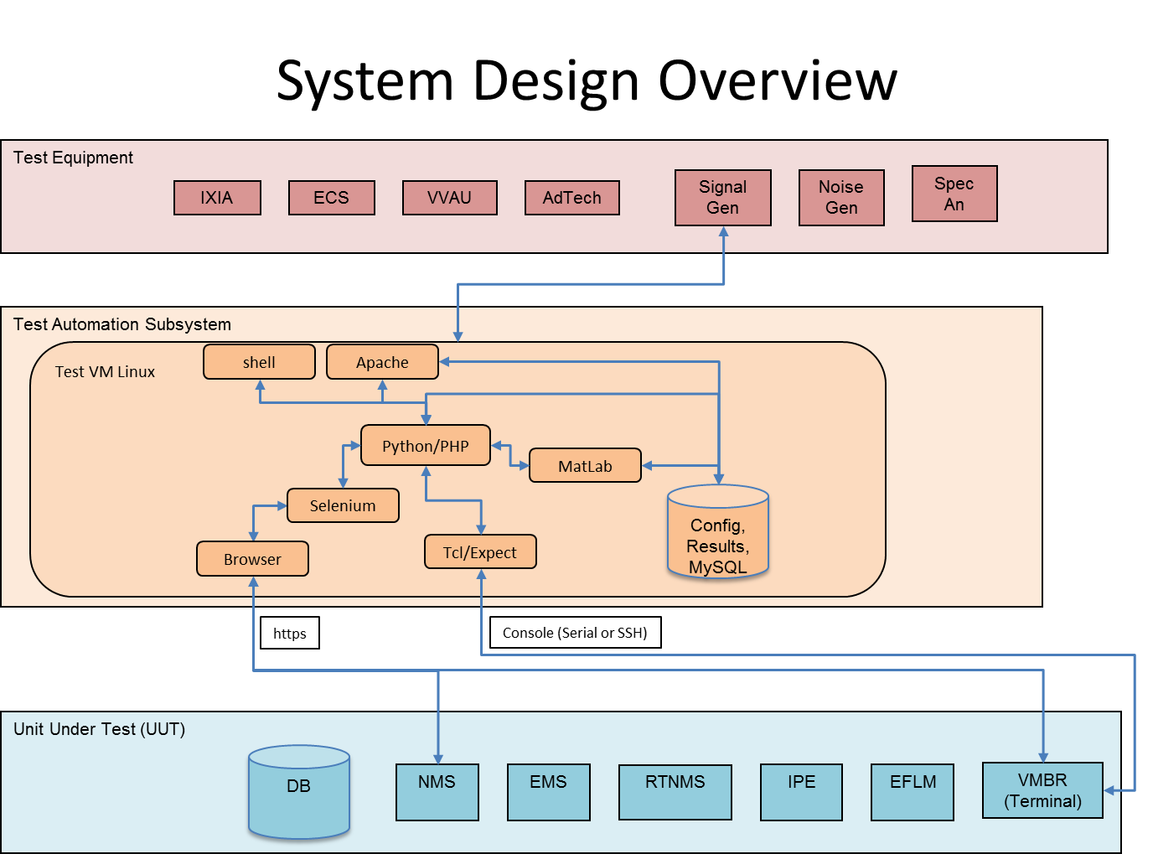
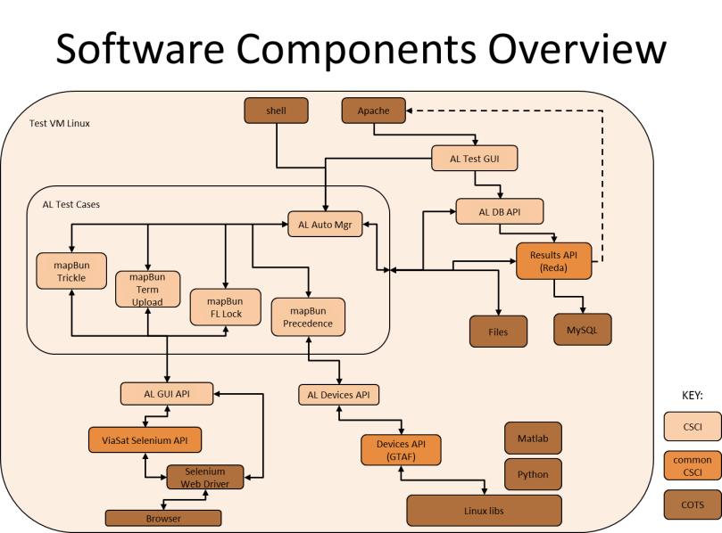
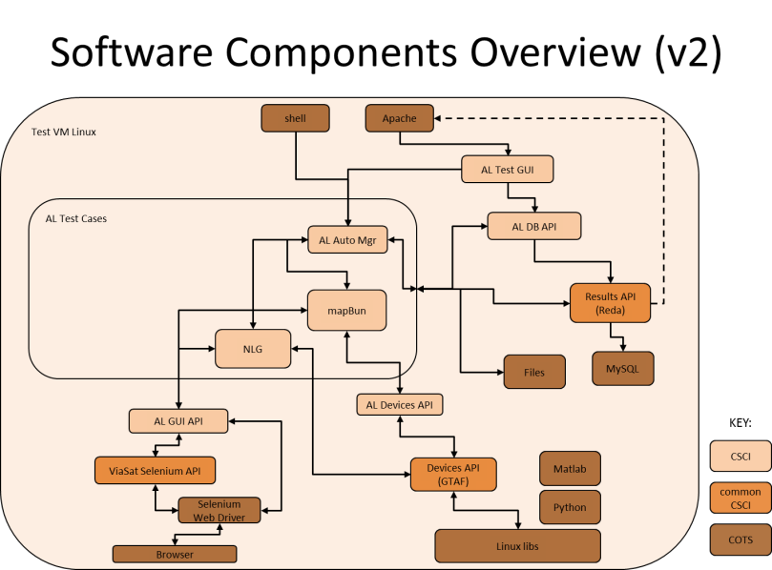
Theory of Operation Additional Designs

Slide 10
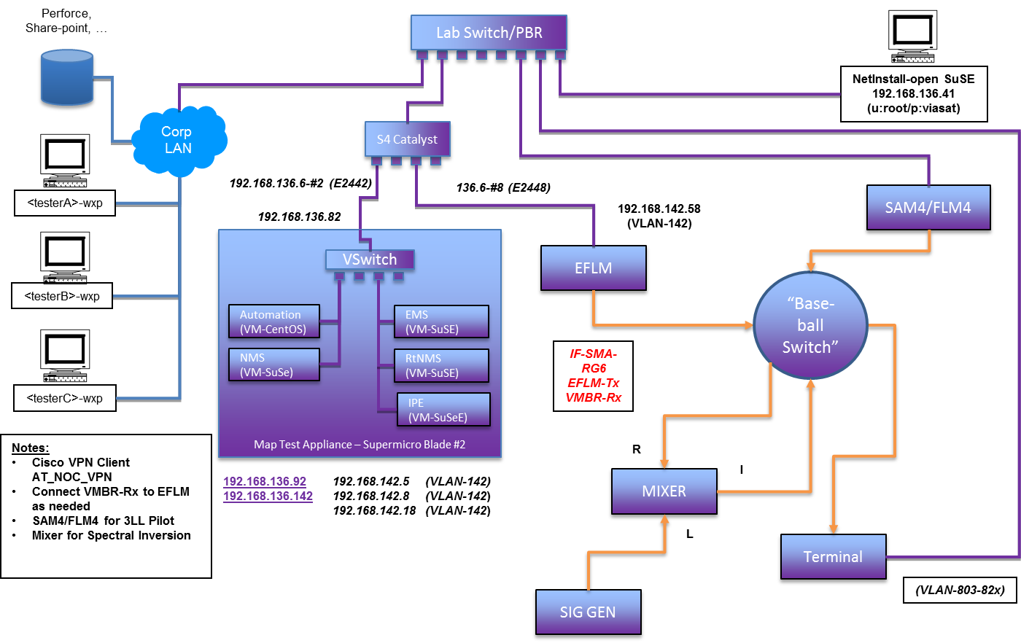
Deployment Configuration
Dedicated NMS/Hub for Map Testing
Access to “any” AL1 NMS and “all” Terminals for Data Collection and VMT Commands

Slide 11
Deployment Configuration
Corporate Access for services, i.e. Perforce, Web access to Automation for testers
Blade Server Hardware
Uses Virtual OS (VMware ESXi) with Virtual Machines (VM)
NMS, EMS, RtNMS, IPE, Linux VM (for test automation controller); (SuSE/CentOS)
Ethernet
virtual networks to each VM
EFLM
EHC with EFLM software
Forward Links
Normal
EFLM to Terminal
Spectral Inversion
EFLM To Mixer (R)
Signal Generator to Mixer (L)
Mixer to Terminal (I)
Special Pilots
SAM4/FLM4 to Terminal
Setup single frequency @SAM and let Automation Tool run test to set Terminal and capture results
Data Collection
Automation Appliance has IP Connectivity to all Terminals (VLANs 8XX) and all NMS/EMS in 136 subnet

Slide 12
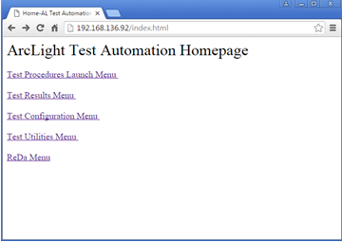
Command and Control Homepage
Homepage
http://192.168.136.92/index.html
Hyperlinks to
Test Procedures Launch
Test Results
Test Configuration
Test Utilities
ReDa

Slide 13
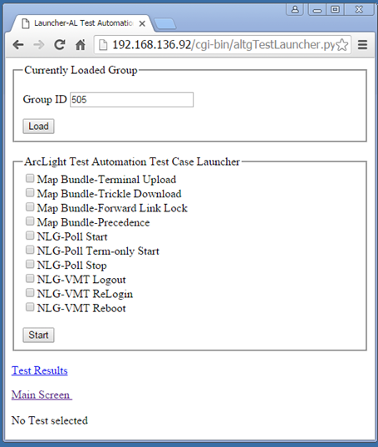
Command and Control Test Launcher
Test Launcher
Choose Configuration Group(s)
Examples: “400-410, 413, 500”, or “505”
Allows for Map serial batch or NLG parallel monitoring
Check one or more desired tests (user should make good choices)
Map Bundle
Terminal Upload
Trickle
Precedence
FL Lock
NLG
Poll Start
Collect NMSPM VMT and Terminal Screen Status
Poll Term-only Start
Collect Terminal Screen Status
Poll Stop
VMT [Logout/ReLogin/Reboot]
Click Start Button
Click “Test Results” to view progress and results

Slide 14
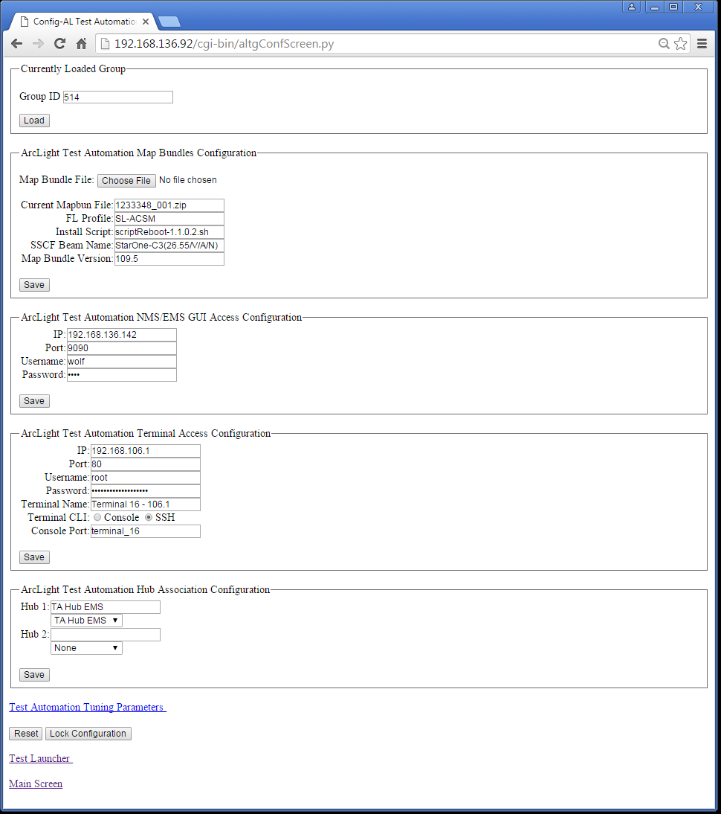
Command and Control Configuration
Set Group Id
Use next new, or
To Edit, set to known id and click load
Set and Save Map Bundle
Choose file from Perforce Local workspace
Choose Beam to Test as specified in SSCF (not SED)
Specify Bundle Version
Set and Save NMS
Choose 192.168.136.142 for Maps
Choose any other NMS in 136 subnet for Data Collection
Set and Save Terminal
Terminal Name must match name in NMS VMT Fleet
Password must be for the loaded terminal SW version
Set and Save Hub Associate
Select both Hub1 and Hub2 pulldowns
For collection, RTNMS syslog will be copied from each hub
For Map Bundle, Hub1 for EFLM control

Slide 15
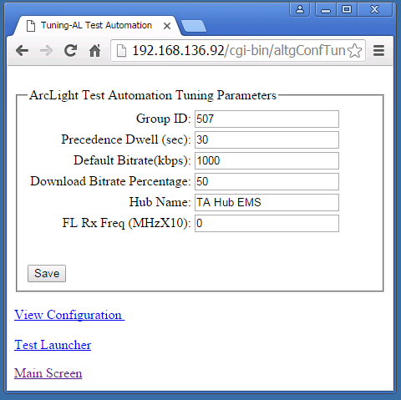
Command and Control Tuning Parameters
Customize algorithm for the group
Precedence Dwell to reduce the SSCF dwell time for satellite search
Hub name (to be deprecated and replaced with the RTNMS Hub Name
FL Rx Freq overrides the frequency from SED; stopgap when SED frequency != 1st entry

Slide 16
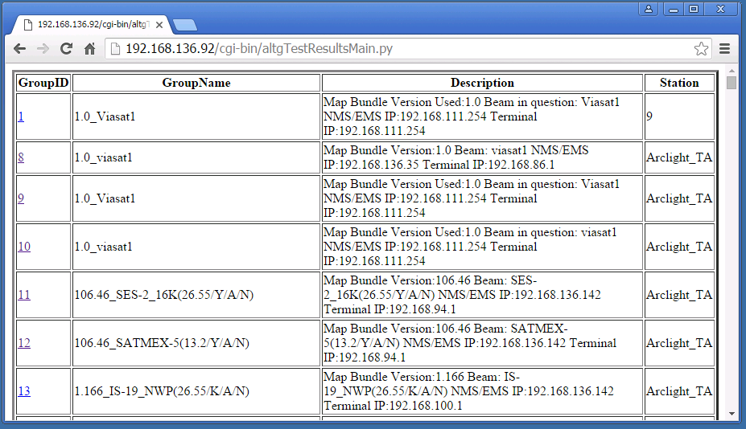
Command and Control Summary Test Results
Summary of each test group
For Map, shows terminal, NMS, Beam
For Collection, shows terminal, NMS
click on Group Id for details

Slide 17
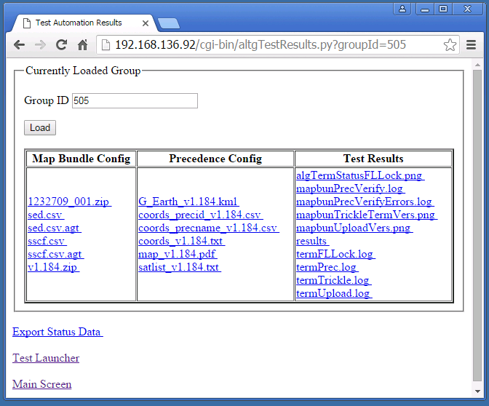
Command and Control Detailed Group Results
Map Bundle Config Files
Release Zip
Bundle Zip
MD5/Signed SED, SSCF, RLC, GDRM
MD5 stripped SED, SSCF, RLC, GDRM
Precedence Config
KLM for Google Earth
Optimum Coordinates
Test Results
.PNG screen shot artifacts
.log for MD5
results text file contains logs of tests and status
*Db.csv contains screen data gathered during collection

Slide 18
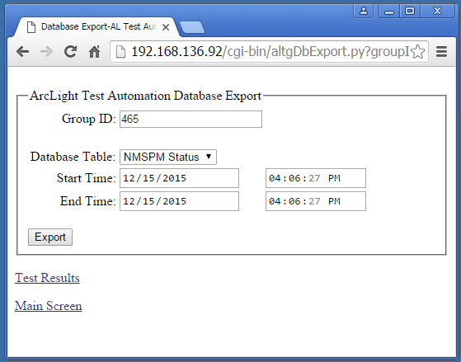
Command and Control Collected Status Database Export
Export Screen Status data collected during and NLG Poll from database to a csv file
Database Table
Select NMSPM Status or Terminal Status
Select data collection window to export by specifying start and stop times (in GMT)
Click Export button, and then click Test Results link to see the file
Naming convention is <tblname>_<start as YYYYMMDDHHMMSS>_<stop YYYYMMDDHHMMSS>
(Enhance to use popup)
The columns of the file are group id, poll time, and n-columns named after each field on the captured screen(s), e.g.
FL_EsNo is EsNo reported on the Forward Link section of the General Status Page, and
FLS_EsNo is EsNo reported on the Terminal Forward Link Status page

Slide 19
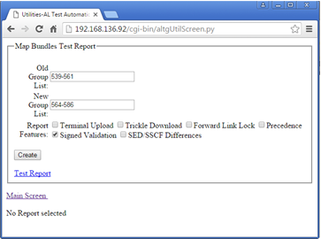
Command and Control Utilities
Map Bundles Test Report
Post processes results from specified group(s) to text file containing gleaned information needed to prepare QA test report
Select groups, checkboxes
Click on Create
Click Test Report to read report, or right-click “save link as” to upload report

Slide 20
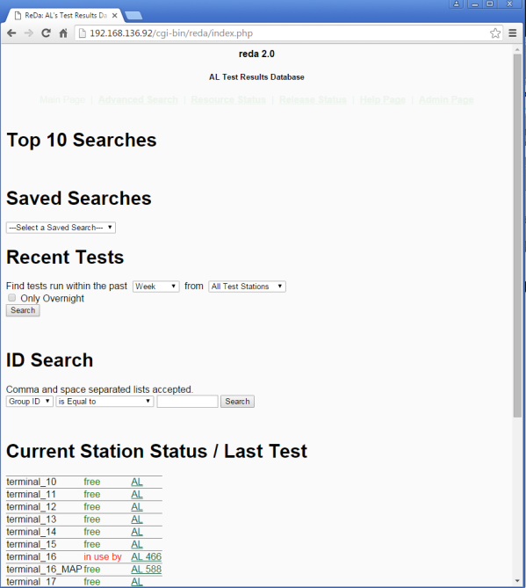
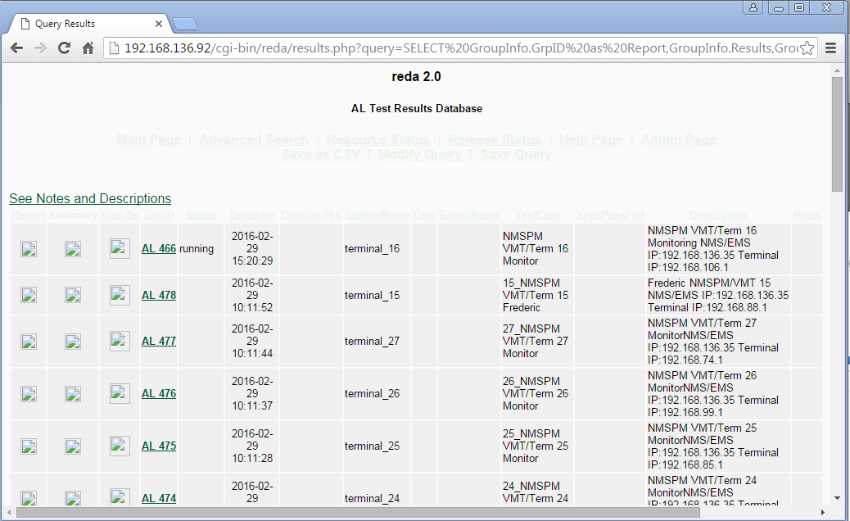
Command and Control ReDa
Summary Dashboard
Current Station Status
Indicates which Terminals are in use and which are free
Summary Test Results
Recent Test Queries
Results Icon
Click to load zip file of all results from group into browser download

Slide 21
Use Cases - Map
mapBun Trickle
mapBun Terminal Upload
NMS
Copy bundle
trickle to download the bundles
Terminal CLI
Get md5 checksum
Verification
successful file transfer to Terminal by version number on Terminal GUI
md5 checksum matches Terminal upload MD5
Run for signed and unsigned
Terminal GUI
Load maps through GUI
Terminal CLI
Get md5 checksum
Verification
successful file transfer to Terminal by version number on Terminal GUI
md5 checksum matches Trickle MD5
Run for signed and unsigned

Slide 22
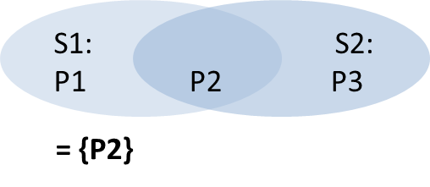
Use Cases - Map
mapBun Precedence
mapBun FL Lock
Test Controller
Generates kml file
Finds all coordinates
Automatically generated
Optimized to use single, unique coordinate for overlapping regions
In diagram below, Lat/Long “P2” verifies satellite beam S1 and S2
Verification
Search order of mapbunPrecVerify.log matches coords_precname.csv
NMS
Set FL frequency based on map coordinates
EMS Configuration
Set Frequency, Chip Rate
Compute FL frequency
Formula:
Terminal
Load SED/SSCF file bundles
Optimize if loaded from previous portion of test
Change the lat/long coordinates of the terminal and turn sat search on.
Clear syslogMsgs file
Reboot the system
grep the syslogMsgs file
Save satellites locked onto
Verification
Examines satellite locking order for correctness

Slide 23
Use Cases – NLG Collection
Poll Start
Poll Term-only Start
Polls NMSPM VMT associated to the group
Polls approximately every 60 seconds and saves screen info to NMSPM Status database (inside Automation tool) that can be exported to CSV
Accesses NMSPM through “Map” of the configured NMS
Selects VMT based on the Configured Terminal Name
Polls Terminal associated to the group
Polls approximately every 45 seconds and saves screen info to Terminal Status database (inside Automation tool) that can be exported to CSV
Selects VMT based on the Configured Terminal Name
Select multiple groups to poll different terminals simultaneously
Polls Terminal associated to the group
Polls approximately every 45 seconds and saves screen info to Terminal Status database (inside Automation tool) that can be exported to CSV
Selects VMT based on the Configured Terminal Name

Slide 24
Use Cases – NLG Collection
Poll Stop
VMT Commands
Stops the active polling for the group(s)
Works for Poll Start or Poll Term-only Start
Waits until next poll cycle
Captures Charts for NMSPM based on the duration between start and stop
Exports NMSPM Status and/or Terminal Status to to CSV based on duration
scp‘s syslogs from Terminal and RTNMS and post processes into .csv files for analysis
Issues Logout, Relogin, Reboot to all groups specified in Group Id
If only 1 group, just as easy to do directly
Issued on the configured NMS
Selects Hub associated RTNMS configuration
Currently does not support Beam Redirect

Slide 25
VMT Commands
Issues NMS VMT Command(s) across 1 or more Group(s) (serially)
Logout
ReLogin
Reboot
Beam Re-Direct (Not Implemented)

Slide 26
Map Testing Process
Steps
Automation Test Cases
Pre-Release Meeting
System Engineering walk-thru on upcoming map features
eMail
Describes bundles for test and Perforce location
Perforce
Get bundles to local workspace
Review changes specified in RDD
SGT Tool
Pre Test Planning
Determine Beams
Configuration
Set up beams and maps according to plan
Automation
Tests and Generates Results
Data Analysis
Scripts (alResults.sh)
Reporting
Analysis, PPT, KML
Perforce
SGT Tool
Upload
Trickle
Precedence
FL
AL1 Normal
AL2 Pilots
Spectral Inversion

Slide 27
Map Bundle Training Exercise
Map at //Arclight/ArcLight/Releases/oldreleases/SED_SSCF_Releases/Agile_Documents/Bundles_v1.184/
Test Unsigned only
Satellite Beam: SES-4(26.55/K/A/N)
Prepare a new test report (Datasheet only)
Hints:
Automation Browser at 192.168.136.92, Connect Cisco VPN first
All physical connection are correct to run this test
Use Group 498 as an example
Create Group 505 (CAREFULLY load 498, and CHANGE Group Id to 505 and then set parameters and save – separate save button for each section)
Terminal 5 (is currently using SW ver 5.2.0.27) pw hint bob, **** use \’ to enter an apostrophe ‘
Unsigned does not have the “vca00…sgn” in filename
Look at results file to see test progress
Run 1 test at a time
Version is in the Perforce path
Datasheet Example at //Arclight/ArcLight/SystemTest/TestReport/SED_SSCF/Bundles_v1.183_v1.184/Datasheet_v1.183_v1.184.xlsx

Slide 28
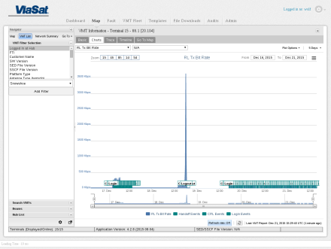
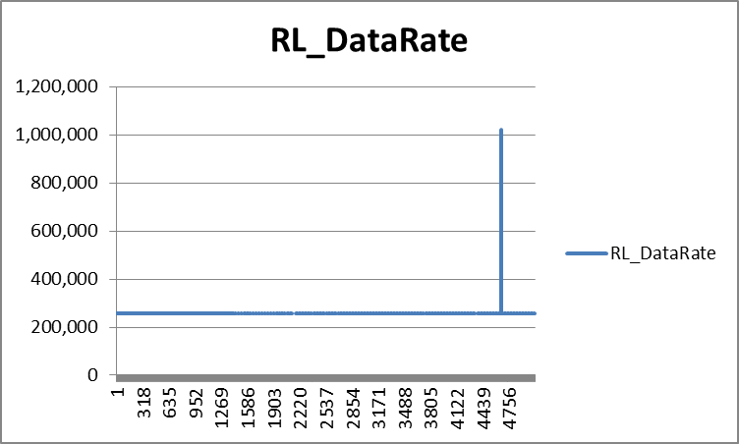
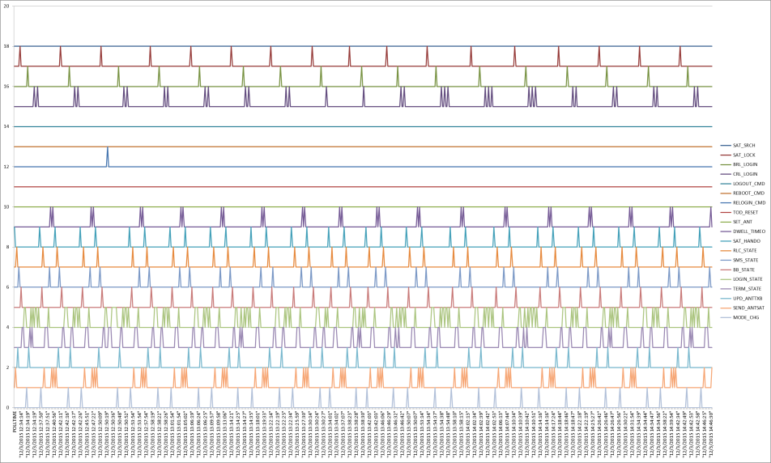
NLG Data Analysis
Status CSV file(s)
Screen values captured on regular time intervals
Import into EXCEL
Plot column(s) to see changes during test
Example RL Data Rate
Correlate NMS charts to data reported.
Validates display at Term matches data at NMSPM
Syslog CSV file(s)
Generated by post-processor
Syslog reorganized into Specific Event columns of binary event triggers (0/1)
Plot several columns over same time period and offset to see “triggers” over time
NOTE: CRL login Bug revealed (2 or 3 peaks instead of 1)

Slide 29
Post-Processed Syslog CSV File Formats
Terminal Syslog CSV
RTNMS Syslog CSV
Currently, the following events are parsed, i.e. columns:
POLLSEC, POLLTIME, VARG_1, VARG_2, SAT_SRCH, SAT_LOCK, BRL_LOGIN, CRL_LOGIN, LOGOUT_CMD, REBOOT_CMD, RELOGIN_CMD, TOD_RESET, SET_ANT, DWELL_TIMEO, SAT_HANDO, RLC_STATE, SMS_STATE, BB_STATE, LOGIN_STATE, TERM_STATE, UPD_ANTTXB, SEND_ANTSAT, MODE_CHG
Each event is represented with a "1" in the event column, and any supporting info is in the VARG column(s) as follows:
If TOD_RESET, then VARG_1 is TOD_NEW and VARG_2 is TOD_OLD
If SET_ANT, then VARG_1 is BEAM_NAME and VARG_2 is 0
If *_STATE, then VARG_1 is state change value and VARG_2 is 0
If SEND_ANTSAT, then VARG_1 is AcuSt and VARG_2 is 0
If UPD_ANTTXB, then VARG_1 is AcuSt and VARG_2 is 0
Currently, the following events are parsed, i.e. columns:
POLLSEC,POLLTIME,VARG_1,VARG_2,VMT_STATE,CRL_STATE,CONN_LOGIN,CONN_OPER,CONN_SESS,PWRCTL_UPD,ACSM_UPD,CONN_LOGOUT,CONN_Vmt,CONN_VMT,CONN_RL
Each event is represented with a "1" in the event column, and any supporting info is in the VARG column(s) as follows:
VARG_1 is Terminal ID (decimal equiv of 0.0.c.d addr), or CRL indicator for CRL_STATE
VARG_2 is State for VMT_STATE or CRL_STATE, otherwise contains message

Slide 30
Extra Slides & Master Diagrams

Slide 31
Browser
Browser
Test Equipment
AL AUTOMATION
Test Automation
Subsystem
Automation SW
DB
Unit Under Test (UUT)
GUI
(HTTP)
Linux
(SSH)
Unit Under Test (UUT)
NMS/EMS/ HUB
Term

Slide 32
Perforce, Share-point, …
Lab Switch/PBR
NetInstall-open SuSE
192.168.136.41
(u:root/p:viasat)
Corp
LAN
S4 Catalyst
192.168.136.6-#2 (E2442)
136.6-#8 (E2448)
SAM4/FLM4
<testerA>-wxp
192.168.136.82
192.168.142.58
(VLAN-142)
Map Test Appliance – Supermicro Blade #2
EFLM
VSwitch
<testerB>-wxp
“Base-ball Switch”
Automation (VM-CentOS)
EMS
(VM-SuSE)
NMS
(VM-SuSe)
RtNMS
(VM-SuSE)
IF-SMA-RG6
EFLM-Tx
VMBR-Rx
<testerC>-wxp
IPE
(VM-SuSeE)
Notes:
Cisco VPN Client AT_NOC_VPN
Connect VMBR-Rx to EFLM as needed
SAM4/FLM4 for 3LL Pilot
Mixer for Spectral Inversion
R
192.168.136.92 192.168.142.5 (VLAN-142)
192.168.136.142 192.168.142.8 (VLAN-142)
192.168.142.18 (VLAN-142)
MIXER
I
L
Terminal
SIG GEN
(VLAN-803-82x)

Slide 33
S1:
P1
S2:
P2 P3
= {P2}

