Slide 1



Population Initialization Techniques for RHEA in GVGP
Raluca D. Gaina, Simon M. Lucas, Diego Perez-Liebana

Slide 2
Introduction
Rolling Horizon Evolutionary Algorithms (RHEA) show promise
in General Video Game Playing (GVGP)
as showcased in the General Video Game AI Competition (GVGAI).
Better than random initialization for faster evolution?
No clear general analysis in previous literature

Slide 3

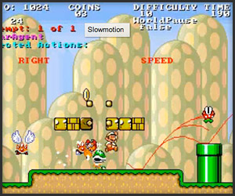
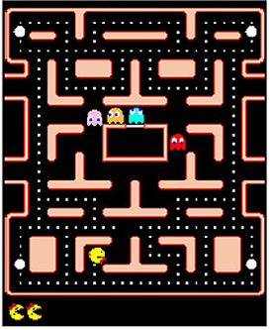
Game AI
Ms. Pacman
Super Mario AI

Slide 4
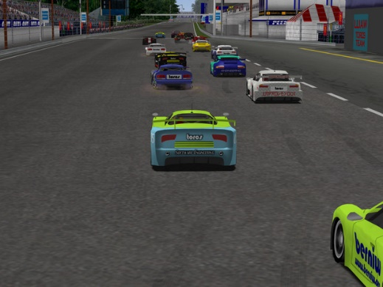

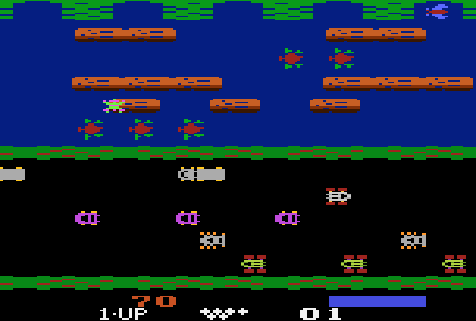
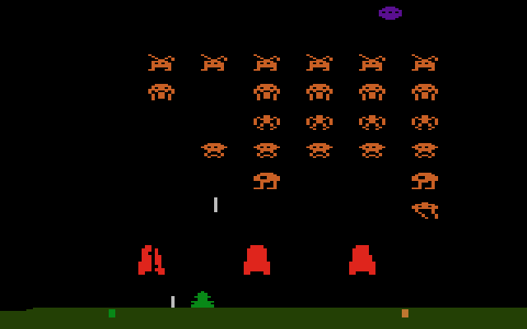
General Video Game AI
any game !

Slide 5
General Video Game AI Competition
2D grid-physics games
Arcade, puzzles, shooters, adventure.
Ways to interact with the environment
Ways to win
Elements in a game
Scoring systems
Single and two player, cooperative and competitive.
… high-level view of current game state for agents; real-time decisions (40ms)

Slide 6
Rolling Horizon Evolution
Population
Mutation
Next Population
Crossover
[0, N_ACTIONS -1]
elitism
Individual x0
Individual x0
Individual 0
Individual 0
Individual 0
Individual 0
+
Individual 2
Individual 1
Individual 2
Evaluation
Individual 2
Individual x1
FM
Individual x0
Individual x0
Individual x0
Individual x0
Individual n
State
Individual xn
H
State value = fitness

Slide 7
Methodology
Try two methods …
One Step Look Ahead (1SLA)
Monte Carlo Tree Search (MCTS-S)
… on 20 GVGAI games …
… with different core parameter configurations.
Δ
Δ
Δ
Δ

Slide 8
Experiment
Population size P - Individual length L = {1-6, 2-8, 5-10, 10-14, 15-16, 20-20}
All other parameters fixed to default values
Budget: 900 Forward Model calls
L FM calls for 1SLA
Half budget for MCTS-S
MCTS-S rollout depth = L
Validation
Comparison with MCTS.
=> one individual, mutate it to form population
Notes:
Using these forward model calls instead of real execution time is more robust to fluctuations on the machine used to run the experiments, making it time independent and results comparable across different architectures
(average obtained by MCTS in 40ms).
For P=1, algorithm becomes a Random Mutation Hill Climber (1 new individual mutated, the best kept)
For P=2, 1 individual is promoted through elitism, 1 new individual from crossover and mutation.

Slide 9
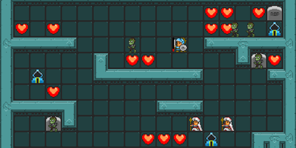
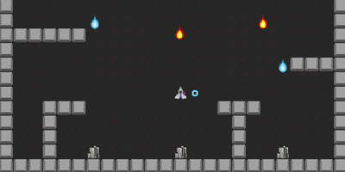
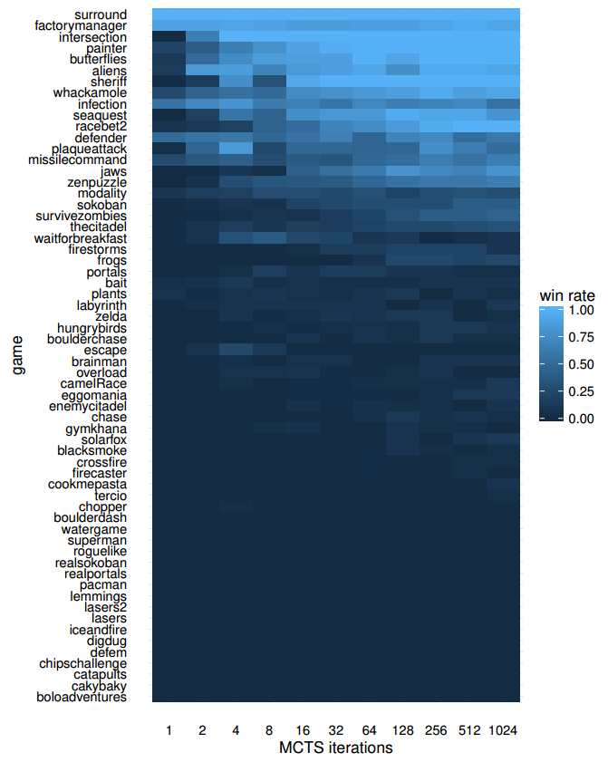
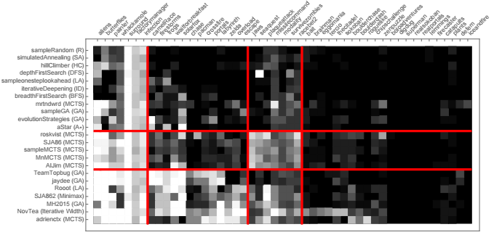
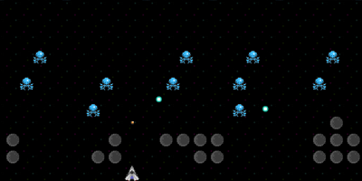
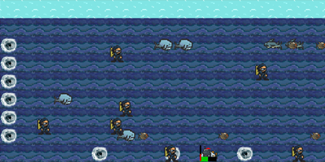
20 Games from GVGAI corpus
2 classifications by Mark Nelson and Bontrager et al.
Balanced set: 10 stochastic, 10 deterministic, varying difficulty and game type.
Survive Zombies
Missile Command
Aliens
Sea Quest

Slide 10
Results Overview
Improvement much bigger when small pop size
MCTS seeding significantly better
3 games in which MCTS seeding consistently bad: puzzles / long term reward
Some games remain at 0% win rate
Game Chopper: 26% => 100% win rate (1-6)
Big improvement in low config shows promise of RHEA with improved evolution
Notes:
Escape, Wait for Breakfast, Intersection
0%: Dig Dug, Lemmings, Roguelike: long term rewards, need more exploration

Slide 11
Results – Vanilla vs 1SLA
Win rate, no. games significantly better
Overall: 8, 6
Score, no. games significantly better
Overall: 11, 8
Notes:
1SLA slight improvement in low config
Overall, 1SLA significantly worse than random initialization
performance is proportional to the individual length, suggesting that the directed search provided by 1SLA is more effective in cases with big $L$ values compared to A-Vanilla's random sampling.

Slide 12
Results – Vanilla vs MCTS-S
Win rate, no. games significantly better
Overall: 4, 12
Score, no. games significantly better
Overall: 5, 16
Notes:
MCTS significantly better, but performance drops when rollout length exceeds 12.
Population size increase negatively affects MCTS seeding performance => search too narrow, not enough exploration
One interesting game to look at is Sea Quest, where C-MCTS-S increases the win rate of the baseline algorithm from $31\%$ to $68\%$ ($p \ll 0.0001$) and the score from

Slide 13
Results – 1SLA vs MCTS-S
Win rate, no. games significantly better
Overall: 3, 10
Score, no. games significantly better
Overall: 5, 13
Notes:
MCTS seeding consistently significantly better in 50% of the games for win rate and 65% of the games for score.
MCTS fails in puzzle games

Slide 14
Results - MCTS Validation
No. games MCTS-S better than Vanilla, but not MCTS
Overall: 10, 15
Notes:
MCTS seeding not significantly better than both Vanilla RHEA and MCTS. However, in games where MCTS and MCTS seeding were not significantly better than each other, the MCTS seeding showed a big improvement over the Vanilla RHEA (50% of the games resulted in a larger win rate and 75% in a bigger score).

Slide 15
Summary
Analysis of One Step Look Ahead (1SLA) and Monte Carlo Tree Search (MCTS-S) seeding for vanilla Rolling Horizon Evolutionary Algorithm (RHEA)
Multiple RHEA parameter configurations
Win rate and score measured on 20 GVGAI games
Overall and pairwise comparison
Validation against MCTS

Slide 16
Conclusions
Seeding improves performance if population size is small
MCTS seeding significantly better (performance drops if rollout depth too large)
MCTS seeding worse in puzzle games / longer lookaheads
Limited exploration, search too narrow
MCTS seeding not worse than simply MCTS

Slide 17
Future Work
Meta-heuristic: which seeding method is best?
Better exploration of search space & use of solution provided by seeding
Better evolution paired with powerful seeding method
More games to better judge significance
Questions?

Slide 18
Thank You!
?
gvgai.net
rdgain.github.io

