Slide 1
Analysis of Rolling Horizon Evolution Parameters in General Video Game Playing
Raluca D. Gaina, Jialin Liu, Simon M. Lucas, Diego Perez-Liebana

Slide 2
Introduction
One of the most promising techniques in General Video Game AI competition (GVGAI) are the Rolling Horizon Evolutionary Algorithms (RHEA).
Analysis of the vanilla version of RHEA on 20 GVGAI games
Special focus on the population size and the individual length.
Comparison with the sample Monte Carlo Tree Search (MCTS)
Best sample agent in GVGAI.
Base of many winning competition entries.

Slide 3
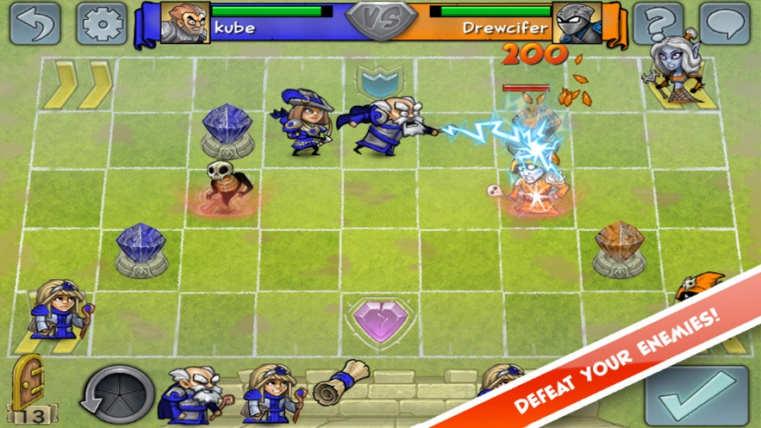
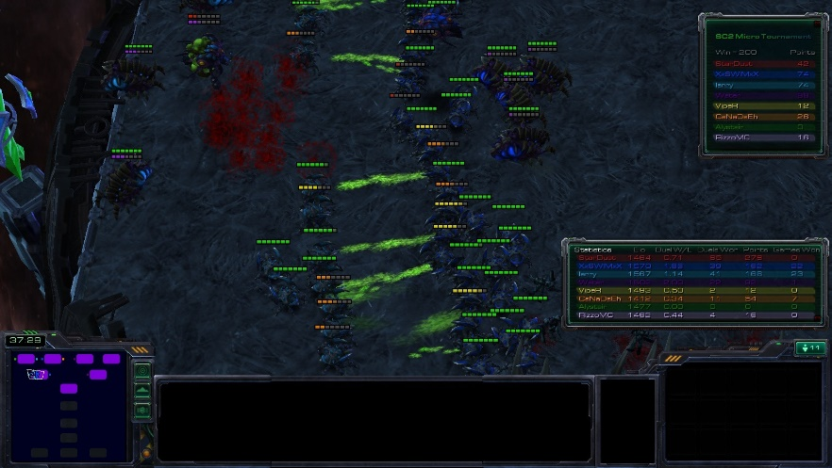
RHEA in Game AI Literature
Perez et al: comparison with tree search on the Physical Travelling Salesman Problem
Justesen et al: Hero Academy, groups of actions evolved for a single turn, for up to 6 different units, fixed population of 100 individuals (online evolution is able to beat MCTS).
Wang et al: modified version in Starcraft micro¹, evolving plans to determine which script each unit should use at each time step.
Hero Academy: https://youtu.be/nox2dk0_aSA
Starcraft micro: https://youtu.be/Xpjp0sm2reE

Slide 4

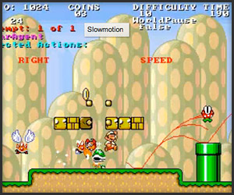
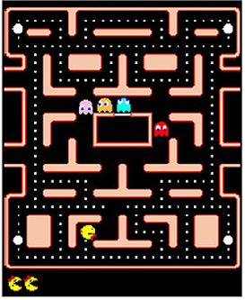
Game AI
Ms. Pacman
Super Mario AI

Slide 5
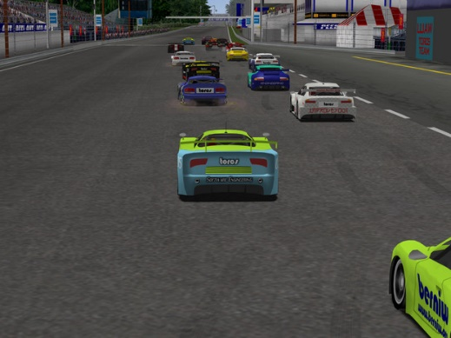

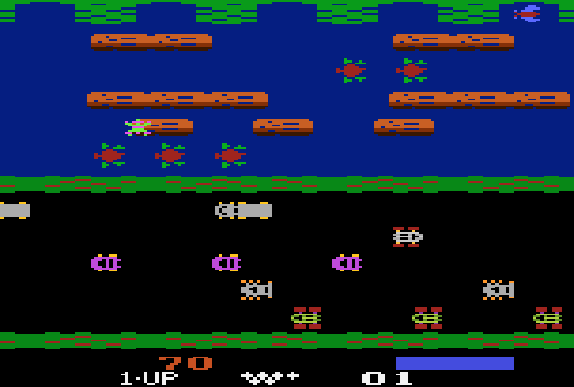
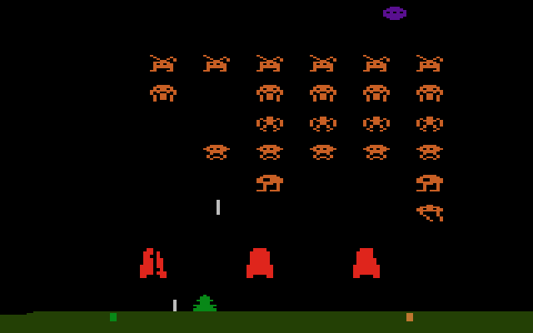
General Video Game AI
any game !

Slide 6
General Video Game AI Competition
2D grid-physics games
Arcade, puzzles, shooters, adventure.
Ways to interact with the environment
Ways to win
Elements in a game
Scoring systems
Single and two player, cooperative and competitive.
… agents receive only a high-level view of the current game state and must make decisions in real-time (40ms)

Slide 7
Rolling Horizon Evolution
Individual length
Population
Mutation
Next Population
Crossover
[0, N_ACTIONS -1]
elitism
Individual x0
Individual x0
Individual 0
Individual 0
Individual 0
Individual 0
+
Individual 2
Individual 1
Individual 2
Evaluation
Individual 2
Individual x1
FM
Individual x0
Individual x0
Individual x0
Individual x0
Individual n
State
Individual xn
Population size
H
State value = fitness

Slide 8
Approach
Population sizes P={1, 2, 5, 7, 10, 13, 20}, individual lengths L={6, 8, 10, 12, 14, 16, 20}
All other parameters fixed to default values
Budget: 480 Forward Model calls
Special case tested – Random Search: P=24, L=20
No evolution.
Validation
Comparison with MCTS.
Budget extension.
Notes:
Using these forward model calls instead of real execution time is more robust to fluctuations on the machine used to run the experiments, making it time independent and results comparable across different architectures
(average obtained by MCTS in 40ms).
For P=1, algorithm becomes a Random Mutation Hill Climber (1 new individual mutated, the best kept)
For P=2, 1 individual is promoted through elitism, 1 new individual from crossover and mutation.

Slide 9
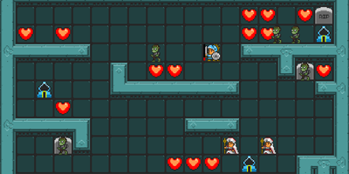
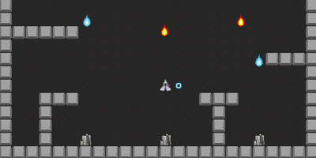
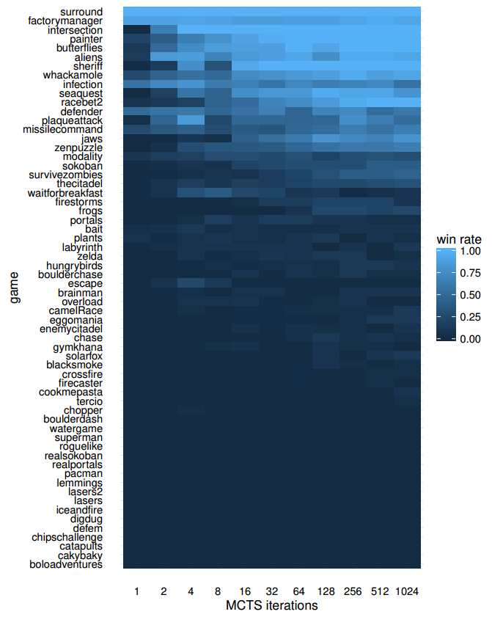
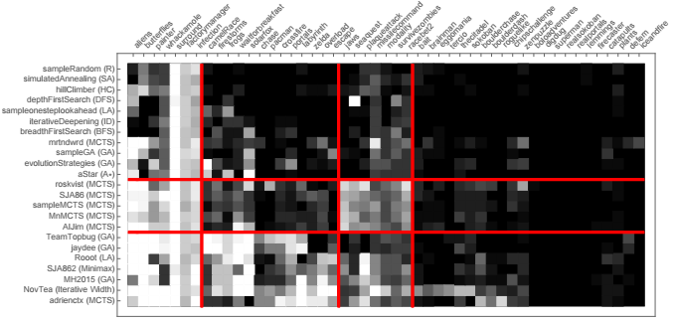
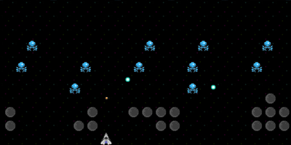
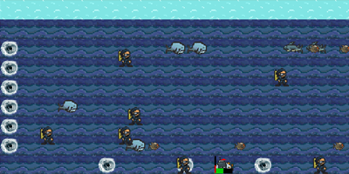
20 Games from GVGAI corpus
Uniformly sampled from two classifications by Mark Nelson (based on vanilla MCTS controller performance in 62 games) and Bontrager et al. (based on sample controllers + competition entries performance in 49 games).
Balanced set: 10 stochastic, 10 deterministic.
Survive Zombies
Missile Command
Aliens
Sea Quest

Slide 10
Results Overview
Trend noticed in most of the games: win rate increases, regardless of game type. Overall, performance increases with greater parameter values.
Exceptions:
win rate starts at 100% (room for improvement, Aliens and Intersection)
win rate stays very close to 0% (outstanding difficulty, Roguelike).
Best: P = 20, L = 20
47.50 (2.33) win rate
Worst: P = 1, L = 20
33.15 (2.60)

Slide 11
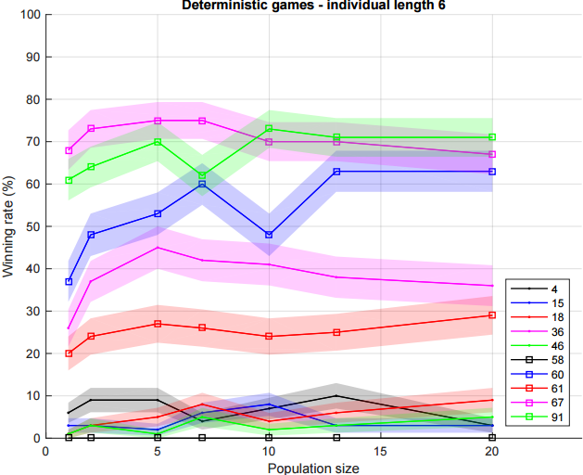
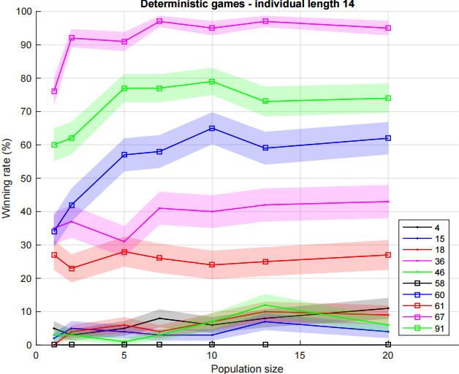
Results – Population Variation (Deterministic)
Winning rate increases progressively in most games.
High diversity in performance
Interesting games (largest performance difference):
Game 67 (Plaque Attack)
Game 91 (Wait for Breakfast)
Game 60 (Missile Command)

Slide 12
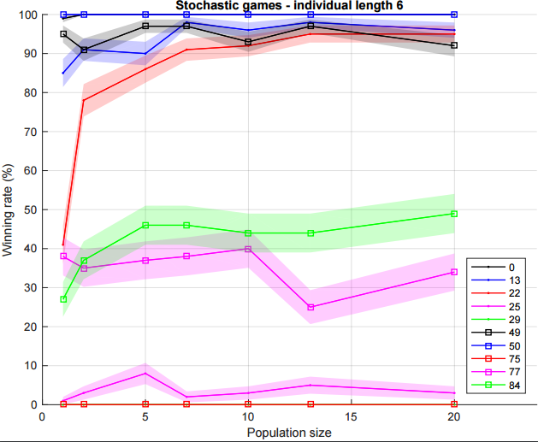
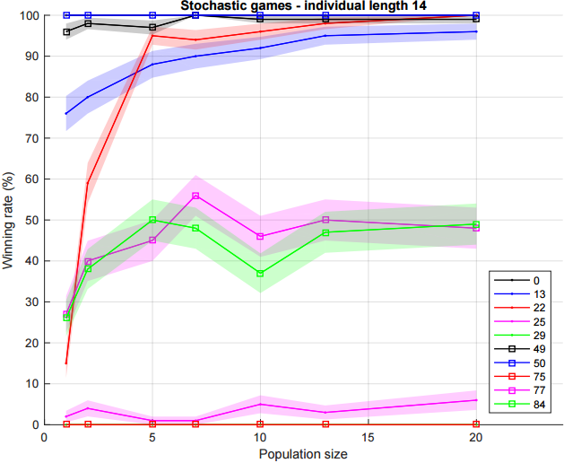
Results – Population Variation (Stochastic)
If the length of the individual is small, increasing the population size is not beneficial in all cases, sometimes causing a drop in win rate
Interesting games (largest performance difference):
Game 13 (Butterflies)
Game 22 (Chopper)
Game 25 (Crossfire)
Game 77 (Sea Quest)
Game 84 (Survive Zombies)

Slide 13
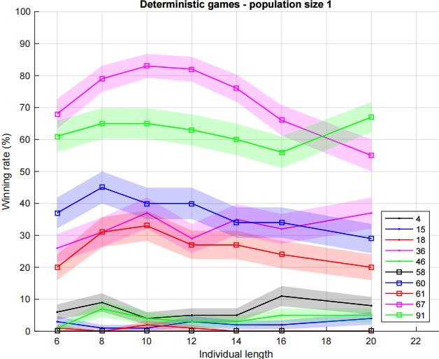
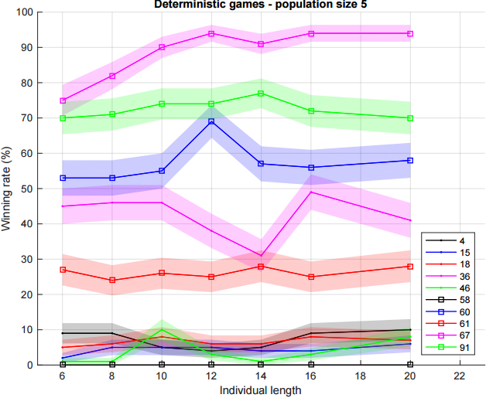
Results – Individual Variation (Deterministic)
If population size is small, win rate sees a significant increase followed by a drop in large individual lengths; this issue is solved by increasing the population size.
Interesting games (largest performance difference):
Game 67 (Plaque Attack)

Slide 14
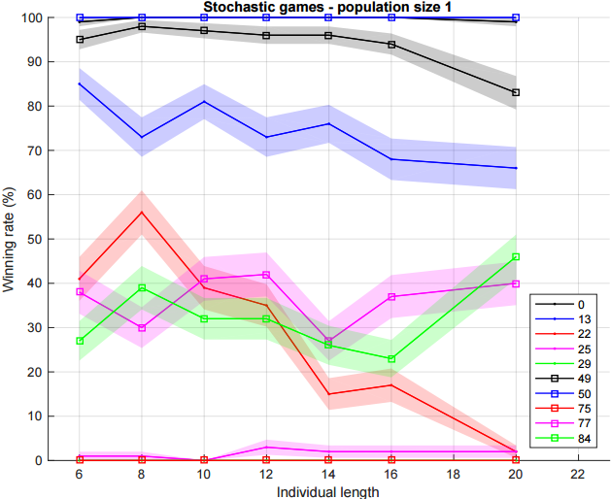
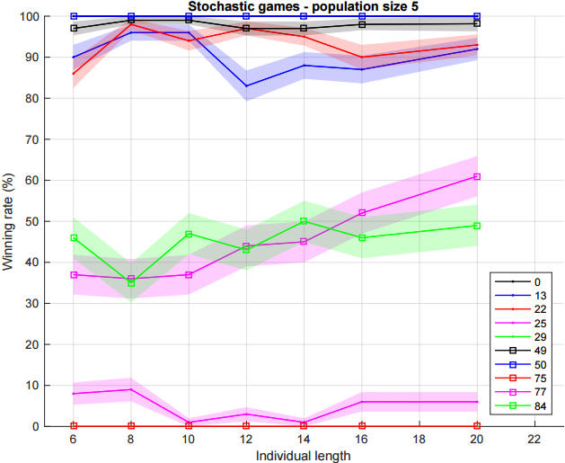
Results – Individual Variation (Stochastic)
Performance highly dependant on game.
No significant change in win rate can be appreciated in larger population sizes.
Interesting games (largest performance difference):
Game 13 (Butterflies)
Game 22 (Chopper)

Slide 15
Results – Random Search & Increased Budget
Reminder:
No evolution.
L = 20, P = 24
Performance no worse than any other RHEA configuration.
Budget increase => Performance increase
Algorithm | Average Wins (T) | Points (T) | Average Wins (D) | Points (D) | Average Wins (S) | Points (S)
RHEA-1920 | 48.25 (2.36) | 351 | 36.30 (2.88) | 181 | 60.20 (1.84) | 170
RHEA-1440 | 48.05 (2.23) | 339 | 35.40 (2.82) | 177 | 60.70 (1.65) | 162
RHEA-960 | 47.85 (2.39) | 323 | 34.60 (2.99) | 162 | 61.10 (1.79) | 161
RHEA/RS-480 | 46.60 (2.40) | 271 | 32.90 (3.04) | 131 | 60.30 (1.76) | 140
Notes:
It's notable that, for these new budgets, the population is evolved during 2, 3 and 4 generations, respectively.

Slide 16
Results – RHEA vs MCTS
If P > 5, RHEA outperforms MCTS.
Random Search (RS) outperforms MCTS in terms of win rate, but not in F1 points.
MCTS is more general.
In deterministic games, MCTS performance similar to worst RHEA configuration (P=1, L=20).
In stochastic games, MCTS and RS performances are similar.
Algorithm | Average Wins (T) | Average Wins (D) | Average Wins (S)
Worst RHEA | 33.15 (2.60) | 22.50 (2.99) | 43.80 (2.22)
RHEA P=1 | 37.95 (2.47) | 26.90 (2.93) | 49.00 (2.01)
RHEA P=2 | 41.05 (2.62) | 27.90 (3.05) | 54.20 (2.20)
RHEA P=5 | 44.65 (2.40) | 31.90 (3.18) | 57.40 (1.61)
RHEA P=7 | 44.65 (2.36) | 30.80 (3.09) | 58.50 (1.64)
RHEA P=10 | 44.06 (2.26) | 29.50 (2.90) | 58.60 (1.63)
RHEA P=13 | 45.15 (2.47) | 32.10 (3.06) | 58.20 (1.88)
RHEA P=20 | 44.75 (2.31) | 31.50 (2.87) | 58.00 (1.74)
RS | 46.60 (2.40) | 32.90 (3.04) | 60.30 (1.76)
MCTS | 41.45 (1.89) | 22.20 (2.45) | 60.70 (1.34)

Slide 17
Summary
Analysis of population size and individual length of vanilla Rolling Horizon Evolutionary Algorithm (RHEA)
Win rate measured on 20 games of the General Video Game AI corpus (selected based on difficulty for a diverse set, deterministic vs stochastic).
Special case of Random Search studied, comparison with MCTS and increased budget effects.

Slide 18
Conclusions
RHEA is no better than Random Search, worse in many cases.
RHEA cannot explore space quickly enough in limited budget (the increased budget results confirm this; so better and faster evolutionary operators and improvements are needed).
RHEA can outperform MCTS if population size is high.
Performance increased in most games in higher population sizes and higher individual lengths, but there are cases where the opposite is true.
Bigger impact noticed in population size variation than individual length.

Slide 19
Future Work
Meta-heuristics: devise methods to identify the type of game being played and …
… employ different parameter settings.
… modify dynamically parameter settings.
Improvement of vanilla RHEA in this general setting.
Seeking bigger improvements of action sequences during the evolution phase, without the need of having too broad an exploration as in the case of RS.
Being able to better handle long individual lengths in order for them to not hinder the evolutionary process.
Consider effects in stochastic games of …
… More elite members.
… Resampling individuals to reduce noise.
Thank you

Slide 20
Thank You!
?
gvgai.net
rdgain.github.io

