Slide 1


Airline Pricing Analytics – Tableau Case Study
“This project focuses on helping an airline pricing manager make faster, data-driven pricing decisions using interactive Tableau dashboards.”
01

Slide 2

A
Market Competitiveness
B
Pricing Trends
Airline Pricing Intelligence Dashboard (Tableau)
C
Decision Support
D
Trend Analysis
02

Slide 3
Decision-Focused. Dashboards
Competitive Positioning
1
4
Market Share Intelligence
Outlier Detection
2
5
Trend Analysis
Price Influencers
3
6
Drill-Down Explorer
03

Slide 4

  Airline pricing manager responsible for route-level
pricing decisions
  Competitive market with multiple airlines per route
  Pricing influenced by:
    Competitor fares
    Stops & flight duration
    Departure dates
    Market presence
Business Context
04

Slide 5


Home
Service
About Us
Contact
  Are our fares competitive on each route?
  Where are we overpriced or underpriced vs market?
Business Questions
  How do prices change over time?
  Do stops and duration justify premium pricing?
  Is low performance caused by pricing or market share?
05

Slide 6
Data Overview
Data Used
  Routes (Origin–Destination)
  Airlines (Carrier)
  Fare (Price incl. stops)
  Number of stops
  Flight duration
  Departure date
06

Slide 7
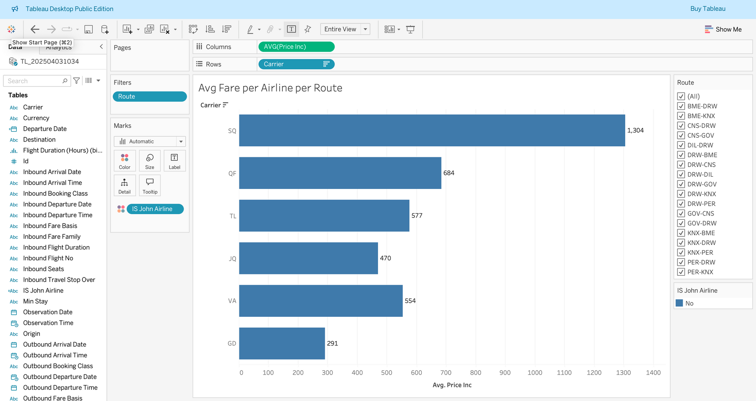
Pricing Competitiveness
Some routes show consistent overpricing vs competitors
Others indicate underpricing opportunities
Highlights where immediate pricing action is needed
07

Slide 8
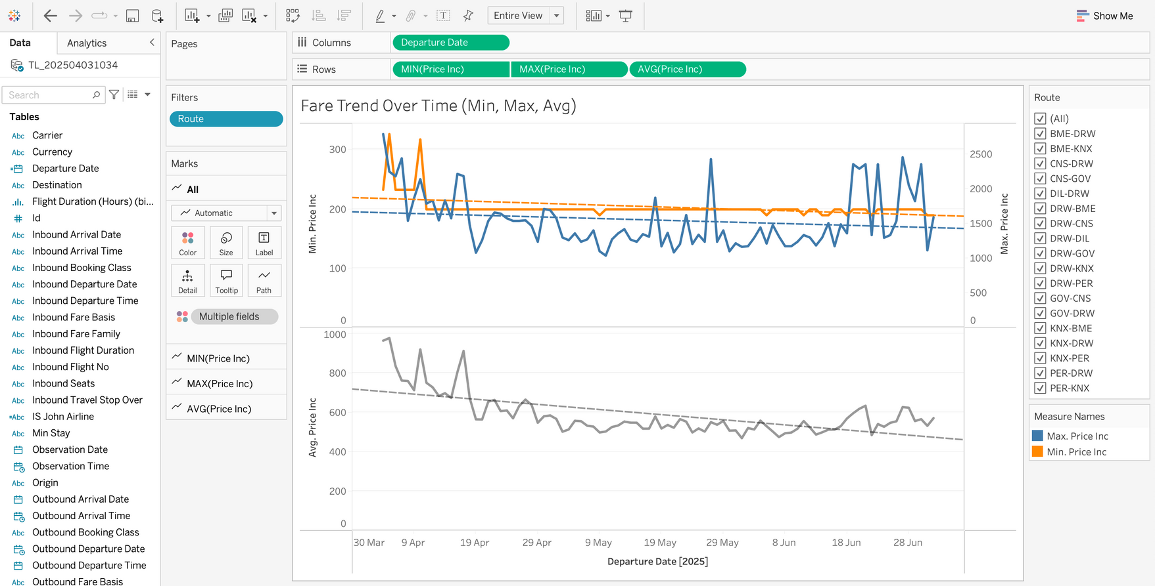
Trends & Volatility
  Certain routes show high daily price volatility
  Stable vs unstable markets clearly visible
  Supports dynamic pricing and monitoring strategy
Learn More
08

Slide 9
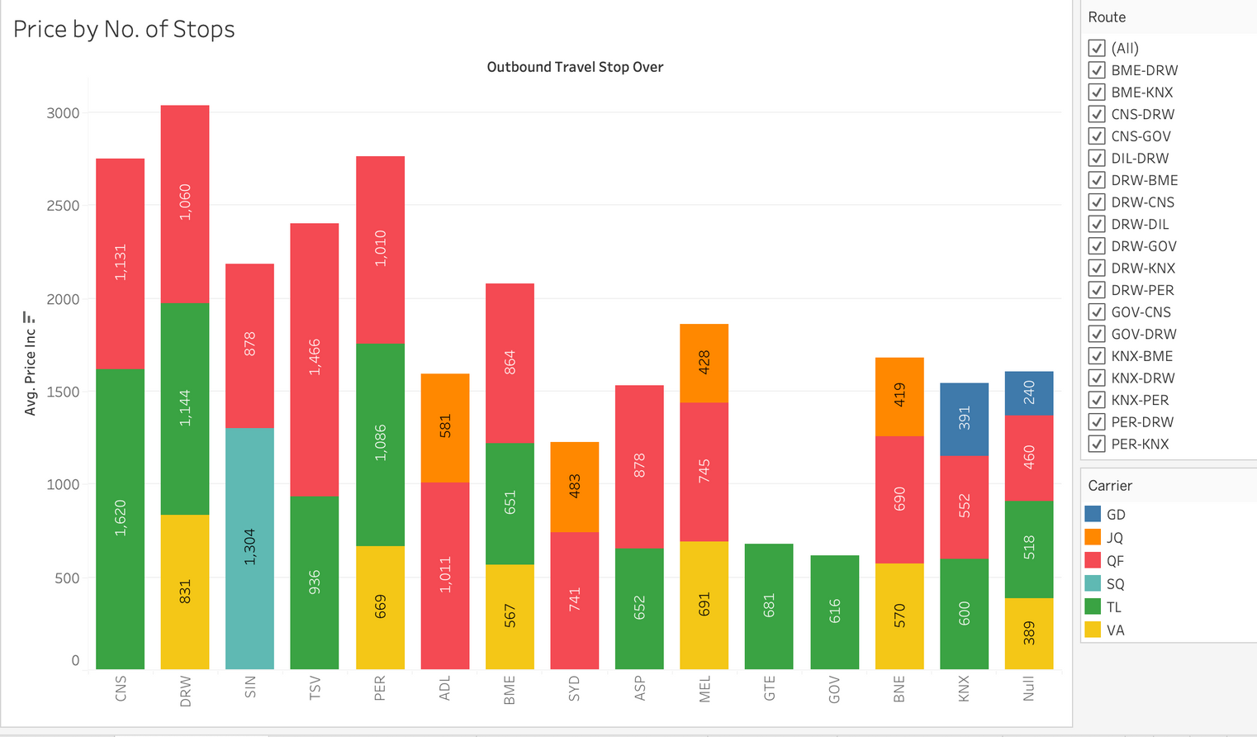
Customer Preference Drivers
  Non-stop flights command higher fares
  Shorter duration flights priced at a premium
  Helps justify differentiated pricing strategies
09

Slide 10
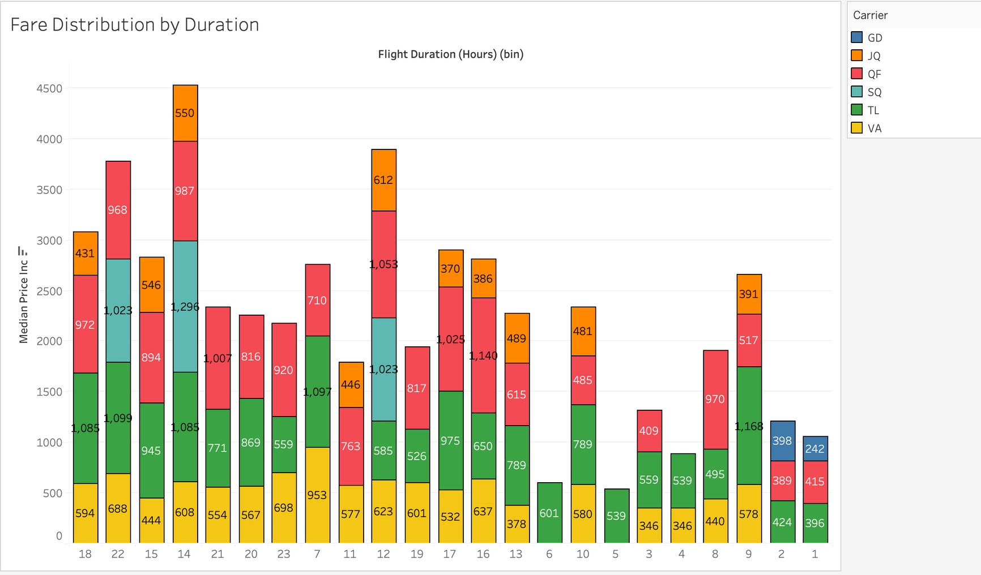


Slide 11
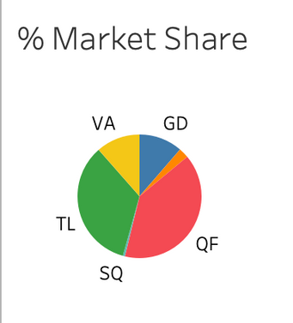
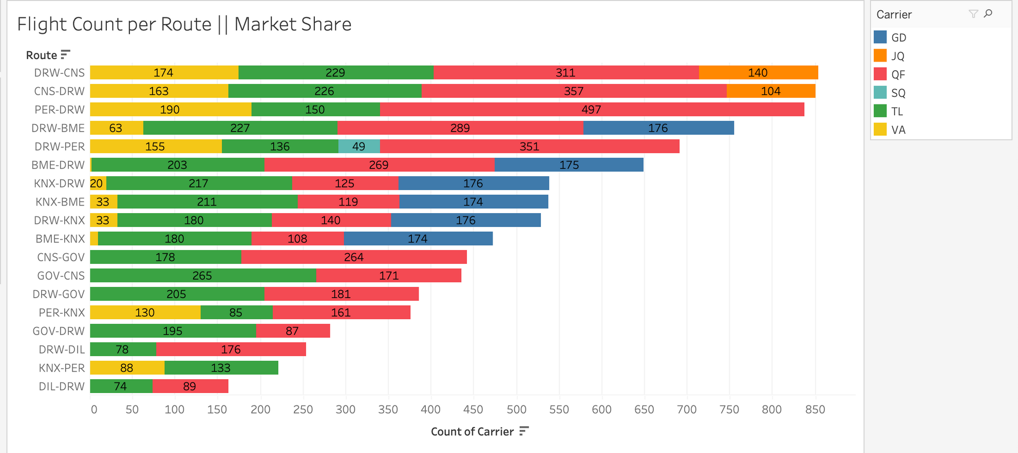
Market Share Context
  Some underperformance driven by lower capacity, not pricing
  Prevents incorrect price cuts
  Adds strategic context to pricing decisions
09

Slide 12
Business Impact & Takeaways
  Faster identification of pricing risks & opportunities
  Clear separation of pricing vs capacity issues
  Reduced manual analysis for pricing teams
  Shift from reactive to proactive pricing decision
06

Slide 13
Thank
You
10

