Slide 1
Sentinel
A Volatility-Aware Agentic Stock-Trading Assistant
Ramesh Dhanasekaran | M.S. Applied Artificial Intelligence, University of San Diego
Notes:
Hi, I'm Ramesh, and my capstone project is called Sentinel. It's an AI-driven stock-trading assistant with one core idea: teach the system to recognize when the market is about to get dangerous, and step back before it loses money. I'll walk you through the problem, how I built it, and what I found. Everything runs in simulation, with no real money.

Slide 2
The problem
• Automated trading strategies do well in calm markets
• But they keep trading straight into sudden crashes
– Think March 2020 (COVID) or the 2022 selloff
• Big losses are hard to recover from
– A 50% loss needs a 100% gain just to break even
• Question: can the system spot danger early and protect itself?
Notes:
Here's the problem. Most automated strategies work fine when the market is calm, but they don't know when to stop. When a sudden shock hits, like the COVID crash in March 2020, they trade right into the fall and rack up huge losses. And big losses hurt, because a fifty percent loss needs a one hundred percent gain just to break even. So my question was: can the system see danger coming and pull back on its own, while still trading normally the rest of the time?

Slide 3
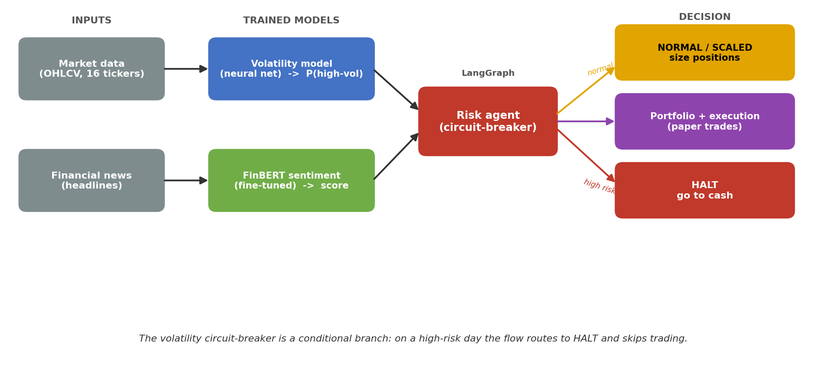
The approach
• A learned "circuit-breaker" for trading
– Predict a high-volatility day, then scale down or halt
• Two trained models feed the decision
• Everything is paper trading only
Notes:
My solution borrows an idea from stock exchanges, which halt trading after an extreme move. I built a learned version. Two trained models, one reading the market and one reading news, feed a risk agent in the middle, and that agent is the circuit-breaker. On a normal day it trades as usual; on a dangerous day it scales positions down or moves to cash. This diagram shows the whole flow, inputs on the left to the decision on the right.

Slide 4
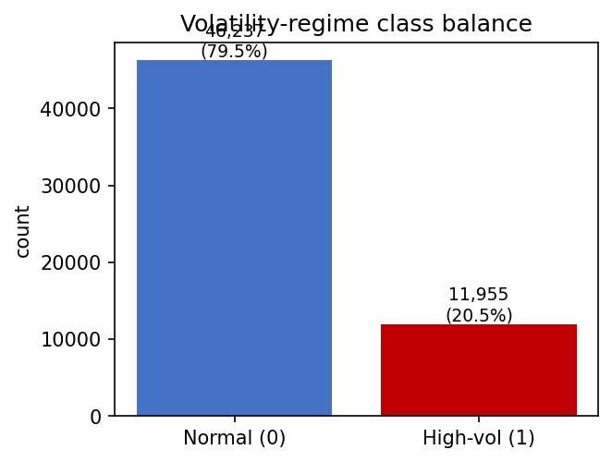
The data
• 15 years of daily prices for 16 large U.S. stocks and ETFs
– Free sources: Yahoo Finance, with Stooq as backup
• Raw prices turned into ~15 stable indicators
– Returns, volatility, momentum, trading-volume signals
• Each day labeled: is the next week unusually volatile?
– About 1 in 5 days is "high-volatility" (~12,000 examples)
Notes:
For data, I used fifteen years of daily prices for sixteen large U.S. stocks and funds, from free sources like Yahoo Finance. Raw prices aren't much use directly, so I turned them into about fifteen standard indicators covering recent returns, how jumpy the price has been, and unusual trading volume. Then I labeled each day with what I want to predict: will the coming week be unusually volatile? These dangerous days are rare, about one in five, giving me roughly twelve thousand examples. Handling that imbalance was an important part of the work.

Slide 5
The two models
• Sentiment model: fine-tuned FinBERT
– A transformer that reads financial news as positive/negative/neutral
– 91% accuracy on held-out sentences
• Volatility model: a neural network built from scratch
– Predicts high-volatility days; trained with PyTorch
– Compared against an XGBoost baseline
• Tools: PyTorch, HuggingFace, XGBoost, scikit-learn
Notes:
The system has two trained models. The first reads financial news. I took FinBERT, a language model already trained on financial text, and fine-tuned it to rate news as positive, negative, or neutral. It reached about ninety-one percent accuracy. The second model is the heart of the project: a neural network I built from scratch in PyTorch that predicts those high-volatility days. I also trained a strong traditional model, XGBoost, as a baseline to compare against, so I could show the neural network was actually pulling its weight. The main tools were PyTorch, HuggingFace, XGBoost, and scikit-learn.

Slide 6
The agent in action
Two real decisions from the system
• Built with LangGraph; the gate is a real branch in the flow
• The agent walks each day and explains its decision:
Calm day (2016-05-26): risk NORMAL
Held full exposure — all 16 names fully invested (gross 16.0).
COVID crash (2020-03-16): risk SCALED
Cut exposure to 5.5 of 16 — 11 names half-sized, 5 moved to cash.
Notes:
I tied it together with LangGraph, a framework for multi-step agents, where the circuit-breaker is an actual branch in the flow. Here it is on two real days. On a calm day in 2016 it saw low risk and stayed fully invested. But on March sixteenth, 2020, in the COVID crash, the volatility model flagged high risk and the agent automatically cut exposure by about two thirds, from sixteen to five and a half. And it explains itself in plain English, so you always see why.

Slide 7
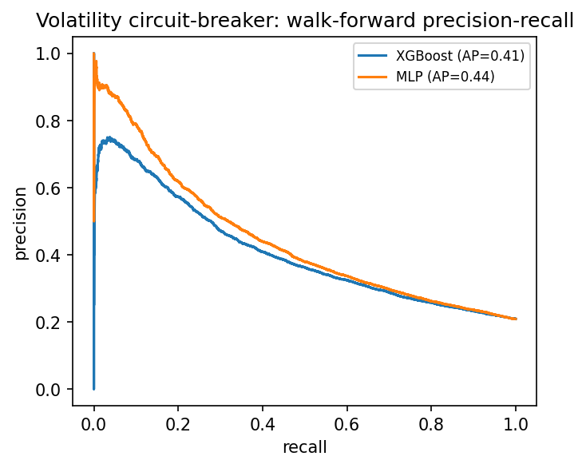
Results: predicting volatility
• Tested with walk-forward retraining (train on the past, predict forward)
• Neural net beats the XGBoost baseline
– PR-AUC 0.44 vs 0.41 (well above the 0.21 base rate)
• Sharpest exactly in the crisis years
– Strong in 2018, 2020, 2022; quiet in calm years
Notes:
So how well does it predict volatility? I evaluated it honestly using walk-forward testing, which means always training on the past and predicting the future, never peeking ahead. The neural network came out ahead of the XGBoost baseline, and both scored well above random. The most interesting finding is in the timing: the model is sharpest exactly in the years that matter, the turbulent ones like 2018, 2020, and 2022, and quieter in the calm years. In other words, it sees trouble most clearly when trouble is actually coming, which is exactly what you want from a risk system.

Slide 8
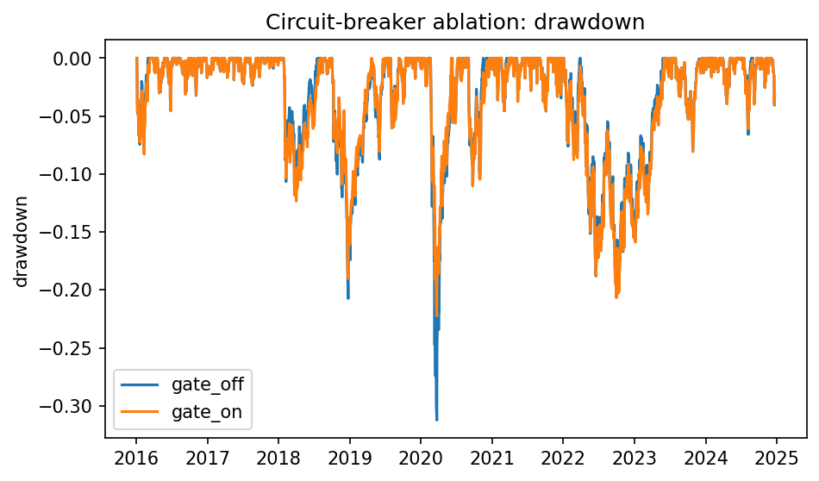
Does the circuit-breaker help?
The main result
• Same strategy, gate OFF vs gate ON:
• Worst drawdown: -31% → -22%
• Sharpe ratio (risk-adjusted return): 1.11 → 1.23
• Exposure barely changes — it acts on ~4% of days
– It protects capital in the danger zone, not by sitting out
Notes:
And now the main result, the test the whole project was built around. I ran the exact same trading strategy twice, once with the circuit-breaker switched off, and once with it on, changing nothing else. With the gate on, the worst loss, the maximum drawdown, shrank from thirty-one percent down to twenty-two percent, and the risk-adjusted return, the Sharpe ratio, went up. And it did this while barely changing how much it was invested overall, because it only acts on about four percent of days, the riskiest ones. You can see it in the chart: the gated line doesn't fall as far during the 2020 and 2022 stress periods. So the circuit-breaker protects capital in the danger zone rather than by sitting out the market. That supports my hypothesis.

Slide 9
Conclusion & next steps
• A learned circuit-breaker measurably reduced losses
• Biggest lesson: how you test matters more than the model
– Honest walk-forward testing changed the whole story
• Limitation: news sentiment is idle in the historical test
– No day-by-day historical news feed to run it on
• Next: add a news feed, try a sequence model, connect a paper broker
Notes:
To wrap up: the learned circuit-breaker did what I hoped and measurably reduced losses in turbulent markets. My biggest lesson was that in financial machine learning, how you test matters even more than which model you pick, honest walk-forward testing changed my results for the better. The main limitation is that the news model, though accurate on its own, sits idle in the historical backtest because I had no day-by-day news feed going back years. So my top next step is adding that feed, then trying a sequence model and a real paper broker. Thanks for watching.

Slide 10
Thank you
github.com/rdhanase/sentinel-agentic-trading
Educational project — paper trading only, not financial advice.
Notes:
Thanks again for your time. The full code and report are on GitHub at the link shown. And one final note: this is an educational research project, everything is paper trading, and none of it is financial advice.

