Slide 1
Search and sort Tools

Slide 2
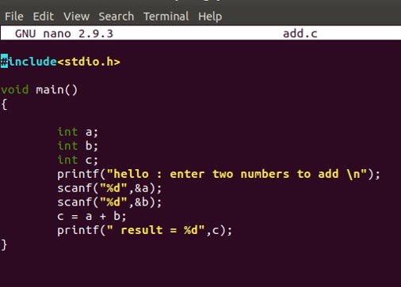
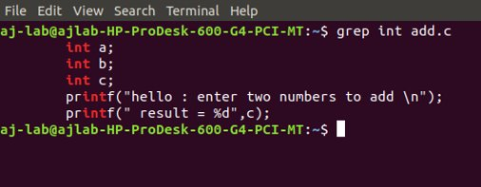
GREP
"grep" stands for global/regular/expression/print
Syntax: grep options pattern files
Example:
grep int add.c

Slide 3
Grep options
c : matches character c
^c : matches a line that starts with character c
c$ : matches c with the end of line
[] : matched any one of the characters in []
. : matches any character
* : matches zero or more characters
RE* : matches zero, or more, repetitions of RE
RE1RE2 : matched two concatenated expressions RE1RE2
RE+ : matches one, or more, repetitions of RE
RE? : matches none, or one, occurrence of RE
RE1|RE2 : matches occurrence of RE1 or RE2

Slide 4
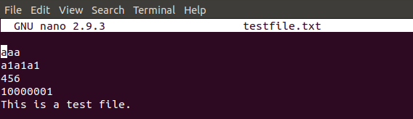
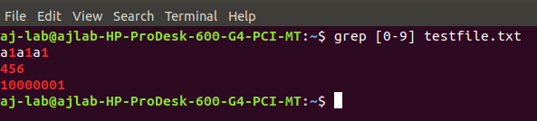
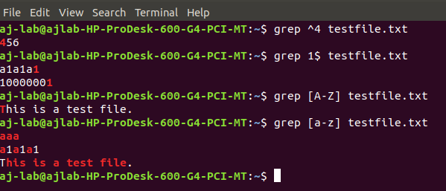

Slide 5
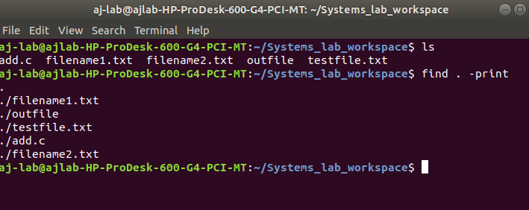
FIND
"find" is used to find files and directories and perform actions on them
Syntax:
find path expression action

Slide 6
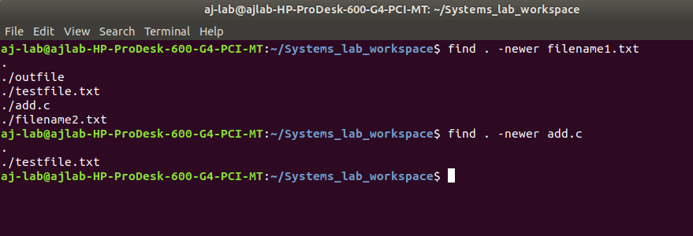
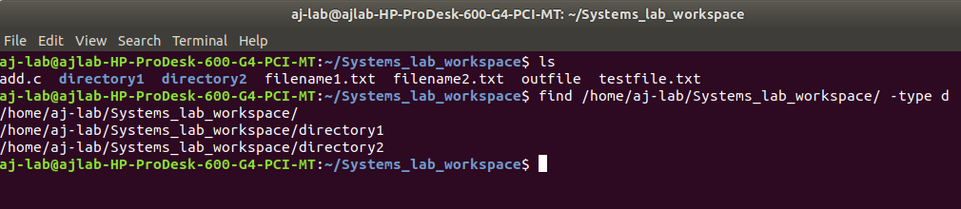
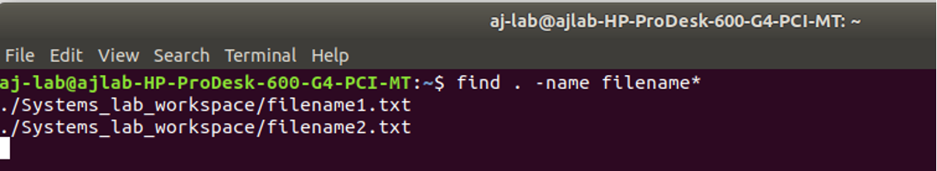

Slide 7
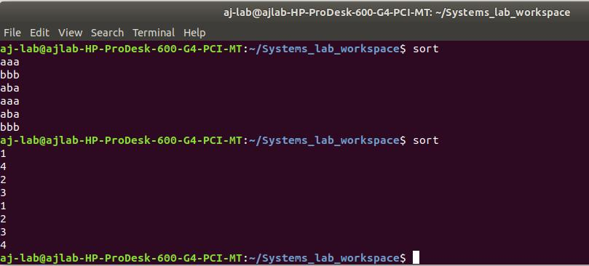
SORT
Sorts lines of text in a text file

Slide 8
Sort options
-r : To get a sort in decreasing order of value
-b : To ignore leading blank spaces
-f : To fold uppercase to lowercase for comparison
-i : To ignore characters outside the ASCII range
-n : To perform numeric comparison. A number may have leading blanks.

