Slide 1
AWK TOOL IN UNIx
Chapter-14

Slide 2
When and where?
AWK was developed in 1978 at the famous Bell Laboratories.
It was developed by Aho, Weinbergeq and Kernighan.
AWK in many flavors .There is gawk which is GNU AWK.

Slide 3
Why do we need it?
To process structured data files.
In programming languages it is common to have a definition of a record which may have one or more data fields. In context, it is common to define a file as a collection of records.
Records are structured items arranged in accordance with some specification. Also the entire process is error prone.

Slide 4
Example for Awk File.
As AWK is used to process a structured set of records, we shall use a small file awk.test given below. It has a structured set of records. The data in this file lists employee's name, employee's hourly wage and the number of hours the employee has worked.
(File awk.test)
bhatt 4,00 0
ulhas 3.75 2
Ritu 5.0 4
vivek 2.0 3

Slide 5
Example:-
Awk ‘$3 > 0 print {$1, $2*$3}’ awk.test
Output:-
Ullas 7.5
Nitu 20
Vivek 6

Slide 6
What if multiple lines are there in awk code?
In the initial example we had a one line awk program.
Basically, we tried to match a and check if that qualified the line for some processing or "action”.
In general AWK program may contain multiple lines of code.
Syntax:-
Pattern {action}
Pattern {action}
Pattern {action}
…..

Slide 7


Using inbuilt variables.
NF is a built-in variable which stores the number of fields in a row.
Another built-in variable is NR, which takes the value of the number of lines read so far.
Code:-
Output:-

Slide 8
Storing Awk code in a file.
If we have many operations to perform, we shall have many lines in the AWK program, It would be then imperative to put such a program in a file.
So if the awk program is very long and kept in a file, use the -f option as shown below: -
awk -f 'awk_program_file_name' [input_files]
#where the awk program_file_name contains the awk program.

Slide 9

Program for employee who did no work.
Code:-
Output:-

Slide 10

Generating meaningful output using verbose.
The formatted data in files is usually devoid of any redundancy. However, one needs to generate a verbose output.
Code:-
Output:-
Note:- Here output should also contains person 5 vivek be paid 6 doallars.

Slide 11


Begin and end keyword
One can generate meaningful headers for the tabulated data using BEGIN keyword.
Usually an AWK code can have a BEGIN keyword that can help generating header before preprocessing the data.
Similarly we can use END keyword to generate trailer.
Example:-

Slide 12
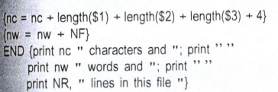

BUILT-IN Functions.
There are some built-in function that will come handy to us.
For instance, the function ‘length’ helps to compute the length of the argument field as the number of characters in that field.
Similar to length there are like built-in functions like sort….
Usage:-
Output:-

Slide 13
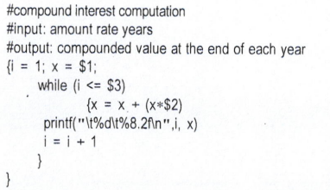
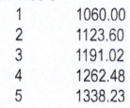
Control Flow statements
AWK supports many control flow statements like if-else, while, for, …
Example for while loop usage.
Code:-
Input:-
Output:-

Slide 14
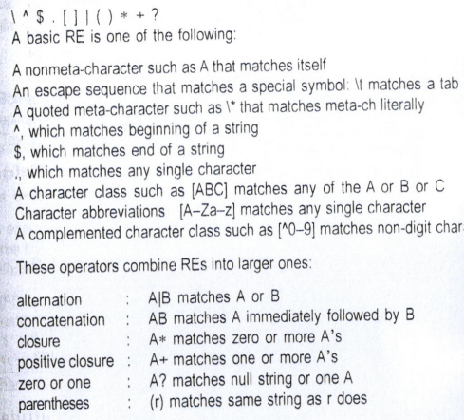
REGULAR EXPRESSIONS

Slide 15
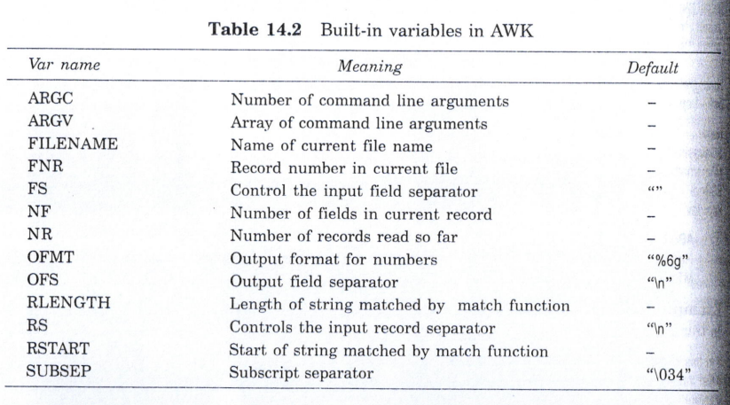
BUILT-IN variables

Slide 16
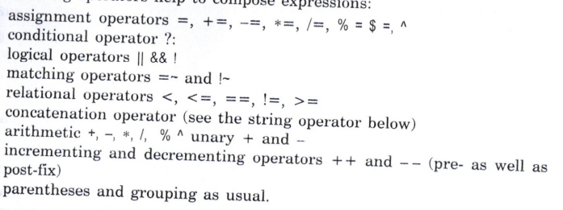
Operators

Slide 17
Thank YOU!!

