Slide 1
Citi Bike Data
File created on: 5/3/2019 9:33:54 PM

Slide 2
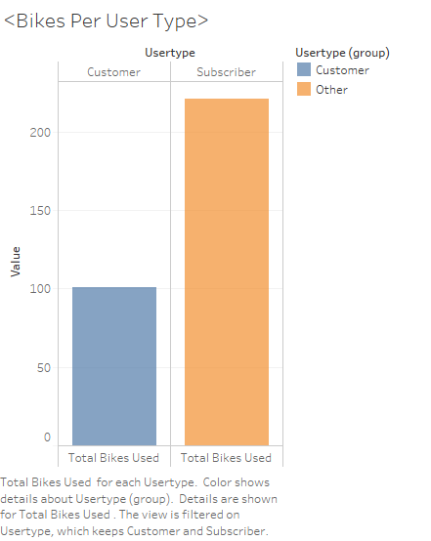

Slide 3


Slide 4
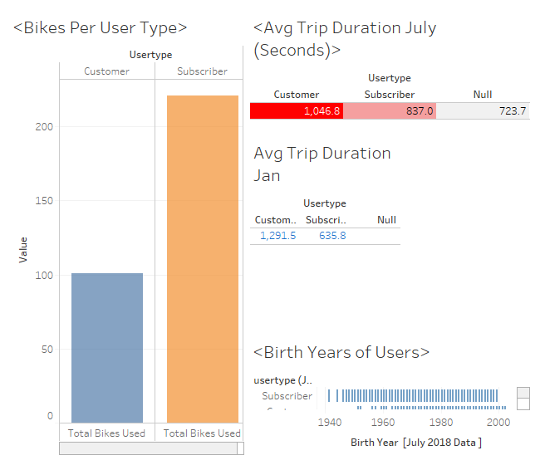

Slide 5
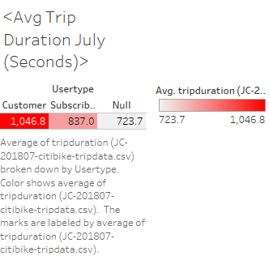

Slide 6
