Slide 1
DATA LAKE CONSTRUCTION AND QUERING WITH PYSPARK
Team Name: PySpark Pioneers
Team Members:
Anitha Dhanekula
Sravya Micheeti
Dinesh Rajamanickam

Slide 2
Project Overview
Objective: To design and build a scalable Data Lake capable of storing and querying raw, structured, and unstructured data efficiently.
Highlights:
Scalable data architecture.
Efficient querying using PySpark.
Support for future analysis and reporting.
Project Components:
Data Ingestion: Collect and store data from various sources (e.g., CSV, JSON, logs) in its raw format.
Data Processing: Use PySpark to process and analyze the ingested data.
Data Storage: Save data in a distributed file system such as HDFS, Amazon S3, or Delta Lake.
Querying and Reporting: Enable querying capabilities using Spark SQL and tools like Amazon Athena for analytical insights.

Slide 3
Technology Stack
Processing: PySpark (v3.3) – Handles data processing and transformations within the pipeline.
Storage: Amazon S3 – Provides scalable and durable storage for raw, processed, and structured data.
Querying: Spark SQL – Facilitates querying and analysis of data stored in the Data Lake.
Orchestration: Amazon Web Services (AWS) – Integrates and manages workflows using services like AWS Glue and Apache Airflow.
Output View: Athena Table – Enables SQL-based querying and visualization of processed data.

Slide 4
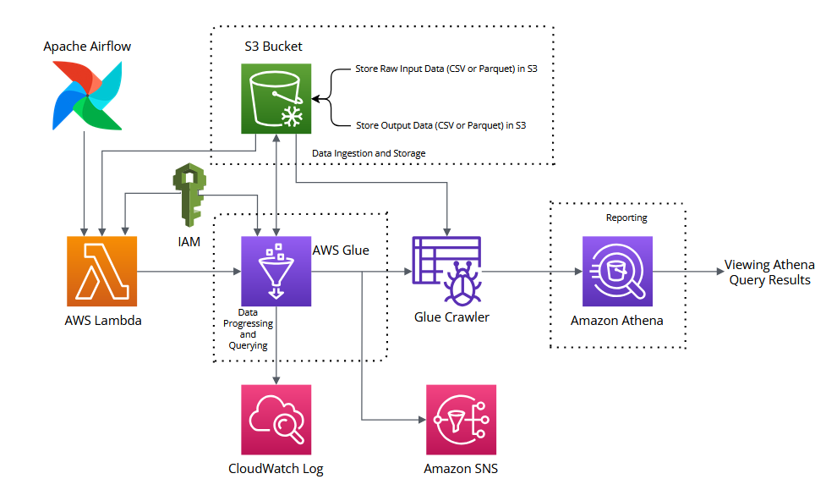
Architectural Diagram

Slide 5
GitHub Repository Overview
Repository Title: Data_Lake_Construction_and_Querying_With_PySpark
Repository URL: https://github.com/rdinesh808/data_lake_construction_and_querying_with_pyspark
Branch: master

Slide 6
Performance Analysis Metrics (CSV to Parquet)
AWS Glue and Crawler Execution Average Time
Service Name | First Execution | Second Execution | Third Execution | Average Execution Time
AWS Glue | 1 m 25 s | 1 m 32 s | 1 m 16 s | 1 min 24.33 sec
AWS Glue Crawler | 01 min 18 s | 1 min 15 sec | 1 min 14 sec | 1 min 15.67 sec
Athena Execution Average Time
Amazon Athena | Run | Time in Queue | Run Time | Data Scanned | Average Execution Time
 | First Execution | 108 ms | 456 ms | 29.79 KB | Average Run Time: 547.33 ms Average Time in Queue: 83 ms Total Data Scanned: 58.3 KB
 | Second Execution | 67 ms | 440 ms | 29.79 KB
 | Third Execution | 74 ms | 746 ms | 29.79 KB

Slide 7
Performance Analysis Metrics (Parquet to CSV)
AWS Glue and Crawler Execution Average Time
Execution | First Execution | Second Execution | Third Execution | Average Execution Time
AWS Glue | 1 min 36 sec | 1 min 27 sec | 1 min 32 sec | 1 min 31.67 sec
AWS Glue Crawler | 1 min 13 sec | 1 min 07 sec | 1 min 02 sec | 1 min 7.33 sec
Athena Execution Average Time
Amazon Athena | Run | Time in Queue | Run Time | Data Scanned | Average Execution Time
 | First Execution | 108 ms | 486 ms | 42.65 KB | Average Run Time: 493.33 ms Average Time in Queue: 93.67 ms
 | Second Execution | 69 ms | 502 ms | 42.65 KB
 | Third Execution | 104 ms | 492 ms | 42.65 KB

Slide 8
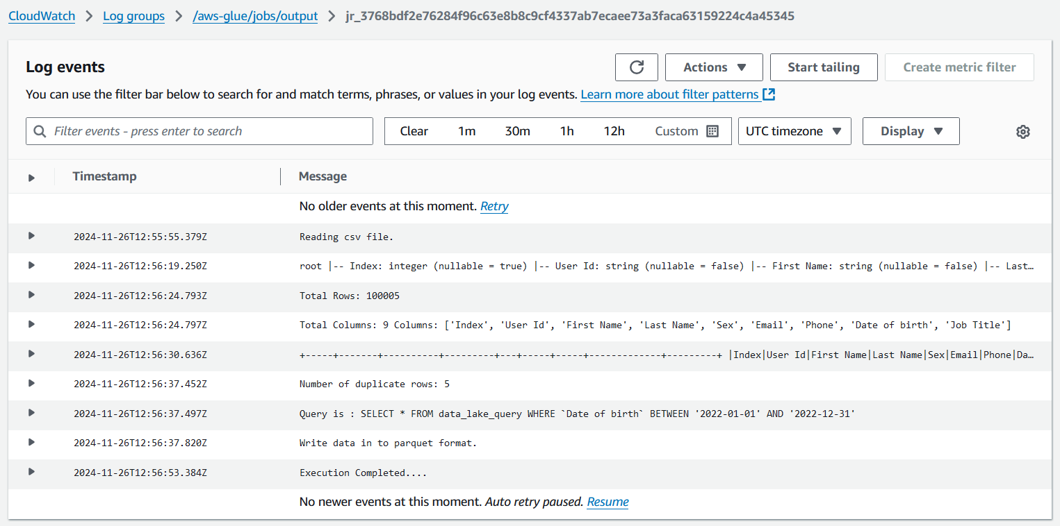
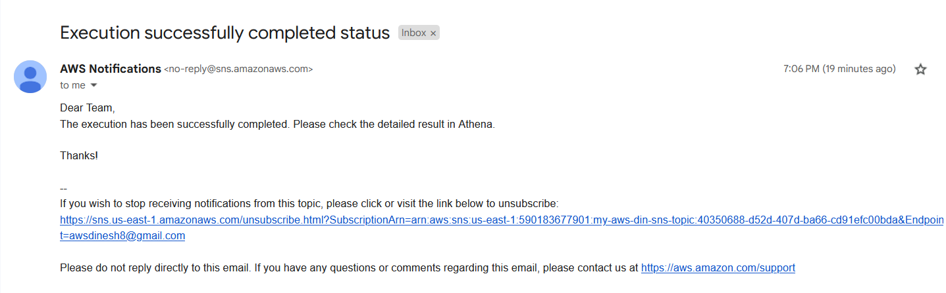
Logs and Notification
Glue CloudWatch Log
SNS Email Notification

Slide 9
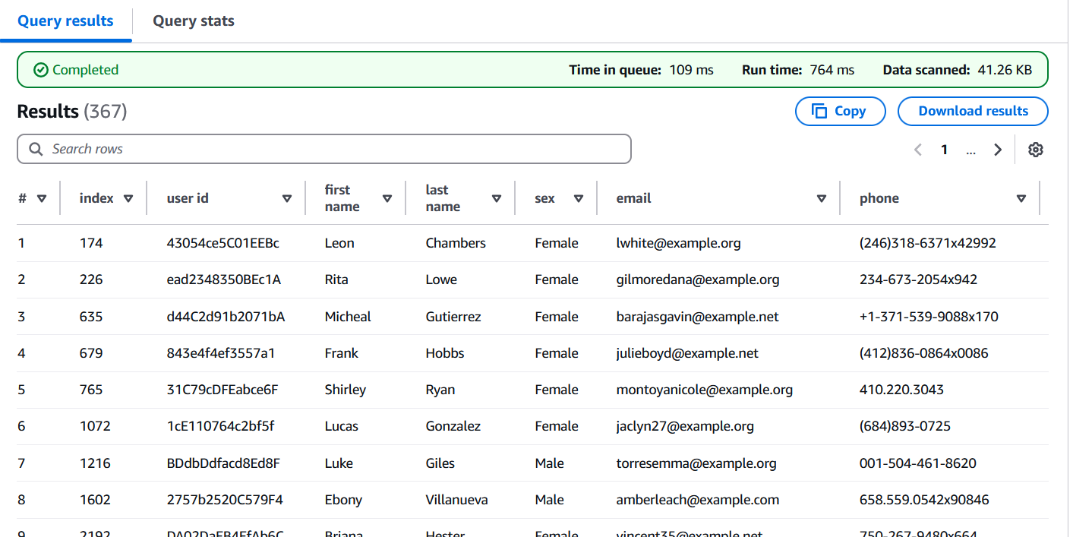
Result view in Athena Table
The query SELECT * FROM output; retrieves all records and columns from the specified dataset. The results are displayed in the Athena console, showing data rows along with column headers for easy analysis. Users can navigate through the results, export them to a CSV file, and view metadata such as execution time and data scanned. This interface simplifies data validation and downstream use.

Slide 10
AWS Cost Metrics
AWS Glue: $5.00
Glue Crawlers: $1.00
Athena: $0.50
Lambda: $0.90
S3: $5.00
CloudWatch: $2.00
SNS: $0.10
Total Estimated Monthly Cost: ~$14.50

Slide 11
Business Value
Faster Insights: Reduce time-to-insight with scalable querying.
Cost Efficiency: Estimated cost of ~$14.50/month for substantial storage and processing.
Flexibility: Supports structured, semi-structured, and unstructured data.
Key Takeaways:
Scalable Data Lake: Successfully built a flexible and future-ready data lake on Amazon S3.
Optimized Querying: Reduced query execution times with efficient formats like Parquet and tools like PySpark and Spark SQL.
Cost-Effective: Delivered a high-performance solution with a low monthly cost of ~$14.50.
Future-Ready Architecture: Built a flexible system that supports structured, semi-structured, and unstructured data, enabling seamless scaling and integration with additional data sources.
Comprehensive Analytics: Integrated with Amazon Athena for advanced analytics and reporting, providing business users with actionable insights on-demand.
Automation and Orchestration: Used AWS Glue and other orchestration tools to automate data ingestion and processing pipelines, ensuring consistency and reliability in data operations.

Slide 12
Challenges
Performance
Optimizing AWS Glue and Spark SQL queries to handle large-scale data efficiently.
Ensuring low query execution times despite complex transformations.
2. Cost Optimization
Balancing performance and cost, maintaining a low operational budget (~$14.50/month).
3. Scalable Architecture
Designing a data lake that supports future data sources and higher data volumes.
4. Automation Challenges
Configuring AWS Glue, Crawler, and CloudWatch for reliable automation.
Managing dependencies in data workflows with minimal manual intervention.
5. Data Visibility and Validation
Ensuring accurate querying and reporting in Athena while validating transformed datasets.

Slide 13
THANK YOU

