Slide 1
DATA LAKE CONSTRUCTION AND QUERING WITH PYSPARK
Team Name: PySpark Pioneers
Team Members: Anitha Dhanekula
Sravya Micheeti
Dinesh Rajamanickam

Slide 2
Project Overview
Objective: Design and build a scalable Data Lake to store and query raw, structured, and unstructured data.
Highlights:
Scalable data architecture.
Efficient querying using PySpark.
Support for future analysis and reporting.
Project Components:
Data Ingestion: Store data from various sources (CSV and PARQUET) in raw format.
Data Processing: Use PySpark to process and analyse the data.
Data Storage: Store data in Amazon S3 Bucket.
Querying and Reporting: Implement querying using Spark SQL.

Slide 3
Technology Stack
Processing: PySpark
Storage: Amazon S3
Querying: Spark SQL
Orchestration: AWS
Output View: Athena Table

Slide 4
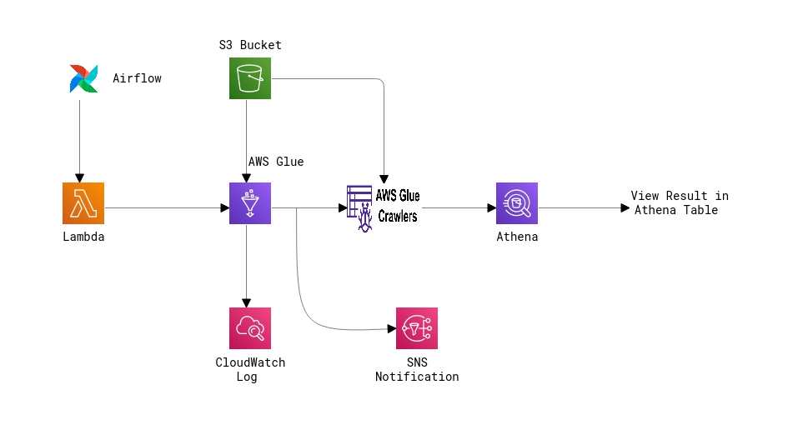
Architectural Diagram

Slide 5
GitHub

Slide 6
THANK YOU

