Slide 1
DATA LAKE CONSTRUCTION AND QUERING WITH PYSPARK
Team Members:
Anitha Dhanekula
Sravya Micheeti
Dinesh Rajamanickam

Slide 2
Project Overview
Objective: Design and build a scalable Data Lake to store and query raw, structured, and unstructured data.
Highlights:
Scalable data architecture.
Efficient querying using PySpark.
Support for future analysis and reporting.
Project Components:
Data Ingestion: Store data from various sources (CSV and PARQUET) in raw format.
Data Processing: Use PySpark to process and analyse the data.
Data Storage: Store data in Amazon S3 Bucket.
Querying and Reporting: Implement querying using Spark SQL.

Slide 3
Technology Stack
Processing: PySpark
Storage: Amazon S3
Querying: Spark SQL
Orchestration: AWS
Output View: Athena Table

Slide 4
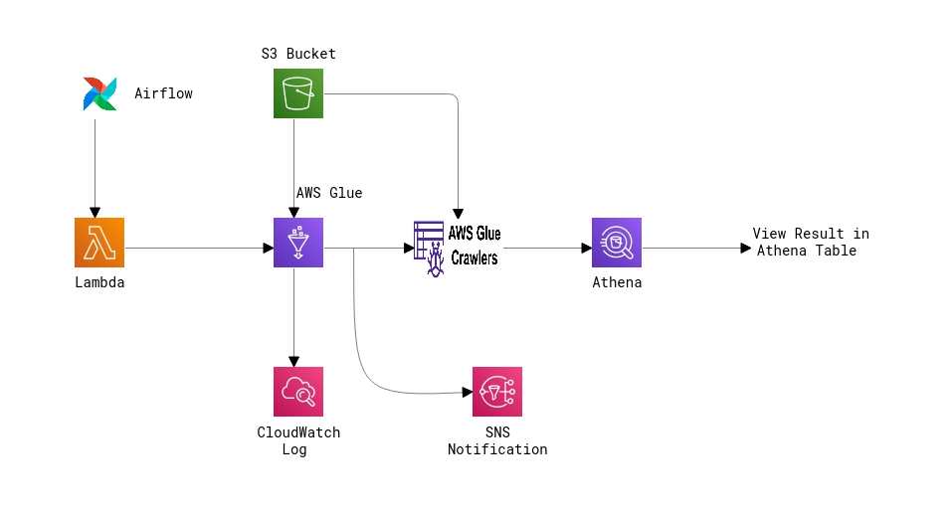
Architectural Diagram

Slide 5
GitHub Repository Overview
Repository Title: Data_Lake_Construction_and_Querying_With_PySpark
Repository URL: https://github.com/rdinesh808/data_lake_construction_and_querying_with_pyspark
Branch: master

Slide 6
Performance Analysis Metrics (CSV to Parquet)
AWS Glue and Crawler Execution Average Time
Service Name | First Execution | Second Execution | Third Execution | Average Execution Time
AWS Glue | 1 m 25 s | 1 m 32 s | 1 m 16 s | 1 min 24.33 sec
AWS Glue Crawler | 01 min 18 s | 1 min 15 sec | 1 min 14 sec | 1 min 15.67 sec
Athena Execution Average Time
Amazon Athena | Run | Time in Queue | Run Time | Data Scanned | Average Execution Time
 | First Execution | 108 ms | 456 ms | 29.79 KB | Average Run Time: 547.33 ms Average Time in Queue: 83 ms Total Data Scanned: 58.3 KB
 | Second Execution | 67 ms | 440 ms | 29.79 KB
 | Third Execution | 74 ms | 746 ms | 29.79 KB

Slide 7
Performance Analysis Metrics (Parquet to CSV)
AWS Glue and Crawler Execution Average Time
Execution | First Execution | Second Execution | Third Execution | Average Execution Time
AWS Glue | 1 min 36 sec | 1 min 27 sec | 1 min 32 sec | 1 min 31.67 sec
AWS Glue Crawler | 1 min 13 sec | 1 min 07 sec | 1 min 02 sec | 1 min 7.33 sec
Athena Execution Average Time
Amazon Athena | Run | Time in Queue | Run Time | Data Scanned | Average Execution Time
 | First Execution | 108 ms | 486 ms | 42.65 KB | Average Run Time: 493.33 ms Average Time in Queue: 93.67 ms
 | Second Execution | 69 ms | 502 ms | 42.65 KB
 | Third Execution | 104 ms | 492 ms | 42.65 KB

Slide 8
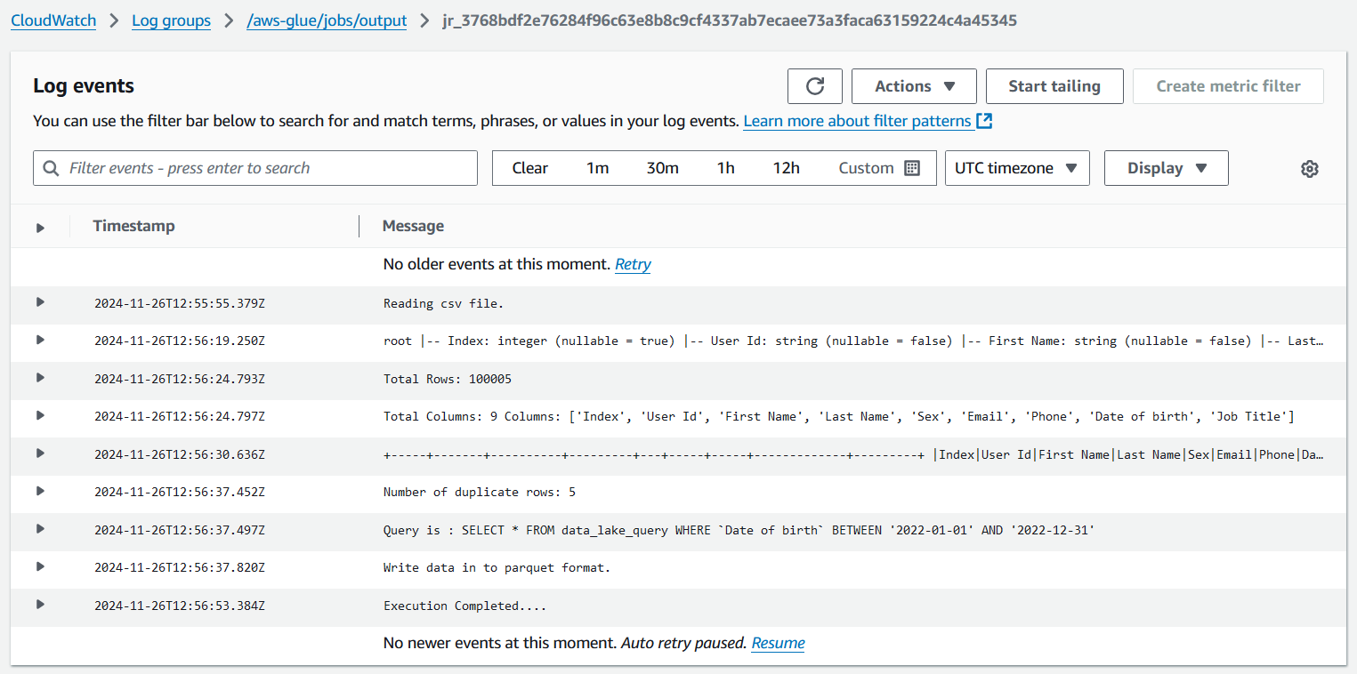
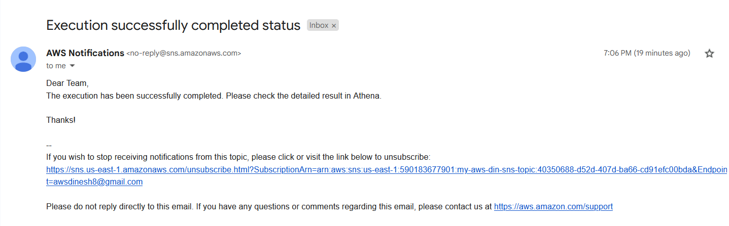
Logs and Notification
Glue CloudWatch Log
SNS Email Notification

Slide 9
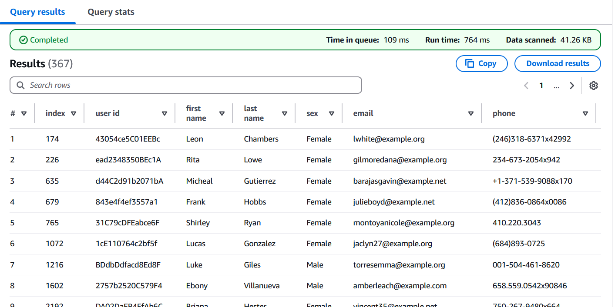
Result view in Athena Table
The query SELECT * FROM output; retrieves all records and columns from the specified dataset. The results are displayed in the Athena console, showing data rows along with column headers for easy analysis. Users can navigate through the results, export them to a CSV file, and view metadata such as execution time and data scanned. This interface simplifies data validation and downstream use.

Slide 10
Total Estimated Monthly Cost
AWS Glue: $5.00
Glue Crawlers: $1.00
Athena: $0.50
Lambda: $0.90
S3: $5.00
CloudWatch: $2.00
SNS: $0.10
Total Estimated Monthly Cost: ~$14.50

Slide 11
THANK YOU

