Slide 1
DATA LAKE CONSTRUCTION AND QUERING WITH PYSPARK
Team Members:
Anitha Dhanekula
Sravya Micheeti
Dinesh Rajamanickam

Slide 2
Project Overview
Objective: Design and build a scalable Data Lake to store and query raw, structured, and unstructured data.
Highlights:
Scalable data architecture.
Efficient querying using PySpark.
Support for future analysis and reporting.
Project Components:
Data Ingestion: Store data from various sources (CSV and PARQUET) in raw format.
Data Processing: Use PySpark to process and analyse the data.
Data Storage: Store data in Amazon S3 Bucket.
Querying and Reporting: Implement querying using Spark SQL.

Slide 3
Technology Stack
Processing: PySpark
Storage: Amazon S3
Querying: Spark SQL
Orchestration: AWS
Output View: Athena Table

Slide 4
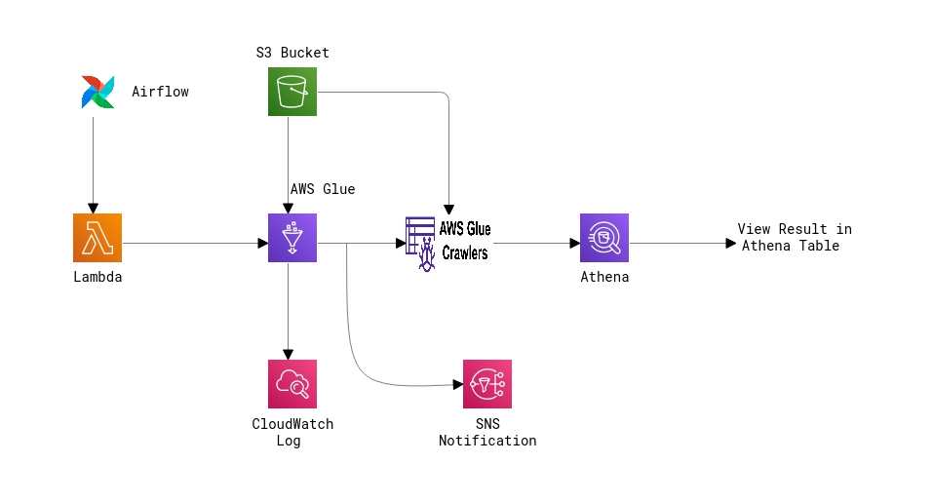
Architectural Diagram

Slide 5
GitHub Repository Overview
Repository Title: Data_Lake_Construction_and_Querying_With_PySpark
Repository URL: https://github.com/rdinesh808/data_lake_construction_and_querying_with_pyspark
Branch: master

Slide 6
Performance Analysis Metrics (CSV to Parquet)
AWS Glue and Crawler Execution Average Time
Service Name | First Execution | Second Execution | Third Execution | Average Execution Time
AWS Glue | 1 min 41 sec | 1 min 40 sec | 1 min 38 sec | 1 min 39.67 sec
AWS Glue Crawler | 1 min 17 sec | 1 min 07 sec | 1 min 10 sec | 1 min 11.33 sec
Athena Execution Average Time
Amazon Athena | Run | Time in Queue | Run Time | Data Scanned | Average Execution Time
 | First Execution | 78 ms | 769 ms | 29.15 KB | Average Run Time: 582.5 ms Average Time in Queue: 95 ms Total Data Scanned: 58.3 KB
 | Second Execution | 112 ms | 396 ms | 29.15 KB
 | Third Execution | 74 ms | 423 ms | 29.15 KB

Slide 7
Performance Analysis Metrics (Parquet to CSV)
AWS Glue and Crawler Execution Average Time
Execution | First Execution | Second Execution | Third Execution | Average Execution Time
AWS Glue | 1 min 48 sec | 1 min 42 sec | 1 min 38 sec | 1 min 42.67 sec
AWS Glue Crawler | 1 min 09 sec | 1 min 16 sec | 1 min 23 sec | 1 min 16 sec
Athena Execution Average Time
Amazon Athena | Run | Time in Queue | Run Time | Data Scanned | Average Execution Time
 | First Execution | 105 ms | 423 ms | 41.26 KB | Average Run Time: 432 ms Average Time in Queue: 99 ms Total Data Scanned: 123.78 KB
 | Second Execution | 72 ms | 446 ms | 41.26 KB
 | Third Execution | 120 ms | 427 ms | 41.26 KB

Slide 8
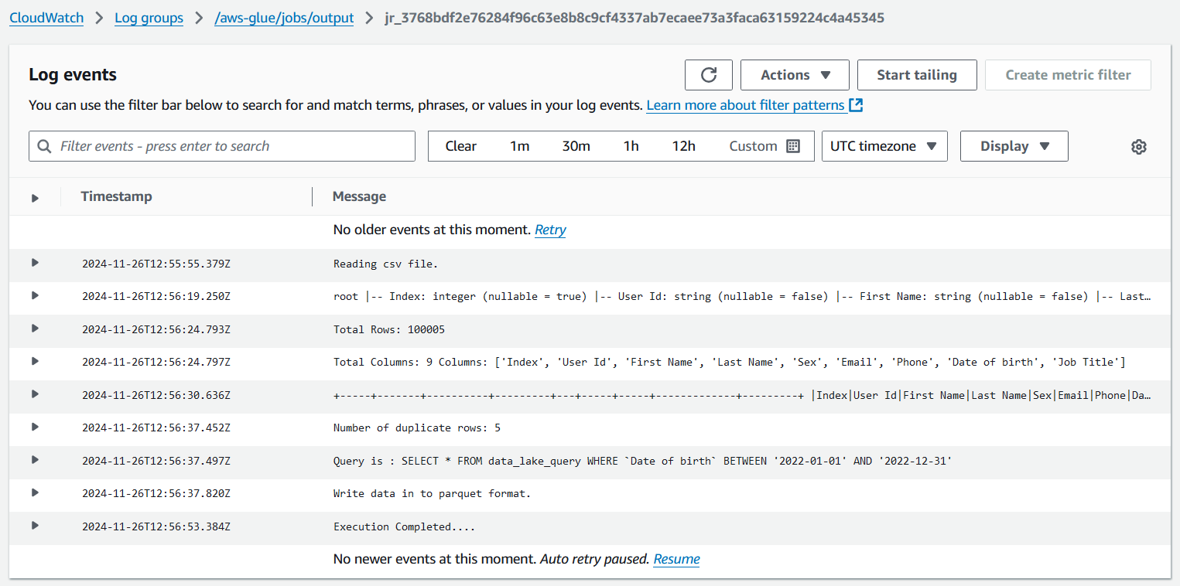
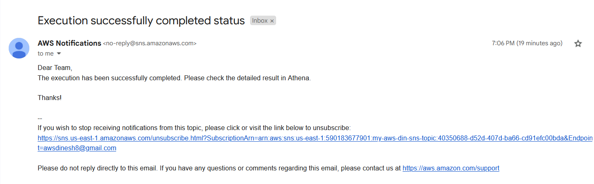
Logs and Notification

Slide 9
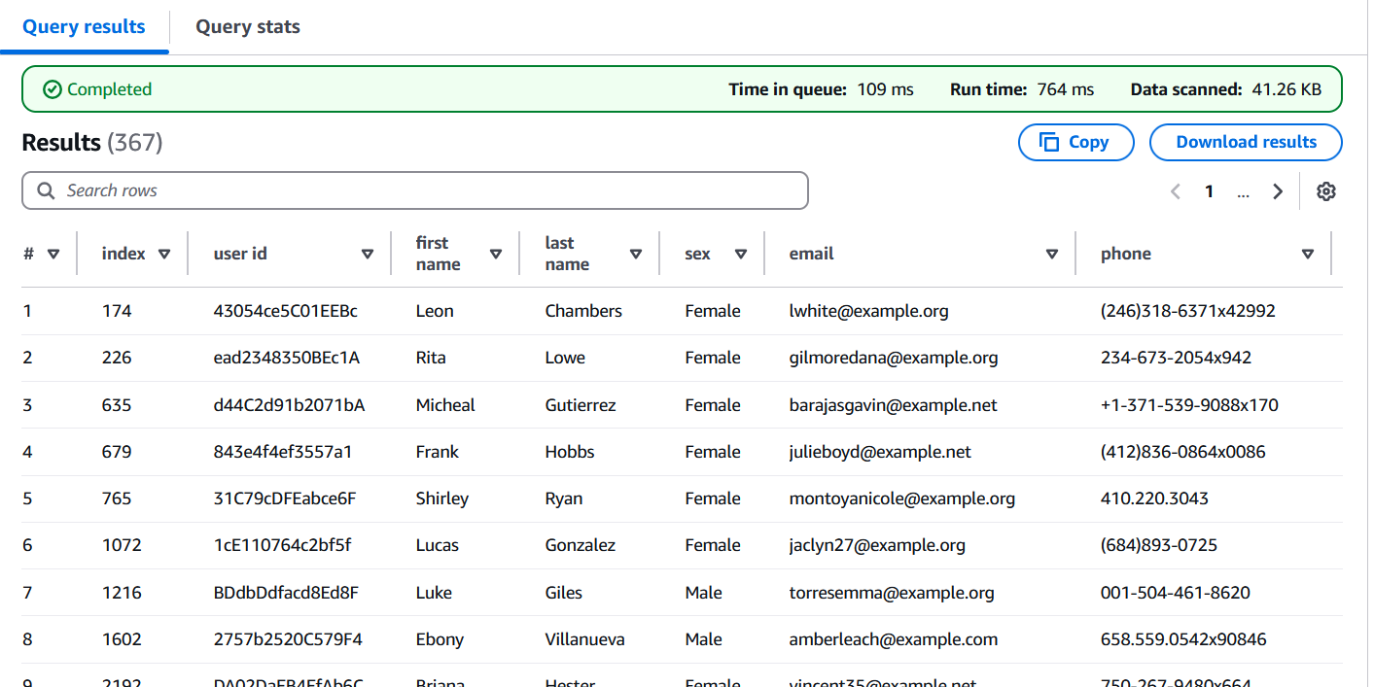
Result view in Athena Table

Slide 10
Total Estimated Monthly Cost
AWS Glue: $5.00
Glue Crawlers: $1.00
Athena: $0.50
Lambda: $0.90
S3: $5.00
CloudWatch: $2.00
SNS: $0.10
Total Estimated Monthly Cost: ~$14.50

Slide 11
THANK YOU

