Slide 1
Final Project Presentation for the IBM Professional Data Science certification Capstone Project On Coursera
RAJVARDHAN DIXIT

Slide 2
Introduction/ Business Problem:
In this project I am going to create a dataset by using various websites, of Bhopal- Capital city of Madhya Pradesh and try to suggest best locations to invest in real estate as development of any part of city or land prices depends on the various utilities in the area like medical facilities, Public transportation, Education and food outlets. These things make life in the city easy so if a place have more utilities then the property price at that area will also become high.

Slide 3
Data Used:
Dataset that can be used in this project is not available completely on internet so I created it using various websites and APIs. I took the pin code and Location names of Bhopal from Indian Post websites then I used geopy library to find out the Coordinates (Latitude and Longitude) of all the pin codes.
After that I used Foursquare API to create one more data frame about the three queries (medical, transport and food) one can add more number of queries to get more accurate results. Then add the two data frame and remove duplicate columns to get the perfect data frame for further use.

Slide 4
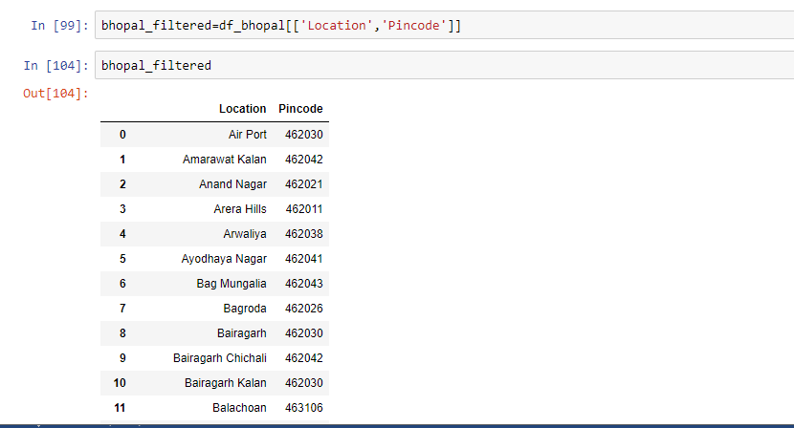

Slide 5
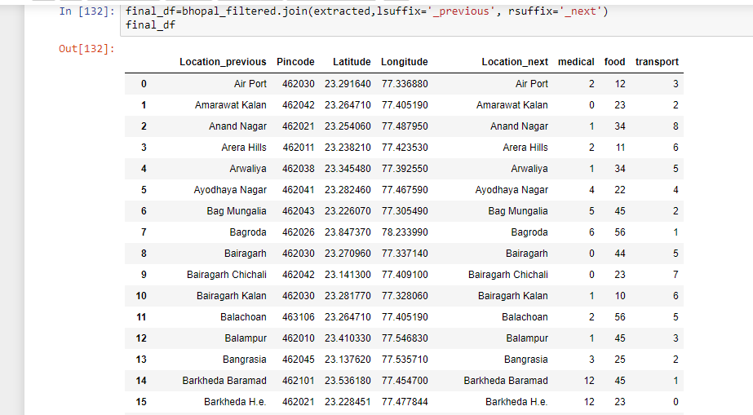

Slide 6
Methodology:
In this project I used Location data of various localities of Bhopal City from Indian post website and created a data frame using pandas then by using the pin codes of the localities I extracted the coordinates (Longitude and latitude) of all those coordinates using geopy library and make a separate data frame and then I joined the two data frame by using the join function.
Now, by using the coordinates and Foursquare API, I extracted the number of medical centres, public transport and food and drinks outlet in the 5000ft radius of all the pin codes. I plot them as bar plots to easily understand the dispersion of data on various pin codes and also plot all the pin codes on the Bhopal city map using Folium Library.

Slide 7
Methodology:
This suggest that the pin codes at the centres and at some of the posh locations of the city have more facilities then the others.
Then I used K means clustering algorithms and then make 4 clusters or categories from the dataset that I created and then place each pin code in any one out of four categories and then plot them on the Bhopal city map to check the property prices in the city. Category 1 Localities have least price while Category 4 in Cyan Colour have most expensive properties because of high level of public utilities availability.

Slide 8
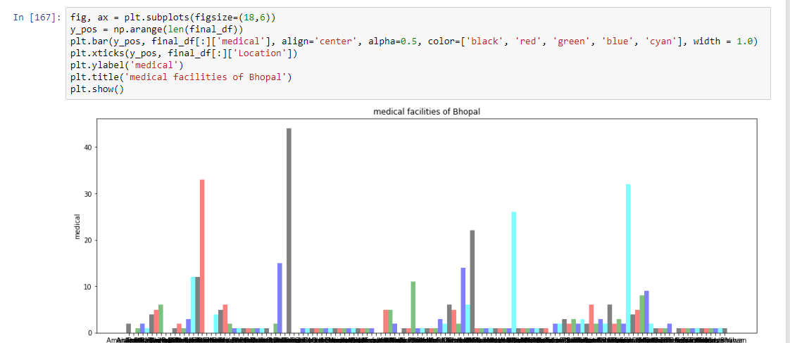
Visualizations:

Slide 9
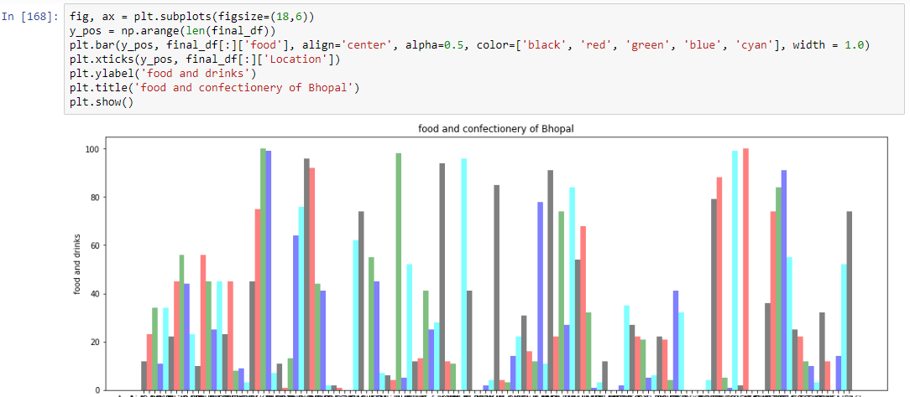

Slide 10
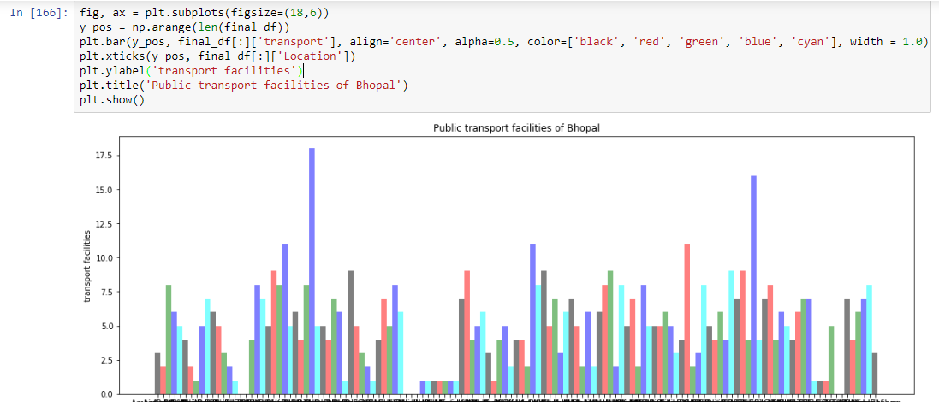

Slide 11
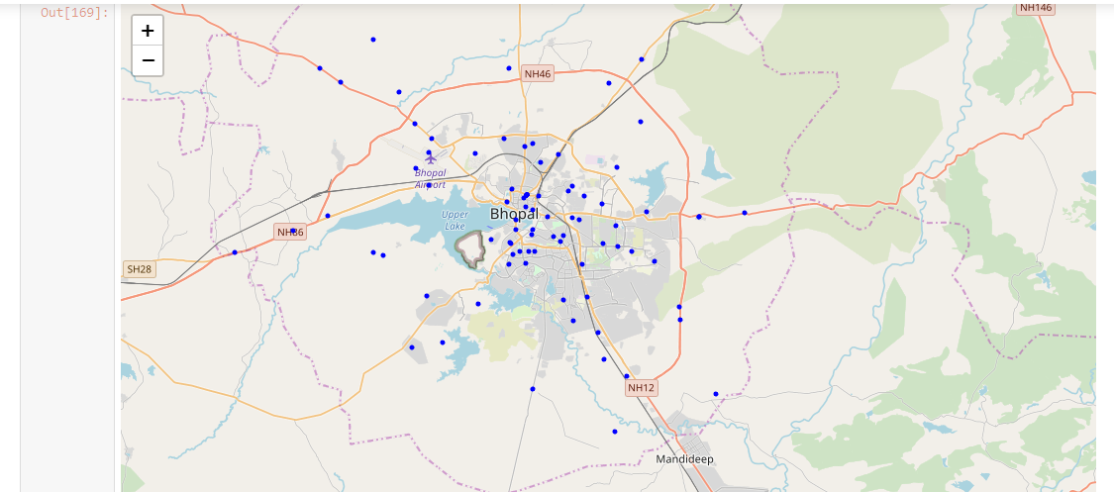

Slide 12
Results:
At last we got a map and a dataset clustered in four categories and depicted on City map that shows the property prices using four different colours.
Here Category 1 have least property price and Category 4 have highest property price.

Slide 13
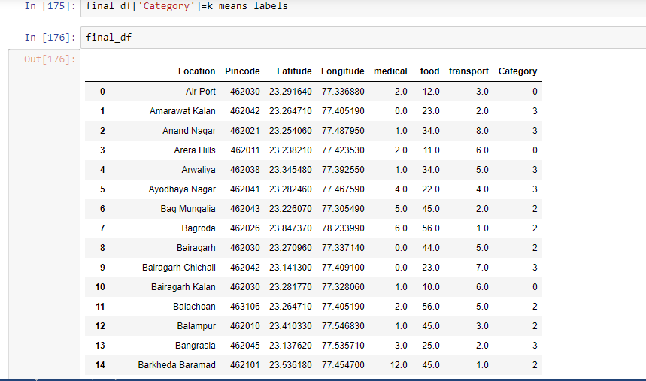
K-means Clustering Result:

Slide 14
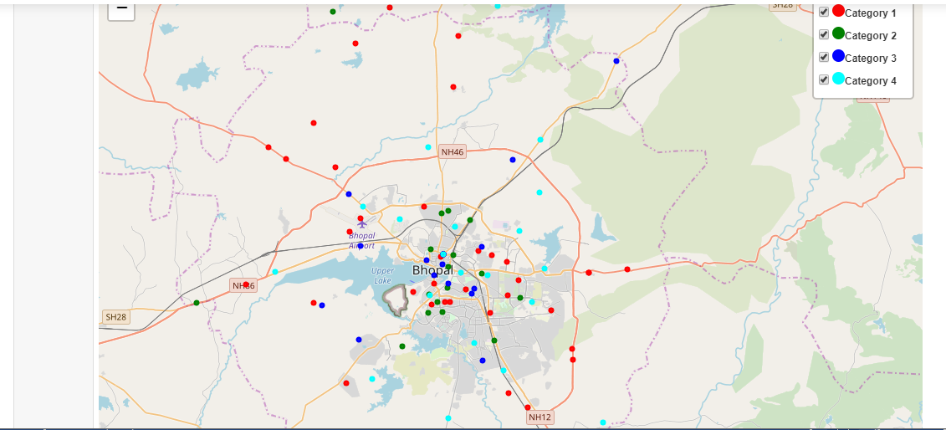

Slide 15
Conclusion and Discussion:
In this project I created a application for the real estate developers, city planners, students of architecture and planning to understand the development of city. The goals of the project can be satisfied with this but to develop the application to the market standards needs a little more efforts as the prices cannot be predicted just by three queries some more queries about educational institutes, amusement parks, city heritage locations and mall and museum will make the application more accurate. By increasing the radius will also increase the number of facilities in a area and by doing this the application will be more better.

