Slide 1
RDK-B
meta-cmf-arm
Virtualisation guide with virt-manager (GUI)
Author: Mathew McBride <matt@traverse.com.au>

Slide 2
System Pre-requisites
Qemu Arm64 installed (qemu-system-aarch64)
Virt-manager installed and functional
A bridge interface for LAN (and optionally, WAN) side interfaces
These instructions have been tested on Ubuntu 24.10
Instructions for ‘headless’ (no GUI manager) setup can be found in the meta-cmf-arm documentation

Slide 3
RDK-B build prerequisites
You will need the “.wic.qcow2” generated by meta-arm-cmf’s rdk-generic-broadband-image
If you only have the ‘.wic’ file, you can convert to qcow2 with qemu-img:
qemu-img convert -O qcow2 rdk.wic rdk.qcow2
To allow upgrades, resize the disk before using it:
qemu-img resize rdk.qcow2 10G

Slide 4
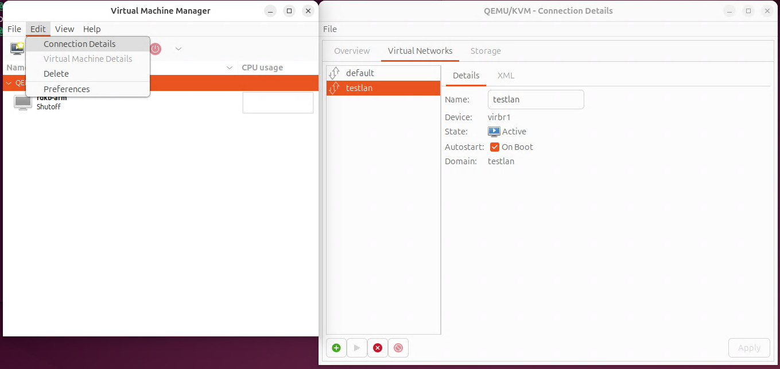
Virtual Networking (1)
It is best to create an “isolated” network to simulate the “LAN” side of the RDK-B router

Slide 5
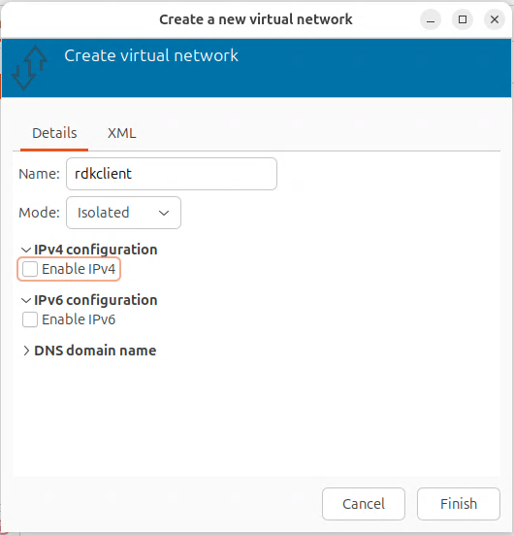
Virtual Networking (2)
Use the following settings:
  Mode: Isolated
  Uncheck ‘Enable IPv4’
  Uncheck ‘Enable IPv6’

Slide 6
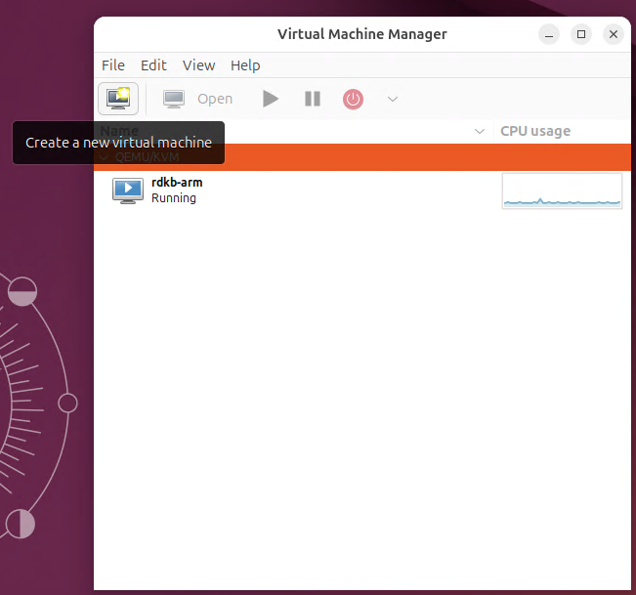
Start
At the home screen of Virtual Machine Manager, click the Create a new virtual machine icon in the toolbar

Slide 7
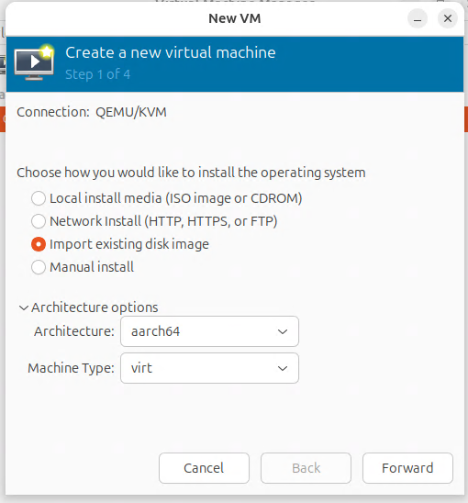
Create a new ARM64 VM
Select Import Existing disk Image
Expand Architecture Options and select Architecture: aarch64
  If this option is missing, you need to install qemu-system-aarch64

Slide 8
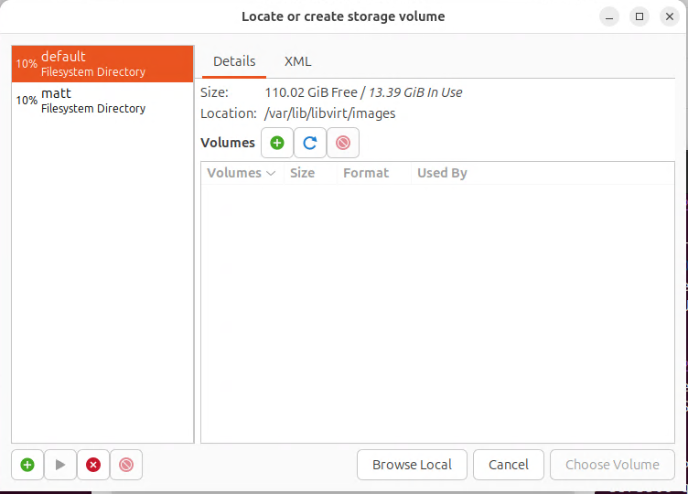
Select RDK-B qcow2 image (1)
In the ‘Locate or create storage volume’ window, click ‘Browse Local’

Slide 9
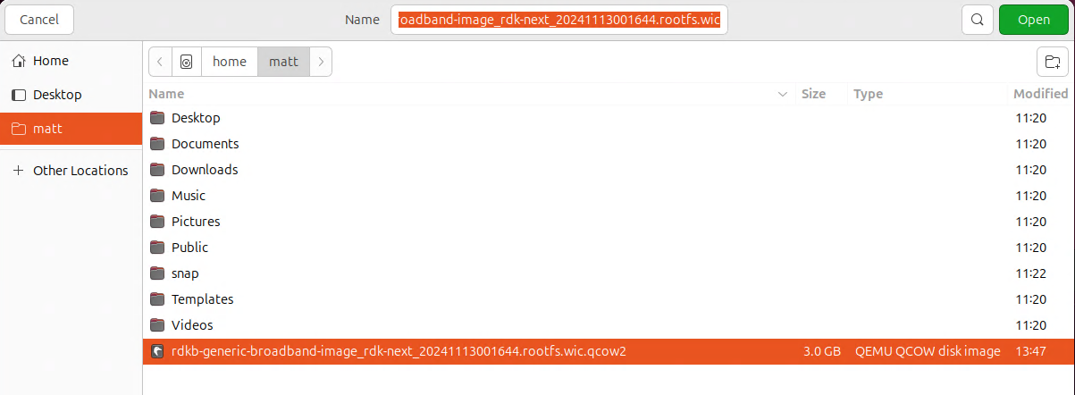
Select RDK-B qcow2 image (2)
Select the .wic.qcow2 from the RDK-B build on your local filesystem
Click “Open”
On first usage, you may get a message asking to modify the security configuration to allow access to the image. Accept this change.

Slide 10
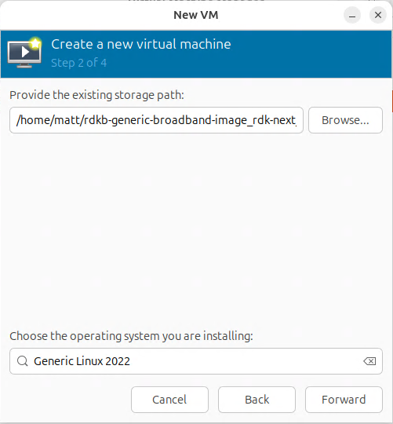
Select OS type
In the “Choose the operating” system box at the bottom, search and choose “Generic Linux 2022”

Slide 11
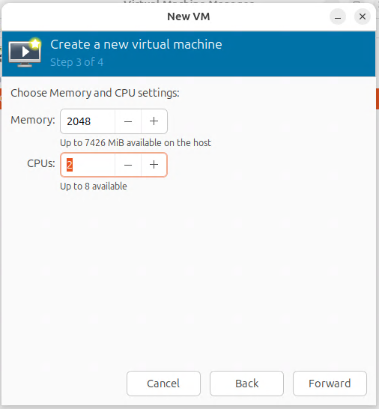
Set RAM and CPU allocation
2GB RAM and 2 vCPUs are sufficient

Slide 12
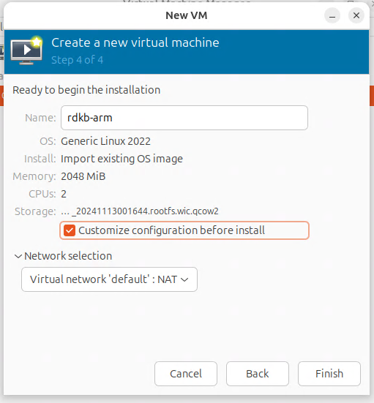
Name and customization
Give the VM a name (like rdkb-arm)
Ensure Customize configuration before install is checked

Slide 13
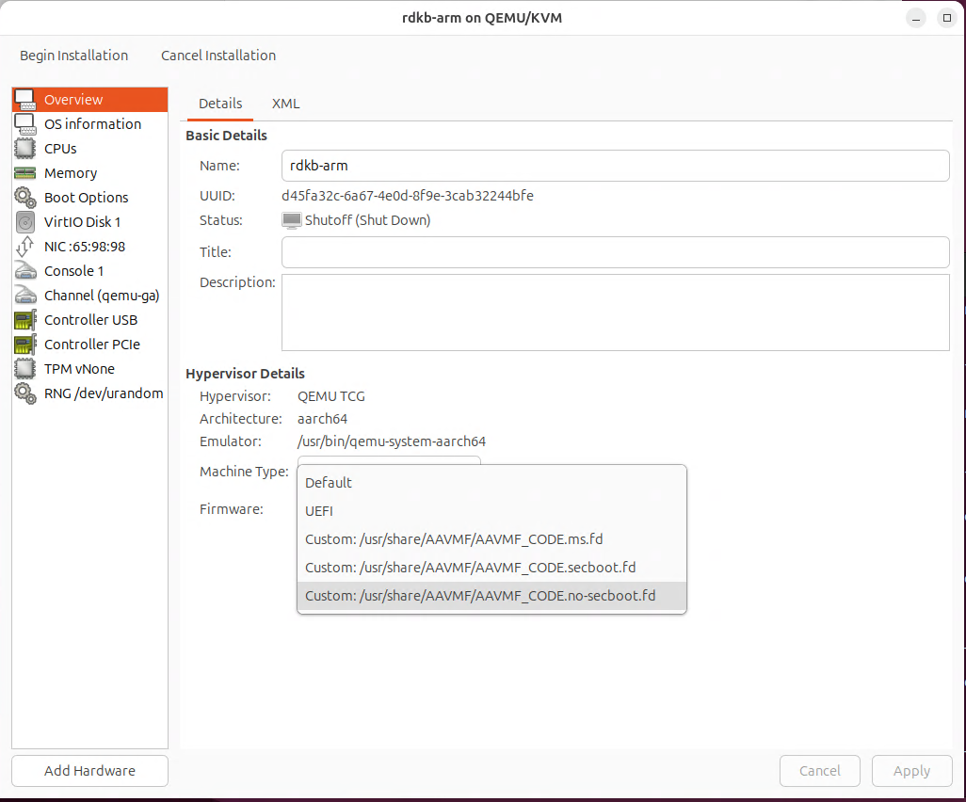
Choose Non secure boot firmware
IMPORTANT!
In the firmware dropdown, select the non-secure boot firmware (AAVMF_CODE.no-secboot.fd)

Slide 14
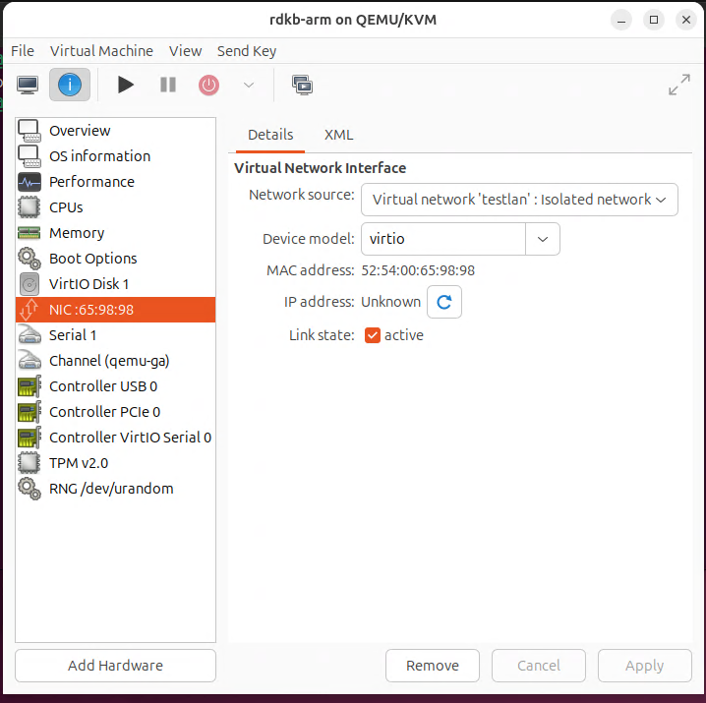
Change LAN network
Change the first NIC to be on your isolated LAN network

Slide 15
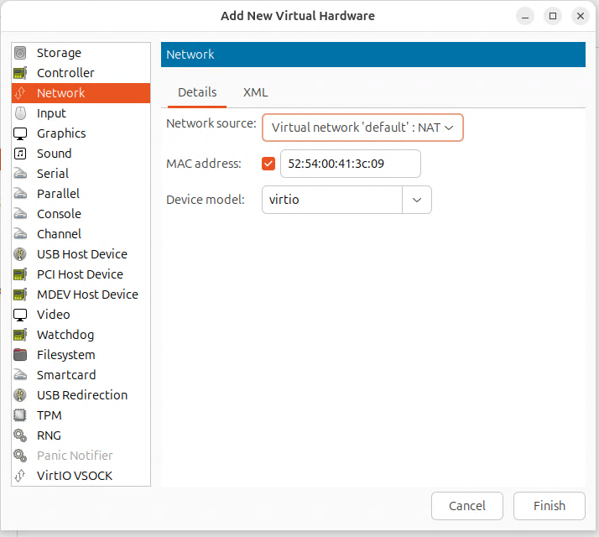
Add a WAN NIC
Click “Add Hardware” and add a second network controller
This will be the WAN interface
NAT is OK for now

Slide 16
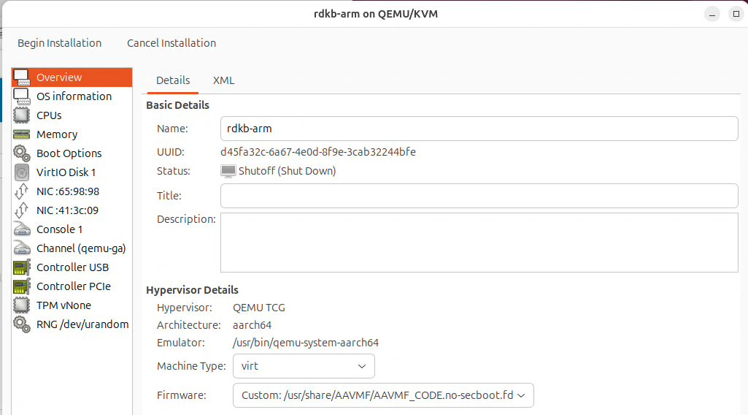
Finish VM configuration
Click Begin Installation at the top left to finish installation

Slide 17
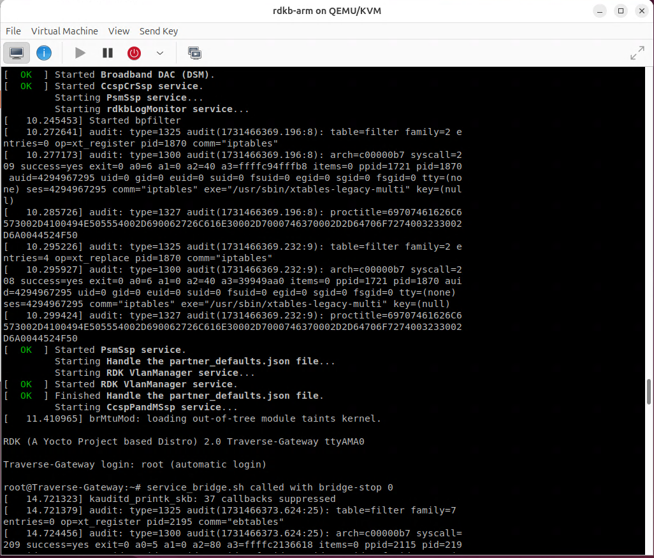
Boot RDK-B
RDK-B will boot inside the virtual machine

