Slide 1
AAMP Auto Triage Tool V2
Fed 04 2022

Slide 2
Today’s agenda
Auto Triage Tool Overview and Usage of the tool
Sample pages
How to use the tool and Visualization of the tool
Improvements for future (easy Triage)
Feedback

Slide 3
Auto Triage Tool Overview
Basically, this is a tool that will help easy log triage for the day-to-day analysis.
Triage tool main page, which will have all the static strings used for log triage and here in the tool it is called Pre-Defined Markers.
Log Viewer, which can show the AAMP Video Engine logs and other module logs, basically all the logs line from the file uploaded.
This tool has a provision for the user to add their own markers to triage the logs in their own way. Which is added here as an option called User-Defined Markers. Simply a JSON file.
Through this tool download statistics can be viewed and can able to pull all the IP_AAMP_TUNETIME statistics data as a .csv file.

Slide 4
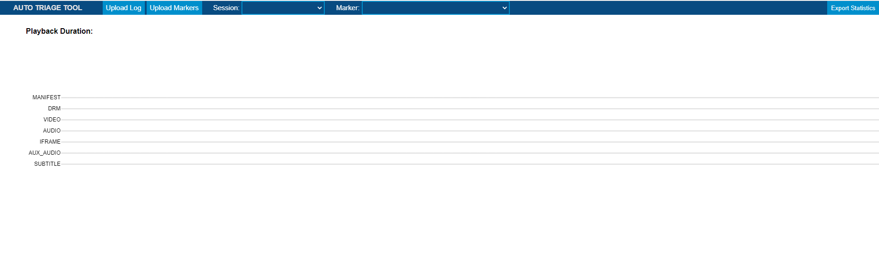
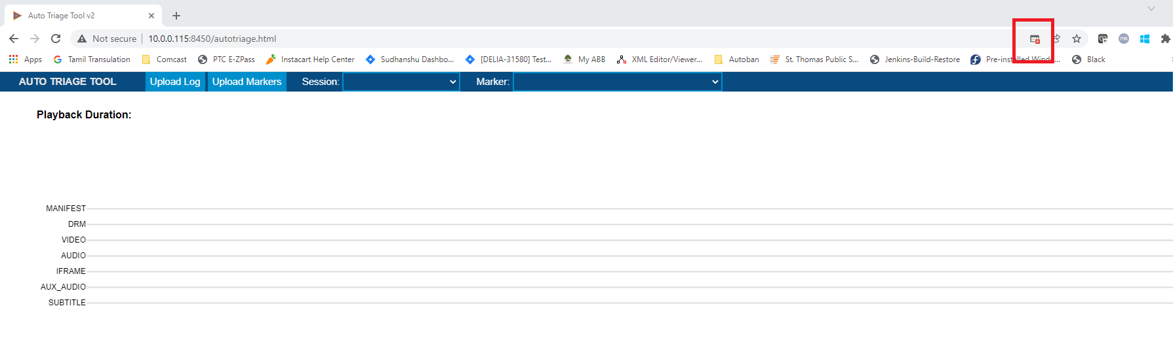
Tool Main Page
Allow Popup-Blockers in order to get log viewer to display (Known Issue)

Slide 5
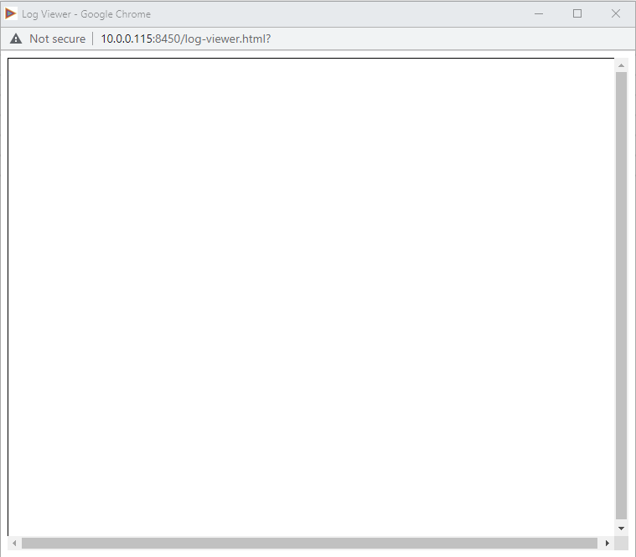
Tool Log Viewer Page (After allowing Popup blockers, then refresh the page)

Slide 6
How to use the tool
Readme file is available inside the tool package. That will help to start and use the tool.
Few steps for easy start
Open autotriage.html in chrome.
As described on page#3, if ”Log Viewer” is not also displayed, disable popup blocking, then refresh the browser.
Then Upload the Log file using the button.
Pre-defined markers are loaded by default. User defined markers can be defined and uploaded using the button.

Slide 7
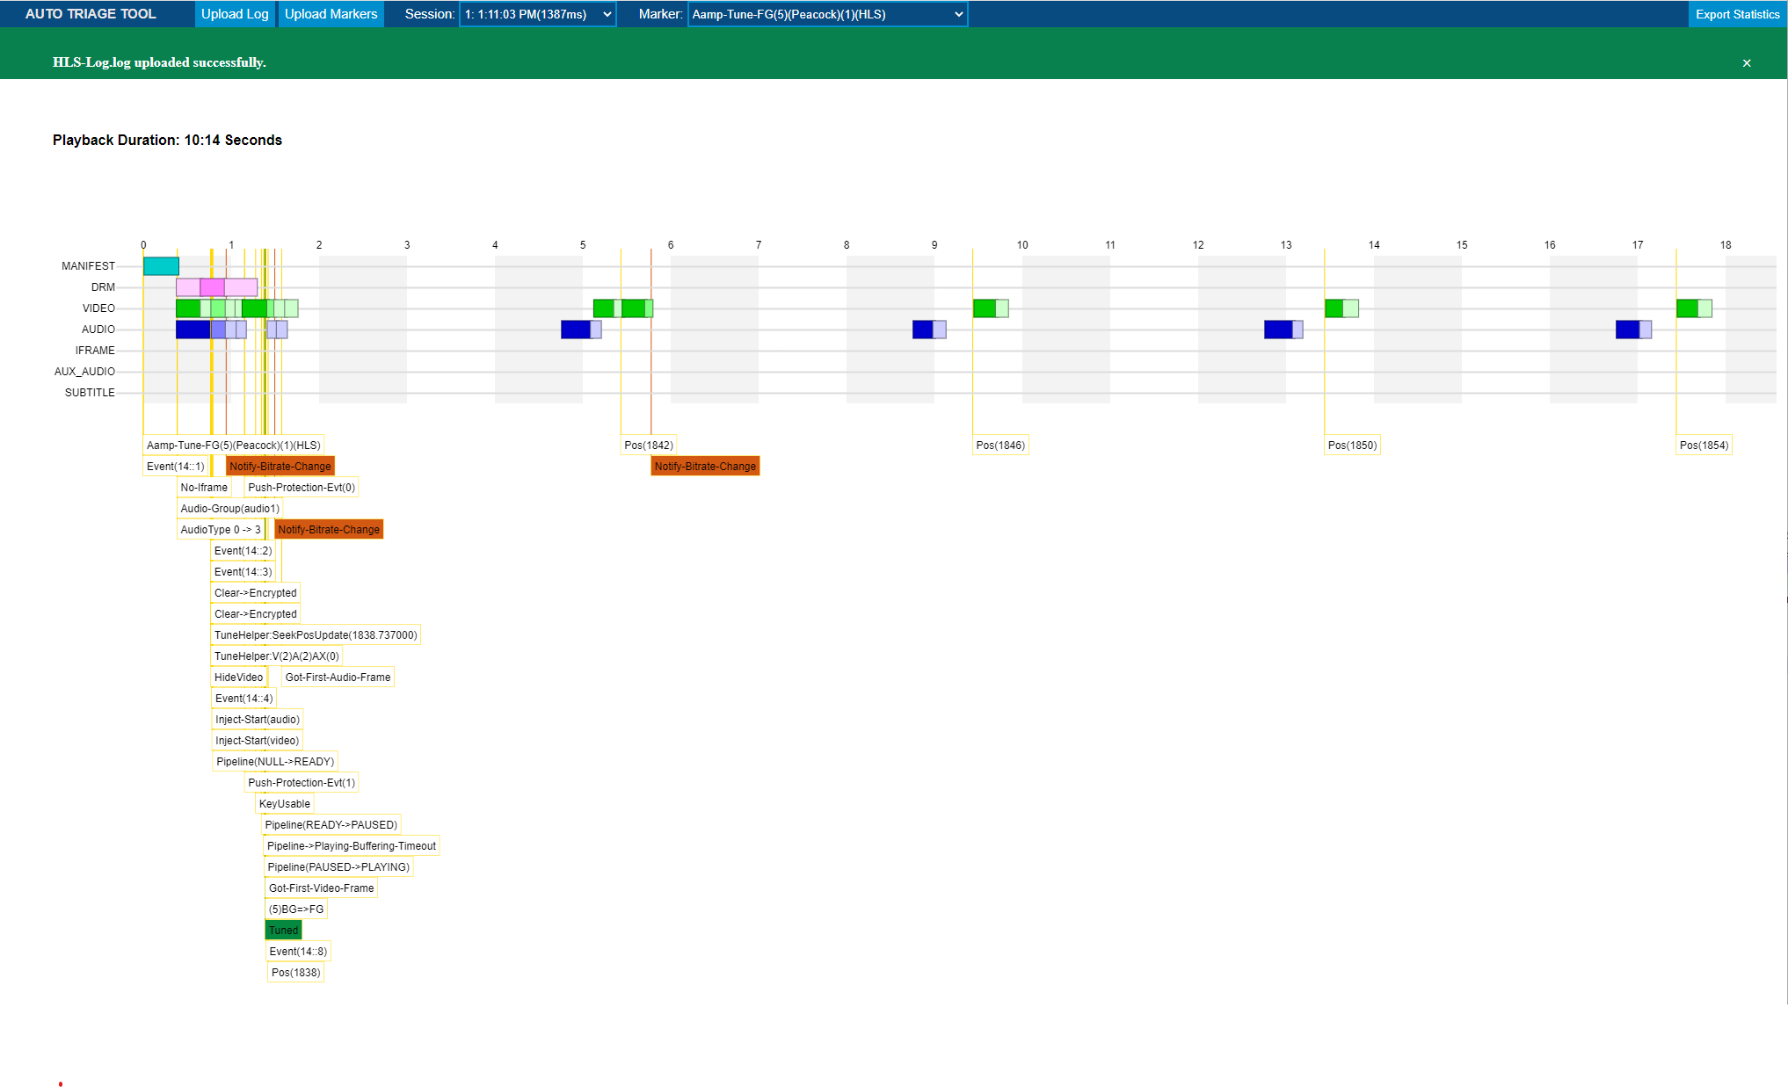

Slide 8
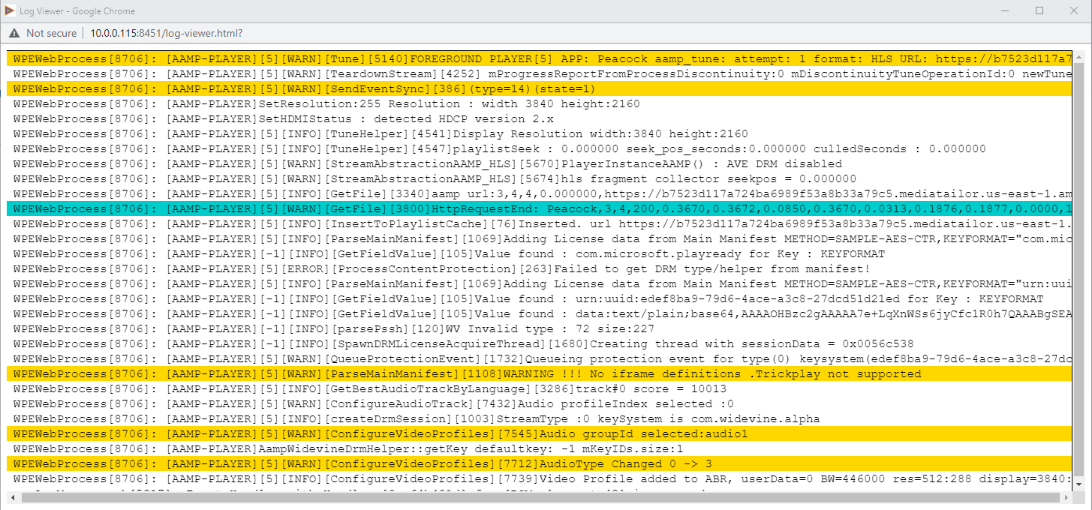
Along with the timeline page, log viewer also getting loaded with the log line and markers are colored for easy understanding in the page.
8
Presentation title (optional)

Slide 9
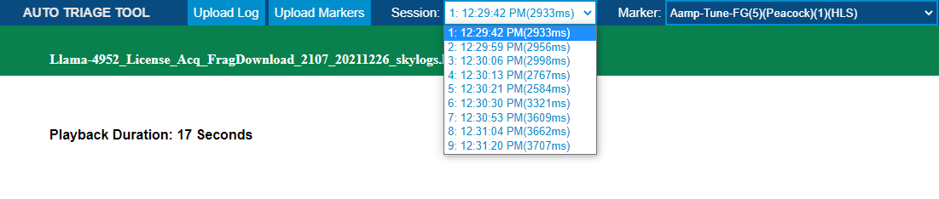
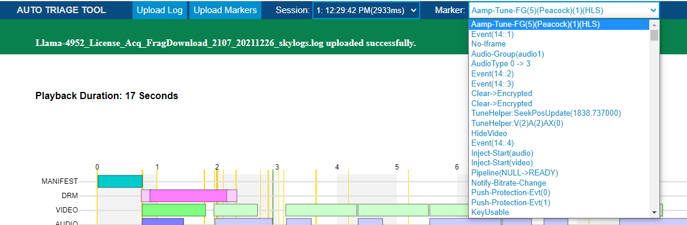
2 more additional fields are Session point to Tune sessions totally available in the log file and Markets points the all the available markers from the logs for easy traversal.
9
Presentation title (optional)

Slide 10
Improvements for future (easy Triage)
All tune session can be exportable through the button.
For log analysis clicking the markers will get the log line in the log viewer and this can be wise versa.
Fog download viewer for Linear with TSB sessions.
Timed metadata parsing duration plot (especially for VOD tunes).
Based on the markers and its flow, try to locate the possible issues and shows to the user for easy RCA identification rather than rolling the logs (Kind of artificial intelligence).
Buffering graph in the timeline based in the underflow markers.
Discontinuity analysis.
ID3 Marking.
Platform/SoC specific Markers for XiOne / PlatCo for better understanding of the issue.
Multi search option in the log viewer, so no need to go and use notepad for log analysis, everything can be done in a single place in the tool.
10
Presentation title (optional)

Slide 11
Feedbacks

Slide 12
Thank You !!

