Slide 1





ESTIMATE WATER SOLUBILITY
Christos Kannas
University of Cyprus
Department of Computer Science

Slide 2
Outline
Introduction
Related Work
  ESOL
RDKit based Implementation
Results
  Correlation Table & Chart
Conclusion

Slide 3
Introduction
Need to estimate the solubility of molecules in:
  DMSO (CS(=O)C), and
  Water.
Predictive Models for DMSO and Water Solubility.

Slide 4
Related Work

Slide 5
Related Work
J. S. Delaney, “ESOL: Estimating Aqueous Solubility Directly from Molecular Structure,” Journal of Chemical Information and Modeling, vol. 44, no. 3, pp. 1000–1005, May 2004.

Slide 6
Related Work: ESOL
ESOL – Estimated SOLubility
Linear Regression Model
8 Molecular Properties (Initially)
Preeminent Method: General Solubility Equation (GSE), logP and melting point (T_{m})
Notes:
Preeminent == Best, Leading

Slide 7
ESOL: Molecular Properties (Initial) 1/3
clogP – Daylight CLOGP v4.72
MolWeight
RotBonds – Rotatable Bonds, Daylight SMARTS structures define rotatable bonds

Slide 8
ESOL: Molecular Properties (Initial) 2/3
Aromatic Proportion (AromProp) – The proportion of heavy atoms in the molecule that are in an aromatic ring. Daylight SMARTS ([a]) aromatic atoms.
Non-Carbon Proportion – The proportion of heavy atoms in a molecule that are not carbon. Daylight SMARTS ([!#6])

Slide 9
ESOL: Molecular Properties (Initial) 3/3
H-bond Donors
H-bond Acceptors
Polar Surface Area – Peter Ertl’s Polar Surface Area

Slide 10
ESOL: Methodology
Multiple Linear Regression
Significance of each parameter based in terms of its absolute t-statistic.

Slide 11
ESOL: Train Dataset
Training Set: 2874 molecules
  Small – Low MolWeight organic compounds
  Medium – Pesticide products, MolWeight 200-300
  Large – Sygenta compounds, MolWeight 300-400

Slide 12
ESOL: Results
4 parameters with t-statistic > 2
  clogP
  MolWeight
  RotBonds
  AromProp
Log(S_{w}) = 0.16
- 0.63 x clogP
- 0.0062 x MolWeight
+ 0.066 x RotBonds
- 0.74 x AromProp
J. S. Delaney, “ESOL: Estimating Aqueous Solubility Directly from Molecular Structure,” Journal of Chemical Information and Modeling, vol. 44, no. 3, pp. 1000–1005, May 2004.

Slide 13
RDKit Implementation

Slide 14
RDKit Based Implementation 1/2
Use Regression Equation:
Log(S_{w}) = 0.16
- 0.63 x clogP
- 0.0062 x MolWeight
+ 0.066 x RotBonds
- 0.74 x AromProp
Calculate properties using RDKit.

Slide 15
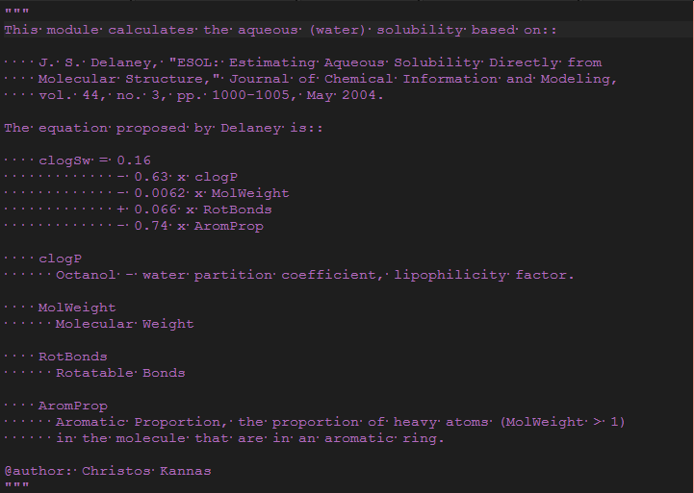

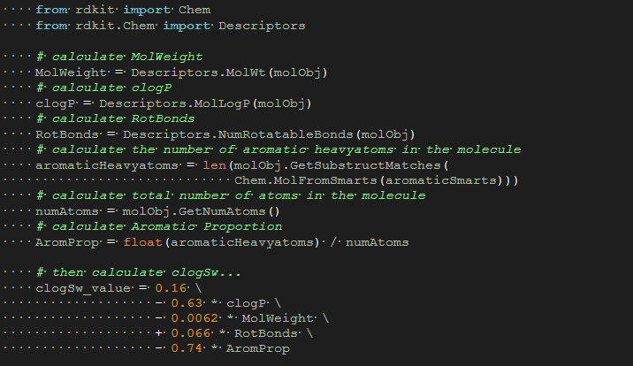
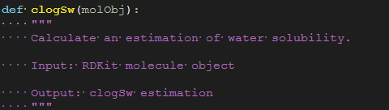
RDKit Based Implementation 2/2

Slide 16
Results

Slide 17
Testing…
Supplementary Dataset:
  1143 molecules with:
    Measured Water Solubility (logSw)
    ESOL
Correlation Charts:
  Measured vs ESOL
  Measured vs RDKit_clogSw
  ESOL vs RDKit_clogSw
  Measured vs ESOL vs RDKit_clogSw

Slide 18
Correlation Table & Chart
 | IMPORTED_measured log(solubility:mol/L) | IMPORTED_ESOL predicted log(solubility:mol/L) | clogSw
IMPORTED_measured log(solubility:mol/L) | 1
IMPORTED_ESOL predicted log(solubility:mol/L) | 0.90794375 | 1
clogSw | 0.864718601 | 0.964683313 | 1
Notes:
Rhombi

Slide 19
Conclusion
Comparable results.
Easy, fast and relatively accurate.
What is importance of adding Hydrogens prior to Aromatic Proportion calculation?

