Slide 1
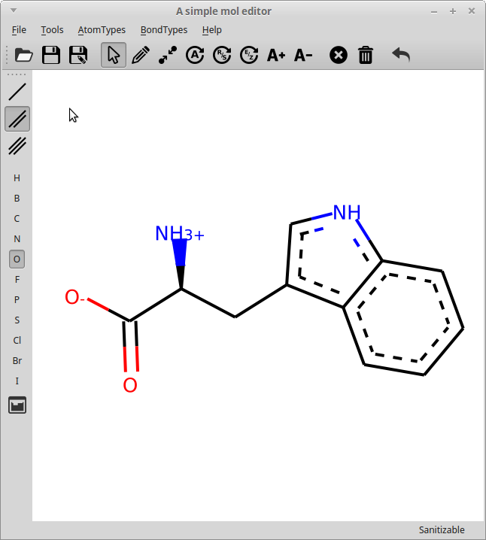
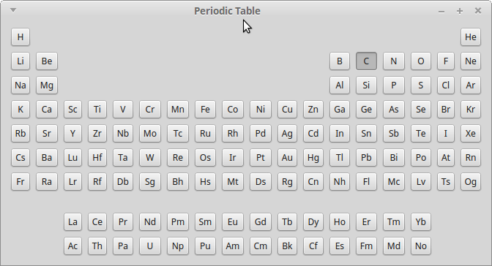
rdEditor: Graphical RDKit molecule editor
RDKit UGM2018: Cambridge

Slide 2
Classes
QtSvg.QSvgWidget (PySide)
  Can draw SVG
MolViewWidget (170 lines)
  Draw the molecule + Selection accounting
MolEditWidget (421 lines)
  Mousepress events and methods to edit the molecule
MainWindow (428 lines)
  GUI elements and actions to call methods/set properties on MolEditWidget

Slide 3
QT Signals and Slots
  Use of signals and slots to link events to code execution (QTCore, not GUI)
    Molviewwidget.mol = Chem.MolFromSmiles('CCCC')
    @mol.setter => Molviewwidget.molchanged.emit()
    Molchanged signal bound to slot molviewwidget.sanitize_draw()
    Method updates SVG => show new molecule

Slide 4
Issues
R/S (after saving/reopening)
E/Z not implemented
Molecule jumps around, especially for small molecules (Editor, not drawing program)
Probably other bugs as well
Available at https://github.com/EBjerrum/rdeditor
LGPL v.3 license (as PySide)

