Slide 1


Collaborative Drug Discovery
RDKit Enhancements
Dr. Tad Hurst
April 10-11, 2025

Slide 2
RDKit Enahancments
Self-Contained Sequence Representation (SCSR)
For Macromolecules
Read support
Internal macro format
Converts to full-atom representation
Rigorous Enhanced Stereochemistry
Removes ambiguity

Slide 3
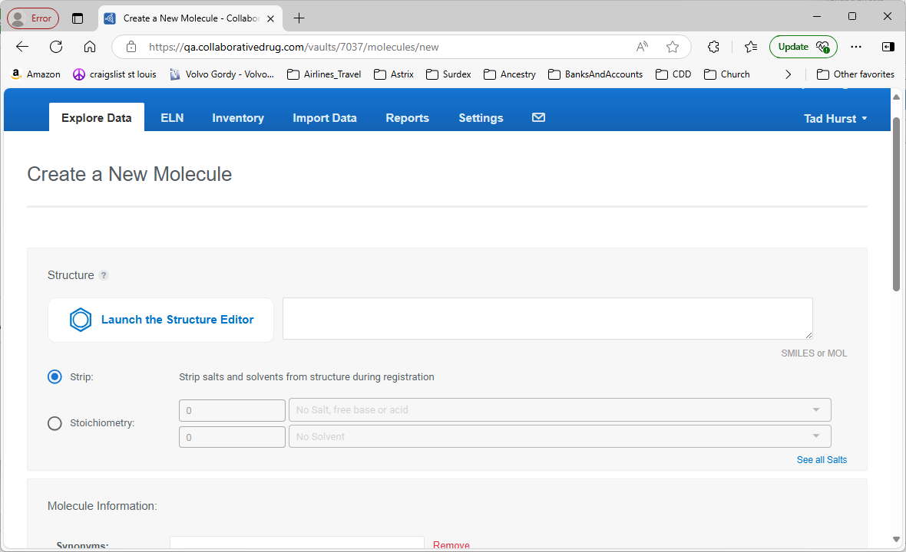

Slide 4
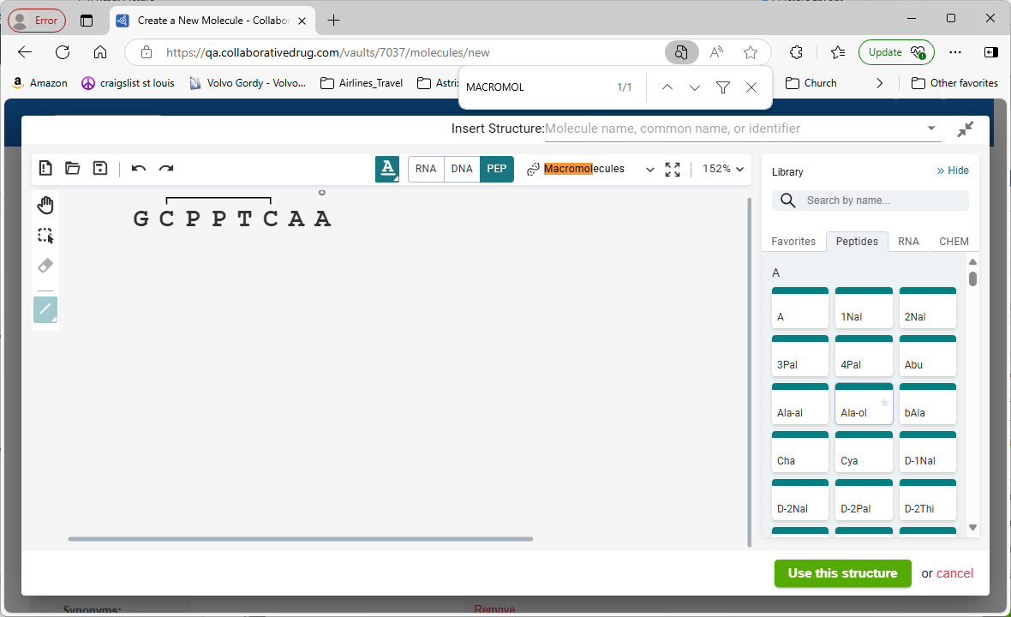

Slide 5
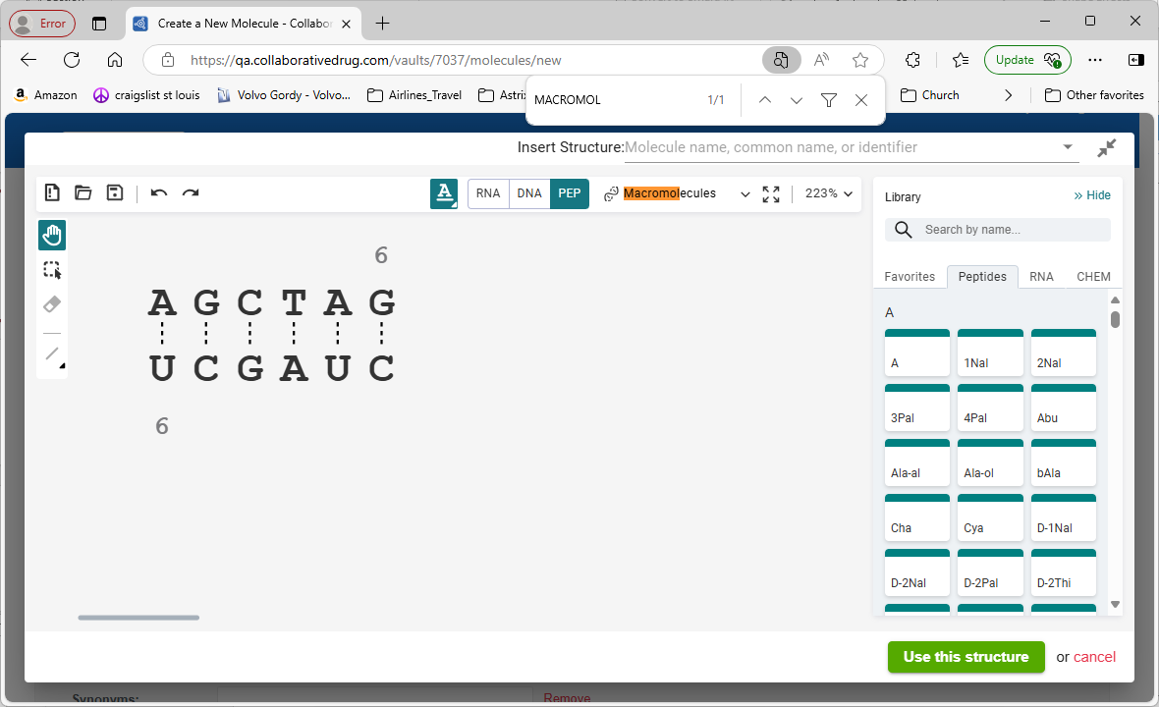

Slide 6
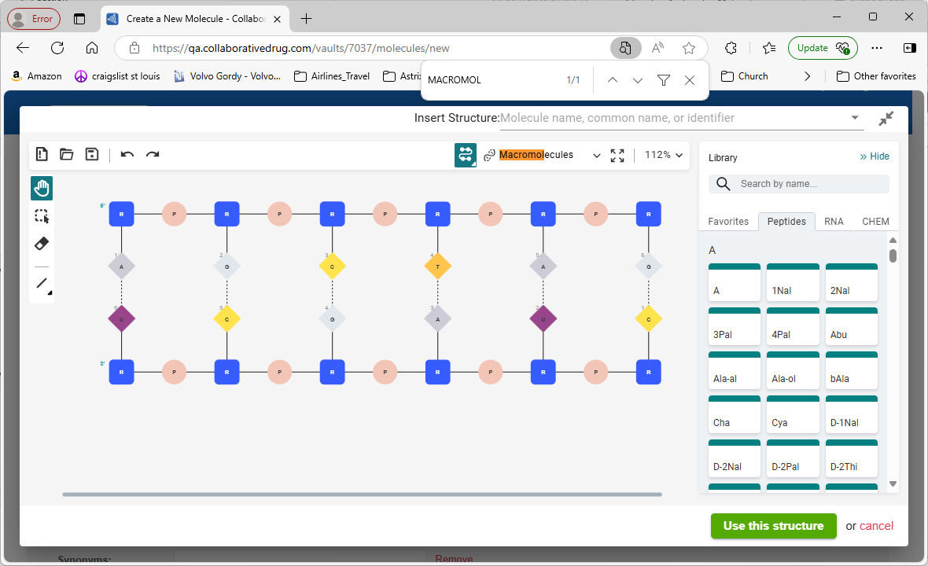

Slide 7
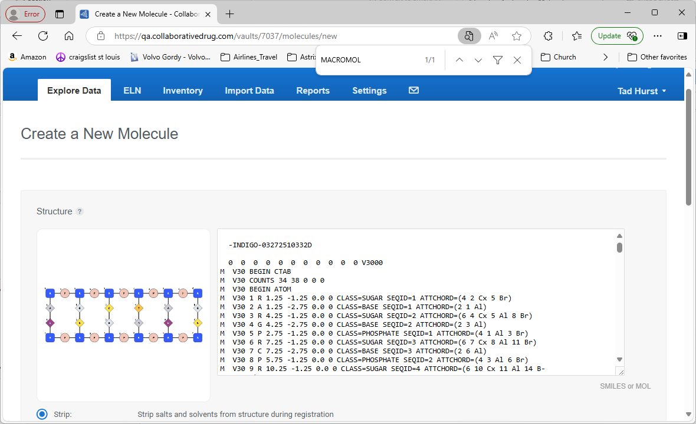

Slide 8
SCSR
Self-Contained Structure Representation
For Macromolecules
The SCSR support tentative added to RDKit follows the description in the BIOVIA document “biovia_ctfileformats_2020.pdf” available from:
“CTfile Formats - Dassault Systèmes”.
That document does not provide any real detail for that format, and contains one example file
In addition, Biovia Draw supports reading and writing this format. As much as possible, the RDKit support allows the functionality supported by Biovia Draw
Exception: treatment of hydrogen bonds in SCSR files/blocks

Slide 9
SCSR Representation
-INDIGO-03112510242D
0 0 0 0 0 0 0 0 0 0 0 V3000
M V30 BEGIN CTAB
M V30 COUNTS 9 8 0 0 0
M V30 BEGIN ATOM
M V30 1 C 3.075 0.2 0.0 0
M V30 2 C 4.075 0.2 0.0 0
M V30 3 C 2.075 0.2 0.0 0
M V30 4 C 3.075 1.2 0.0 0
M V30 5 C -0.325 -1.275 0.0 0
M V30 6 O -0.825 -0.408975 0.0 0
M V30 7 C -0.825 -2.14103 0.0 0
M V30 8 Tza 1.25 -1.25 0.0 0
CLASS=AA SEQID=1
ATTCHORD=(4 9 Br 5 Al)
M V30 9 C 3.0625 -1.24375 0.0 0
CLASS=AA SEQID=2
ATTCHORD=(4 8 Al 1 Cx)
M V30 END ATOM
M V30 BEGIN BOND
M V30 1 1 1 2
M V30 2 1 1 3
M V30 3 1 1 4
M V30 4 2 5 6
M V30 5 1 5 7
M V30 6 1 8 9
M V30 7 1 9 1
M V30 8 1 8 5
M V30 END BOND
M V30 END CTAB
M V30 BEGIN TEMPLATE
M V30 TEMPLATE 1 AA/Tza/Tza/ NATREPLACE=AA/A
M V30 BEGIN CTAB
M V30 COUNTS 12 12 3 0 0
M V30 BEGIN ATOM
M V30 1 C 0.8925 0.4863 0.0 0
M V30 2 C 0.8948 -1.0144 0.0 0 CFG=1
M V30 3 C 2.1952 -1.7637 0.0 0
M V30 4 N -0.4056 -1.7637 0.0 0
M V30 5 O 2.197 -2.9637 0.0 0
M V30 6 O 3.2337 -1.1625 0.0 0
M V30 7 H -1.4447 -1.1635 0.0 0
M V30 8 N -0.5669 2.7257 0.0 0
M V30 9 C -0.4057 1.2344 0.0 0
M V30 10 C -1.7742 0.6202 0.0 0
M V30 11 S -2.7811 1.7319 0.0 0
M V30 12 C -2.035 3.0333 0.0 0
M V30 END ATOM
M V30 BEGIN BOND
M V30 1 1 2 1 CFG=1
M V30 2 1 4 2
M V30 3 1 2 3
M V30 4 2 3 5
M V30 5 1 3 6
M V30 6 1 4 7
M V30 7 1 8 9
M V30 8 2 9 10
M V30 9 1 10 11
M V30 10 1 11 12
M V30 11 2 8 12
M V30 12 1 9 1
M V30 END BOND
M V30 BEGIN COLLECTION
M V30 MDLV30/STEABS ATOMS=(1 2)
M V30 END COLLECTION
M V30 BEGIN SGROUP
M V30 1 SUP 1 ATOMS=(1 7) XBONDS=(1 6) LABEL=H CLASS=LGRP
M V30 2 SUP 2 ATOMS=(1 6) XBONDS=(1 5) LABEL=OH CLASS=LGRP
M V30 3 SUP 3 ATOMS=(10 1 2 3 4 5 8 9 10 11 12) XBONDS=(2 5 6)
LABEL=Tza CLASS=AA SAP=(3 4 7 Al) SAP=(3 3 6 Br)
NATREPLACE=AA/A
M V30 END SGROUP
M V30 END CTAB
M V30 TEMPLATE 2 AA/Cys/C/ NATREPLACE=AA/C
M V30 BEGIN CTAB
M V30 COUNTS 9 8 4 0 0
M V30 BEGIN ATOM
M V30 1 N -0.866 -1.0 0.0 0
M V30 2 C 0.0 -0.5 0.0 0 CFG=2
M V30 3 H -1.732 -0.5 0.0 0
M V30 4 C 0.866 -1.0 0.0 0
M V30 5 O 1.732 -0.5 0.0 0
M V30 6 O 0.866 -2.0 0.0 0
M V30 7 C 0.0 0.5 0.0 0
M V30 8 S -0.866 1.0 0.0 0
M V30 9 H -0.866 2.0 0.0 0
M V30 END ATOM
M V30 BEGIN BOND
M V30 1 1 1 2
M V30 2 1 1 3
M V30 3 1 2 4
M V30 4 1 4 5
M V30 5 2 4 6
M V30 6 1 2 7 CFG=1
M V30 7 1 7 8
M V30 8 1 8 9
M V30 END BOND
M V30 BEGIN COLLECTION
M V30 MDLV30/STEABS ATOMS=(1 2)
M V30 END COLLECTION
M V30 BEGIN SGROUP
M V30 1 SUP 1 ATOMS=(1 3) XBONDS=(1 2) LABEL=H CLASS=LGRP
M V30 2 SUP 2 ATOMS=(1 5) XBONDS=(1 4) LABEL=OH CLASS=LGRP
M V30 3 SUP 3 ATOMS=(1 9) XBONDS=(1 8) LABEL=H CLASS=LGRP
M V30 4 SUP 4 ATOMS=(6 1 2 4 6 7 8) XBONDS=(3 2 4 8) LABEL=C
CLASS=AA SAP=(3 1 3 Al) SAP=(3 4 5 Br) SAP=(3 8 9 Cx)
NATREPLACE=AA/C
M V30 END SGROUP
M V30 END CTAB
M V30 END TEMPLATE
M END

Slide 10
Main Molecule
CTAB in v3000 format
Can contain elemental atoms and macro atoms
Macro atoms must have:
Description of the macro name
Class attribute:
As per BIOVia document, one of: AA, dAA, DNA, RNA, SUGAR, BASE, PHOSPHATE, LINKER, CHEM, LGR, P MODAA, MODdAA, MODDNA, MODRNA, XLINKAA, XLINKdAA, XLINKDNA, XLINKRNA.
This implementation ignores the allowed list (any class name is allowed)
ATTCHORD attribute – describes bonds to other atoms
ATTCHORD=(6 15 Al 21 Br 13 Cx)
Optional SEQID – sequence ID – the 3 parts of an RNA or DNA element typically have the same sequence ID. This implementation ignores the SEQID

Slide 11
Templates
BEGIN TEMPLATES
M V30 TEMPLATE 1 SUGAR/Rib/R NATREPLACE=SUGAR/R
<CTAB>
V30 TEMPLATE 2 BASE/Ade/A NATREPLACE=BASE/A
<CTAB>
M V30 TEMPLATE 3 PHOSPHATE/P/P NATREPLACE=PHOSPHATE/P
<CTAB>
END TEMPLATE

Slide 12
Template CTAB
Normal atoms and bonds
Main SUP (Sgroup)
ATOMS – the atoms of the macro atom (not leaving group atoms)
XBONDS – bonds to atoms NOT in the macro atom (to leaving groups) (ignored)
LABEL – must be one of the names of the template in the TEMPLATE definition line
CLASS – must be the same as the class from the TEMPLATE definition line
SAP (Sgroup Attachment Point) for each leaving group:
SAP=(3 10 11 Al)
Leaving group SUPs
ATOMS – all atoms of the leaving group
XBONDS – bonds from a leaving group atom to a main SUP atom (ignored)
LABEL – name for the leaving group (e.g. H, OH)
CLASS – must be LGRP

Slide 13
RDKit Methods – C+
MolFromSCSRDataStream( std::istream &inStream, unsigned int &line, const MolFileParserParams &molFileParserParams, const MolFromSCSRParams &molFromSCSRParams)
MolFromSCSRBlock( const std::string &molBlock, const MolFileParserParams &molFileParserParams, const MolFromSCSRParams &molFromSCSRParams)
MolFromSCSRFile( const std::string &fName, const MolFileParserParams &molFileParserParams, const MolFromSCSRParams &molFromSCSRParams)

Slide 14
RDKit Methods - Python
MolFromSCSRBlock(molBlock, sanitize, removeHs, molFromSCSRParams)
MolFromSCSRFile(fileName, sanitize, removeHs, molFromSCSRParams)

Slide 15
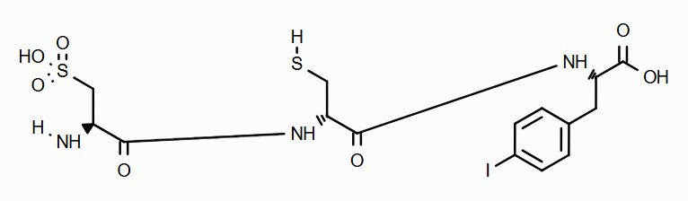
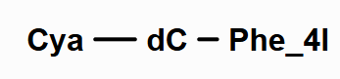
MolFromSCSRParams
SCSRBaseHbondOptions: (more later)
ScsrTemplateNames: Control how Sgroups are created for the atoms derived from templates. The value is one of:
“UseFirstName”
“UseSecondName”
“AsEntered”
includeLeavingGroups (bool): If set to True, the leaving groups that are not replaced by connection to another atom in the main molecule are included in the final atomistic version of the structure.

Slide 16
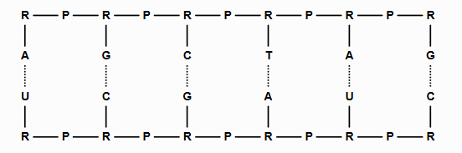
Hydrogen Bonding
Not addressed in BIOvia document, nor in the one example, and not handled by BIOvia Draw.
Represented in SCSR blocks as main molecule bonds between two macro atoms, typically between two base units. (Hydrogen atoms are not involved).
The bond is of type H (10) in V3000 format, and only 1 bond appears between two associated BASE atoms. This bond can represent more than one bond – typically 2 or 3 bonds.

Slide 17
Hydrogen Bond Specification Methods
SCSRBaseHbondOptions
Ignore – all hydrogen bonds in the main molecule are ignored
UseSapAll - Use all ATTCHORD/SAP defined H-bonds
UseSapOne - Use only the first ATTCHORD/SAP defined H-bond
May NOT give a final H-bond between a donor and an acceptor
Does indicate which BASES comprise a base-pair
Auto - Automatically determine Hydrogen bonding sites for common bases and their derivatives.
Uses substructure searching for common bases and derivatives

Slide 18
UseSapAll and UseSapOne
In the main molecule, each macro atom to be part of a hydrogen bond has an ATTACHORD entry. Typically, the entry will be named “Ch”, as in:
M V30 2 A 32.9805 -19.6796 0.0 0 CLASS=BASE SEQID=1 ATTCHORD=(4 1 Al 6 Ch)
In the template, the main SUP with have one or more SAPs for the hydrogen bond(s) to be produced in the atomistic molecule. Typically, 2 or 3 SAPs will be provided:
SAP=(3 7 11 Al) SAP=(3 5 0 Ch) SAP=(3 6 0 Ch) SAP=(3 10 0 Ch)
The H-bond sites on each expanded template examined to see if they are acceptors or donors.

Slide 19
Auto Hbond Site Determination
Substructure searching of the template
Guanine
Adenine
Cytosine
Thyamine-Uracyl
Inosine
Searches determine the Donor-Acceptor sites on the base.

Slide 20
Connecting the Hbond Sites
If there are 3 H-bond sites on both ends, and they are complimentary, all three bonds are created. (Standard Watson-Crick binding).

Slide 21
Wobbly Pairs
Wobbly pairs contain only 2 H-bonds between the bases.
There are 4 recognized wobbly pairs:
I-C
I-U
I-A
G-U
I is Inosine, and has only 2 H-bonding sites (DA configuration)
For I-C and I-A, the second and third sites for A or C are used (AD).
For I-U, the first type sites for U are used (AD).
For G-U, the second and third sites of G and used (DA), and first two sites for U are used (AD)
For anything else, only one (1) hydrogen bond is created
Between the first site on each side
They may NOT be complimentary

Slide 22
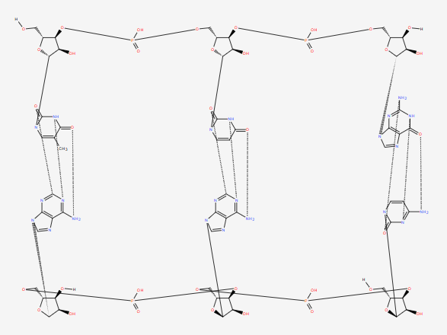
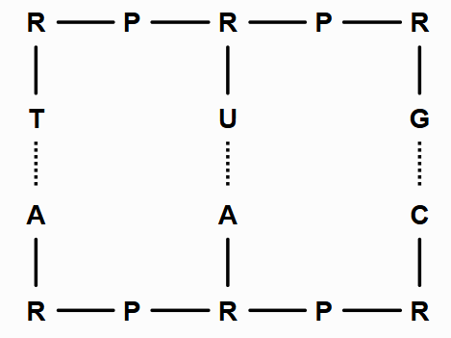
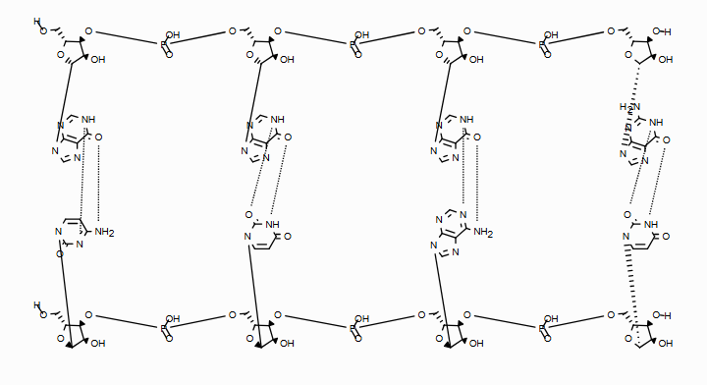
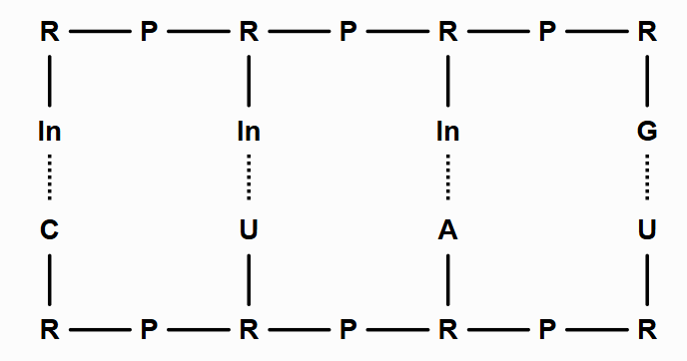

Slide 23
RDKit Enahancments
Self-Contained Sequence Representation (SCSR)
For Macromolecules
Read support
Internal macro format
Converts to full-atom representation
Rigorous Enhanced Stereochemistry
Removes ambiguity

Slide 24
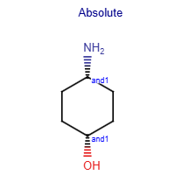
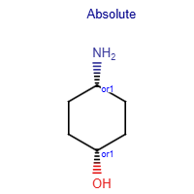
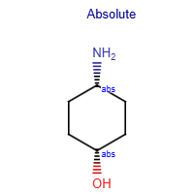
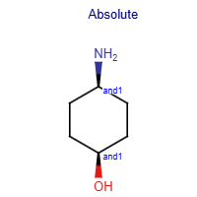
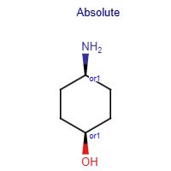
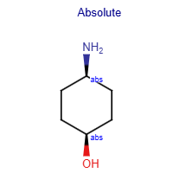
Rigorous Enhanced Stereochemistry
The problem:

Slide 25
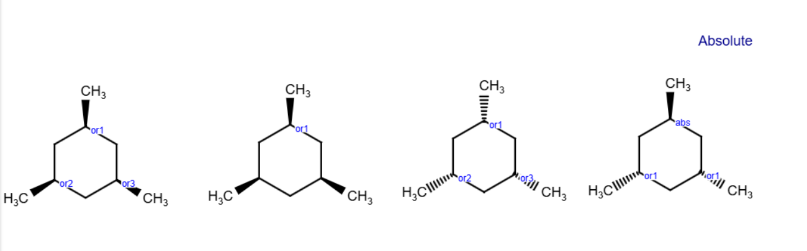
More Complex Example

Slide 26
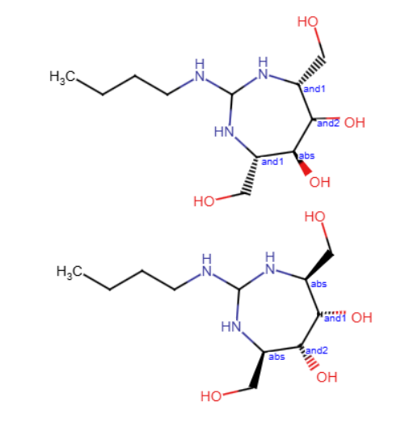

Slide 27
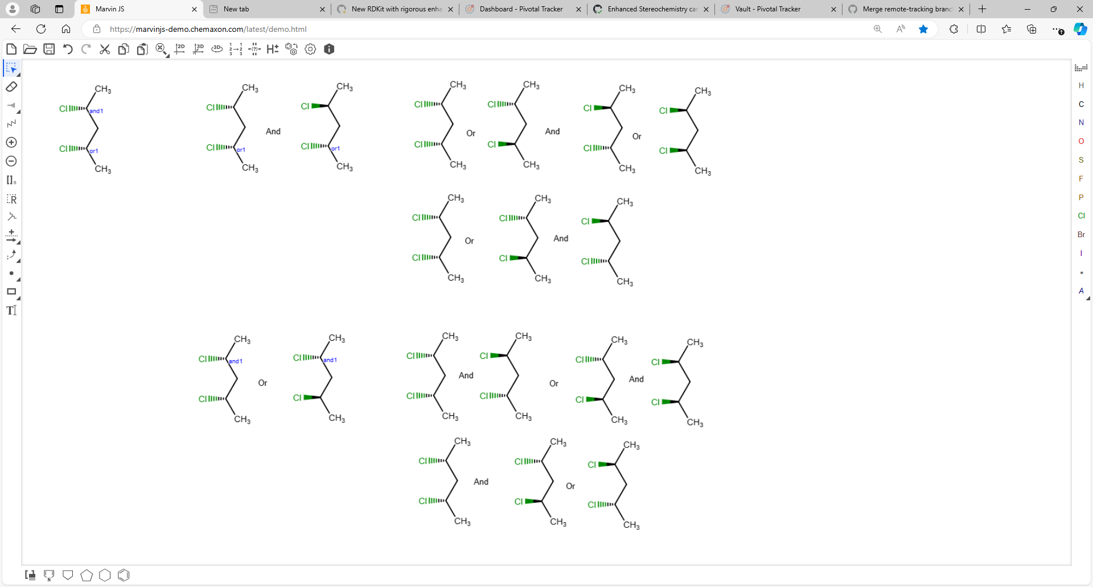
ANDs and Ors together
And first
Or first

Slide 28
Method
If there are ANDs and ORs, process the ORs first, then the ANDs (arbitrary)
Expand all stereo groups to multiple structures.
Canonicalize all expanded structures
Compare stereochemistry atom-by-atom in the expanded, canonical structures
Any stereo centers (atom and atropisomers) that do NOT vary become part of an ABS group
For a center that varies, create an AND or OR group for all atoms/bonds that vary the same way across all unique mols.
R…R….S First two vary the same, the third does not R…S….S R…R….R R…S….R S…S….S S…R….S S…S….R S…R….R
Re-unique the one result.

Slide 29
Collaborative Drug Discovery
www.collaborativedrug.com

