Slide 1
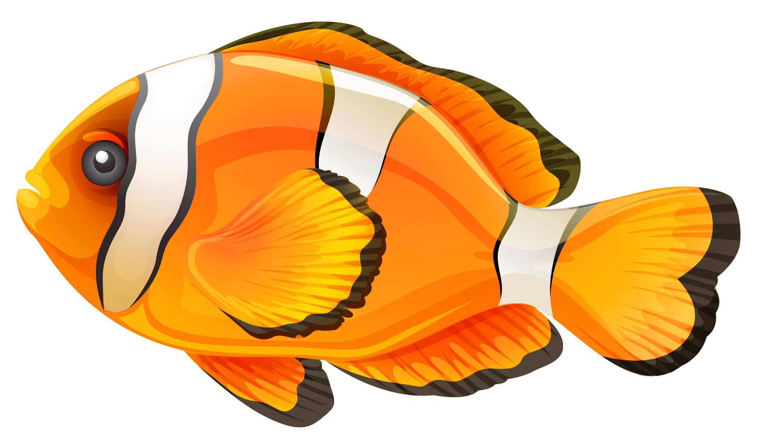

Finding Tautomers
North American RDKit UGM
April 11, 2025
Jeremy Monat, Ph.D.
GitHub: @bertiewooster
Email: jemonat@gmail.com
Blog: bertiewooster.github.io
Fish image attribution: https://pngimg.com/image/25114 License: Attribution-NonCommercial 4.0 International (CC BY-NC 4.0)

Slide 2
Outline
What Are Tautomers and Why Are They Important?
What Do Several Methods Find For Tautomers?
Experimental Tautomer Data
RDKit Tautomer Enumerators
Other Cheminformatic Tautomer Enumerators
Comparing Tautomer Sources
How Tautomer-Invariant is InChI?
Talk based on my blog post Comparing Tautomer Generation Algorithms, doi: https://doi.org/10.59350/j8vcr-a9x26

Slide 3
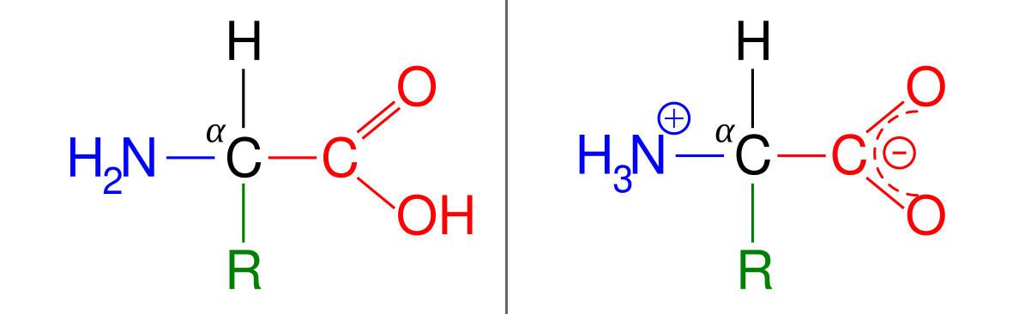
What Are Tautomers?
Structural isomers that readily interconvert
A molecule may be configured differently in nature than how we draw it
Tautomers are important because multiple different arrangements of atoms may be in the same form in nature
We’d like to synthesize or purchase compounds knowing what their structure will be in nature
Prototropic example (migration of a proton)
Image credit: TimVickers vector version by YassineMrabet

Slide 4
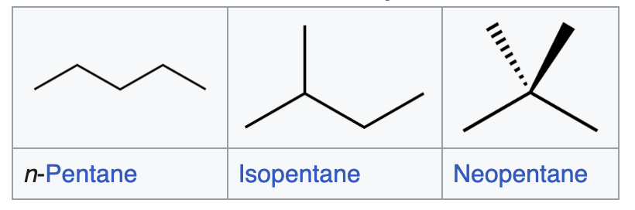
Tautomers vs. Other Structural Isomers
Tautomers are a special case of structural isomers
In general, structural isomers may not easily interconvert, so they may be chemically distinct species in nature
To be tautomers, it must be easy for the required bonds to be broken and formed
Tautomers because O-H and N-H bonds labile, proton can move between O and N
Not tautomers because C-C bonds not labile
Image credit: TimVickers vector version by YassineMrabet
Image credit: Wikipedia https://en.wikipedia.org/wiki/Structural_isomer

Slide 5
Ways to Find Tautomers (Sources)
Source | Have data for all compounds | Nature | Algorithm source | Interface | Role
Experiment | Yes | Experimental | Not applicable | Not applicable | Comparison
RDKit v1 Enumerator | Yes | Cheminformatic | RDKit (36 rules) | Programmatic | Comparison
RDKit v2 Enumerator | Yes | Cheminformatic | RDKit (37 rules) | Programmatic | Baseline
cactus | No | Cheminformatic | CACTVS (86 rules) | Web page | Comparison
CACTVS | No | Cheminformatic | CACTVS (120 rules) | Programmatic | Comparison

Slide 6
Experimental Tautomer Data

Slide 7
Experimental Tautomer Database
Use as a source of structures that have tautomers
Apply cheminformatic algorithms to experimental structures to find predicted tautomers
Marc Nicklaus and team created Tautomer Structures Extracted from Experimental Literature*
Contains 1,776 structurally different tautomeric tuples, termed Refs
Comprise 3,911 different structures, averaging 2.2 structures per Ref
*”Tautomer Database: A Comprehensive Resource for Tautomerism Analyses,” Devendra Dhaked, Laura Guasch, Marc Nicklaus, J Chem Inf Model. 2020; 60(3): 1090–1100, doi: 10.1021/acs.jcim.9b01156.

Slide 8
RDKit Tautomer Enumerators

Slide 9
RDKit Tautomer Enumerators
Usage: TautomerEnumerator or GetV1TautomerEnumerator in rdkit.Chem.MolStandardize.rdMolStandardize.<ENUMERATOR>.Enumerate(mol)
Rules are in SMARTS (SMiles ARbitrary Target Specification) format
All RDKit tautomer rules are prototropic (involve migration of protons)
v1 has 36 rules; v2 has 37 rules
v2 follows published rules more closely
Enabled by RDKit supporting more SMARTS extensions; v1 kept as an option
In v2, one more rule is added, special imine r2, for six-membered rings
In v2, 17 rules are more specific, for example the number of rings an atom belongs to is constrained
In v2, two rules are generalized to allow for aromaticity beyond Kekulé (alternating double and single bonds)
Applying v1 and v2 to all 3,911 distinct experimental structures in database took about 1.5 minutes total on a laptop

Slide 10
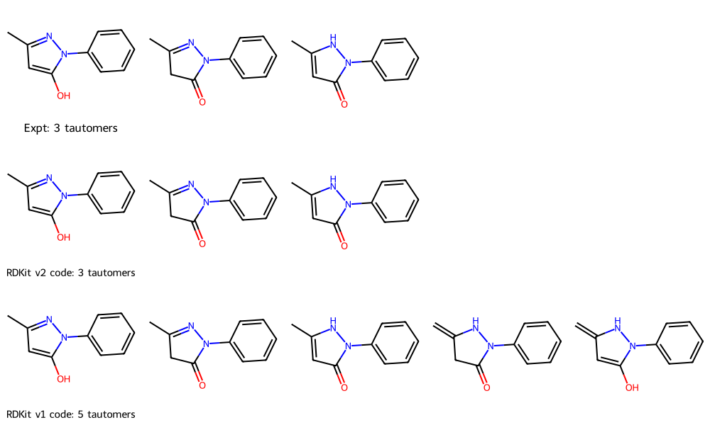
RDKit Tautomer Enumerators Examples
For Ref 42, v1 and v2 find all three experimental tautomers
v1 also finds two additional tautomers
Graphic made using my RDKit contribution Draw. MolsMatrixToGridImage

Slide 11
MolsMatrixToGridImage
Added in RDKit 2023.09.1
Builds on MolsToGridImage
Creates a rectangular row-and-column format using nested input data structures
This graphic can be made using MolsMatrixToGridImage([ [ex_a, ex_b, ex_c], [v2_a, v2_b, v2_c], [v1_a, v1_b, v1_c, v1_d, v1_e]])
Otherwise would have to use MolsToGridImage([ ex_a, ex_b, ex_c, None, None, v2_a, v2_b, v2_c, None, None, v1_a, v1_b, v1_c, v1_d, v1_e], molsPerRow=5)
Tutorial blog post: “Plotting rows and columns of molecules with MolsMatrixToGridImage,” https://greglandrum.github.io/rdkit-blog/posts/2023-10-25-molsmatrixtogridimage.html

Slide 12
MolsMatrixToGridImage
Added in RDKit 2023.09.1
Builds on MolsToGridImage
Creates a rectangular row-and-column format using nested input data structures
This graphic can be made using MolsMatrixToGridImage([ [ex_a, ex_b, ex_c], [v2_a, v2_b, v2_c], [v1_a, v1_b, v1_c, v1_d, v1_e]])
Otherwise would have to use MolsToGridImage([ ex_a, ex_b, ex_c, None, None, v2_a, v2_b, v2_c, None, None, v1_a, v1_b, v1_c, v1_d, v1_e], molsPerRow=4)
which must be updated if # mols changes
4
Tutorial blog post: “Plotting rows and columns of molecules with MolsMatrixToGridImage,” https://greglandrum.github.io/rdkit-blog/posts/2023-10-25-molsmatrixtogridimage.html

Slide 13
Other Cheminformatic Tautomer Enumerators

Slide 14
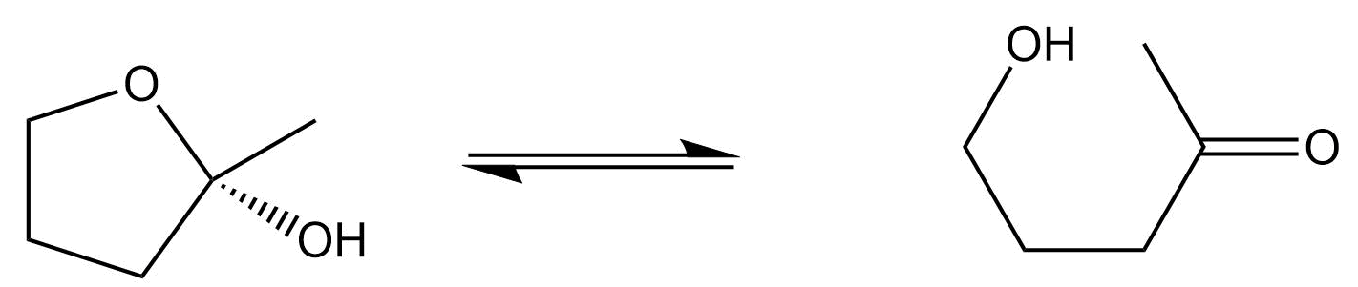
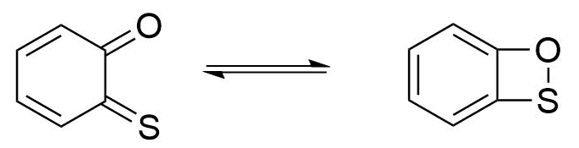
CACTVS Enumerators
CACTVS is a cheminformatics package from Xemistry GmbH
NIH Tautomerizer cactus web interface has 86 rules from CACTVS
54 protoropic
21 ring-chain
11 valence
I ran multi step with all rules
CACTVS has 120 rules
Marc Nicklaus ran “exhaustive multi-step enumeration iteratively with all rules, until no more new tautomer is found (with a limit of 1,000 attempts)”
Ring-chain
tautomerization
Valence
tautomerization
Tautomerization rules from https://cactus.nci.nih.gov/tautomerizer
Notes:
Ring-chain tautomerization Rule RC_03_00: 5_exo_trig
Valence tautomerization Rule VT_01_00: monothio-o-benzoquinone/benzoxathiete

Slide 15
Comparing Tautomer Sources

Slide 16
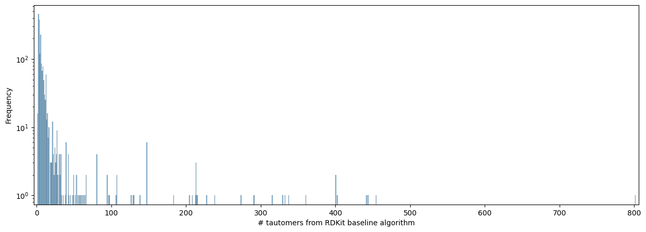
Tautomers from RDKit v2 Algorithm
For the 1,776 Refs, the number of tautomers has mean 11.9, stdev 42.6

Slide 17
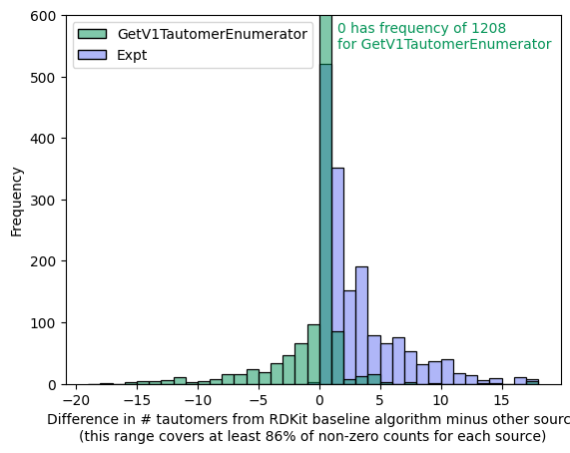
Graphical Comparison of RDKit v1, v2, Experimental
For 68% of Refs, RDKit v1 and v2 enumerators find same number of tautomers
v1 generally finds more tautomers than v2
Fewer tautomers are observed experimentally than v2 finds
An algorithmically- predicted tautomer may be energetically unfavored and so not observed

Slide 18
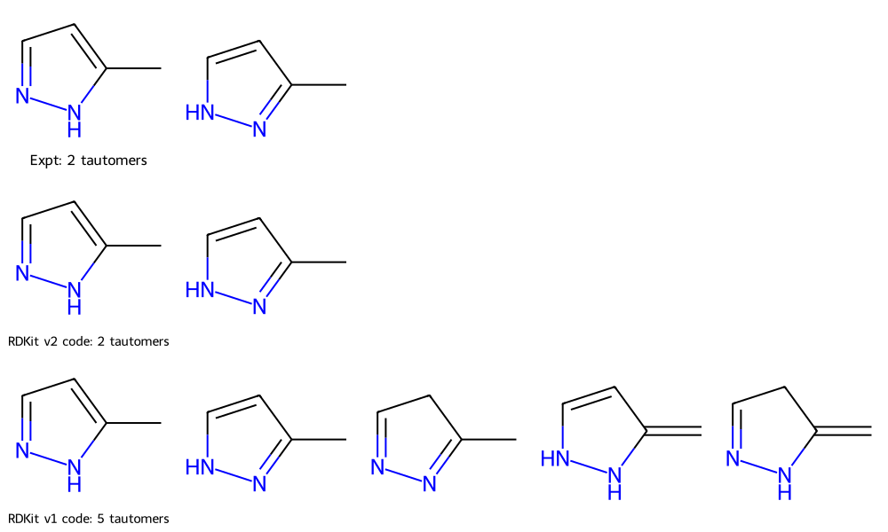
Tautomer Structure Comparison of RDKit v1, v2, Expt
Ref 3

Slide 19
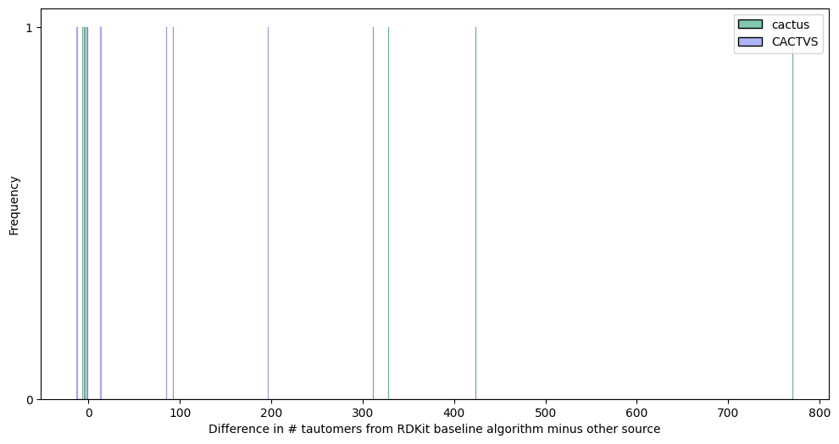
CACTVS Enumerators Graphical Results
Datasets are limited because I didn’t have programmatic access
For the 5 structures where I have data for all sources, compared to RDKit v2
CACTVS algorithm (120 rules) finds about 56 fewer tautomers per Ref
cactus algorithm (86 rules) finds about 211 fewer tautomers per Ref
Unclear why CACTVS-based algorithms find fewer tautomers despite having more rules

Slide 20
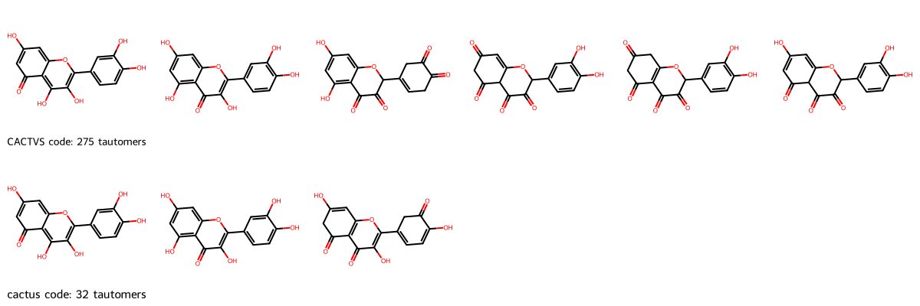
CACTVS Enumerators Visual Results
Ref 467

Slide 21
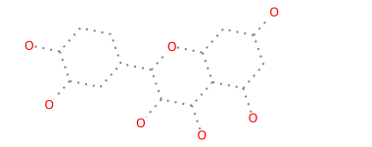
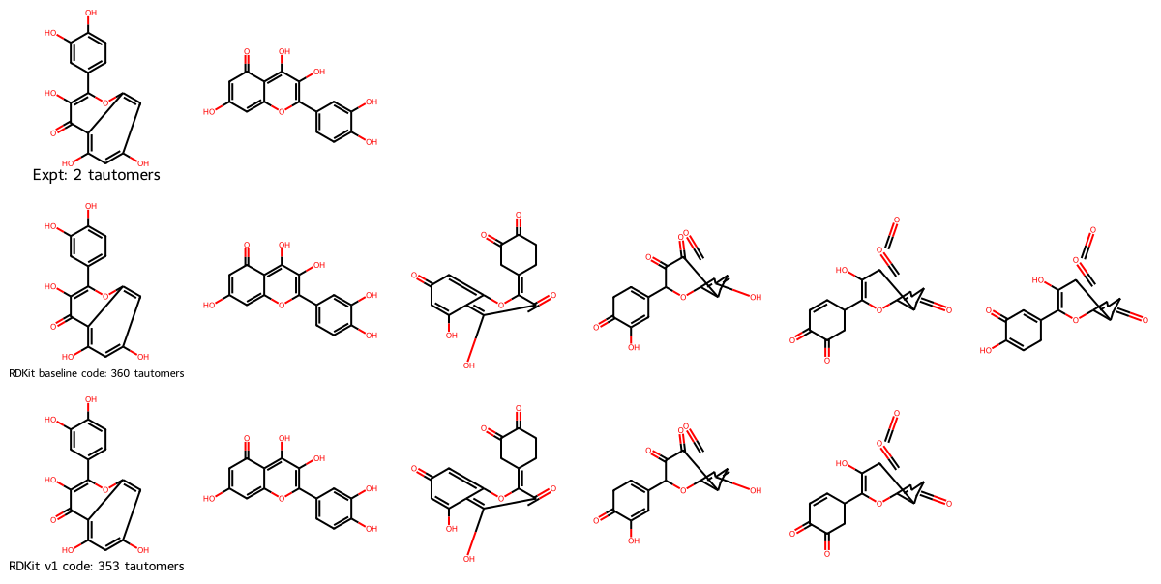
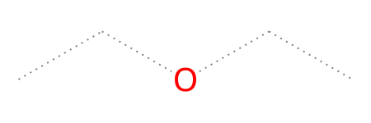
Tautomeric Structure Comparison Tip
It’s easiest to compare tautomeric structures when they’re visually aligned
Accomplish using maximum common substructure via FindMCS
Tip: Allow matching of any bond type because tautomers often have different bond orders at the same position using bondCompare=rdFMCS.BondCompare.CompareAny
MCS with CompareAny
Alignment without CompareAny yields odd-looking structures
MCS without CompareAny

Slide 22
How Tautomer-Invariant is InChI?

Slide 23
InChI is Designed to be Tautomer-Invariant
Meaning all tautomers of a structure should be assigned the same InChI*
Why: Facilitates storing and searching in databases for equivalent structures
How: Describes molecule at multiple levels, e.g. hydrogen atom sublayer
“It was recognized early on that important types of tautomerism are missing”* so we should not expect InChI to be completely successful yet
InChI v2 should improve†
How successful is InChI at representing all tautomers (experimental or generated by RDKit v2 enumerator) of a Ref?
Evaluate by converting SMILES-derived molecules to InChI using RDKit’s Chem.MolToInchi and then removing duplicate InChI
*”Tautomers in InChI,” Marc C. Nicklaus, NIH InChI Workshop, March 22-24, 2021.
†”Toward a Comprehensive Treatment of Tautomerism in Chemoinformatics Including in InChI V2,” Devendra K. Dhaked, Wolf-Dietrich Ihlenfeldt, Hitesh Patel, Victorien Delannée, and Marc C. Nicklaus, J Chem Inf Model. 2020; 60: 1253−1275, doi: 10.1021/acs.jcim.9b01080.

Slide 24
InChI Tautomer Invariance For RDKit v2: Statistical
How many fewer InChI are required than SMILES to represent all tautomers for a Ref from RDKit v2 enumerator
For ~73% of the Refs, InChI cannot reduce the number of representations compared to SMILES: one InChI is not covering multiple SMILES
For about 9% of Refs, InChI needs one fewer representation than SMILES
Per Ref, on average 10.5 InChI representations are needed vs. 11.9 SMILES; InChI goal is 1.0
~12% reduction
Also ~12% reduction for tautomers from experiment: 1.95 InChI needed per Ref, vs. 2.2 SMILES
# fewer InChI than SMILES | Count | % | Cumulative %
0 | 1292 | 72.7 | 72.7
1 | 162 | 9.1 | 81.9
2 | 110 | 6.2 | 88.1
3 | 56 | 3.2 | 91.2
4 | 36 | 2.0 | 93.2
5 | 27 | 1.5 | 94.8

Slide 25
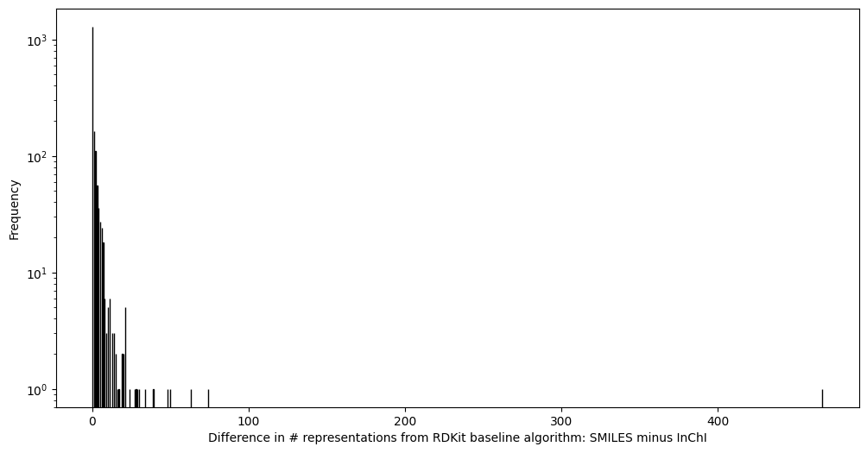
InChI Tautomer Invariance For RDKit v2: Graphical
There are 37 Refs (2%) reduced by ≥ 10 representations
Overall, InChI reduces the number of representations by about 12%
InChI needs as many representations as SMILES: 73%
InChI needs dozens or hundreds fewer representations for some Refs

Slide 26
Conclusion

Slide 27
Summary
Number of tautomers found, from most to fewest
*RDKit’s v1 algorithm produces the most, about 5 more per Ref
*RDKit’s v2 algorithm is our baseline
+CACTVS’s algorithm finds about 56 fewer tautomers per Ref
+cactus’s algorithm finds about 211 fewer tautomers per Ref
*Experimental results find about 229 fewer tautomers per Ref
Finding more tautomers isn’t necessarily better
Energies determine which will be observed in nature
InChI is currently about 12% better than SMILES at representing all tautomers of a given structure with one identifier, but has a ways to go: Per Ref, goal is 1.0 InChI, but average is
10.5 InChI for RDKit v2 tautomers
1.95 InChI for experimental tautomers
*Comparison of all Refs because data source includes all Refs
+Comparison of 5 Refs because data source does not include all Refs because it had to be run manually for each Ref

Slide 28
Acknowledgements
Marc Nicklaus for running CACTVS tautomer enumerations, giving background on the web tool, informative discussions, and reviewing a draft of the blog post this talk is based on
Former co-workers at Aionics, Inc. for discussions about tautomers
Blog post and talk were done on my own and do not necessarily represent my former employer’s views
Jeremy Monat, Ph.D.
GitHub: @bertiewooster
Email: jemonat@gmail.com
Blog: bertiewooster.github.io
Fish image attribution: https://pngimg.com/image/25114 License: Attribution-NonCommercial 4.0 International (CC BY-NC 4.0)

Slide 29
Backup

Slide 30
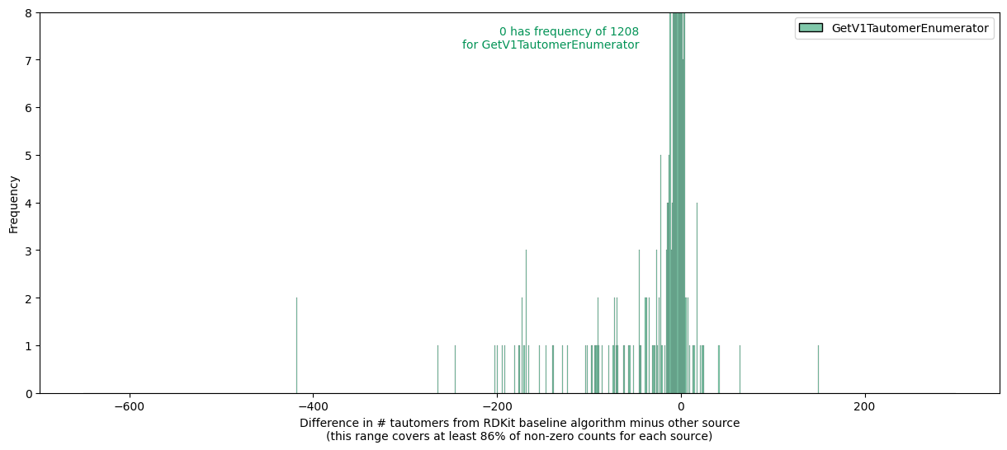
Graphical Comparison of RDKit v1, v2 Zoomed Out

