Slide 1
RDKit: A software suite for cheminformatics, computational chemistry, and predictive modeling
  Greg Landrum
  glandrum@users.sourceforge.net

Slide 2
Availability
SourceForge Page:
  http://rdkit.sourceforge.net
Source code:
  Browse:
    http://svn.sourceforge.net/viewcvs.cgi/rdkit/trunk/
  Download using subversion:
    svn co https://svn.sourceforge.net/svnroot/rdkit/trunk rdkit
Binaries: available for Win32
Licensing: BSD license (except for GUI components, which are GPL)

Slide 3
Components
End User
Developer
Command-line scripts
Python interface
Database extensions
Python programming library
C++ programming library

Slide 4
General Molecular Functionality
Input/Output: SMILES/SMARTS, mol, SDF, TDT
“Cheminformatics”:
  Substructure searching
  Canonical SMILES
  Chirality support
  Chemical transformations
  Chemical reactions
  Molecular serialization (e.g. mol <-> text)‏
2D depiction, including constrained depiction and mimicking 3D coords
2D->3D conversion/conformational analysis via distance geometry
UFF implementation for cleaning up structures
Fingerprinting (Daylight-like, circular, atom pairs, topological torsions, “MACCS keys”, etc.)‏
Similarity/diversity picking (include fuzzy similarity)‏
2D pharmacophores
Gasteiger-Marsili charges
Hierarchical subgraph/fragment analysis
Hierarchical RECAP implementation

Slide 5
General Molecular Functionality, cntd
Feature maps and feature-map vectors
Shape-based similarity
Molecule-molecule alignment
Shape-based alignment (subshape alignment)‏*
Very fast 3D pharmacophore searching
Integration with PyMOL for 3D visualization
Database “cartridge” (PostgreSQL, sqlite coming) *
* functional implementations, but not really recommended for use

Slide 6
General “QSAR” Functionality
Molecular descriptor library:
  Topological (κ3, Balaban J, etc.)‏
  Electrotopological state (EState)‏
  clogP, MR (Wildman and Crippen approach)‏
  “MOE like” VSA descriptors
  Feature-map vectors
Machine Learning:
  Clustering (hierarchical)
  Information theory (Shannon entropy)
  Decision trees, naïve Bayes*, kNN*
  Bagging, random forests
  Infrastructure:
    data splitting
    shuffling (y scrambling)
    out-of-bag classification
    serializable models and descriptor calculators
    enrichment plots, screening, etc.
* functional implementations, but not really recommended for use

Slide 7
Command Line Tools
ML/BuildComposite.py: build models
ML/ScreenComposite.py: screen models
ML/EnrichPlot.py: generate enrichment plot data
ML/AnalyzeComposite.py: analyze models (descriptor levels)
Chem/Fingerprints/FingerprintMols.py: generate 2D fingerprints
Chem/BuildFragmentCatalog.py: CASE-type analysis with a hierarchical catalog

Slide 8
Database Utilities
DbUtils.ExcelToDatabase('::GPCRs','bzr_raw85',keyCol='name')
DbUtils.DatabaseToExcel('::GPCRs','bzr_raw85')
DbUtils.TextFileToDatabase('::GPCRs','bzr_raw85',
file('input.txt',delim=',',
keyCol='name')
DbUtils.DatabaseToText('::GPCRs','bzr_raw85')

Slide 9
Reading/Writing Molecules
MolFromSmiles
MolFromSmarts
MolFromMolBlock
MolFromMolFile
mol = Chem.MolFromSmiles('CCCOCC')
SmilesMolSupplier
SDMolSupplier
TDTMolSupplier
SupplierFromFilename
mols = [x for x in Chem.SDMolSupplier('input.sdf')]
MolToSmiles
MolToSmarts
MolToMolBlock
print >>outF,Chem.MolToMolBlock(mol)
SmilesWriter
SDWriter
TDTWriter
w = Chem.SDWriter('out.sdf')
for m in mols:
w.write(m)

Slide 10
Working with molecules:
Substructure matching
>>> m = Chem.MolFromSmiles('O=CCC=O')
>>> p = Chem.MolFromSmarts('C=O')
>>> m.HasSubstructMatch(p)
True
>>> m.GetSubstructMatch(p)
(1, 0)
>>> m.GetSubstructMatches(p)
((1, 0), (3, 4))
>>> m = Chem.MolFromSmiles('C1CCC1C(=O)O')
>>> p= Chem.MolFromSmarts('C=O')
>>> m2 =Chem.DeleteSubstructs(m,p)
>>> Chem.MolToSmiles(m2)
'O.C1CCC1'
>>>
>>> def findcore(m):
... smi = Chem.MolToSmiles(m)
... patt = Chem.MolFromSmarts('[D1]')
... while 1:
... m2 = Chem.DeleteSubstructs(m,patt)
... nSmi = Chem.MolToSmiles(m2)
... m = m2
... if nSmi==smi:
... break
... else:
... smi = nSmi
... return m
...
>>> m = Chem.MolFromSmiles('CCC1CCC1')
>>> c = findcore(m)
>>> Chem.MolToSmiles(c)
'C1CCC1'

Slide 11
Working with molecules: properties
>>> suppl = Chem.SDMolSupplier('divscreen.400.sdf')
>>> m = suppl.next()
>>> list(m.GetPropNames())
['Formula', 'MolWeight', 'Mol_ID', 'Smiles', 'cdk2_ic50', 'cdk2_inhib', 'cdk_act_bin_1', 'mol_name', 'scaffold', 'sourcepool']
>>> m.GetProp('scaffold')
'Scaffold_00'
>>> m.GetProp('missing')
Traceback (most recent call last):
File "<stdin>", line 1, in ?
KeyError: 'missing'
>>> m.HasProp('missing')
0
>>> m.SetProp('testing','value')
>>> m.GetProp('testing')
'value'
>>> m.SetProp('calcd','45',computed=True)
>>> list(m.GetPropNames())
['Formula', 'MolWeight', 'Mol_ID', 'Smiles', 'cdk2_ic50', 'cdk2_inhib', 'cdk_act_bin_1', 'mol_name', 'scaffold', 'sourcepool', 'testing']

Slide 12
Generating Depictions
>>> from rdkit import Chem
>>> from rdkit.Chem import AllChem
>>> m = Chem.MolFromSmiles('C1CCC1')
>>> m.GetNumConformers()
0
>>> AllChem.Compute2DCoords(m)
0
>>> m.GetNumConformers()
1
>>> print Chem.MolToMolBlock(m)
4 4 0 0 0 0 0 0 0 0999 V2000
1.0607 0.0000 0.0000 C 0 0 0 0 0 0 0 0 0 0 0 0
-0.0000 -1.0607 0.0000 C 0 0 0 0 0 0 0 0 0 0 0 0
-1.0607 0.0000 0.0000 C 0 0 0 0 0 0 0 0 0 0 0 0
0.0000 1.0607 0.0000 C 0 0 0 0 0 0 0 0 0 0 0 0
1 2 1 0
2 3 1 0
3 4 1 0
4 1 1 0
M END
>>>

Slide 13
Generating 3D Coordinates
>>> from rdkit import Chem
>>> from rdkit.Chem import AllChem
>>> m = Chem.MolFromSmiles('C1CCC1')
>>> AllChem.EmbedMolecule(m)
0
>>> m.GetNumConformers()
1
>>> AllChem.UFFOptimizeMolecule(m)
0
>>> m.SetProp('_Name','testmol')
>>> print Chem.MolToMolBlock(m)
testmol
4 4 0 0 0 0 0 0 0 0999 V2000
-0.8040 0.5715 -0.2537 C 0 0 0 0 0 0 0 0 0 0 0 0
-0.3727 -0.9165 -0.2471 C 0 0 0 0 0 0 0 0 0 0 0 0
0.7942 -0.5376 0.6386 C 0 0 0 0 0 0 0 0 0 0 0 0
0.3825 0.8826 0.6323 C 0 0 0 0 0 0 0 0 0 0 0 0
1 2 1 0
2 3 1 0
3 4 1 0
4 1 1 0
M END
>>> list(AllChem.EmbedMultipleConfs(m,10))
[0, 1, 2, 3, 4, 5, 6, 7, 8, 9]
>>> m.GetNumConformers()
10

Slide 14
Low-budget conformational analysis
>>> from rdkit import Chem
>>> from rdkit.Chem import AllChem
>>> from rdkit.Chem import PyMol
>>> v = PyMol.MolViewer()
>>> m=Chem.MolFromSmiles('OC(=O)C1CCC(CC(=O)O)CC1')
>>> AllChem.EmbedMultipleConfs(m,10)
<rdBase._vectint object at 0x00A2D2B8>
>>> for i in range(m.GetNumConformers()):
... AllChem.UFFOptimizeMolecule(m,confId=i)
... v.ShowMol(m,confId=i,name='conf-%d'%i,showOnly=False)
>>> w = Chem.SDWriter('foo.sdf')
>>> for i in range(m.GetNumConformers()):
... w.write(m,confId=i)
...
>>> w.flush()

Slide 15
Molecular Miscellany
>>> from rdkit import Chem
>>> from rdkit.Chem import Crippen
>>> Crippen.MolLogP(Chem.MolFromSmiles('c1ccccn1'))
1.0815999999999999
>>> Crippen.MolMR(Chem.MolFromSmiles('c1ccccn1'))
24.236999999999991
>>> AllChem.ShapeTanimotoDist(m1,m2)
>>> Chem.Kekulize(m)
>>> m = Chem.MolFromSmiles('F[C@H]([Cl])Br')
>>> Chem.AssignAtomChiralCodes(m)
>>> m.GetAtomWithIdx(1).GetProp('_CIPCode')
'R'
>>> m = Chem.MolFromSmiles(r'F\C=C/Cl')
>>> Chem.AssignBondStereoCodes(m)
>>> m.GetBondWithIdx(1).GetStereo()
Chem.rdchem.BondStereo.STEREOZ

Slide 16
Database CLI tools
# building a database:
% python $RDBASE/Projects/DbCLI/CreateDb.py --dbDir=bzr --molFormat=sdf bzr.sdf
# similarity searching:
% python $RDBASE/Projects/DbCLI/SearchDb.py --dbDir=bzr --molFormat=smiles \
--similarityType=AtomPairs --topN=5 bzr.smi
[18:23:21] INFO: Reading query molecules and generating fingerprints
[18:23:21] INFO: Finding Neighbors
[18:23:21] INFO: The search took 0.1 seconds
[18:23:21] INFO: Creating output
Alprazolam,Alprazolam,1.000,Ro13-9868,0.918,Triazolam,0.897,Estazolam,0.871,U-35005,0.870
Bromazepam,Bromazepam,1.000,Ro05-3072,0.801,Ro05-3061,0.801,Nordazepam,0.801,Ro05-2921,0.772
...
Delorazepam,Delorazepam,1.000,Ro05-4619,0.900,Nordazepam,0.881,Lorazepam,0.855,Ro20-8065,0.840
# substructure and property searching:
% python $RDBASE/Projects/DbCLI/SearchDb.py --dbDir=bzr --smarts='c1ncccc1' \
-q 'activity>6.5' --sdfOut=search1.sdf
[18:27:25] INFO: Doing substructure query
[18:27:25] INFO: Found 1 molecules matching the query
[18:27:25] INFO: Creating output
Bromazepam
[18:27:25] INFO: Done!

Slide 17
RDKit Developer's Overview
  Greg Landrum
  glandrum@users.sourceforge.net

Slide 18
Installation
Download and install boost libraries (www.boost.org)
Download distribution from http://rdkit.sourceforge.net (or get the latest version using subversion)
Download and install other python dependencies (see $RDBASE/Docs/SoftwareRequirements.txt)
Follow build instructions in $RDBASE/INSTALL

Slide 19
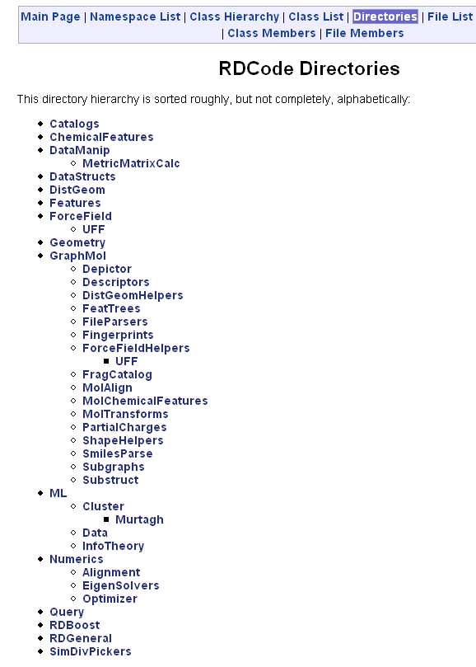
Documentation
C++:
  Generated using doxygen:
  cd $RDBASE/Code
  doxygen doxygen.config
Python:
  Currently generated using epydoc:
  cd $RDBASE/rdkit
  epydoc --config epydoc.config

Slide 20
Organization
$RDBASE/
  External/: essential 3rd party components that are hard to get or have been modified
  Code/: C++ library, wrapper, and testing code
  rdkit/: Python library, GUI, and scripts
  Docs/: Manually and automatically generated documentation
  Data/: Testing and reference data
  Scripts/: a couple of useful utility scripts
  Web/: some simple CGI applications
  bin/: installation dir for DLLs/shared libraries

Slide 21
C++ "Guiding Ideas"
If boost already has the wheel, don't re-invent it.
Try to keep classes lightweight
Maintain const-correctness
Test, test, test
Include tests with code
Keep namespaces explicit (i.e. no using namespace std;)
Keep most everything in namespace RDKit
Test, test, test

Slide 22
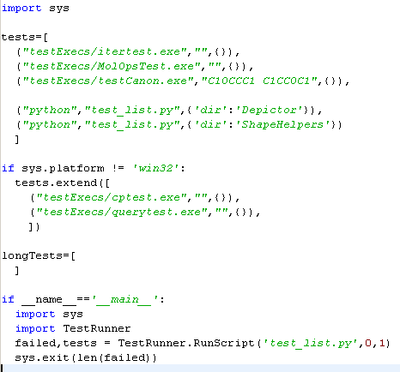
Test Harness
Sample test_list.py:

Slide 23
Wrapping code using BPL:
Intro
boost::python is not an automatic wrapper generator: wrappers must be written by hand.
very flexible handling of "primitive types"
tight python type integration
allows subclassing of C++ extension classes

Slide 24
Wrapping code using BPL: defining a module
DataStructs/Wrap/DataStructs.cpp
#include <boost/python.hpp>
#include <RDBoost/Wrap.h>
#include "DataStructs.h"
namespace python = boost::python;
void wrap_SBV();
void wrap_EBV();
...
BOOST_PYTHON_MODULE(cDataStructs)
{
python::scope().attr("__doc__") =
"Module containing an assortment of functionality for basic data structures.\n"
"\n"
"At the moment the data structures defined are:\n"
...
;
python::register_exception_translator<IndexErrorException>(&translate_index_error);
python::register_exception_translator<ValueErrorException>(&translate_value_error);
...
wrap_SBV();
wrap_EBV();
...
}

Slide 25
Wrapping code using BPL: defining a class
DataStructs/Wrap/wrap_SparseBV.cpp
struct SBV_wrapper {
static void wrap(){
python::class_<SparseBitVect>("SparseBitVect",
"Class documentation",
python::init<unsigned int>())
.def(python::init<std::string>())
.def("SetBit",(bool (SBV::*)(unsigned int))&SBV::SetBit,
"Turns on a particular bit on. Returns the original state of the bit.\n")
...
.def("GetNumBits",&SBV::GetNumBits,
"Returns the number of bits in the vector (the vector's size).\n")
};
void wrap_SBV() {
SBV_wrapper::wrap();
}

Slide 26
Wrapping code using BPL: making it "pythonic"
DataStructs/Wrap/wrap_SparseBV.cpp
struct SBV_wrapper {
static void wrap(){
python::class_<SparseBitVect>("SparseBitVect",
"Class documentation",
python::init<unsigned int>())
...
.def("__len__",&SBV::GetNumBits)
...
.def("__getitem__",
(const int (*)(const SBV&,unsigned int))get_VectItem)
.def("__setitem__",
(const int (*)(SBV&,unsigned int,int))set_VectItem)
...
.def(python::self & python::self)
.def(python::self | python::self)
.def(python::self ^ python::self)
.def(~python::self)
...
;
}
};

Slide 27
Wrapping code using BPL: supporting pickling
DataStructs/Wrap/wrap_SparseBV.cpp
// allows BitVects to be pickled
struct sbv_pickle_suite : python::pickle_suite
{
static python::tuple
getinitargs(const SparseBitVect& self)
{
return python::make_tuple(self.ToString());
};
};
struct SBV_wrapper {
static void wrap(){
python::class_<SparseBitVect>("SparseBitVect",
"Class documentation",
python::init<unsigned int>())
...
.def_pickle(sbv_pickle_suite())
;
}
};

Slide 28
Wrapping code using BPL: returning complex types
DataStructs/Wrap/wrap_SparseBV.cpp
struct SBV_wrapper {
static void wrap(){
python::class_<SparseBitVect>("SparseBitVect",
"Class documentation",
python::init<unsigned int>())
...
.def("GetOnBits",
(IntVect (*)(const SBV&))GetOnBits,
"Returns a tuple containing IDs of the on bits.\n")
...
;
}
};
IntVect is a std::vector<int>
Convertors provided for: std::vector<int>, std::vector<unsigned>, std::vector<string>, std::vector<double>, std::vector< std::vector<int> >, std::vector< std::vector<unsigned> >, std::vector< std::vector<double> >, std::list<int>, std::list< std::vector<int> > in rdBase.dll
Others can be created using:
RegisterVectorConverter<RDKit::Atom*>();
RegisterListConverter<RDKit::Atom*>();

Slide 29
Wrapping code using BPL: accepting Python types
DataStructs/Wrap/wrap_SparseBV.cpp
void SetBitsFromList(SparseBitVect *bv, python::object onBitList) {
PySequenceHolder<int> bitL(onBitList);
for (unsigned int i = 0; i < bitL.size(); i++) {
bv->SetBit(bitL[i]);
}
}
struct SBV_wrapper {
static void wrap(){
python::class_<SparseBitVect>("SparseBitVect",
"Class documentation",
python::init<unsigned int>())
...
.def("SetBitsFromList",SetBitsFromList,
"Turns on a set of bits. The argument should be a tuple or list of bit ids.\n")
...
;
}
};

Slide 30
Wrapping code using BPL: keyword arguments
GraphMol/Wrap/rdmolfiles.cpp
docString="Returns the a Mol block for a molecule\n\
ARGUMENTS:\n\
\n\
- mol: the molecule\n\
- includeStereo: (optional) toggles inclusion of stereochemical\n\
information in the output\n\
- confId: (optional) selects which conformation to output (-1 = default)\n\
\n\
RETURNS:\n\
\n\
a string\n\
\n";
python::def("MolToMolBlock",RDKit::MolToMolBlock,
(python::arg("mol"),python::arg("includeStereo")=false,
python::arg("confId")=-1),
docString.c_str());
This also demonstrates defining a function and taking a complex (wrapped) type as an argument

Slide 31
Wrapping code using BPL: returning pointers
GraphMol/Wrap/rdmolfiles.cpp
docString="Construct a molecule from a SMILES string.\n\n\
ARGUMENTS:\n\
- SMILES: the smiles string\n\
- sanitize: (optional) toggles sanitization of the molecule.\n\
Defaults to 1.\n\
RETURNS:\n\
a Mol object, None on failure.\n\
\n";
python::def("MolFromSmiles",RDKit::MolFromSmiles,
(python::arg("SMILES"),
python::arg("sanitize")=true),
docString.c_str(),
python::return_value_policy<python::manage_new_object>());
GraphMol/Wrap/Mol.cpp
.def("GetAtomWithIdx",(ROMol::GRAPH_NODE_TYPE (ROMol::*)(unsigned int))
&ROMol::getAtomWithIdx,
python::return_value_policy<python::reference_existing_object>(),
"Returns a particular Atom.\n\n"
" ARGUMENTS:\n"
" - idx: which Atom to return\n\n"
" NOTE: atom indices start at 0\n")

