Slide 1
FIELDCLAW
Field intelligence layer for construction execution
Rishi Divyakirti · Harshit Tomar
IIT Kanpur · 4th Year Undergraduate
Kaya AI Hackathon 2026 · Open Innovation · Stage 1

Slide 2

PROBLEM
Different versions of the truth on the same site
McKinsey: the area supervisor, project manager, planner, and owner often disagree on what is going on because they do not get the right information in time — or the same information.
mckinsey.com — The construction productivity imperative (2015)
98%
Relay
48%
of megaprojects overrun cost by more than 30% — when the site picture is late or split
Field asks → phone chain → lost record. Crew learns when work already stalled.
of U.S. rework from poor project data and miscommunication ($31.3B)
McKinsey, 2015
Mechanism — next slide
PlanGrid + FMI, 2018
Notes:
McKinsey (Changali, Mohammad, van Nieuwland), The construction productivity imperative, July 2015: https://www.mckinsey.com/capabilities/operations/our-insights/the-construction-productivity-imperative Local PDF: research/mckinsey-productivity/The_construction_productivity_imperative.pdf PlanGrid+FMI 2018: https://www.autodesk.com/blogs/construction/construction-disconnected-fmi-report/

Slide 3
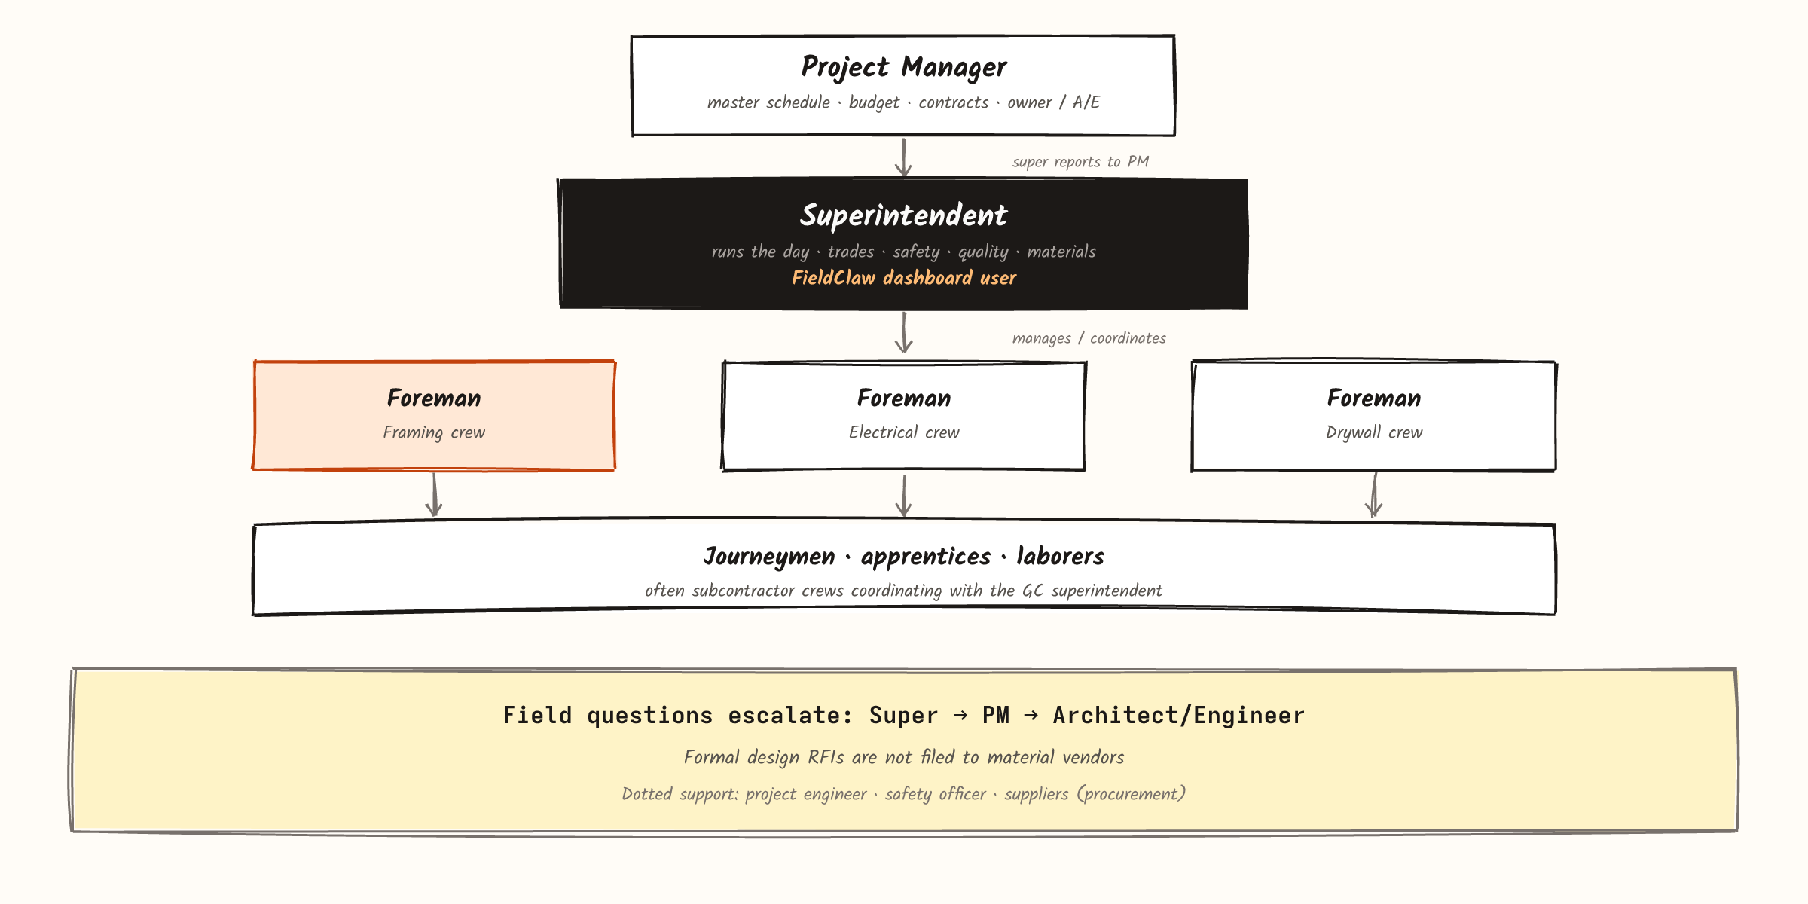
WHO
The site hierarchy FieldClaw plugs into

Slide 4
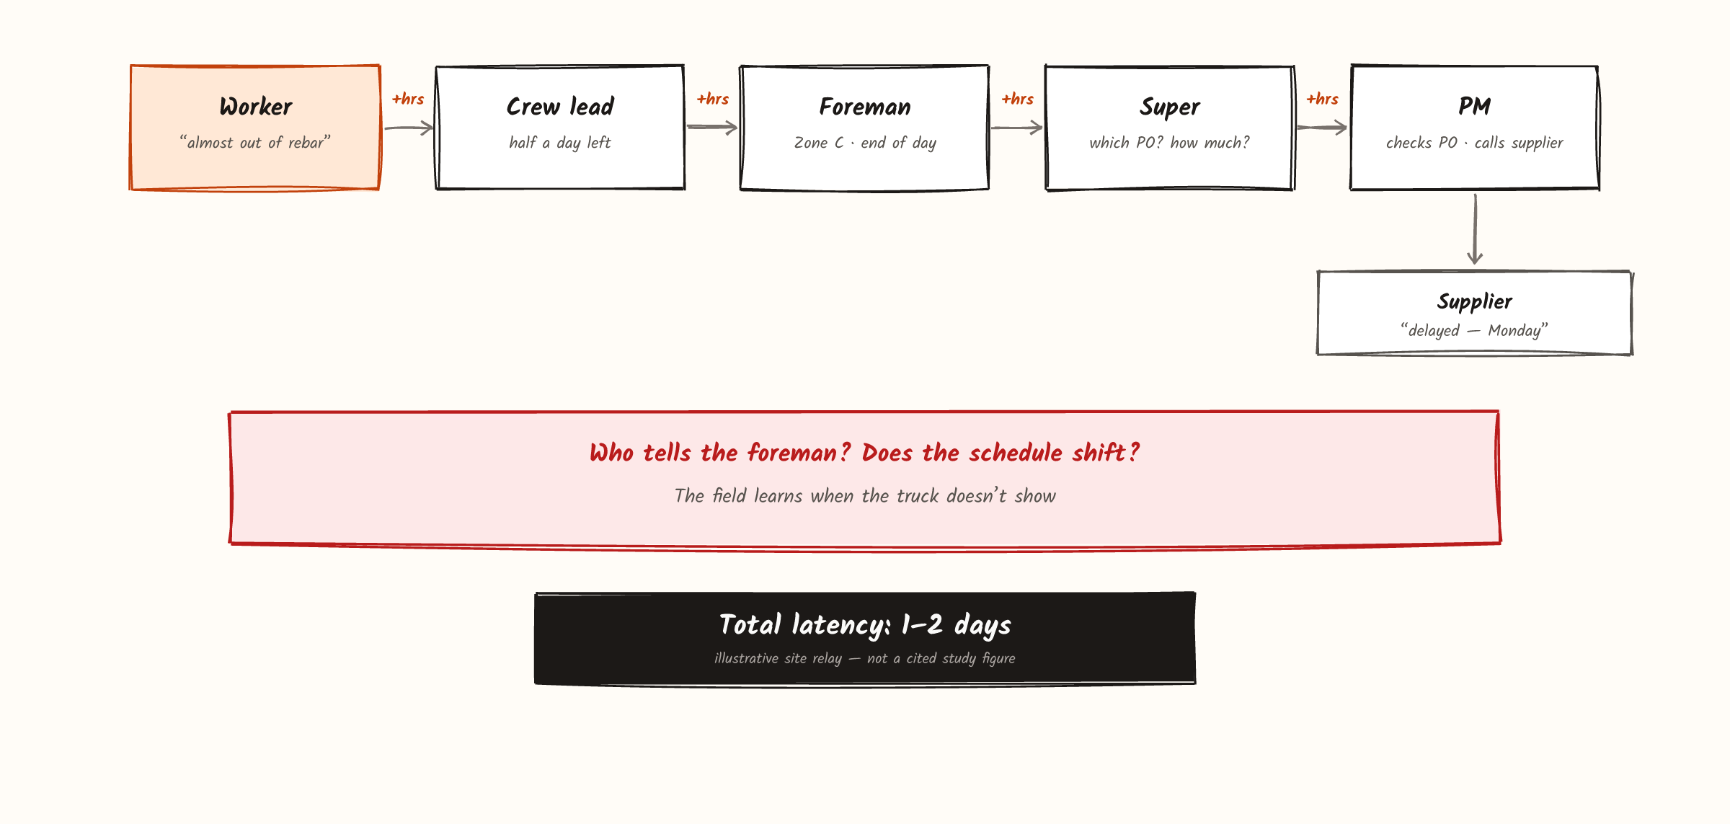
PROBLEM
How information moves today

Slide 5
SOLUTION
Skip the relay. Keep the decision human.
A phone call still fails when the foreman lacks the PO, the drawing, or the authority. The record dies when someone hangs up. The crew learns the answer when work has already stalled.
FieldClaw replaces that relay. Foremen report by voice from the site. The report is structured, matched to read-side PO context, and landed in one ops picture for the superintendent. Judgment stays with the super — the lost record and the phone chain do not.
Voice → structure → schedule flag → human decision → answer back to the field. Next: how that path runs.

Slide 6
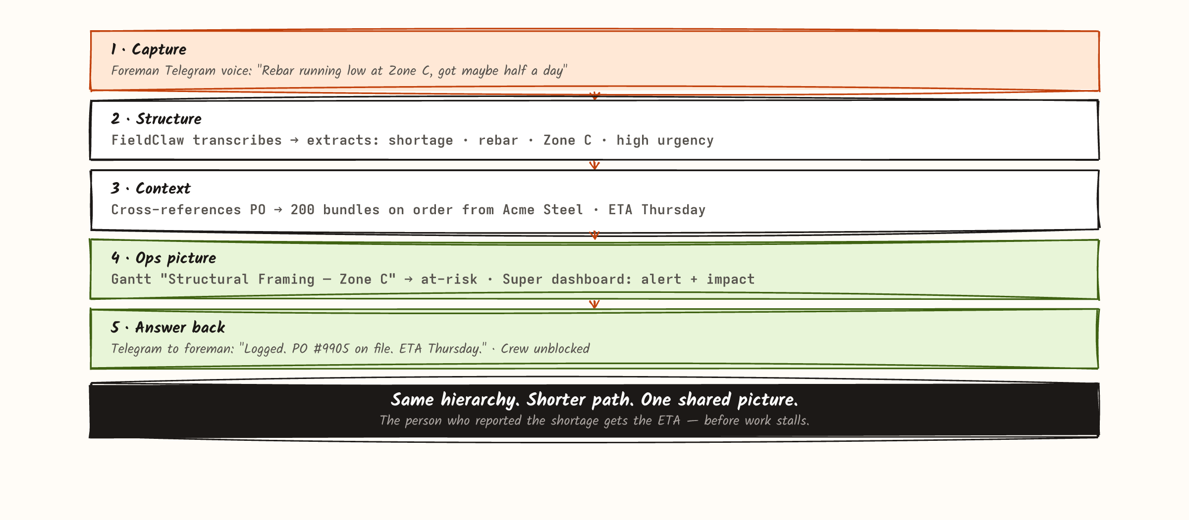
PRODUCT
How information moves with FieldClaw

Slide 7
USE CASES
On-ground realities FieldClaw handles
What foremen and crew report that tools today still miss.
Daily progress
Material shortages
Quality issues
Safety / near misses
Weather & site
Zone updates → Gantt shift · ahead/behind flags
Voice shortage → PO match or super flag
Observation + location · rework → schedule impact
Severity tag · compliance record · notify if critical
Outdoor delay · re-sequence · claims log
Equipment down
Trade conflicts
Inspections
Field questions
Crew & labor
Cascade blocked tasks · impact for the super
Clash logged · both crews see it · re-sequence
Sign-off unlocks next phase · PM notified
Voice → super / PM path · answer logged on task
Understaffed flag · resource gap on the schedule

Slide 8
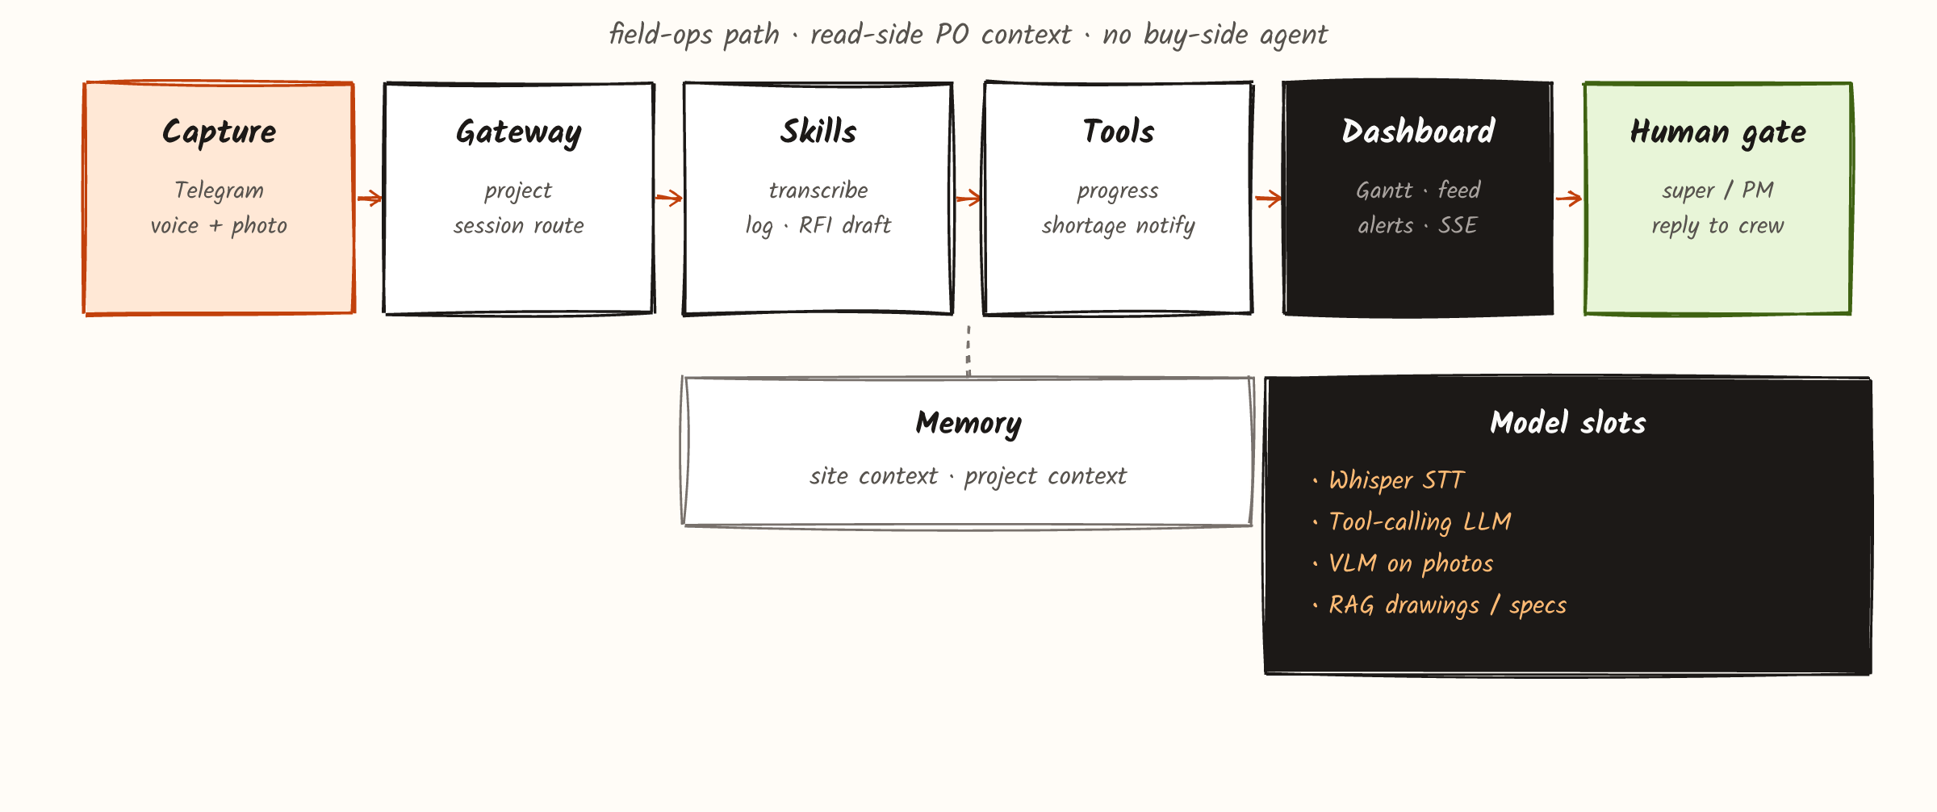
HOW
Proposed architecture, Stage 1

Slide 9
WITH KAYA
Kaya covers the PO. FieldClaw covers the site.
KAYA
FIELDCLAW
What was ordered
What is happening
Procurement and supply-chain intelligence.
Office to suppliers.
POs, lead times, vendor workflows.
Execution-layer field intelligence.
Field to superintendent to field.
Voice, photos, ops picture, answers back.

Slide 10
Thank you :)
Excited to build.

