Slide 1

Building a Nation from a Land of City States
Lincoln D. Stein
Cold Spring Harbor Laboratory

Slide 2
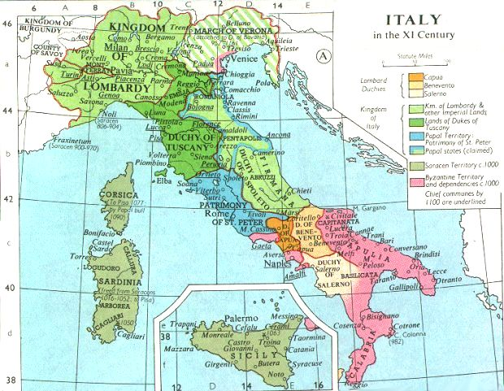
Italy in the Middle Ages

Slide 3

Italy in the Middle Ages

Slide 4

Italy in the Middle Ages

Slide 5

Italy in the Middle Ages

Slide 6


Italy in the Middle Ages

Slide 7
Affect on Trade & Technology
Italian city states had
  Different legal & political systems
  Different dialects & cultures
  Different weights & measures
  Different taxation systems
  Different currencies
Italy generated brilliant scientists, but lagged in technology & industrialization

Slide 8
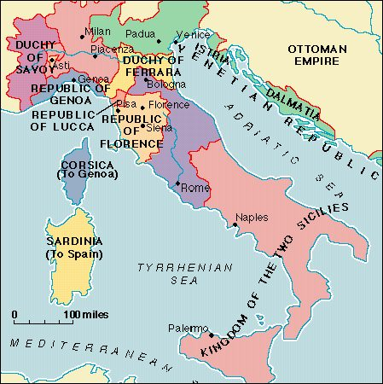

Italy, 1796

Slide 9


Italy, ca 1820

Slide 10







Bioinformatics, ca. 2002
Bioinformatics
In the XXI Century

Slide 11
Making Easy Things Hard
Give me all human sequences submitted to GenBank/EMBL last week.

Slide 12
Lots of ways to do it
Download weekly update of GenBank/EMBL from FTP site
Use official network-based interfaces to data:
  NCBI toolkit
  EBI CORBA & XEMBL servers
Use friendly web interfaces at NCBI, EBI

Slide 13
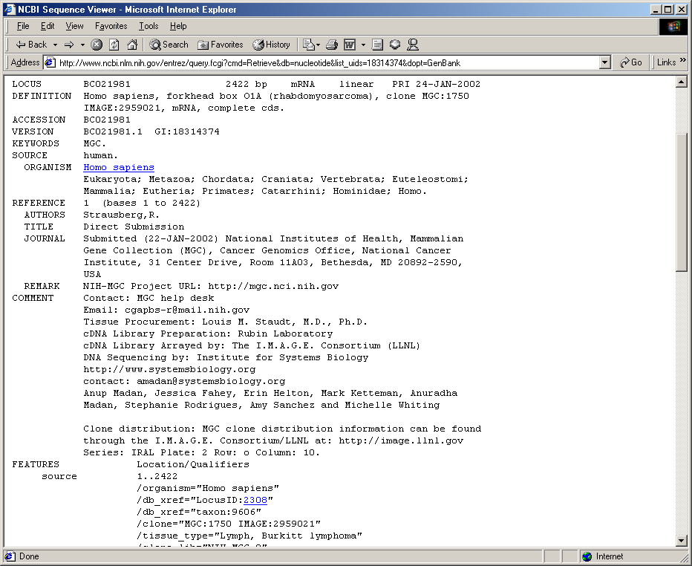
From GenBank
homo sapiens[ORGN] AND 2001/01/20[Modification Date]

Slide 14
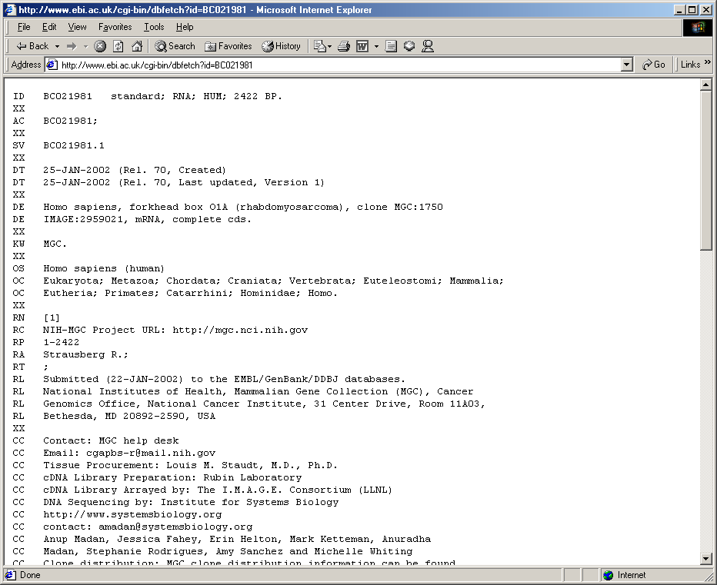
From EMBL
([embl-Division:hum] & [embl-DateCreated#20020120:])

Slide 15
Perl/Java/Python to the Rescue
One script to do the web fetch
Another to parse the file format
A third to move into private database
A fourth to repeat this weekly
Result:
  6,719 scripts that do the same thing
  None of them work together

Slide 16
Bioinformatics Rights of Passage
Very own GenBank flat file parser
Very own BLAST parser
Very own DNA/Protein manipulation library
Very own genome database
Very own web genome browser
Very own model organism database

Slide 17
What’s Wrong with This?
My EMBL fetcher is poorly documented so you write your own
Your fetcher won’t work with my parser
My parser won’t work with your fetcher
We’ve now wasted 20 hours rather than 10
Multiply this by 6,719

Slide 18
What’s else is Wrong?
NCBI/EBI tweaks something
6,719 scripts fail at once
6,719 bioinformaticists tear their hair
21,261 biologists curse the bioinformaticists
6,719 bioinformaticists curse their own existence

Slide 19
Seeing the Open Source Light
Open Source libraries
  Bioperl, Biojava, Biopython
Open Source protocols
  BioXML, OmniGene, MOBY, DAS, G2G, I3C
Open Source end-user applications
  Genquire, Generic Genome Browser, Apollo, PyMol

Slide 20
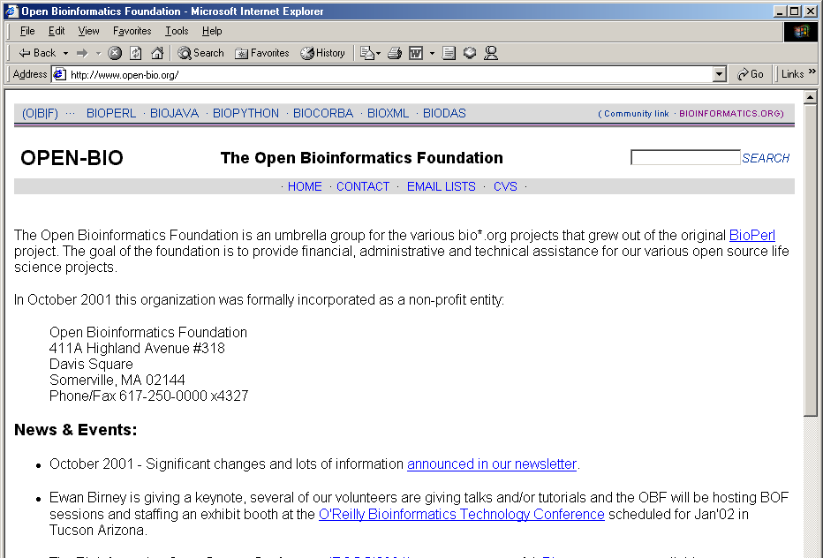
Open-Bio.org
1st half of Biohackathon ended yesterday

Slide 21

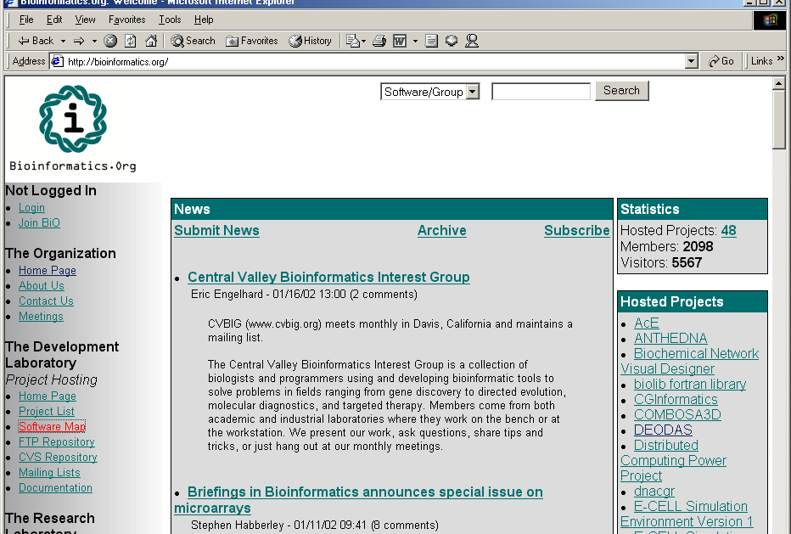
Bioinformatics.org
See Bioinformatics.org track on Wednesday

Slide 22
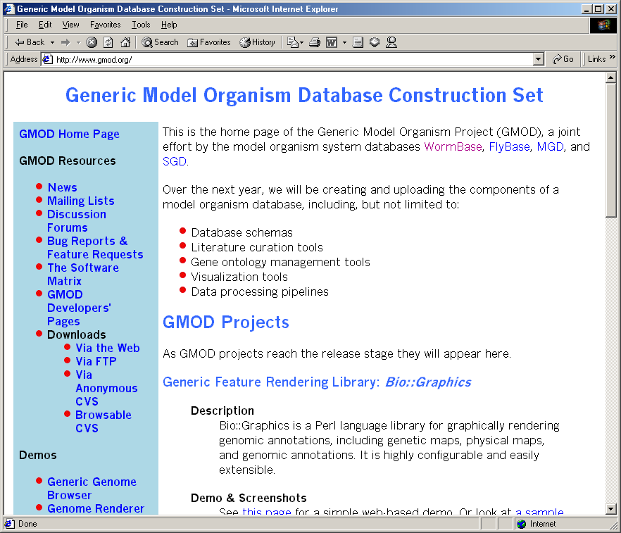
GMOD Project http://www.gmod.org

Slide 23
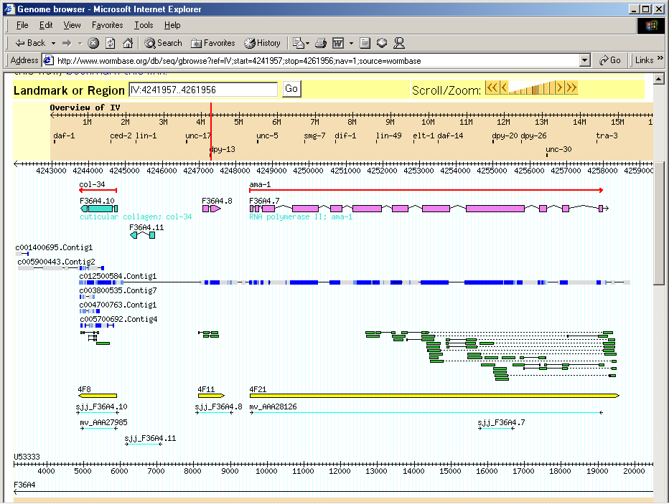
Generic Genome Browser

Slide 24
Making Hard Things Impossible
Give me the sequences & chromosomal locations of all human genes that have a zinc-finger domain and have a good ortholog in drosophila.

Slide 25
Bioinformatics, ca. 2002
Bioinformatics
In the XXI Century

Slide 26
Unifying Bioinformatics Services
MIMBD: Meetings on the Interconnection of Molecular Biology Databases
Federated models: Gaea, Kleisli
Data warehouses: GUS, MODs, Ensembl, UCSC
Ad hoc web services
Formal web services

Slide 27

Ad hoc services
BioXXX
Conf file
Your Script

Slide 28
Formal Web Services
GO
Service
SeqFetch
Service
BLAST
Service
BLAT
Service
SeqFetch
Service
Microarray
Service

Slide 29
Formal Web Services
GO
Service
SeqFetch
Service
BLAST
Service
BLAT
Service
SeqFetch
Service
Service
Registry
Microarray
Service

Slide 30
Formal Web Services
GO
Service
SeqFetch
Service
BLAST
Service
BLAT
Service
SeqFetch
Service
BioXXX
Service
Registry
Microarray
Service
Microarray
Service
Your Script

Slide 31
Technical Infrastructure is Here*
Common vocabulary: GO
Transport format: XML
Data definition language: XSD
Wire protocol: SOAP
Service definition language: WSDL
Service registry: UDDI
*(almost)

Slide 32

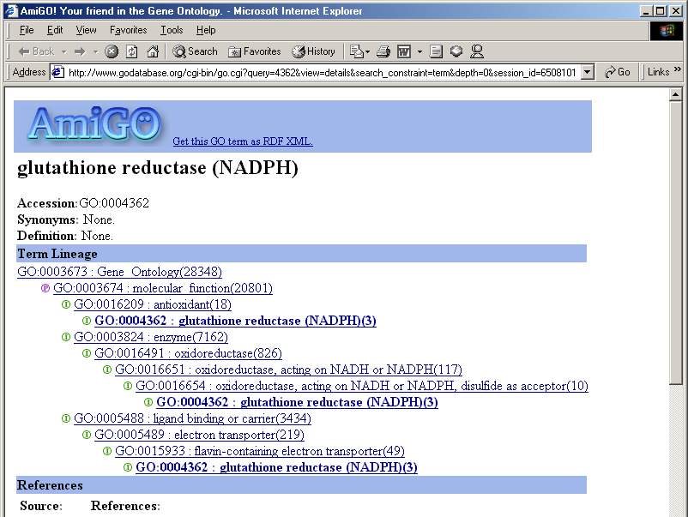
Gene Ontology Consortium
http://www.geneontology.org
Brad Marshall, Wednesday 5:00, Canyon III

Slide 33
Distributed Annotation System http://www.biodas.org
Annotation Server
Reference Server
Annotation Server
Annotation Server
AC003027
M10154
AC003027
M10154
AC005122
AC005122
WI1029
AFM820
AFM1126
WI443
Thursday 10:30 AM
Canyon IV

Slide 34
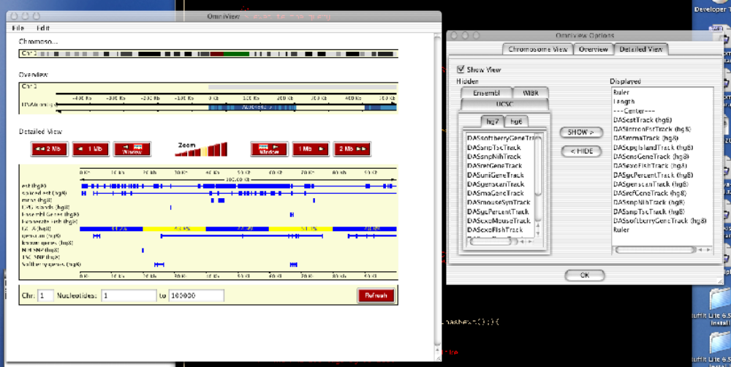
OmniGene http://omnigene.sourceforge.net
Brian Gilman, Thursday 11:15 AM, Canyon III

Slide 35
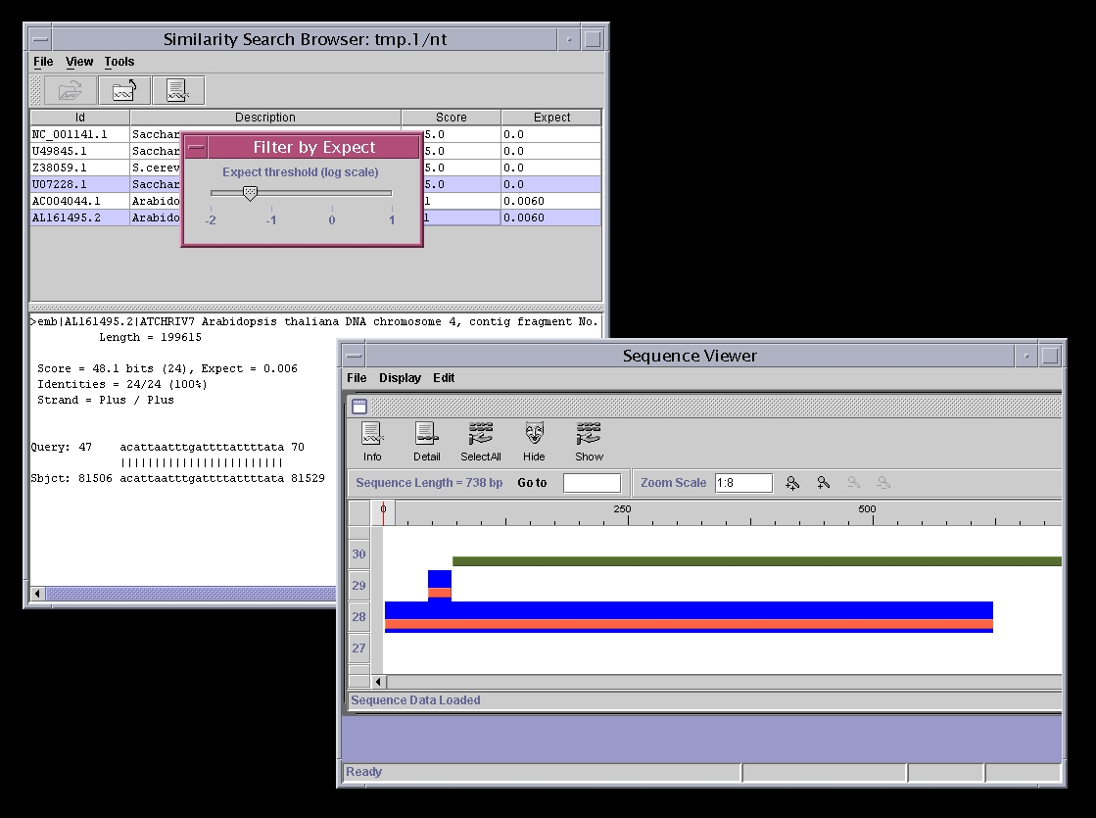
ISYS http://www.ncgr.org/isys
Damian Gessler, Wednesday 4:15 pm, Canyon IV

Slide 36

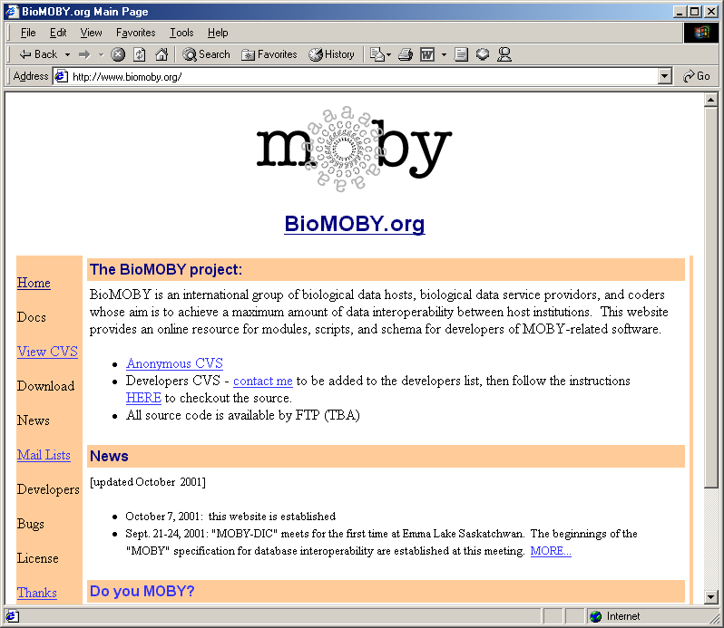
http://www.biomoby.org

Slide 37
Moving Towards Nationhood
World of web services still in future
What can data providers do now to become good citizens of the bioinformatics nation?

Slide 38
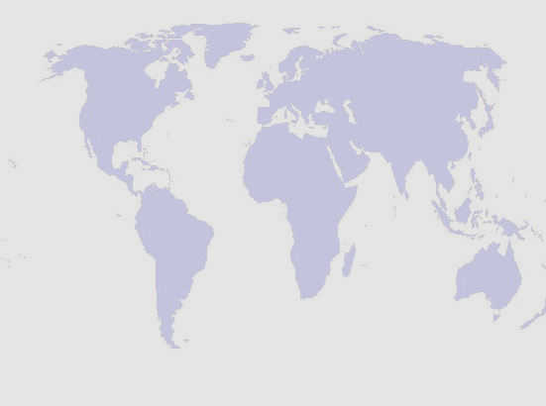
Bioinformatics Data Provider’s
Code of Conduct

Slide 39
A Web Page is an Interface
Primary access to data & services is via dynamic web pages
Web pages should be easy to use, attractive, &c, &c, &c
BUT: Bioinformatics people will use your web pages as an interface for batch scripts
Don’t fight it; guide it

Slide 40
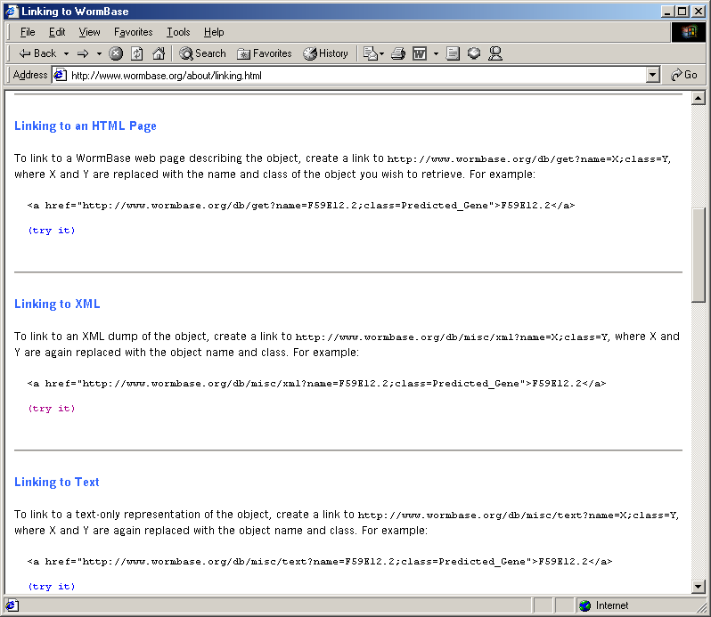
WormBase Links Page

Slide 41
An Interface is a Contract
An interface is a contract between data provider and data consumer
Document interface; warn if it is unstable
Do not make changes lightly
  Even little fiddly changes can break things
  Provide plenty of advance warning
When possible, maintain legacy interfaces until clients can port their scripts

Slide 42
Choice is Good
Support as many interfaces as you can
HTML (least desired)
Text only (better)
CORBA (if you insist)
HTTP-XML (even better)
SOAP-XML (sweet!)
Easy Interfaces + Power User Interfaces

Slide 43
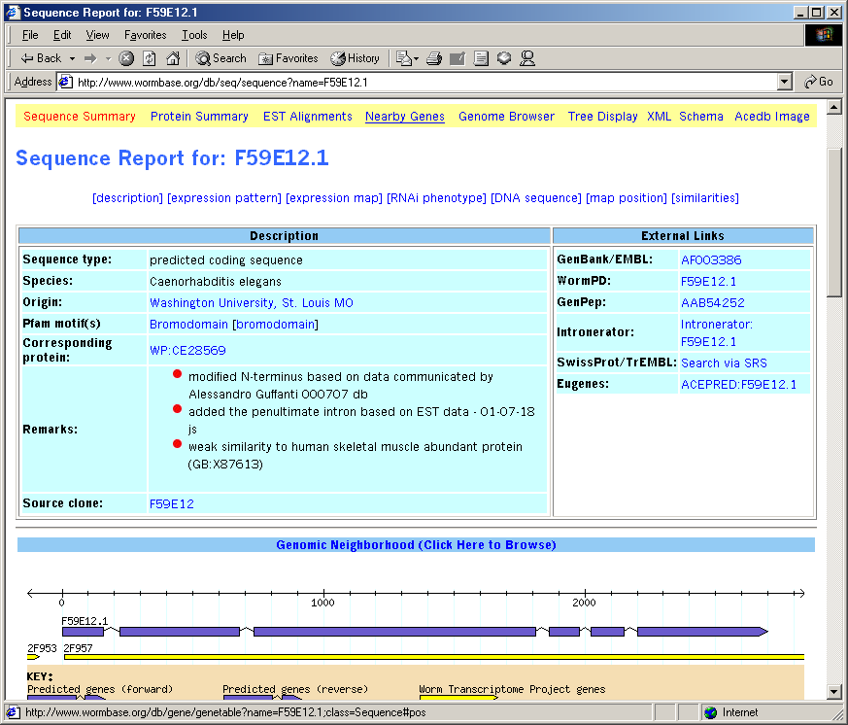
WormBase HTML Page

Slide 44
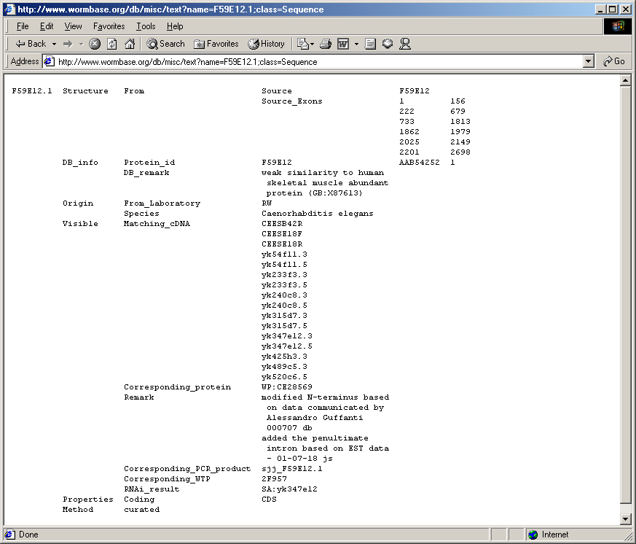
WormBase Text Page

Slide 45
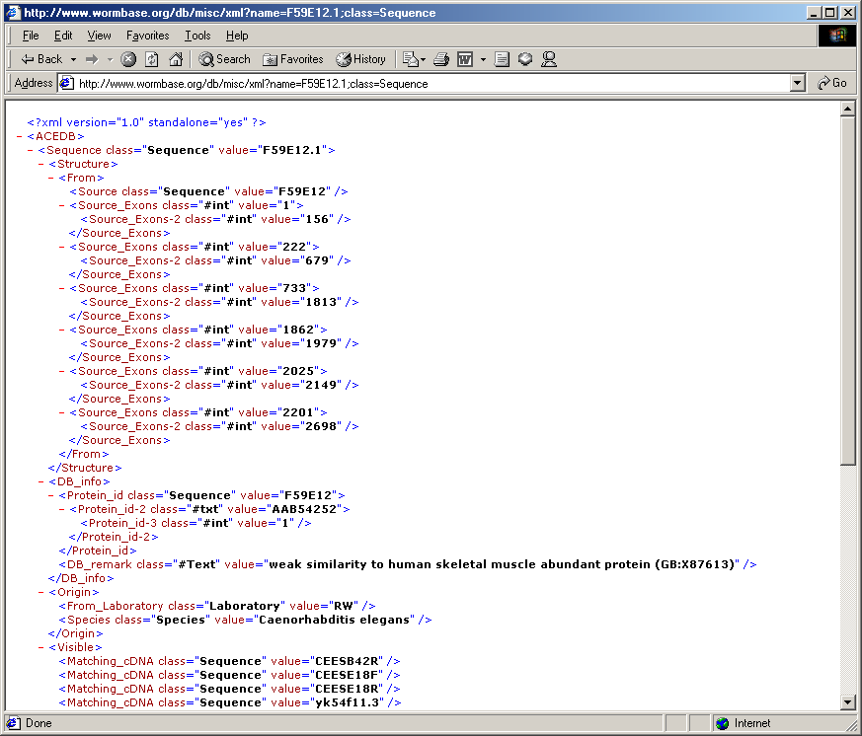
WormBase XML Page

Slide 46
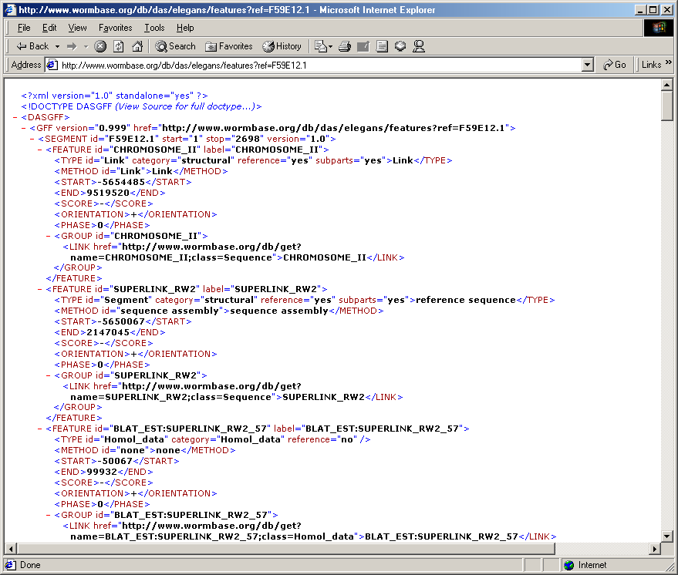
WormBase DAS Output

Slide 47
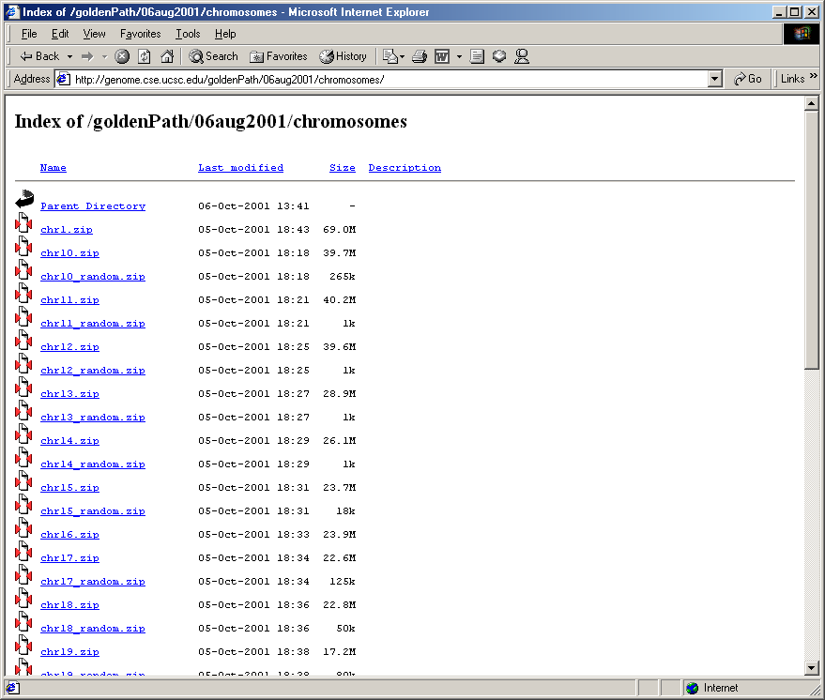
Allow Batch Download

Slide 48
Use Existing Data Formats
Avoid reinventing wheels when you can
Sequence Feature Formats
  GenBank, EMBL, GFF, FASTA, BSML, Agave, GAME, DAS
Microarray Formats
  MAML
3D Structures
  PDB,CML

Slide 49
Design Sensible Formats
If you have to create a new data format, use common sense.
Everyone understands tab-delimited text.
XML is natural for hierarchical data.
Start simple.

Slide 50
Support ad hoc Queries
People will use data in unexpected ways
Provide ad hoc queries
Web forms are a start
A scriptable API is better
A real query language is best

Slide 51
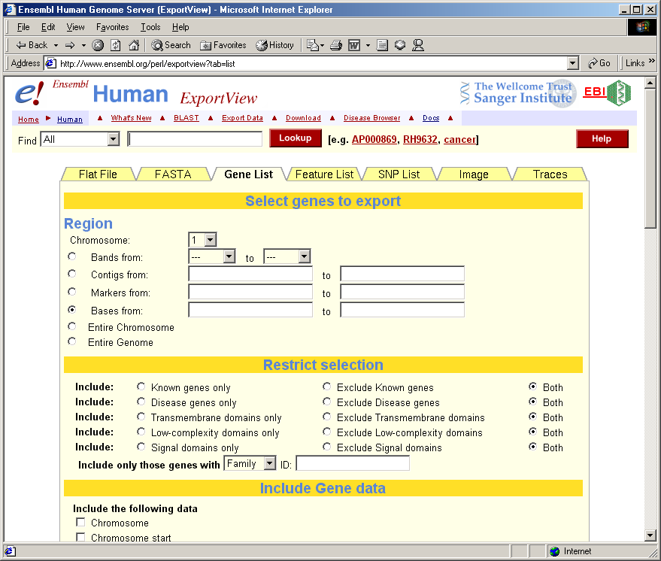
Ensembl via Web Query Form

Slide 52
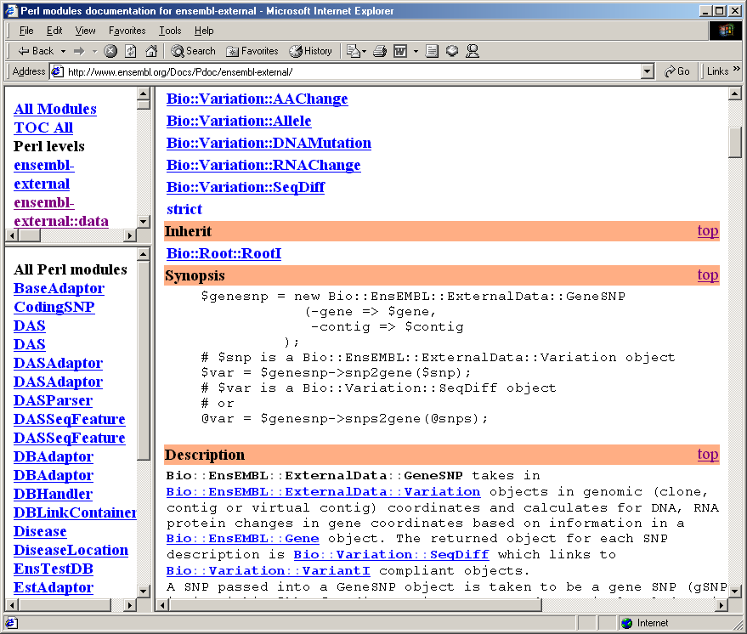
Ensembl via BioPerl

Slide 53
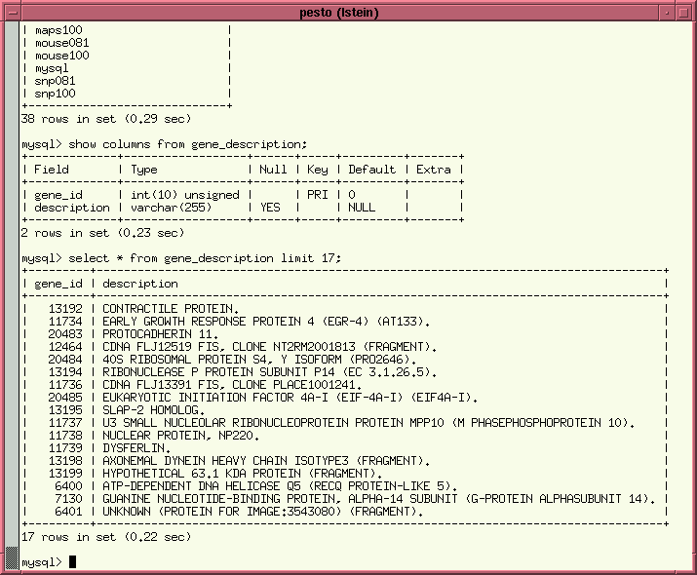
Ensembl via SQL Access

Slide 54
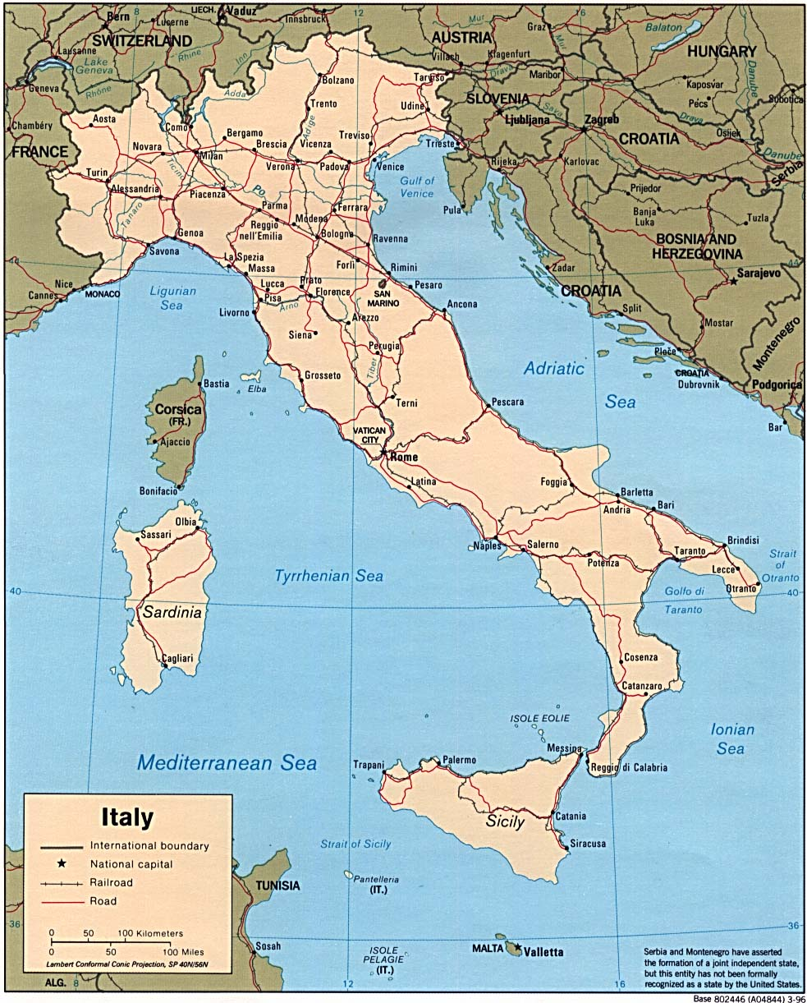
Italy, ca 2000

Slide 55
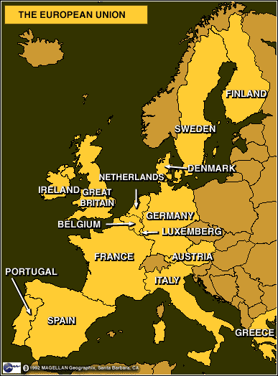

Europe, ca 2000

Slide 56

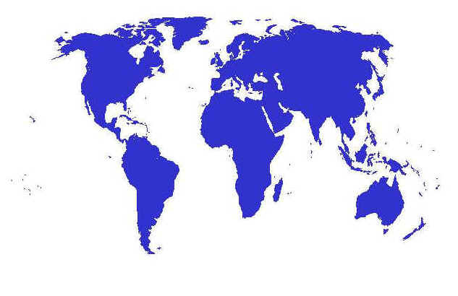
Bioinformatics, ca 2010?

