Slide 1
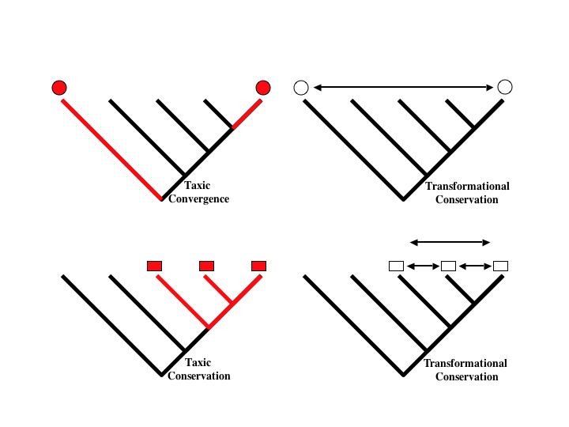
Bang et al. 2000. 49(1): 19-27
Notes:
Comparison of the detection of convergences in taxic and transformational approaches to comparative biology. Taxic biology is capable of uncovering convergence, whereas transformational biology cannot. Transformational biology offers a first approximation of the identities of organismic features. Taxic biology's advantage over transformational biology lies in its ability to distinguish between features that have a unique origin (taxic conservation) from those that may have arisen more than once (taxic convergences). Transformational biology will ALWAYS infer a conservation due to the nonhierarchical interpretative nature of the approach.
Top: Taxa with the occurrence of a particular character or character state are indicated by the red circles above the terminal. In the taxic approach (left) because the character evolution can be reconstructed on the tree, the occurrence of the character is interpreted as a convergence as indicated by the red shading on the tree. In the transformational approach (right) the double headed red arrow indicates the "apparent" discovery of continuous change.
Bottom: Taxa with occurence of a second character as indicated by the red square over the terminal. In the taxic approach (left), a single origin for the character can be inferred by character state reconstruction. In the transformational approach (right) there are three potential inferences of continuity as indicated by the red arrows.

