Slide 1
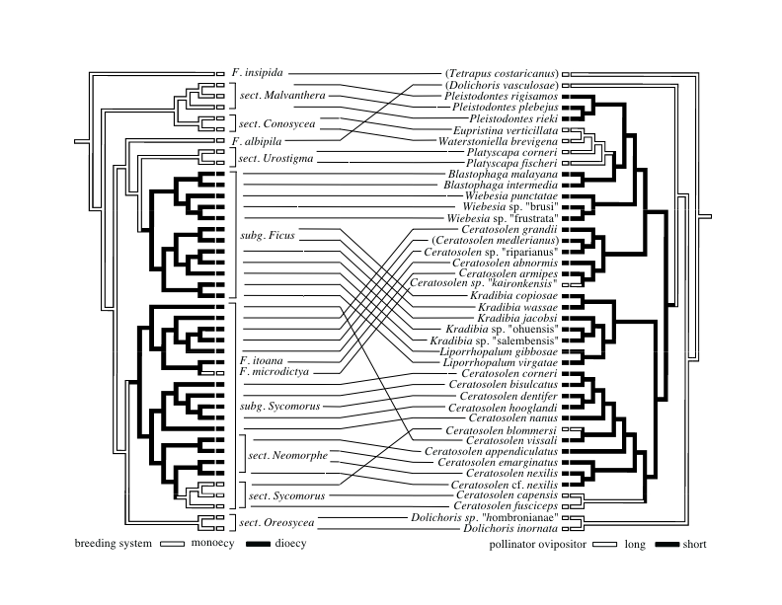
Correlated evolution of figs and pollinating fig wasps
Coevolution occurs when interacting lineages undergo reciprocal trait changes and we can expect phylogenetic patterns of correlated trait change when coevolution has occurred. Phylogenies of fig plants (Ficus, Moraceae) and their host-specific wasp pollinators (Agaoninae, Hymenoptera) are shown with ancestral reconstructions of fig breeding system and wasp ovipositor length, traits believed to be coevolved. (Weiblen, 2004. Syst. Biol. 53(1)128-139)

Slide 2
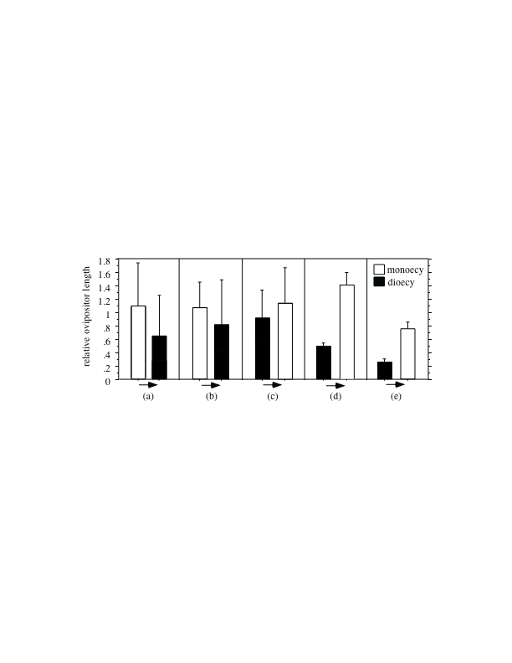
Correlated evolution of figs and pollinating fig wasps
Fig breeding system is thought to have coevolved with fig wasp ovipositor length because the length of the ovipositor interacts with the length of fig flowers to affect whether flowers are parasitized or pollinated and the length distribution of flowers varies depending on whether the fig is monoecious or dioecious. It is predicted that changes in breeding system are correlated with changes in pollinator ovipositor length. Comparisons of sister groups from fig and wasp phylogenies helped to test this prediction.
In each of five cases where an ancestral shift between fig monoecy and dioecy was reconstructed, there was a corresponding shift in pollinator ovipositor length and the direction of these changes was always consistent. When figs shifted from monoecy to dioecy, ovipositor lengths were reduced. When breeding system shifted the other way, ovipositors became elongated. This is evidence for the correlated evolution of interacting traits. (Weiblen, 2004. Syst. Biol. 53(1)128-139)

