Slide 1
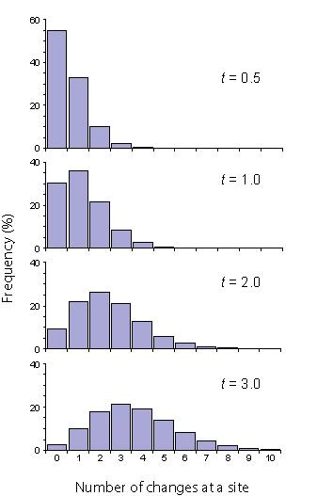
Multiple substitution profiles for sequences generated on an unrooted four-taxon tree, with terminal edges each of length t time units. Each graph shows the frequency (%) of sites that have changed X times, where X = 0, 1, …, 10. Even after a short time (t = 0.5), some sites experienced up to four changes. When terminal edges had evolved for t = 3 time units, producing a tree with a total length of 3.606 average substitutions per site, some sites had experienced up to 12 substitutions (not on chart scale).
Ho & Jermiin (2004) Syst. Biol. 53:623-637.

Slide 2
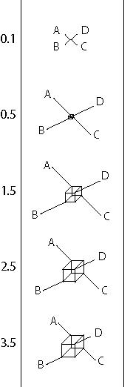
Network representations of the split information contained in sequence data generated on an unrooted four-taxon tree, for times ranging from t = 0.1 to t = 3.5, where t is the length (in time units) of each terminal edge. The nucleotide composition was stationary throughout the tree. Initially, the correct tree is inferred, but as t increases and multiple substitutions at the same sites accumulate, some sites begin to support non-historical splits (i.e., AC|BD and AD|BC). When substitutional saturation occurs to the extent that the historical signal is completely lost, the lengths of different internal edges are approximately equal, and the central prism representing the internal edges metamorphoses into a cube.
Ho & Jermiin (2004) Syst. Biol. 53:623-637.

Slide 3
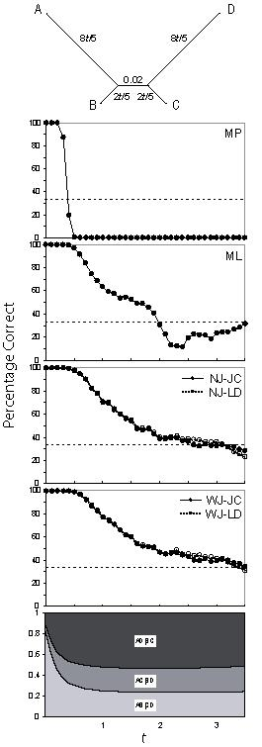
The ability of four phylogenetic methods to infer the correct tree from nucleotide sequences (length 10,000 bp) generated by Monte Carlo simulation using the tree at the top of the figure. The nucleotide composition was stationary throughout the tree. The expected tree is illustrated above the five panels, followed by four panels showing how frequently the correct tree topology is inferred by the following methods, respectively: maximum parsimony (MP); maximum likelihood (ML); neighbor-joining using Jukes-Cantor (NJ-JC) and LogDet (NJ-LD) distances; and weighted neighbor-joining (with down-weighting of large distances in the matrix) using Jukes-Cantor (WJ-JC) and LogDet (WJ-LD) distances. Note that the points and curves for NJ-JC and NJ-LD coincide; the same applies to WJ-JC and WJ-LD. In the analyses using maximum likelihood, we used the F81 model of nucleotide substitution, corresponding to the model used in generating the data. Each point represents 1,000 replicates. The dashed horizontal line represents the probability of randomly choosing the correct tree (33%). The fifth panel shows the relative proportions of sites supporting each of the three parsimoniously informative splits.
Ho & Jermiin (2004) Syst. Biol. 53:623-637.

Slide 4
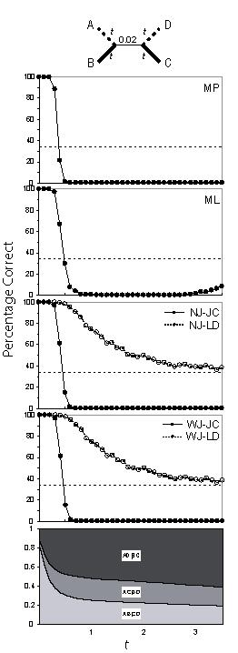
The ability of four phylogenetic methods to infer the correct tree from nucleotide sequences (length 10,000 bp) generated by Monte Carlo simulation using the tree at the top of the figure. Dashed lines represent edges with elevated AT nucleotide content, while thick solid lines represent edges with elevated GC content. The expected tree is illustrated above the five panels, followed by four panels showing how frequently the correct tree topology is inferred by the following methods, respectively: maximum parsimony (MP); maximum likelihood (ML); neighbor-joining using Jukes-Cantor (NJ-JC) and LogDet (NJ-LD) distances; and weighted neighbor-joining (with down-weighting of large distances in the matrix) using Jukes-Cantor (WJ-JC) and LogDet (WJ-LD) distances. In the analyses using maximum likelihood, we used the F81 model of nucleotide substitution, corresponding to the model used in generating the data. Each point represents 1,000 replicates. The dashed horizontal line represents the probability of randomly choosing the correct tree (33%). The fifth panel shows the relative proportions of sites supporting each of the three parsimoniously informative splits.
Ho & Jermiin (2004) Syst. Biol. 53:623-637.

