Slide 1
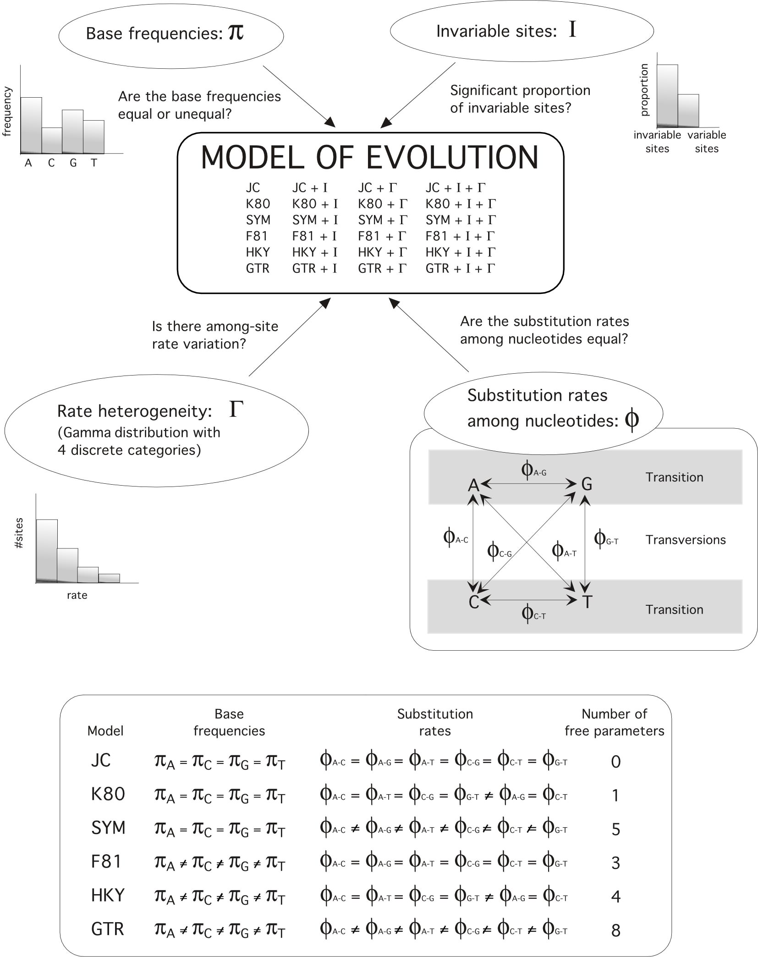
Models of nucleotide substitution. Models of nucleotide substitution allow for the calculation of probabilities of specific base changes along a branch. They include different parameters that aim to describe distinct aspects of the process of nucleotide substitution.
From: Posada & Crandall, 2001. Syst. Biol. 50(4): 580-601, 2001

Slide 2
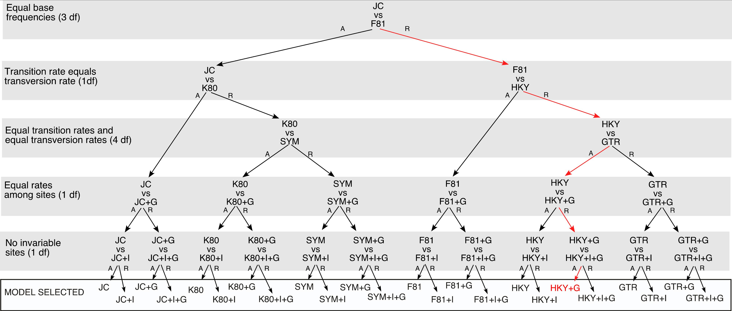
Hierarchical likelihood ratio tests. Here likelihood ratio tests are used to select the best-fit model among a set of 24 candidate models. At each test, two models differing in a set of parameter constraints are contrasted. The null o simple model (above vs) can be accepted (A) or rejected (R) against the alternative or complex model (below vs). In the former case the null model, and in the later case the alternative model, becomes the null model of the next test. In red, a potential sequence of test outcomes, leading the selection of the HKY+G model. Many other hierarchies (order of addition/removal of parameters) could be constructed.
From: Posada & Crandall, 2001. Syst. Biol. 50(4): 580-601, 2001

